Slide 1
NHS Short Breaks for Carers
OVERVIEW OF CHANGES
ASCH Staff Briefings
April/May 2025

Slide 2
1. Introduction and Overview of the session
KEY CHANGES – overview of what has changed and why
IMPORTANT INFORMATION – budget allocation, contracted and banded rates, use of DP’s, and PA’s, provider payments etc.
NEW SHORT BREAKS STEPS – Mosaic screens of the new form
SERVICE PLACEMENT TEAM – processes and key information
QUESTION AND ANSWER SESSION

Slide 3
2. KEY CHANGES
Transfer of overall budget and administration of short breaks scheme from health (Nottingham and Nottinghamshire ICB) to NCC ASCH for 2025/26 onwards
ICB (Carers Breaks team), stopped receiving requests from 1 April 2025
This means that:
ASCH workers are now responsible for agreeing and commissioning short breaks for eligible carers
£229k transferred over from the ICB to NCC ASCH Better Care Fund (for carers) for 2025/26
Carers in Bassetlaw can have access to the wider scheme
Agreeing and commissioning breaks will be much easier and quicker
Providers will get paid based on commissioned activity in Mosaic (quicker and easier processes for providers)

Slide 4
3. important INFORMATION
The current annual budget allocation amounts will remain the same (£650 high level needs and £1300 complex level)
Budget amount to be set against current NCC contracted rates (‘Banded’ residential and hourly for home-based care). Providers should be charging LA rates – opportunity to bring these costs back in line
Allocated budget will only be used to pay against contracted rates
People who are fully funded CHC and/or Fasttrack are NOT eligible for the scheme, however those that are part funded can access the scheme (subject to other criteria)
Providers set-up on Mosaic (i.e. contracted to NCC) are only to be used.

Slide 5
3. important INFORMATION (2)
The offer of using the budget as a Direct Payment to pay for care support in a residential care home is no longer available
Requests for overnight breaks in an external residential care home can only be commissioned with providers on the NCC Ageing Well Care Home Framework.
Carers can continue to take their NHS Short Break budget as a Direct Payment with a home care agency (at NCC contracted rates or agreed DP rate for that area if not contracted)
Use of family members or friends for support – carer has to inform that person that it is their responsibility to inform HMRC and/or DWP of the additional income they receive (February 2025)
Workers should include a short summary of the details of the break (including DP’s)

Slide 6
3. important INFORMATION (3)
BUDGET ALLOCATION AMOUNT:
Two amounts - £650 for ‘High Impact’ and £1300 for ‘Extremely High Impact’
Budget originally to cover the cost of up to one weeks’ stay in a residential care setting. £650 to purchase replacement/respite care where the cared for person has medium or high level needs and £1300 for those who need more specialist support due to complex needs
Those carers who are eligible to receive the higher budget should be the exception and the cared-for person should be known to us due to their level of need and be receiving support in their own right

Slide 7
3. important INFORMATION (4)
TOP-UP’s
All providers should be accepting referrals for breaks based on the following:
Banded rates for care homes on the NCC Ageing Well Care Home Framework
Agreed contracted home care hourly rates for that provider and district
Day Care sessional rates (low level needs for MIS) as per Day Care provider framework
Where providers are insisting on charging more than the contracted rate, brokerage of the break should be considered
If the carer still wants to use a particular provider for the short break, then the carer/family would be expected to fund the additional short-fall (this should be clear in the additional information on the step)

Slide 8
4. new mosaic short breaks steps
Carer Conversation identifies need for breaks. Offered NHS Short Breaks scheme
(eligibility checked)
Agree the budget amount based on the carers needs (most will be £650)
Provider and dates identified for breaks. Confirmation of rates being at NCC Banded/contracted rates
Complete the NHS Short Breaks step with provider, dates and break costs

Slide 9
4.1 new mosaic short breaks steps
Talk through the screens to demo what the new steps look like
Show some screen shot examples of what ‘good’ looks like
Examples included for residential care, home based care, day care and Direct Payments

Slide 10
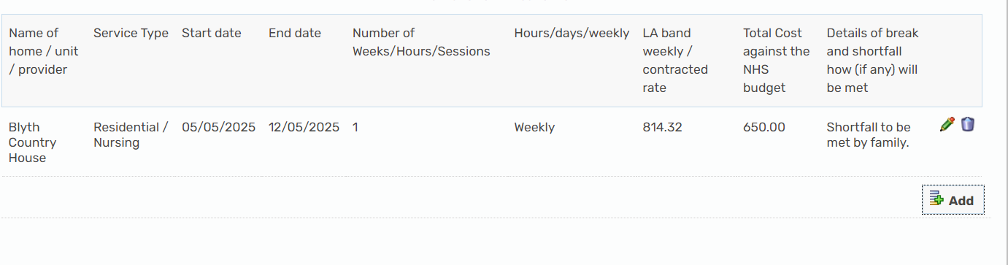
Examples of a care home stay.
When a break is being commissioned for anything more than the £650 amount, you would commission one weeks stay. This would enable the carer to use all the budget rather than working out the cost per night

Slide 11
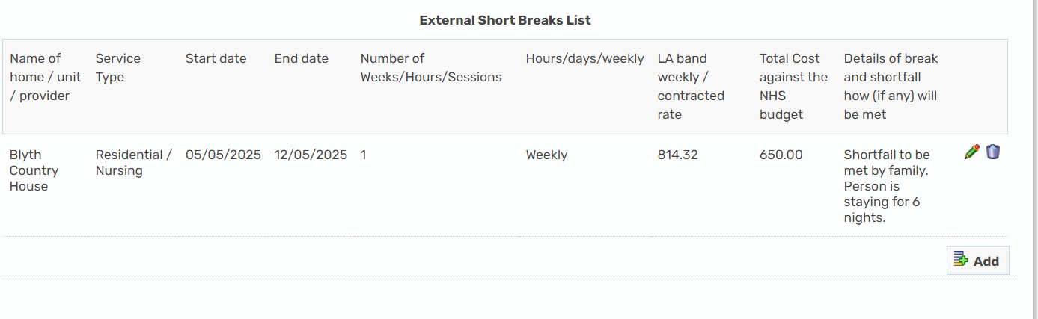
As the above is only staying for 6 nights, the addition cost for the carer would be calculated as follows:
Weekly ‘Banded’ rate: £814.32
Pro-rata (x 6): £697.99
Less NHS budget: £650.00
Additional cost: £ 47.99
(to be met by carer/family)

Slide 12
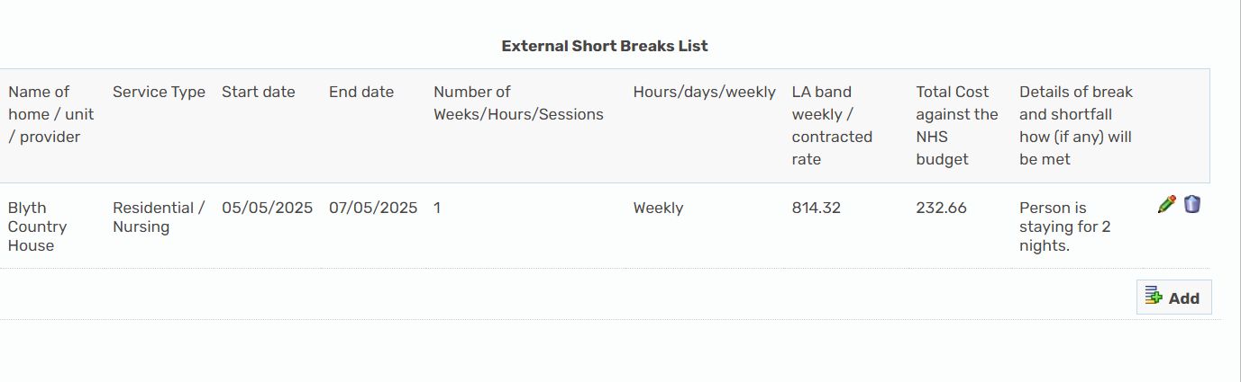
Using the budget to part-fund breaks
If you are only using part of the NHS short breaks budget towards a break, you’ll need to enter the actual dates of the break duration (for example 2 nights), however you still need to input the weekly contracted/banded rate. Divide the rate by 7 then multiply by 2 to calculate the cost of the break amount (see example screen shot below)

Slide 13
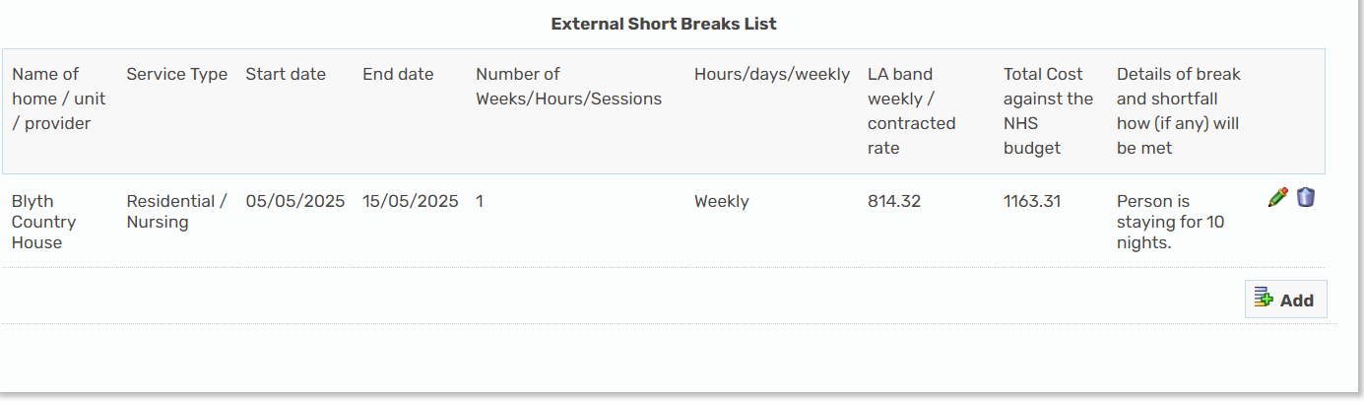
Using the £1300 budget to fund breaks less than two-weeks
The example below shows the details of if the carer has been allocated the higher rate budget of £1300, but is using the budget to fund less than 2 weeks (14 nights) – budget remaining = £136.69

Slide 14
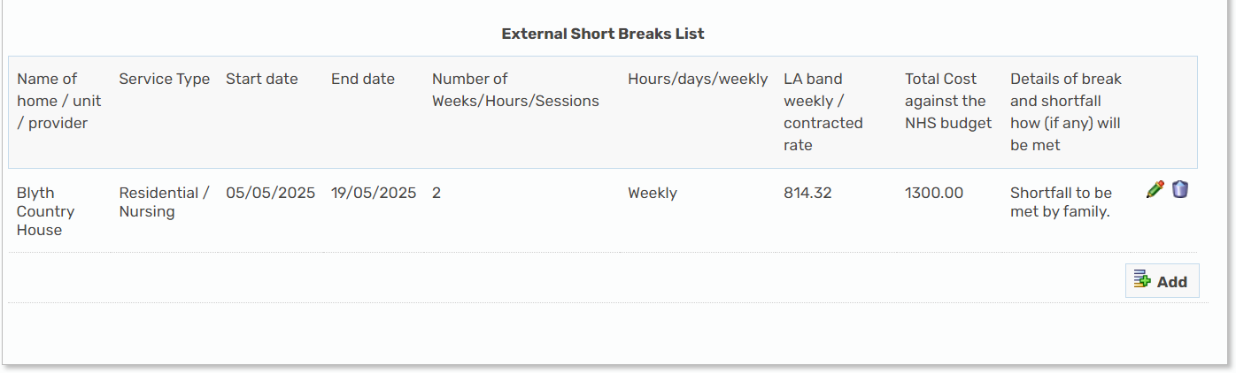
Using the £1300 budget to fund a two-week stay
The example below shows the details of where a 2 week stay is requested using the higher rate budget of £1300 towards the cost of the stay. Carer/family would need to fund the short-fall of £328.64

Slide 15
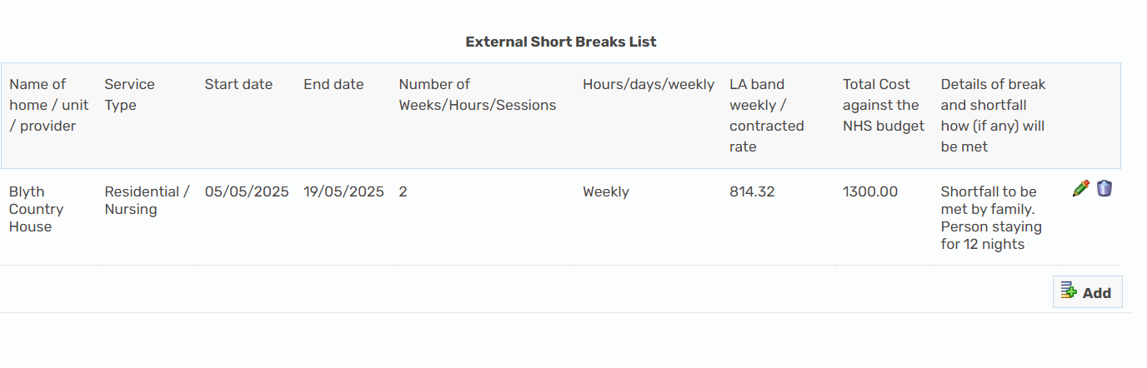
Using the £1300 budget to fund a 12-night stay
The example below shows the details of where a 12-night stay is requested using the higher rate budget of £1300 towards the cost of the stay. Carer/family would need to fund the short-fall of £95.98

Slide 16
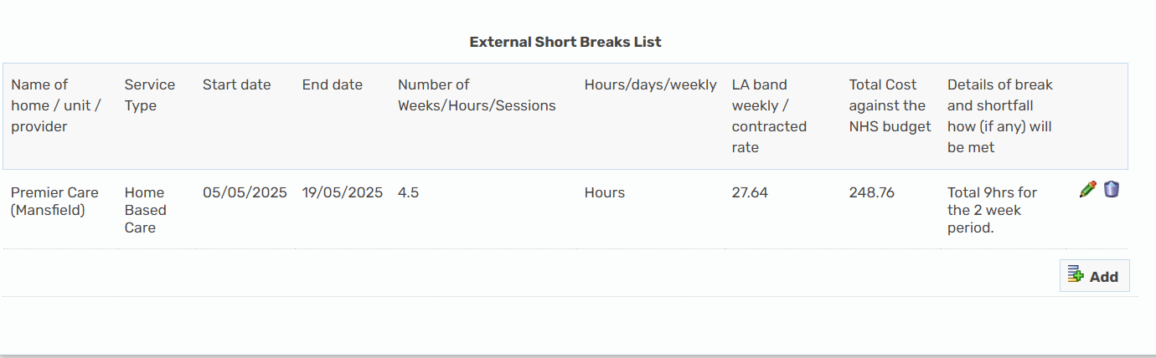
Contracted Home-Based Care
The break duration is requested in the total number of hours per week, at the providers contracted hourly rate for that district area. This example shows request for 2 weeks’ support at £124.39 per week

Slide 17
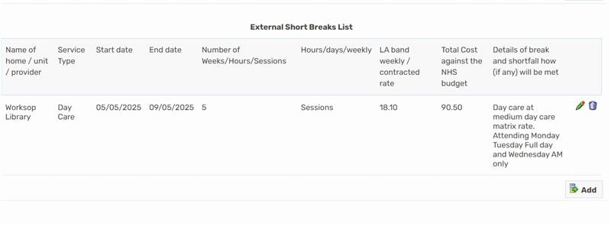
Contracted Day Care
The break duration is requested in sessions – 1 session is half a day. This example shows request for 5 sessions:

Slide 18
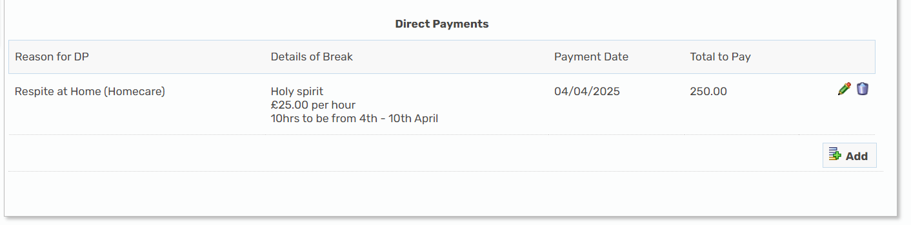
Direct Payment – Home-care Agency

Slide 19
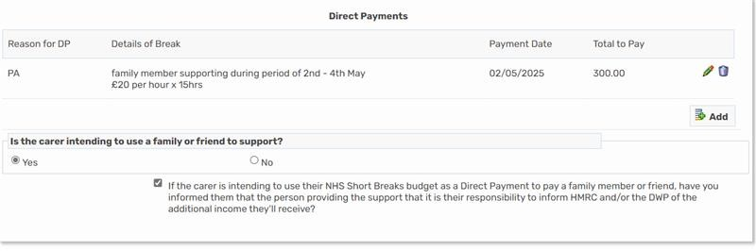
Direct Payment – Use of Family Member as a PA

Slide 20
6. Question and answer session

Slide 21
Additional Support
Guidance documents available – Resource Hub
Recording of the briefing – Resource Hub
Peer support from Carer Champions
Team meetings/huddles - share peer to peer experiences
Lisa Talma-Smith – Service Improvement Team Officer
Dan Godley – Senior Commissioning Officer

Slide 22
contacts
Dan Godley – Senior Commissioning Officer
dan.godley@nottscc.gov.uk
0115 977 4596
Lisa Talma-Smith – Service Improvement Team Officer
lisa.talma-smith@nottscc.gov.uk
0115 977 2815

