Slide 1


Preparing Students for Industry Using Open Source and GitHub
Harmony Li and Patrick Cozzi
University of Pennsylvania
Notes:
Harmony: http://harmonymli.com/
Patrick: http://www.seas.upenn.edu/~pcozzi/

Slide 2
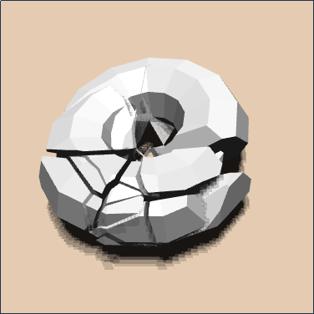
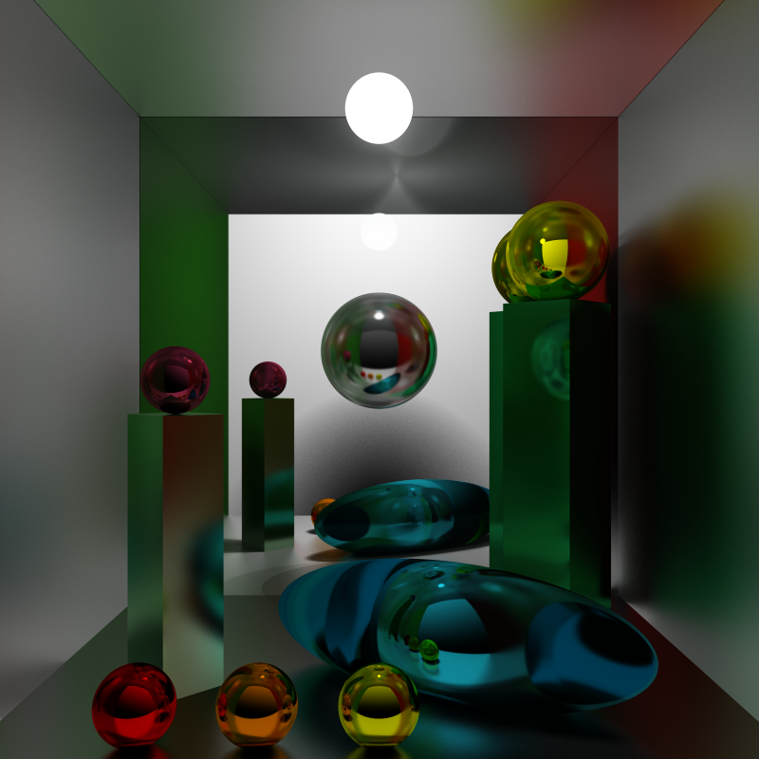
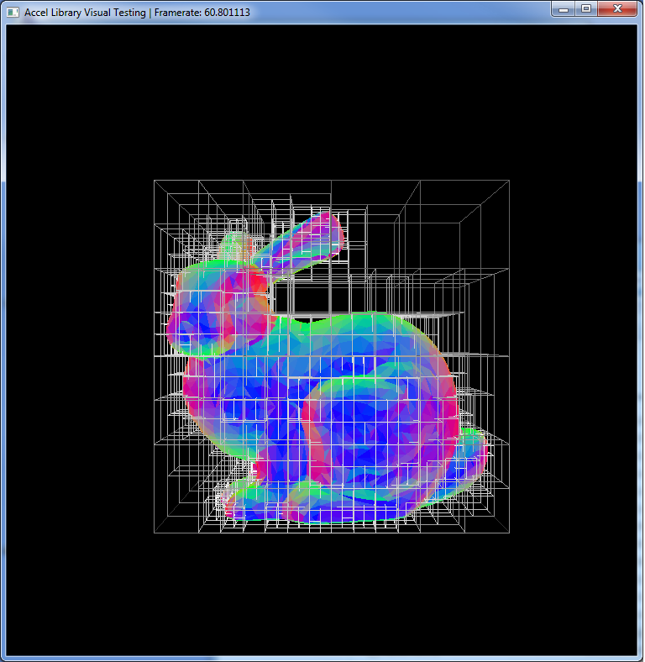
Background
CIS 565: GPU Programming and Architecture
Pragmatic, project-based, industry-focused
CUDA, OpenGL, WebGL
Notes:
Today we are going to talk about our experience with using GitHub and open-source projects in CIS 565 at the University of Pennsylvania. CIS 565 is a graduate-level graphics course on using the GPU for both massively parallel compute algorithms and graphics applications. Most students are second-year master’s students who have already taken at least one intro graphics course. Usually, a few undergrads and sometimes a PhD student also take the course.
CIS 565 is project-focused. Patrick stopped giving exams and pure written assignments after his second semester teaching. The mindset for CIS 565 is a “a series of projects with supporting lectures.” It’s kind of like the class is a sports team, and the instructor is a coach preparing them for games.
Student work from left to right: GPU-Accelerated Dynamic Fracture in the Browser with WebCL by Kai Ninomiya and Jiatong He; Bidirectional Path Tracer in CUDA by Paula Huelin Merino and Robbie Cassidy; Uniform grid and kd-tree in CUDA by Jeremy Newlin and Danny Rerucha.

Slide 3
TODO - Harmony
~3 slides for CIS 565 project demos. Use some recent ones from Fall 2014 and perhaps some from this talk: https://t.co/xuy7V2Q06m

Slide 4
Our Perspectives
Instructor
Hiring Manager
Teaching Assistant
Student
Software Developer
Notes:
We try to look at using GitHub and open-source from many different angles. Between the two of us, we cover many perspectives:
Harmony was a student in the course before TAing it, and is now in industry.
Patrick is the instructor, but works in industry full-time as a hiring manager and software developer.
For the software developer perspective, there are two angles: (1) providing students with useful skills to become software developers, and (2) preparing the students for technical interviews with software developers.

Slide 5
Motivation
A posting for an AMD internship in 2012:
    “The profile for the candidates: C++, OpenGL, OpenCL. Applications with a source code and for the principle of it, a resume.”
Notes:
This is just one example that the recruiting world is changing. Attending a prestigious university, earning a high GPA, and creating a website with descriptions of their projects is no longer enough to stand out. Employers want to see code.
AMD internship posting by Christophe Riccio: http://www.g-truc.net/post-0461.html

Slide 6
TODO - Harmony
Mechanics on how we use GitHub, e.g., starter code in course repo, fork to work on project, pull request to submit, each project is unique and in-class presentations to help with academic integrity.
Benefits: students learn git, learn version control, easy to provide patches, students have a public portfolio, exposure outside of class

Slide 7
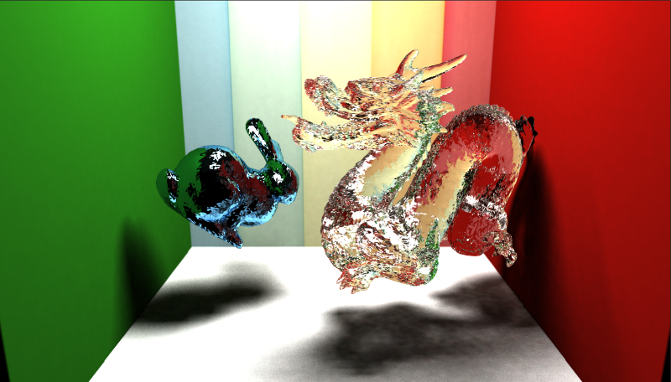
README.md Tips
Provide context and contact info
Have a representative image
Notes:
The README.md file in the root directory is displayed when we visit a GitHub repo. We encourage students to make this as compelling as possible to showcase their work.
Screenshot: Accelerated Stochastic Progressive Photon Mapping on the GPU by Ishaan Singh, Yingting Xiao, and Xiaoyan Zhu, https://github.com/ishaan13/PhotonMapper

Slide 8
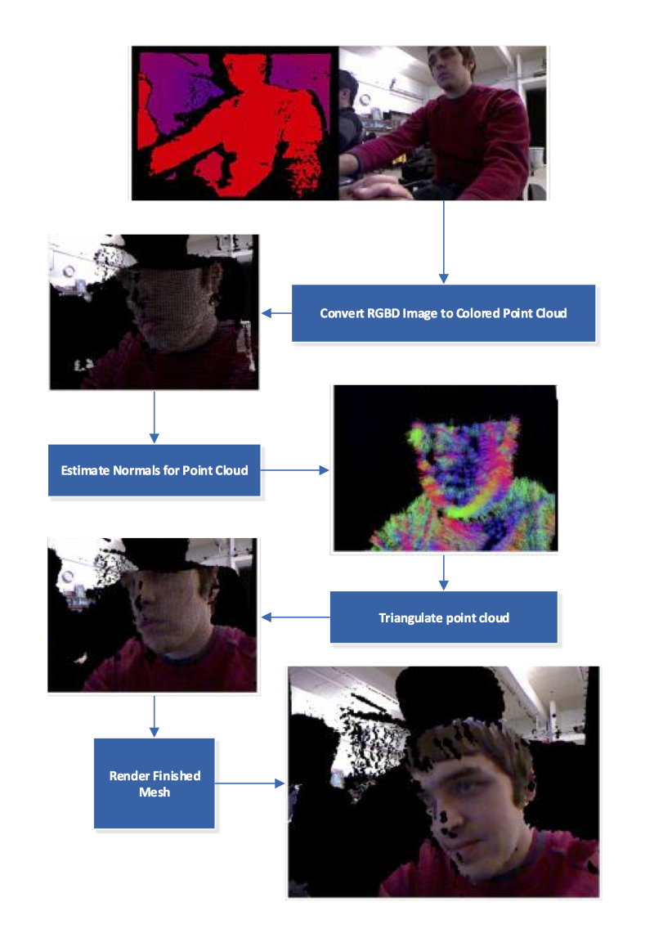
README.md Tips
Use screenshots with captions to walk through features
Notes:
Screenshot: Surface Mesh Reconstruction from RGBD by Collin Boots and Dalton Banks, https://github.com/cboots/RGBD-to-Mesh

Slide 9
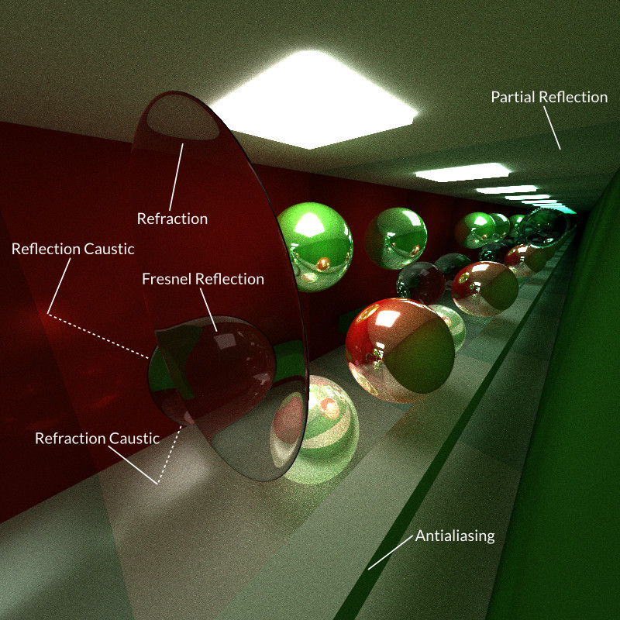
README.md Tips
Annotate
Notes:
Screenshot: GPU path tracer by Kai Ninomiya, https://github.com/kainino0x/Project3-Pathtracer

Slide 10
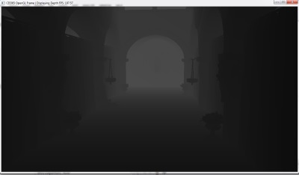
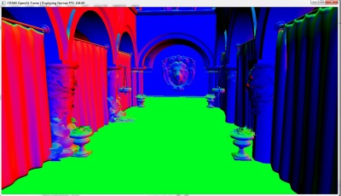
README.md Tips
Debug screenshots
Notes:
Screenshot: Deferred Shader by Cheng-Tso Lin, https://github.com/otaku690/GLSLDeferredShading

Slide 11
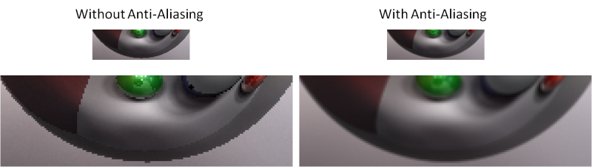
README.md Tips
Side-by-side comparisons
Notes:
Screenshot: GPU Path Tracer by Wei-Chien Tu, https://github.com/foxking0416/Project3-Pathtracer

Slide 12
README.md Tips
Bloopers
Videos
Demos
Performance analysis
Build instructions
Focus on what is unique

Slide 13
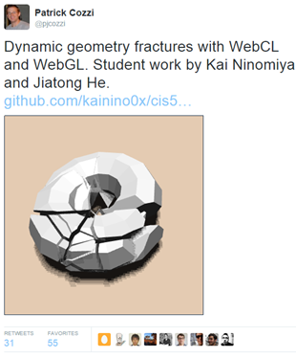
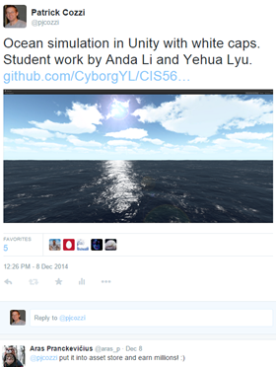
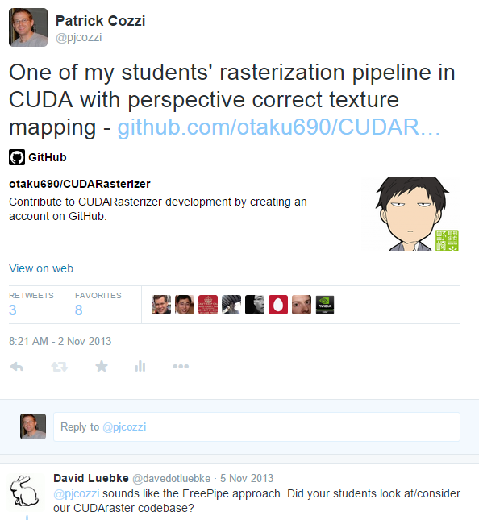
Twitter
Notes:
Exciting for students to have their work noticed outside of class and the university.
Sometimes, someone famous will notice.
Open source isn’t necessary for twitter, but it helps drive engagement.
Dynamic geometry fractures with WebCL and WebGL by Kai Ninomiya and Jiatong He, https://twitter.com/pjcozzi/status/542364663166824450
Ocean simulation in Unity by Anda Li and Yehua Lyu, https://twitter.com/pjcozzi/status/542007352925642753
Rasterization pipeline byCheng-Tso Lin, https://twitter.com/pjcozzi/status/396613045553623040

Slide 14
Alumni
Survey
Results
Notes:
34 responses from CIS 565 alumni over six semesters (5 of which Patrick taught). The course is taught about once a year and has ~20 students.

Slide 15
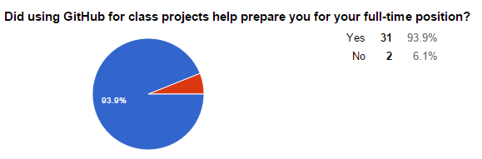
Survey Results - GitHub
Why didn’t it help?
  “I was familiar with git/github already. My employer uses centralized version control (Perforce).”
  “I am not working in a full-time position yet.”

Slide 16
Survey Results - GitHub
Why did it help?
  “Github is used extensively in the company I work for now. They also listed git as desired skill when recruiting for this position.”
Notes:
Most responses were similar to this. Companies are using git or GitHub, and are looking for students familiar it.

Slide 17
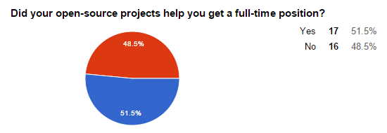
Survey Results – Open Source
Notes:
Keep in mind, it didn’t hurt the students who said No, and it helped 51.5%. I expect this to only increase as recruiting practices continue to change.
Several students also already had job before starting the course or received full-time positions based on their internships.

Slide 18
Survey Results – Open Source
“I have my personal website, and I have the github link on it. Employers are interested in the projects, and we had a great discussion. It's actually not about the coding part. I think code portfolio is not that popular when interviewing a candidate. The key part is still about the interview itself.”
Notes:
This quote is representative of many responses:
The project portfolio is useful: demos, videos
Employers generally don’t look at the code (or the student doesn’t realize it)
The interview itself is what matters

Slide 19
Survey Results – Open Source
“One of the companies I interviewed specifically went through my code samples on git and asked me questions based on that”
“A lot of companies are asking for my code sample on git.”
Notes:
Being asked about your own code is a great way to stack the odds in your favor.
I expect more companies to ask for code samples; as a hiring manager, I do.

Slide 20
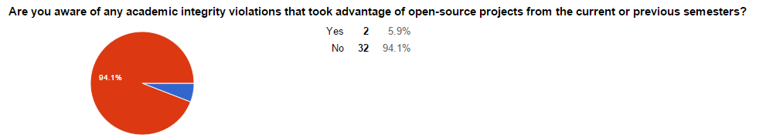
Survey Results – Academic Integrity

Slide 21
Survey Results – Academic Integrity
Based on your experience, do you think open-source projects increase the chance of academic integrity violations?
  “It is possible but in my experience for such specialized courses like GPU programming, most students are in it to win it.”
  “I do not. If anything it makes them much more blatant and therefore high-risk.”
  “If students want to share code, they can regardless of policies”
  “I also think having rendered images and README files publicly viewable online is great motivation for current students who want to one-up students from previous years.”

Slide 22
Conclusion
GitHub: adopt it as early as possible in coursework
Open source projects: use them if it makes sense for your course

Slide 23
Resources
Free GitHub educator’s accounts: https://education.github.com/guide/private_repos
How to make an attractive GitHub repo: https://github.com/pjcozzi/Articles/tree/master/CIS565/GitHubRepo

Slide 24
TODO - Patrick
Screenshot credits on slides
Cite like research
Hackathon? Speakers?
Valve?

