Slide 1
USMA – Chemistry and Life Science Department
Using Cloud Based Jupyter Notebooks to Effectively Analyze and Share Microbiome Data
MAJ Preston Dihle, Department of Chemistry and Life Science, USMA
Preston.Dihle@westpoint.edu

Slide 2
Problem Statement
Network Restrictions
Reproducible Research
Initial raw data quality visualization was carried out in FastQC. All raw read quality control was performed in Quantitative Insights into Microbial Ecology (QIIME 2) software. Reads were demultiplexed, denoised, merged, low-quality reads were trimmed, filtered and chimaeras were removed using DADA2. After filtering, reads per sample were an average of 11,925 ± 4051. Amplicon sequence variant (ASV) data were generated by a Naive–Bayes machine-learning classifier in QIIME 2, which subsequently output a feature table identifying a total of 39,085 ASVs. A phylogenetic tree was inferred from ASVs using FastTree v.2.1.3 and taxonomic classification was carried out in QIIME 2 using a Naive–Bayes classifier based on Greengenes database v.13.8 clustered at 97% similarity. Prior to taxonomic analyses, we removed one sample that yielded no mapped reads and any singleton ASVs and taxa with an unassigned phylum level.

Slide 3
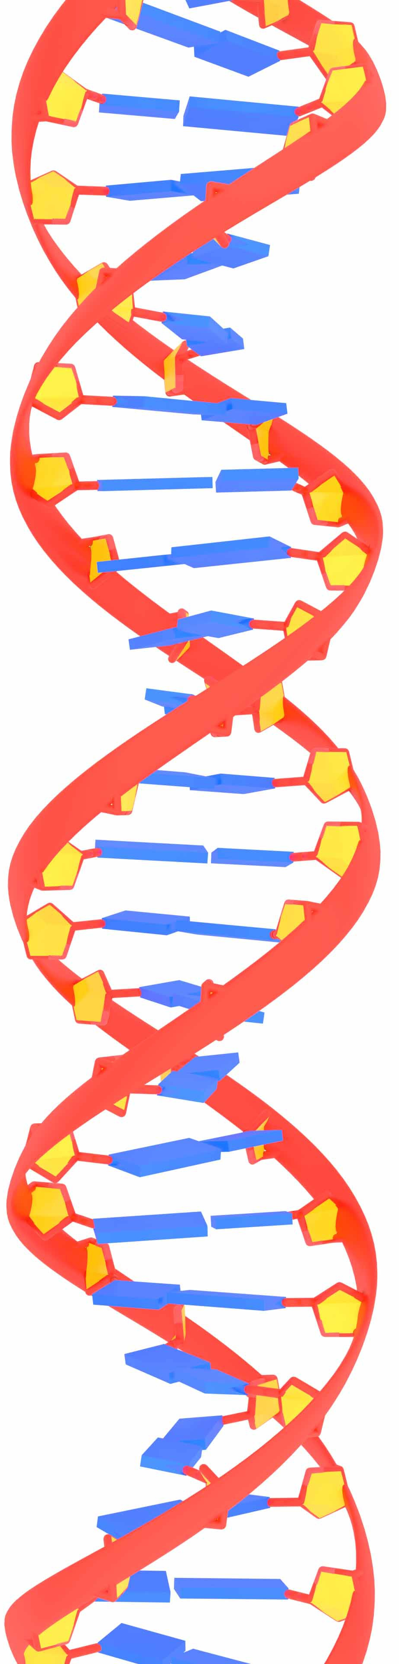

Google Colab – Cloud Based Jupyter Notebook
Built on top of Jupyter Notebook
Fully Compatible
Simple to Create and Share
No downloads needed
Simple user interface
Multiple data entry points
Supports real time editing by multiple people
Maintains history
Highly Customizable
Graphics
Text
Code
Supports Multiple Languages
BASH
Python
R
Accepts Data From Multiple Sources
Google Drive
Dropbox
Local Drive

Slide 4
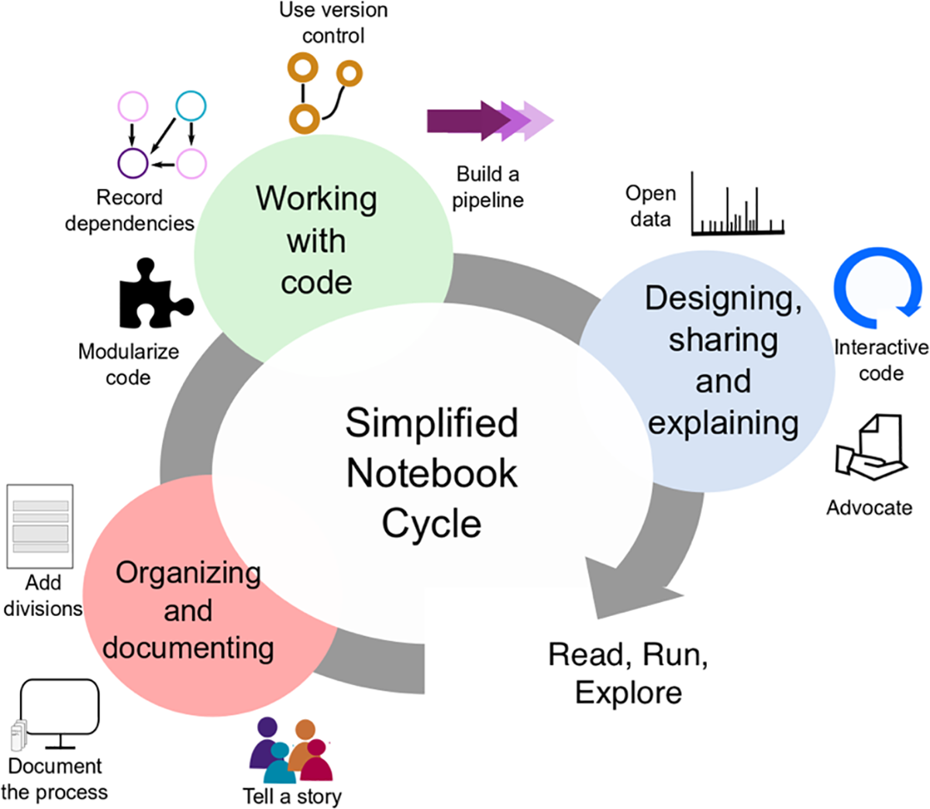
Reproducible Microbiome Research With Jupyter Notebooks
Design your notebooks to be read, run, and explored
Tell a story for an audience
Document the process, not just the results
explain your data
Build a pipeline
Use cell divisions to make steps clear
Modularize code
Record dependencies
Don’t forget version control
(Rule, 2019)

Slide 5
Comments
Alternatives to Google Colab
Binder
https://mybinder.org/
Gradient
https://gradient.run/
Kaggle
https://www.kaggle.com/
LTC Jason Barnhill Ph.D., USMA
COL F. John Burpo, Sc.D., USMA
Dr. Elodie Ghedin Ph.D.,
Sandve, Geir Kjetil et al. “Ten simple rules for reproducible computational research.” PLoS computational biology vol. 9,10 (2013): e1003285. doi:10.1371/journal.pcbi.100328
Barba, Lorena A. “The hard road to reproducibility.” Science (New York, N.Y.) vol. 354,6308 (2016): 142. doi:10.1126/science.354.6308.142
Rule, Adam et al. “Ten simple rules for writing and sharing computational analyses in Jupyter Notebooks.” PLoS computational biology vol. 15,7 e1007007. 25 Jul. 2019, doi:10.1371/journal.pcbi.1007007
Preston.Dihle@westpoint.edu

