Slide 1
DOXING
AN EXCUSE TO GOOGLE YOURSELF.
By: Patrick Williamson

Slide 2

WHAT IS DOXING?
Doxing is gathering information available on the internet, usually to release it publicly.
To compile and release a dossier of personal information on someone (http://www.wired.com/2014/03/doxing/).
The tactics are the same as the ones you would use to gather information to launch an attack on someone.
Popular in the cracker and gaming communities.
Useful to take revenge on anyone who values their anonymity online.
Has been used a lot recently to get information about people in the news.
It is legal...mostly
Notes:
Doxing is mostly legal. Because you are gathering information available on the internet it is perfectly fine to compile and release. The exception to this is if you use social engineering or bypass any security mechanism to gather information. In that case not only is the act of gathering illegal but also release the data would be.

Slide 3
WHAT IS DOXING?
Reconnaissance
Scanning
Gaining Access
Maintaining Access
Clearing Tracks
Doxing is a process that is in the reconnaissance stage of an attack.
The information gathered in this stage can help in the Scanning and Gaining Access phases.
The information gathered from an individual could be used to attack their current or previous employers.
Notes:
This information can help in spear phishing attacks.
If you have any kind of password reset that uses employees personal information then Doxing could be used to exploit your network. Especially because with many sites you can go through the process of resetting a password but stop before the last step and the end user never receives an email, this means you can get the questions that are asked and then go and research them at your own leisure.

Slide 4
GOALS
The goals of doxing someone is to get personal information about someone, this can include:
Name (if you have their username)
Usernames (if you have their name)
Address
SSN
Email Addresses
Phone Number
Computer Operating Systems
Sexual Orientation
This information could be used for worse things like SWATing.
Notes:
A person can use multiple username and even different names online, you are trying to discover all of these.
A person can have multiple email addresses.
Learning a persons computer OS or mobile OS can help further down the road if the person is going to do a longer engagement.

Slide 5

BLACK HAT
Used by black hats for several things
Making a point
Taking revenge
Getting attention
Sony Leak (Several Celebrities had their information leaked after the Sony networks were compromised).
http://www.theregister.co.uk/2014/12/09/sony_hackers_dox_celebs/

Slide 6
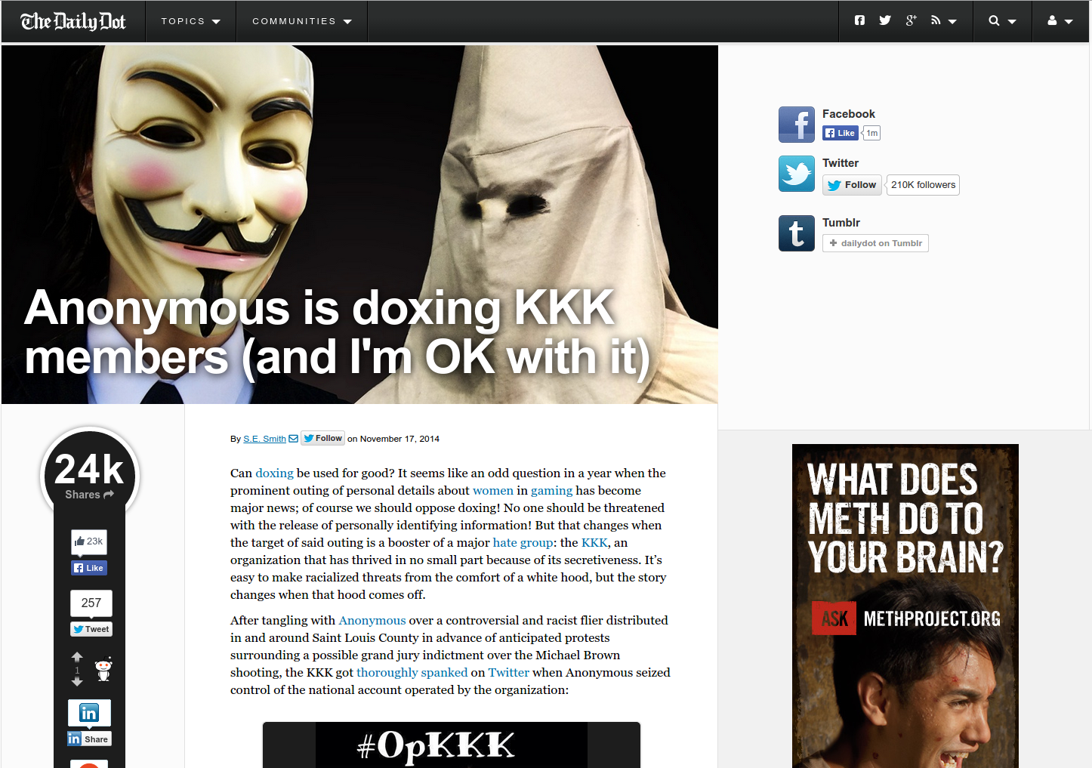
GREY HAT

Slide 7
WHITE HAT
Officers are using some of these techniques to track suspects.
Federal agencies are getting into the action as well.
These are not active attacks so this could be a valid method for offensive security in many companies to aid in investigation.
Notes:
Federal agencies are actually pros at doing this.

Slide 8

HOW TO DO IT
Start with a little and build to a lot
Tools of the trade
Public records
Whois lookup
Google
WhatsTheirIP.com
Phonebook
White pages (website)
FreeCreditReport.com
Notes:
Other search engines besides Google will give different information (Bing for example).
If you don’t know how to Google hack then learn. There is no reason to not have at least a few Google hacking skills in your back pocket besides putting things in quotes. (Johnny Long, Google hacking DB)
What’s their IP is a site used to trick people into giving you their IP, from there you can track down their location.

Slide 9
HOW TO DO IT
More Tools
Social network (you can get a lot of information about like and dislikes, as well as, where people go)
This can also be a good place to get information for security questions for banks and the like
Social engineering (once you know where people may go you might be able to get more information from those place [e.g. schools, hospitals])
Tor
This can be used by Black hats to purchase services from people.
it can be used by white hats as a resource.
Roxer Doxer
Maltego
Don’t forget the Meta Data
Notes:
Once into a bank or some other protected site it is possible to keep digging and get more personal information like SSN.
Roxer Doxer is a tool that can be used to automatically pull information from things like email.
Meta data can be an important source of information. If you are able to find a persons Facebook or Flickr the meta data in the pictures can be used to track other places that they go. If you’re able to have them go to a site you own you can try to get the meta data that comes from their browsers.

Slide 10

HOW TO PROTECT YOURSELF
Lock down your social profiles (Facebook, Linkedin, Twitter, Google+).
Be careful about who you friend
Try to compartmentalize your information
Different usernames on different sites
Google yourself, know what’s out there.
Sketchy and Scumbler
Alternate Tactic
Accept it
Notes:
Sketchy and Scumbler (and others) are both tools that can be used to search the internet for mentions of names companies or whatever else you set it up for.
There really isn’t anything much you can do to protect yourself, the information is already out there and people will be able to find it. It is still good to know what is out there and lockdown profiles but for the most part there isn’t anything you can really do about it.

Slide 11
ADDITIONAL RESOURCES
Helpful sites
http://resources.infosecinstitute.com/doxing-the-dark-side-of-reconnaissance/
http://www.exploit-db.com/google-dorks/
http://school-of-privacy.com/selfdox
http://www.hackershandbook.org/tutorials/doxing
Other
Search SSNDOB on Google to get a list of sites to get SSN
Notes:
The ssndob sites have a tendency of going down on occasion so a Google search will usually tell the ones that are up.

Slide 12
ABOUT ME
Patrick Williamson, CISSP, Security+
(520) 487-4071
pjdamws@gmail.com
www.confoundedsecurity.com
Thank You

