Slide 1

House Price Prediction Using Machine Learning Algorithm
PROJECT – 1: CSCE 5214
Software Development for AI
Presented by:
Ya Meng (11614910)
Puja Dhungana (11534933)

Slide 2
OBJECTIVES
Introduction to Project
Problem Statement
Workflow
Data Collection and Data Preprocessing
Machine Learning Models
Prediction of House Price
Conclusion
Future Scopes
References

Slide 3
Introduction to Project
Investment on house is big decision
Different factor influence the price
Prediction gives people idea when and where to invest
Using different machine learning (ML) model to estimate
And compare their results to find best model

Slide 4
Problem Statement
Different factor influence house price
Like: Social political, economical, topographical
Here, only structure and location of house
Price estimation to aid budgeting and find property
Home buyer, property investor and builders can be benefited

Slide 5
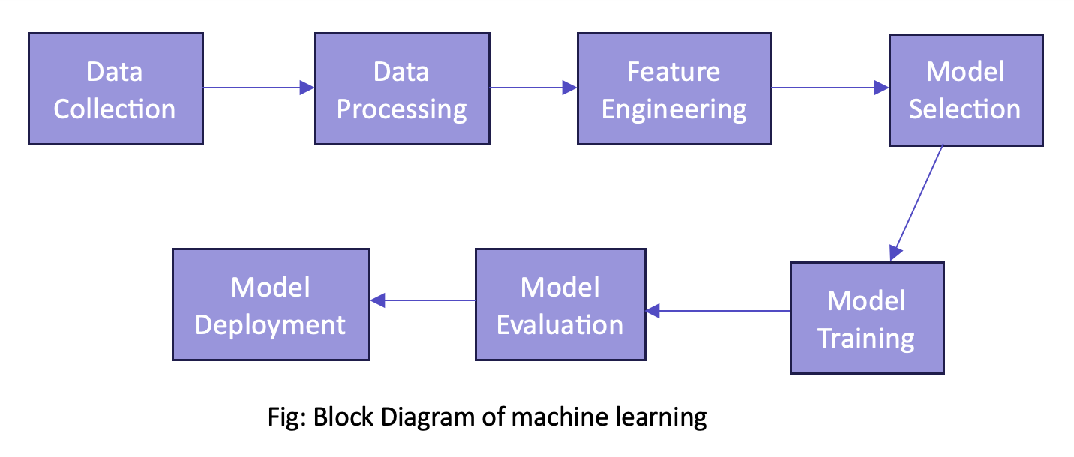
Workflow

Slide 6
Data Collection and Data Preprocessing
Collected ‘USA Real Estate Dataset’ data from Kaggle
30600 data (rows) and 10 features (column)
(status, price, bed, bath, acre lot, city, state, zip code, house size, previous sold date)
Here, only 7 features creating new pandas data-frame
(pd.dataframe)
(features not used zip code, previous sold data, city)
Drop any row with at least one NAN in any column
( df.dropna(how=‘any’) )
Change status feature to binary i.e. for_sale =1 and ready_to _built = 0

Slide 7
Feature Extraction and Data Split
Extract features and target variables
( drop ‘price’ to extract features i.e. x and define price as target i.e. y )

Slide 8
Data Collection and Data Preprocessing
Define numerical and categorical feature ‘states’
Make numerical features have similar scale values
(numerical_transformer = StandardScalar( ) )
Convert categorical feature into binary feature
(Categorical_transfom = OneHotEncoder( sparse = False, handle_unknown = ‘ignore’))
Handling preprocessed heterogeneous data, create class ‘ColumnTransformer’
(preprocessor = ColumnTransformer(transformers = [ …….]) )
Call class ‘ColumnTransformer’ and Fit the pre-processed data
(preprocessor.fit_transform(X) )
fit_transform( ) → fitting and trsnsforming

Slide 9
Data Split: Train and Test
Split data frame into train and test set
using Sklearn framework’s train_test_split function
test size = 30% and train size = 70%

Slide 10
Machine Learning Models
4 Machine Learning Models
Linear regression
Random forest regression
Decision tree regression
KNN regression

Slide 11
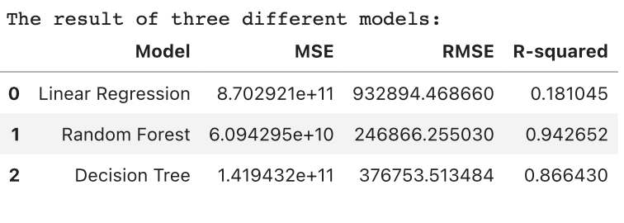
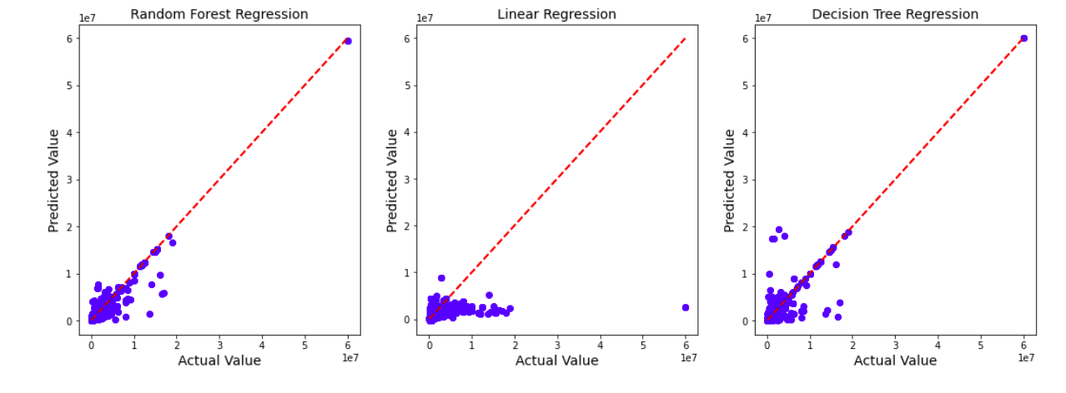
Results from Different ML Models

Slide 12
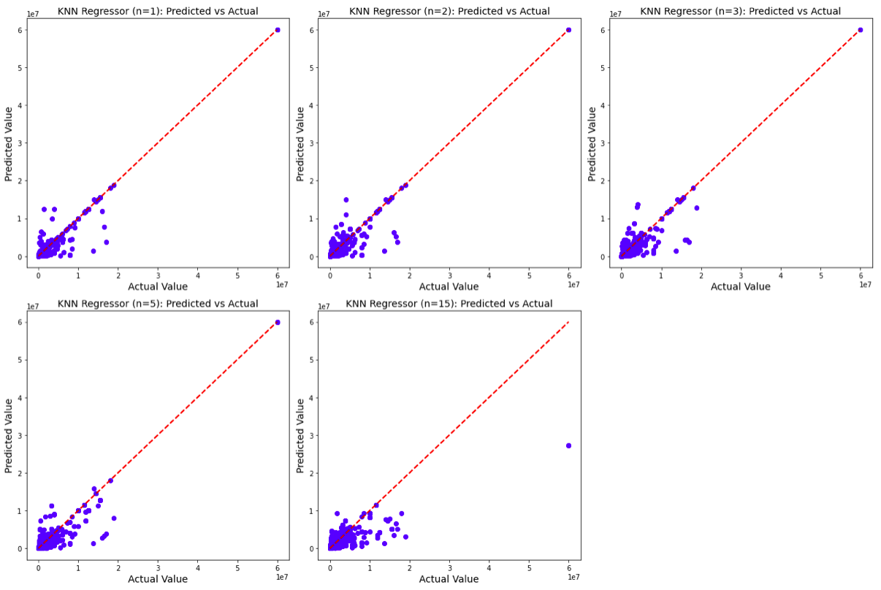
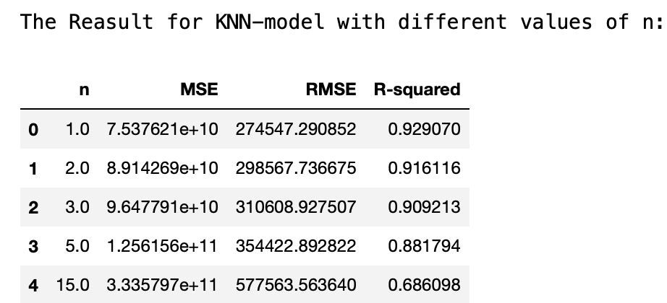
Results from Different ML Models

Slide 13
Results from Different ML Models
Predication Evaluation based on R squared score:
Random Forest is 0.9426, highest and best prediction
Linear regression is 0.18104, lowest and does worst prediction
KNN and Decision Tree have also have good score
KNN with n = 1 has 0.9290 but n=1 is not best choice
KNN n=2 has score 0.9161

Slide 14
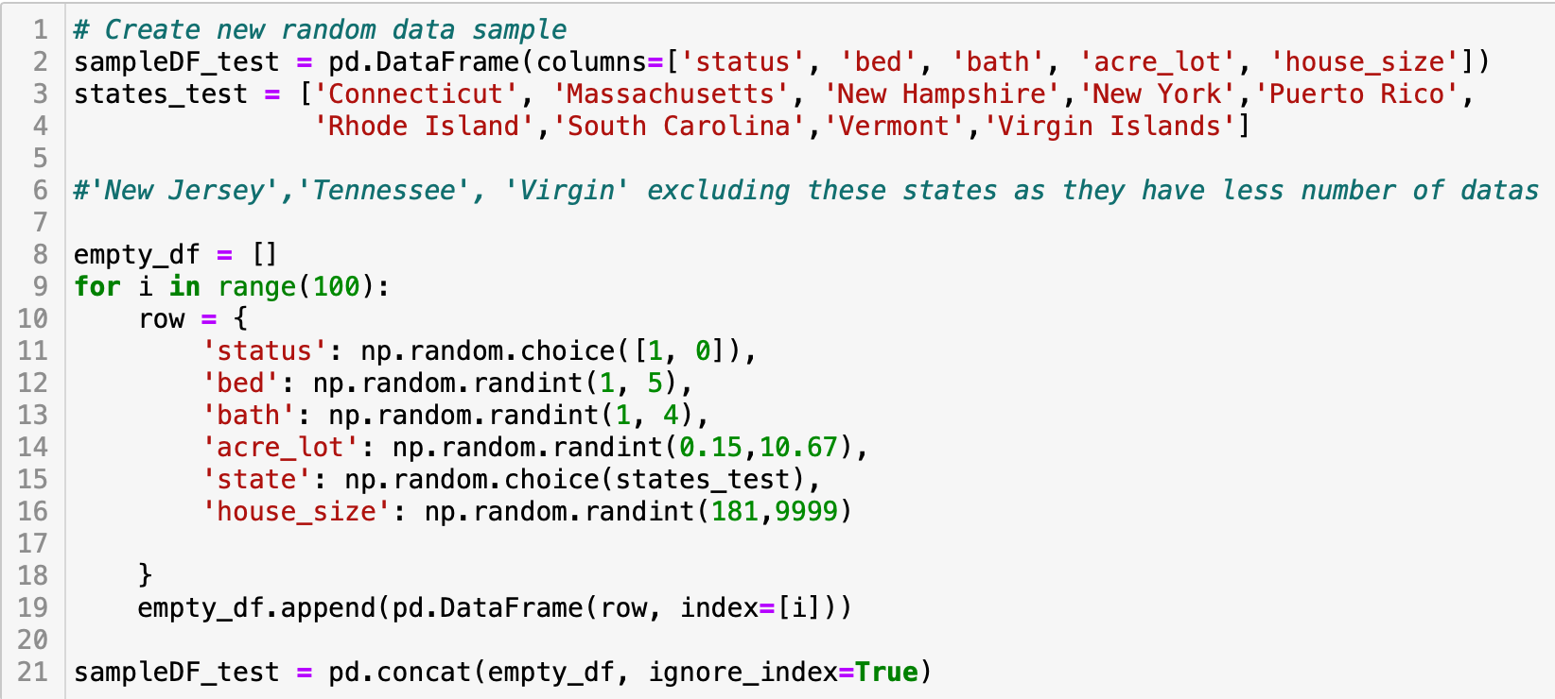
Predicting the Price of New House Data Samples Created Randomly
Randomly created dataset excludes states that has less than 25 data samples i.e. New Jersey, Virginia, Tennessee and South Carolina

Slide 15
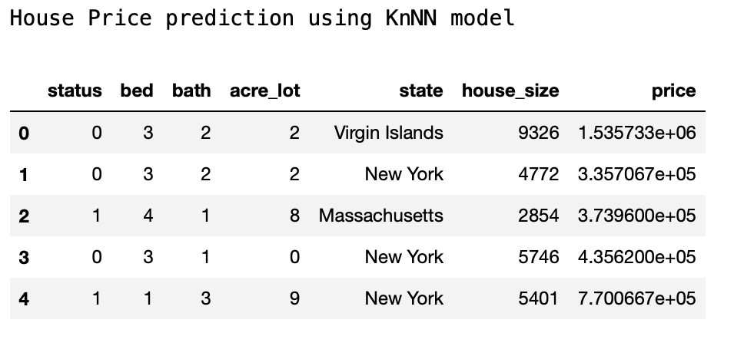
Predicting the Price of New House Data Samples Created Randomly

Slide 16
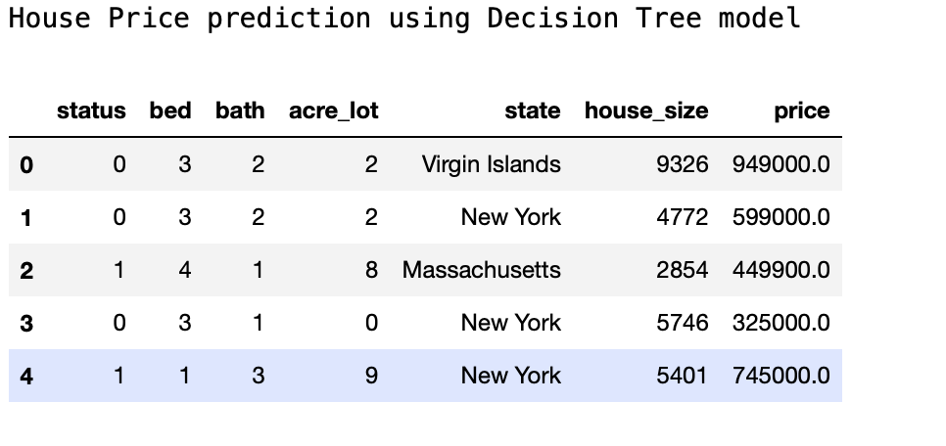
Predicting the Price of New House Data Samples Created Randomly

Slide 17
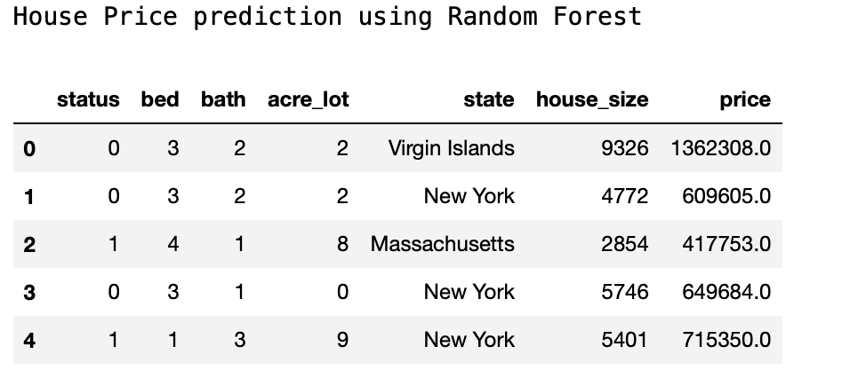
Predicting the Price of New House Data Samples Created Randomly

Slide 18
Conclusion and Future Scopes
This project can be used to predict the house price which can be beneficial for house buyers, investors or constructors.
Further, this project can be made advanced like using dockers container and make it more streamline the development process, ensure consistency, simplify development and enhance collaboration among team members.

Slide 19
References
https://www.kaggle.com/datasets/ahmedshahriarsakib/usa-real-estate-dataset
https://www.kaggle.com/code/erobrer/real-estate-usa-price-apredictions/notebook

