Slide 1
MLC Technical Exercise Prepared by : Paul Dominguez

Slide 2
Objectives
Develop a RESTful API using a platform that exposes Rocket Launch Windows based on the weather conditions from the given API
https://openweathermap.org/forecast5
Considerations
Best coding practices
Scalability
Reliability
Reusability
Automation
Security
Versioning
Performance

Slide 3
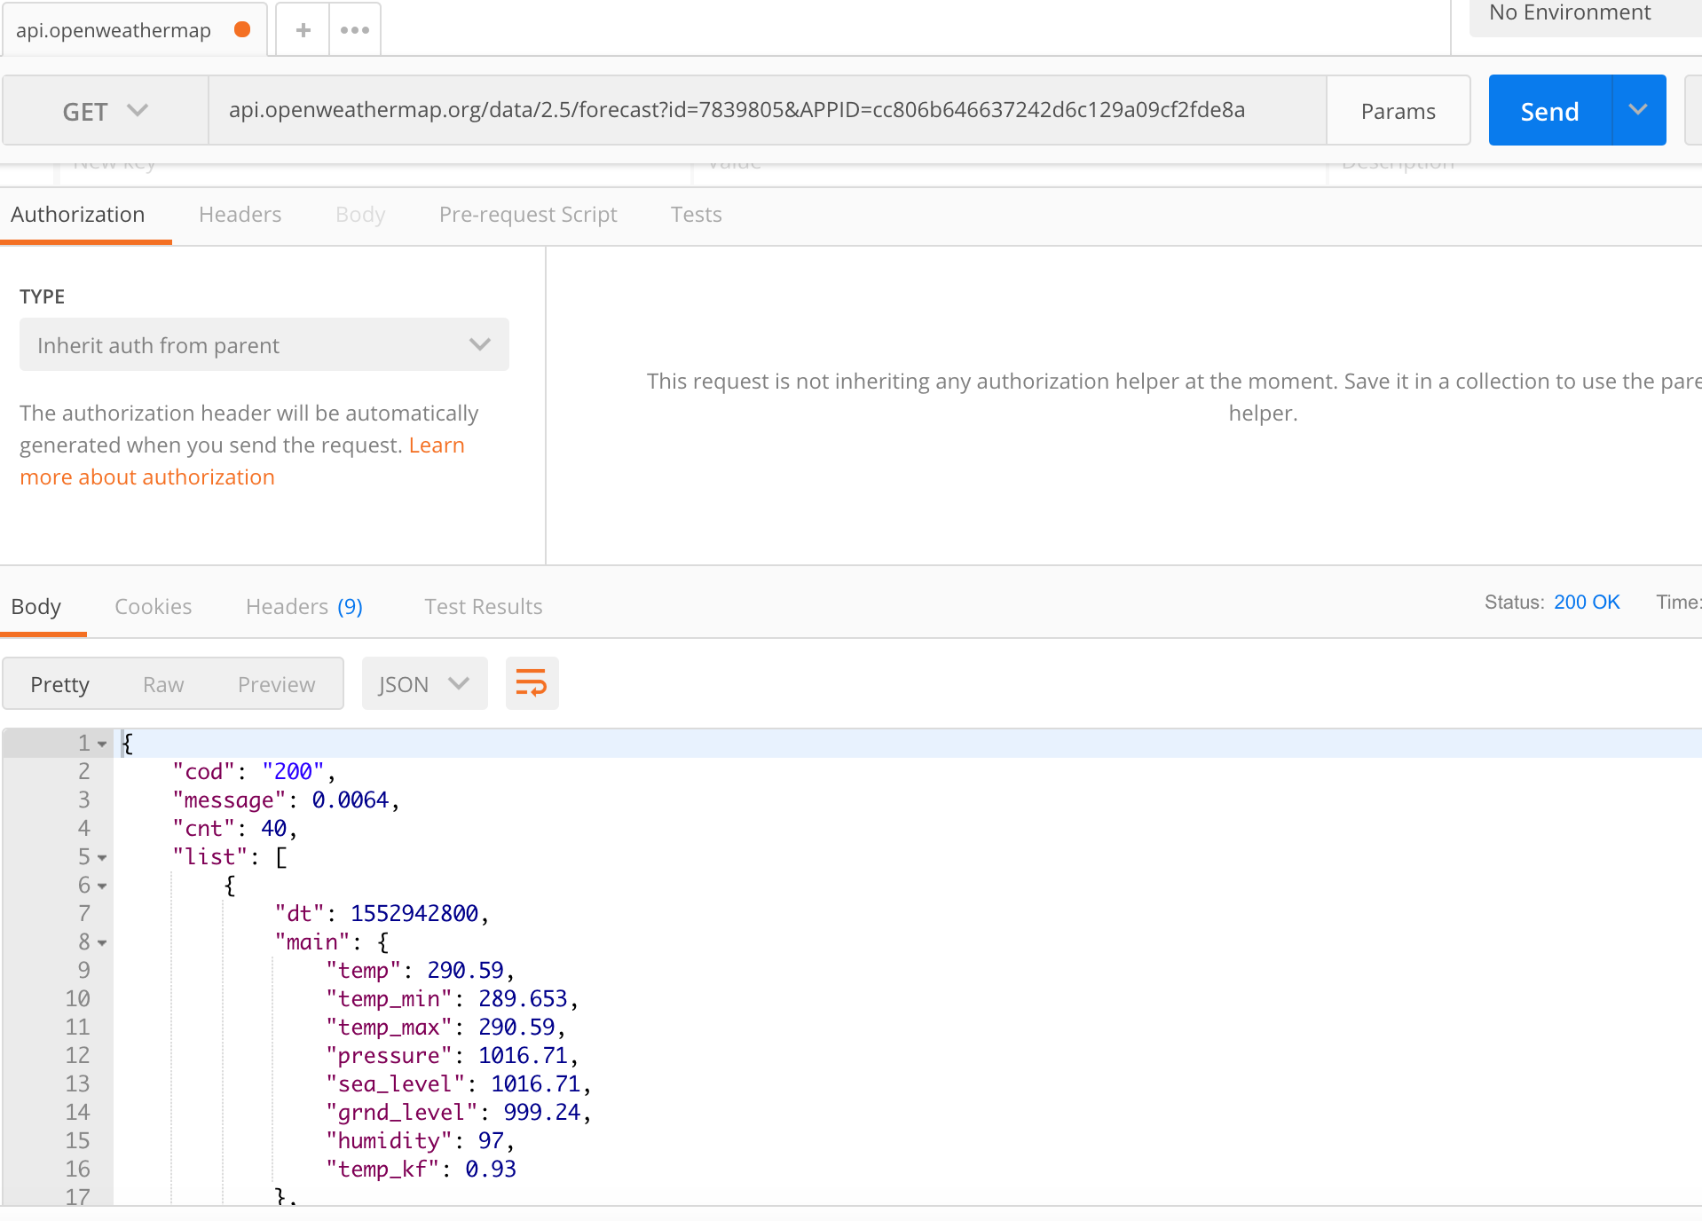
Invoking the API and Getting the Sample Response based on City ID

Slide 4
Observations
There was no bulk query so looping on all the given locations is needed
API calls are using City ID will will need Value Cross Referencing from the given values
Filtering of response data should be based on the threshold per city
Only return the top five(5) Rocket Launch windows based on computation of Environmental Variables

Slide 5
Technical Analysis
Since there was no data on the GetWeather Webservice I have decided to use the provided Docker Image to host the mock webservice for the second operation
After building the image and running the container, I noticed that the mock data source was not formed properly. I fixed the close tag on the RelativeHumidity field and rebuilt the image to be able to process the XML.

Slide 6
API Endpoints and Design
GET /locations?location={location} – returns a list of launch windows for the specific location
GET GET /locations = returns a list of launch windows for all available location
City ID, threshold and computation formula is given in the provided document

Slide 7
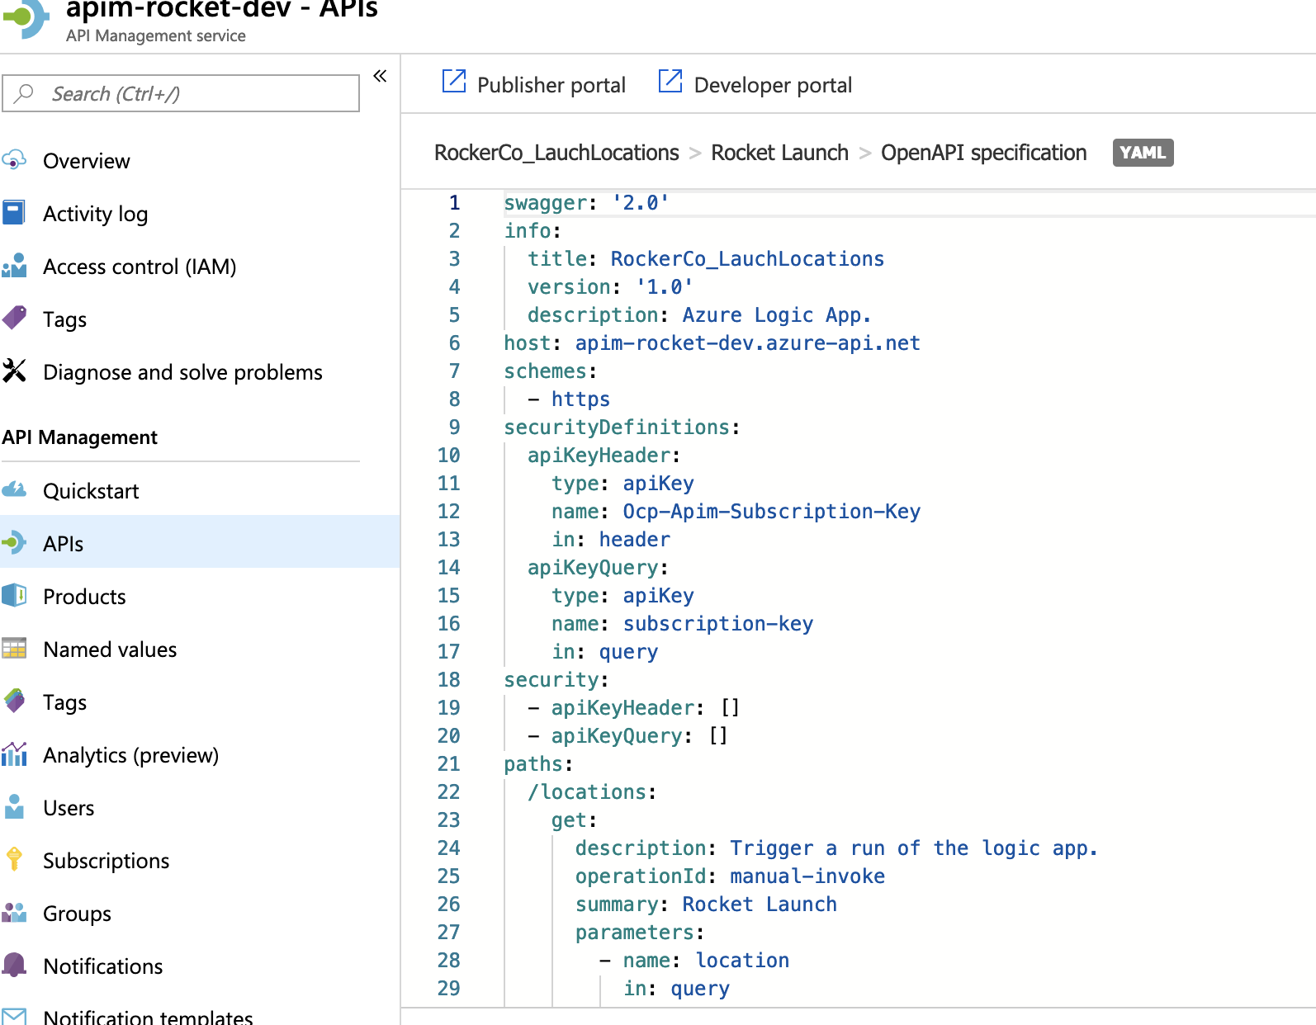
OAS Implementation
* Full Specification Available in the Repo

Slide 8
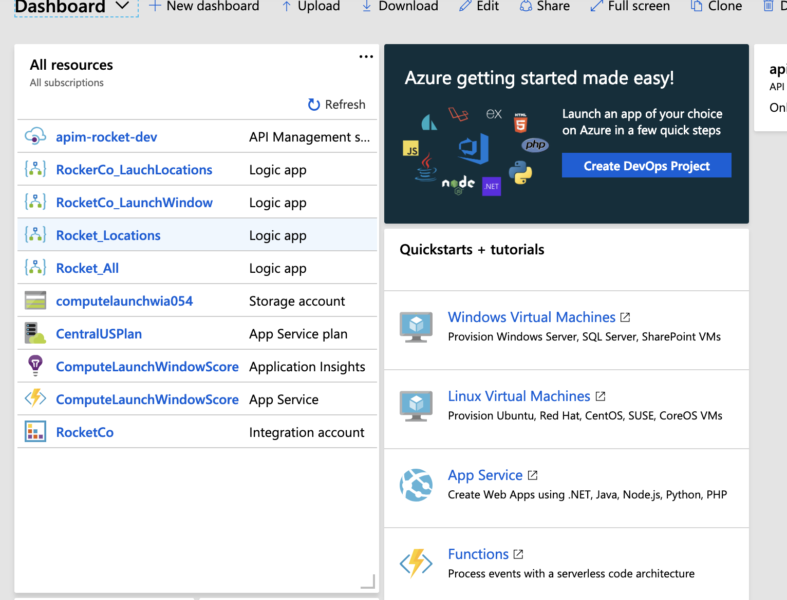
Azure Cloud Platform
Implemented the Solution based on available Azure Serverless Components (Logic Apps, Azure Functions)

Slide 9
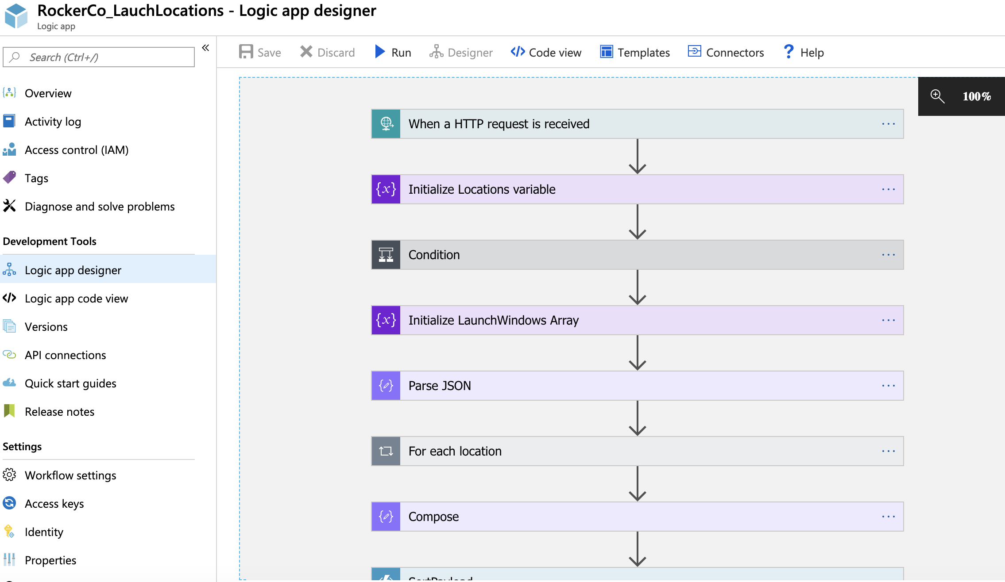
Logic App Implementaton
Orchestration and Workflow

Slide 10
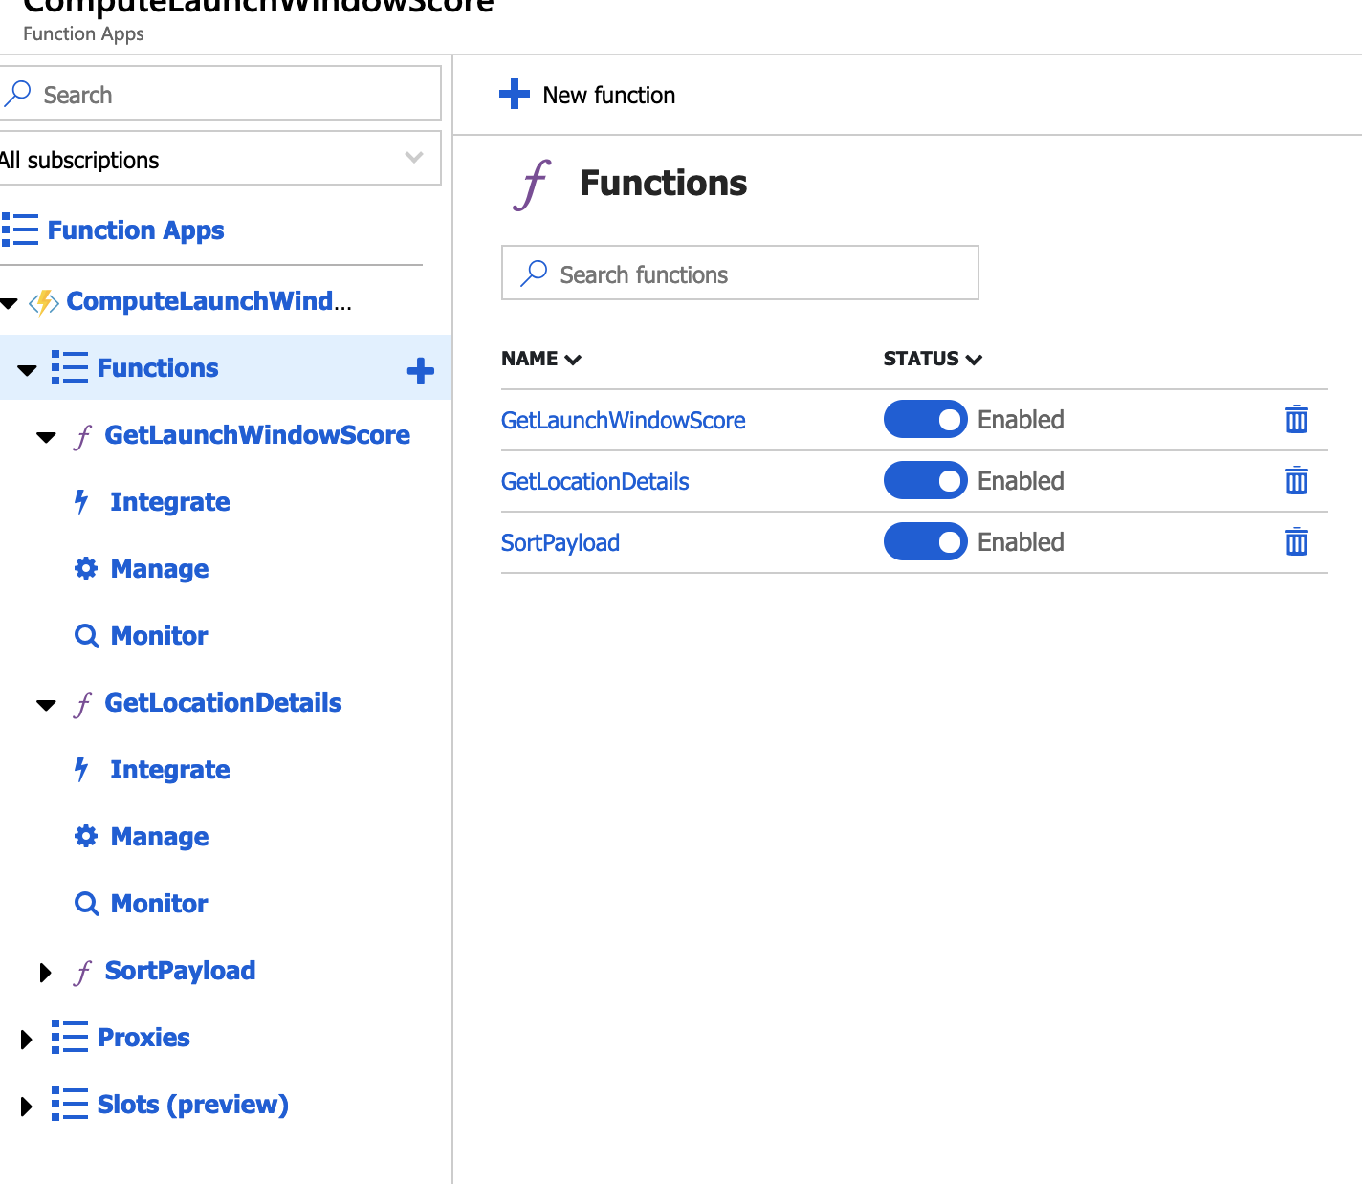
Azure Function Apps
Exposed functions as callable HTTP Service as a microservice for reuseablity. Auto scales on demand and no infrastructure provisioning needed. Full Code available in the repo

Slide 11
Technical Analysis
I have exposed the Azure Function as its own service to enable reusability for common use
Logic App orchestrates the flow an consumes the available services when native component is not fit for purpose
API Management was used for Governance and Application of Policies

Slide 12
Challenges
I was working on Logic App components to follow the Integration Patterns but some of it is not as performant. As I was using a free-tier subscription, the underlying resource is not scaling as much and only hits certain limits. I tried to work around that by fine tuning the threads and/or just using a direct code but is still not performing as I would like to.
Some of the Azure Kubernetes Service need to be on a higher subscription so I wasn’t able to use it
As I was tasked to use other platform than what I was already using (Mulesoft,AWS,GCP), I chose Azure and was also learning as I go (Might as well learn something new and enjoy it). I would admit that there was some hiccups here and there might used than more than the maximum required time
The Automation Script for Azure DevOps is available for CI/CD usage. Unfortunately, I didn’t had the time to implement it but will surely be a point of improvement
Unit/Smoke Test was not implemented as well and will be good to add it on the pipeline

Slide 13
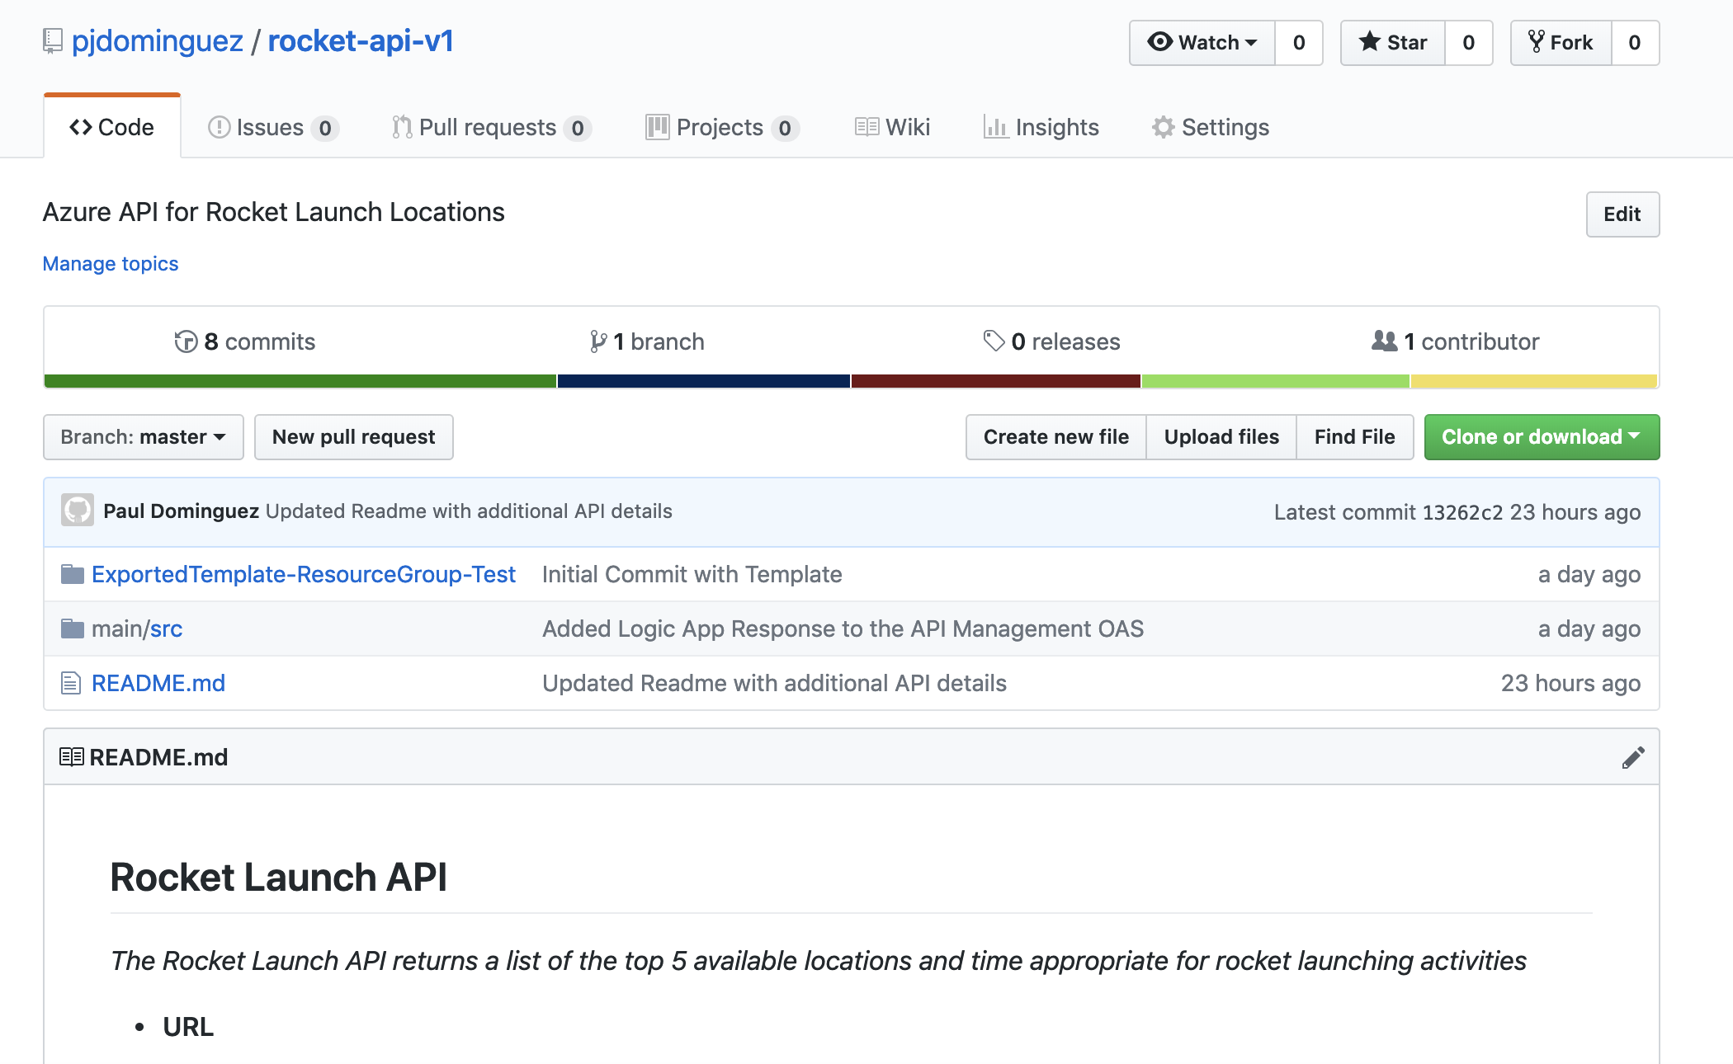
Solution References
I created a repository in github to put all my code and resources
https://github.com/pjdominguez/rocket-api-v1

Slide 14
Solution References
Azure Endpoint
https://apim-rocket-dev.azure-api.net/locations?location={location}
[{"key":"Ocp-Apim-Subscription-Key","value":"97131e95875847a484de509673ec5c44","description":"","enabled":true}]

Slide 15
Questions?

Slide 16
THANKS!

