Slide 1
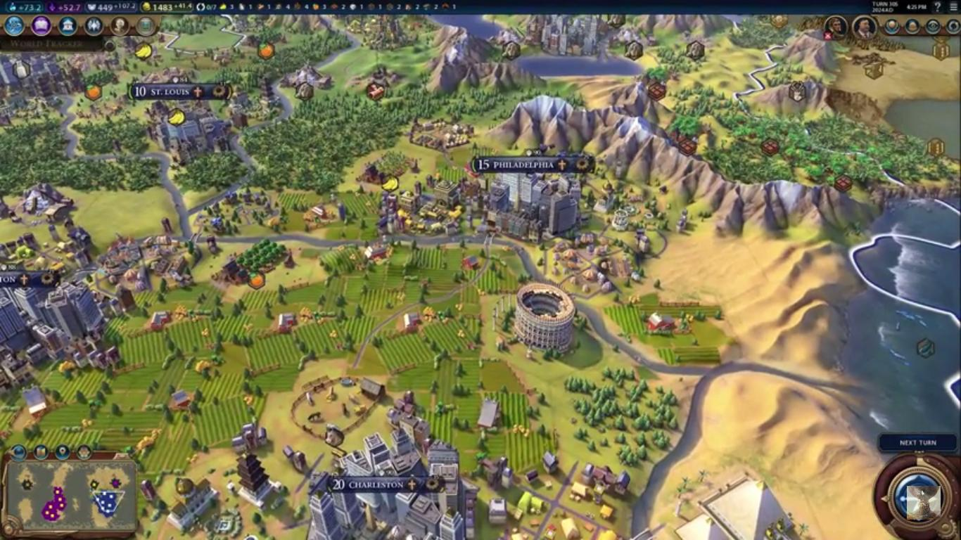
Invasion Planning in RTS and Turn Based Strategy Games
Peter Ebear

Slide 2
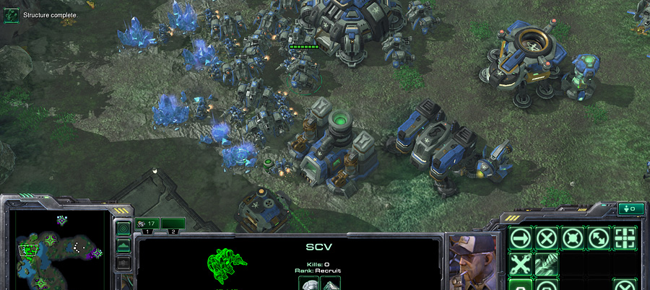
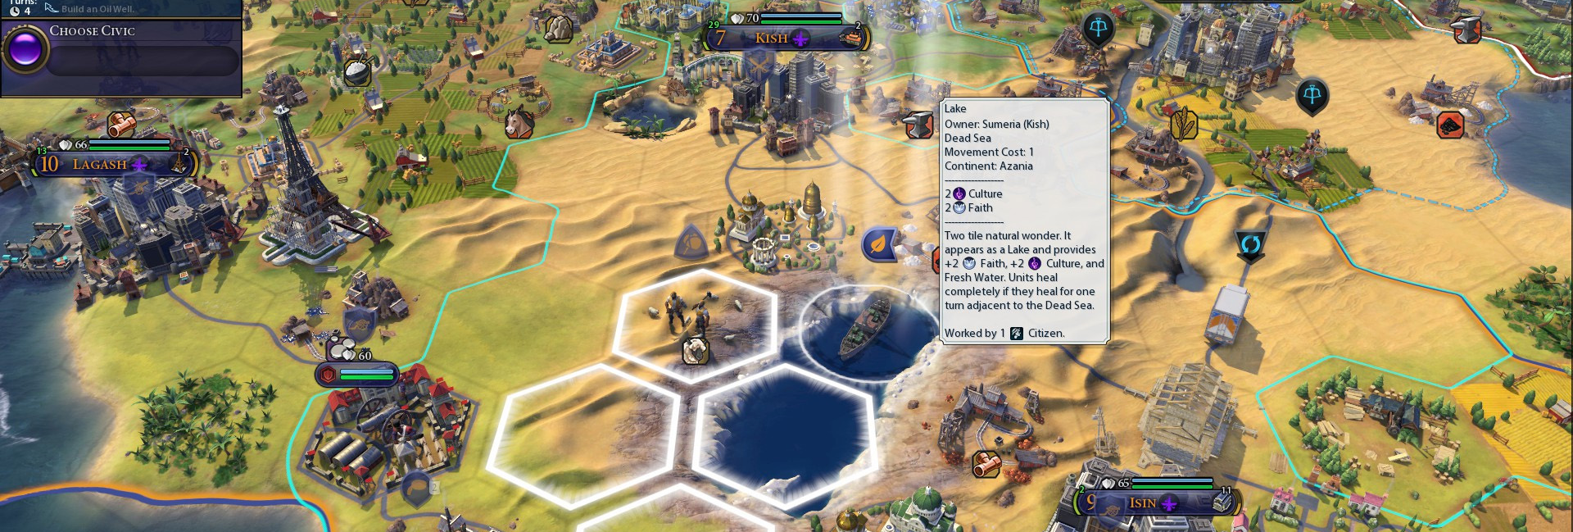
What are RTS/Turn Based Strategy Games?
Resource gathering
Base creation and expansion
Army creation
Map control
Be first to destroying other players bases…

Slide 3
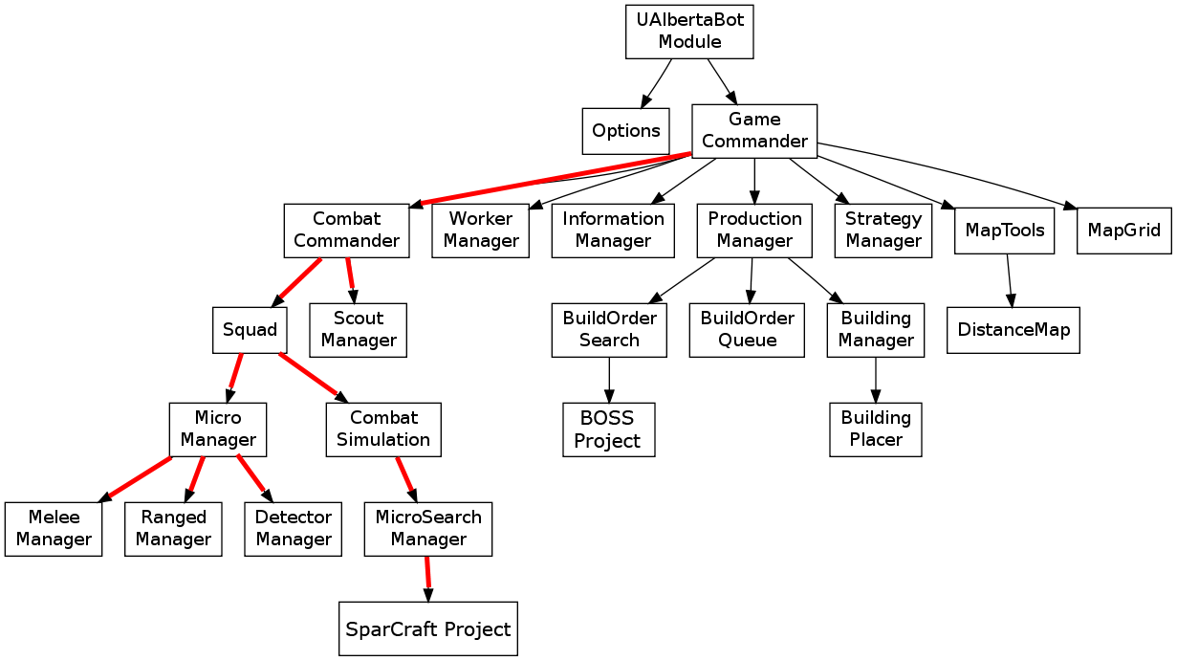
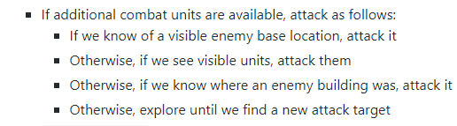
AI in Starcraft

Slide 4
Sequential Attack Strategies
Pros:
Computationally Inexpensive
Emphasis on ‘Per Unit AI’
Maximizes on group bonuses of units
Cons:
Tunnel Vision
Potentially longer to capture all cities
Potentially impossible to capture all cities..

Slide 5
Invasion Planning: Goal
Sequential Invasions vs Parallel Invasions
Invasion Performance
Computation Difference
Emerging patterns
Develop a difficulty rating for Invasion scenarios

Slide 6
Alternative Problem: Package Delivery Problem With Timing Windows
N locations to delivery to
Each location has an expected delivery time
Not always possible to do with only one truck
Split delivery between multiple trucks

Slide 7
Package Delivery Problem With Timing Windows: Massaged into Invasion Solver
N locations to delivery to
N Cities to capture
Each location has an expected delivery time
Not always possible to do with only one truck
Split delivery between multiple trucks

Slide 8
Package Delivery Problem With Timing Windows: Massaged into Invasion Solver
N locations to delivery to
Each location has an expected delivery time
Fortification is too strong to capture
Not always possible to do with only one truck
Split delivery between multiple trucks

Slide 9
Package Delivery Problem With Timing Windows: Massaged into Invasion Solver
N locations to delivery to
Each location has an expected delivery time
Not always possible to do with only one truck
N locations means >N time steps to capture last fort
Split delivery between multiple trucks

Slide 10
Package Delivery Problem With Timing Windows: Massaged into Invasion Solver
N locations to delivery to
Each location has an expected delivery time
Not always possible to do with only one truck
Split delivery between multiple trucks
Split the invading army into sub armies

Slide 11
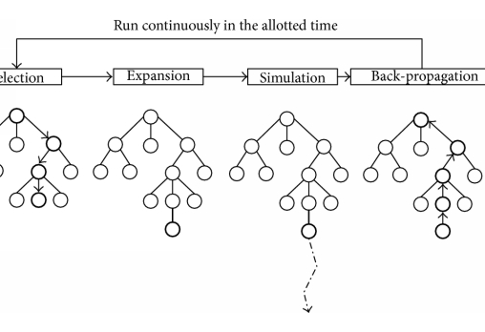
Package Delivery Problem With Timing Windows: How to Solve?
Constraint Solvers
And-Tree
Exponential search times
Find the best case
Or-Tree
Worst case Exponential
Finds a solution

Slide 12
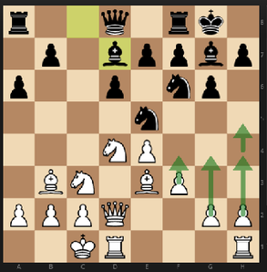
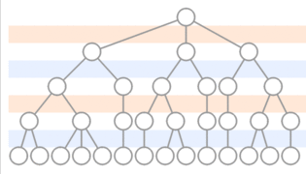
And-Trees in Games: Chess
Min-Max Tree

Slide 13
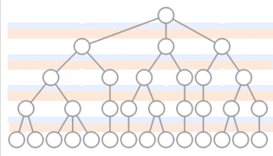
Invasion Solver: And-Tree
Opponent’s strength is a function of time
Only one ‘Counter Move’
Merge with player move.
Result: And-Tree

Slide 14

Invasion Solver: Implementation
Three Unit Types:
Soldier, Healer, Archer
Unit Group Bonuses
Exponential
Variable Nation Layout
Border Cities vs Internal Cities
Configurable Unit and Fort Strengths
Tune to match game

Slide 15
Invasion Solver: Implementation
Each node in the search contains:
State of the Invaders
State of the Defenders
Each transition contains:
Army split into sub armies
Attack or Heal
Result of transition:
Merged sub armies
Remaining forts

Slide 16
How attacks are Calculated
Units positioned relative to fort
Soldiers up front
Archers in back
Damage spread across each row until distributed
Fort damage relative to army strength
The stronger the army, the less time a fort can retaliate
Stacking bonuses
Stronger in groups
Solver has incentive for units to group up!

Slide 17
Two Simulations: Sequential Army vs Parallel army
Sequential Invasion run first
Army must stay together
Can either attack or heal
Create a depth bound on Parallel Invasion search
Parallel Invasion
Army can stay together or split into sub armies
One sub army devoted to healing
Only solutions that are faster than sequential invasion considered

Slide 18


Running time? Bell Numbers
Worst case scenario:
n units to split up, k forts to capture
All forts are attackable
Sterling Number of Second Kind:
..count the ways to partition a set of n objects into k nonempty subsets..
Bell Numbers
..the sum over the values for k of the Stirling numbers of the second kind..
1 sub army + 2 sub armies + n sub armies…
Exponential!
Sum of Exponentials

Slide 19
Optimizations Necessary!
Caching unit combinations
Similarity function for sub armies
Sub army must succeed
Army damage >= Fort Health, Army Health > Fort damage
Transition must be beneficial
Eval(State _{i} ) > Eval(State _{i+1})

Slide 20
Results of Optimizations
2 Archers 1 Healer 2 Soldiers
All forts can be attacked
Result:
Better!
Still exponential

Slide 21
Extensions to this project
Invading army can receive reinforcements
Logical fort upgrades from position in Nation
Directional fortifications on forts.
Paths opened up after other forts are taken
Unit bonuses against particular fortifications
Siege against walls
Better Similarity functions
unit group abstractions
Multi threading: Can this occur in the background of a game AI similar to what is done in Starcraft model?

Slide 22
Summary
Sequential attacks give better ‘per fort’ results but can be too slow for large scale tactics
Computationally expensive to run higher level army divisions
Results can be used instead as ‘post game film’ for analyzing short comings/potential strategies for a light weight rule based system
Difficulty rating is possible but may be difficult to tune without knowledge of tree topology

Slide 23
Questions?

