Slide 1


its time for a real one-on-one.
ISO — Intimate Setting Online · an interactive product prototype
one conversation at a time
Notes:
ISO is a dating app built around one enforced constraint: you can have exactly one live conversation at a time. This deck walks the product and the thinking.

Slide 2
Dating apps monetize attention — not connection.
79%
of U.S. college students aren't on any dating app
Swipe economics reward infinite options: more matches, more boosts, more time in-app.
Users end up managing a roster of lukewarm “talking stages” — a part-time job nobody signed up for.
Ghosting is normalized. Everyone feels disposable. Burnout drives people off the apps entirely.
The incumbent business model can't fix this — optionality is the revenue.
50%+
of Gen Z feel burned out by dating apps — the highest of any age group
~90%
of Gen Z say they'd rather meet someone offline
Sources: Axios · Forbes Health 2025 · Kinsey / DatingAdvice
Notes:
The category's symptoms — rosters, ghosting, burnout — are downstream of a business model that sells optionality. That's the opening.

Slide 3
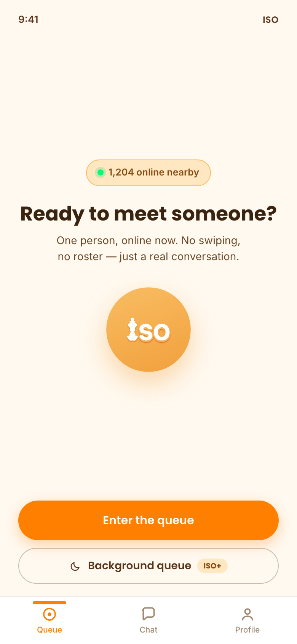
One conversation at a time.
Enforced.
Queue like joining a game. Get matched live with one present person. Talk in a real-time room.
It only continues if both of you say yes — otherwise it closes kindly and you're back in the queue.
Exclusivity is a mechanic, not a promise: with an active chat you literally cannot queue for another.
No inbox. No roster. No feed. Three tabs, forever.
Notes:
The whole product in one sentence. The screenshot is the home screen: a live count and a single CTA — there is nothing to browse.

Slide 4
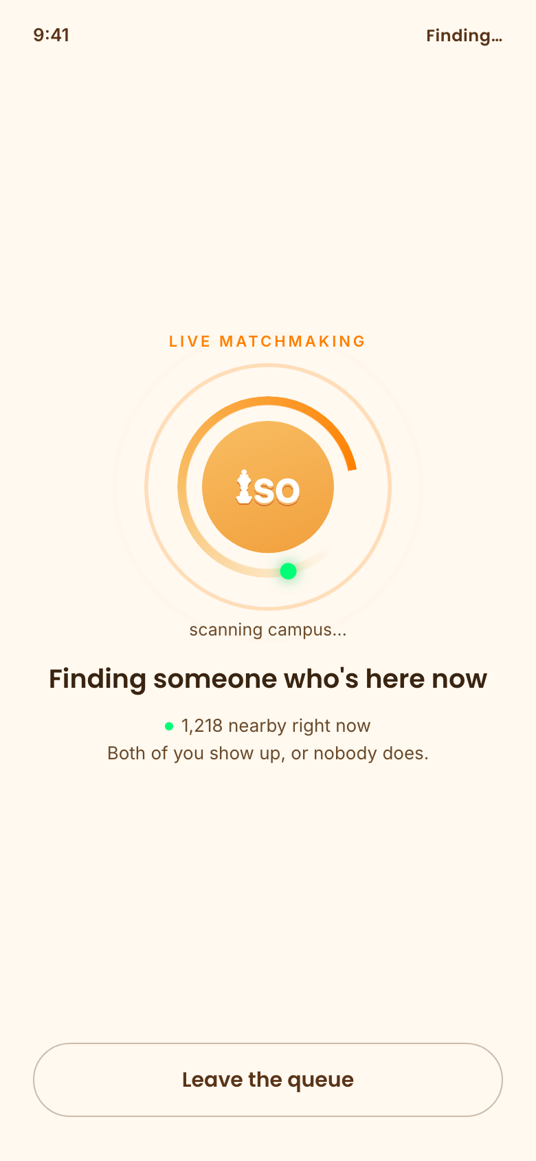
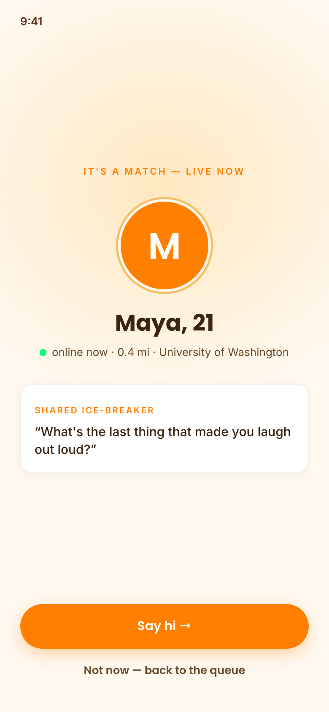
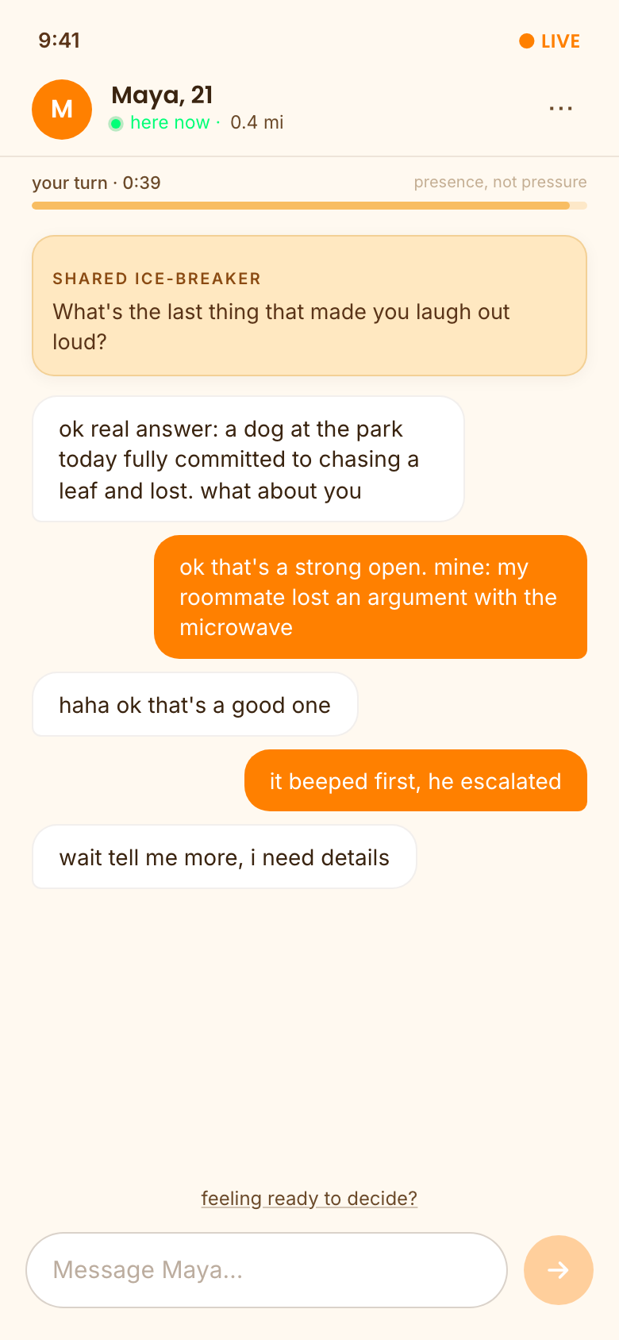
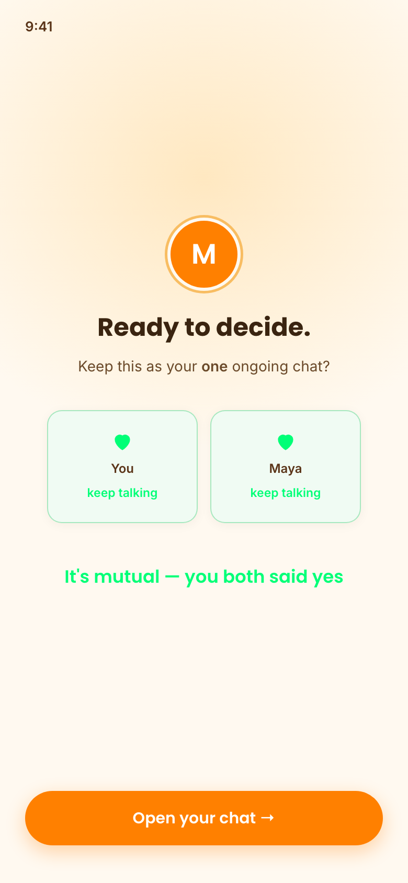
The loop: show up → meet → talk → decide together
→
→
→
Queue up — matched with someone who's here right now
One match, live — with a shared ice-breaker
A real-time room with a gentle reply timer
It continues only if you both say yes
Notes:
Four screens, one loop. Liquidity is concentrated with prime-time queue windows on a single campus at launch.

Slide 5
Presence, not pressure
A shared ice-breaker
Both people arrive holding the same opener — no “who talks first” freeze, no “hey.”
A gentle reply timer
A calm amber bar labeled “presence, not pressure.” At zero, nothing bad happens — just a soft “still there?”
Silence is read kindly
Only a second lapse suggests deciding: “seems like a natural pause.” Never a penalty, never an abrupt kill.
Either side can decide
A quiet “feeling ready to decide?” link ends the ambiguity without an eject button.
Notes:
The timer was the riskiest design element — it must create presence without feeling like a countdown bomb. Zero-penalty expiry, second-lapse framing.

Slide 6

Nobody ever answers second.
When the conversation reaches a natural point, both people privately answer one question: keep talking?
Answers are sealed until both have committed, then revealed simultaneously — nobody performs for the other's visible choice, nobody is rejected in public.
Mutual yes → it becomes your one ongoing chat, marked with a restrained green moment.
Anything else → “closed kindly, nothing left behind.” No dead thread. Back to the queue, one tap.
Answers stay sealed…
…and reveal together.
Notes:
The scariest moment in any dating product is the decision. The simultaneous sealed reveal removes rejection asymmetry entirely.

Slide 7
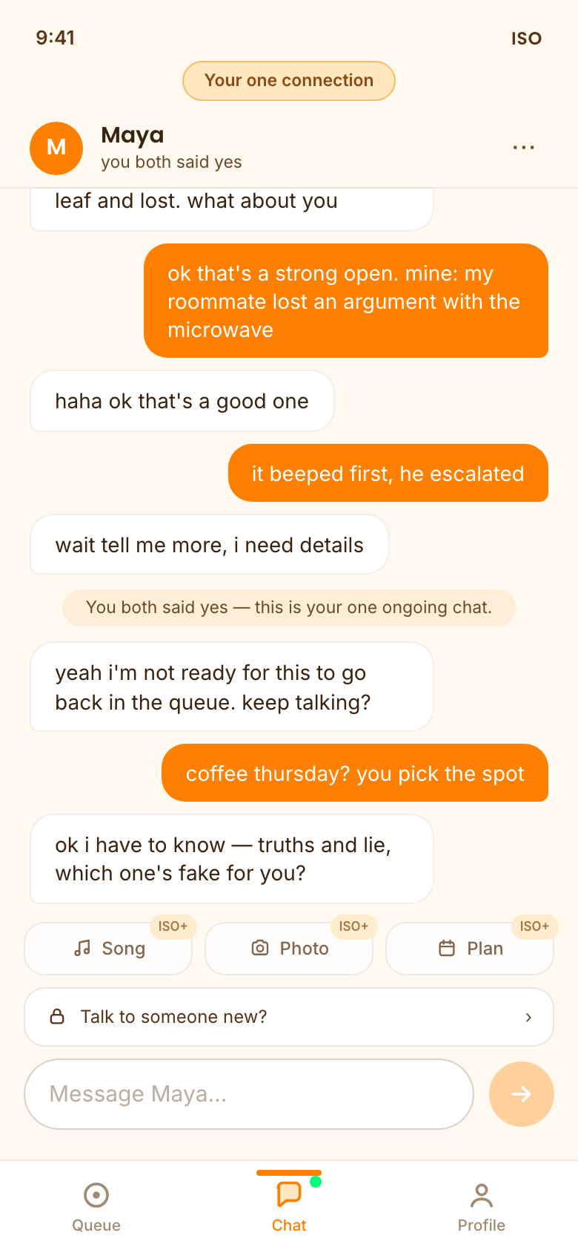
Then: one chat, your whole attention
The Chat tab holds exactly one connection — full-screen attention on a single person is the product's whole competitive position, rendered literally.
Want someone new? You end this one first — visibly, deliberately, kindly. The lock is part of the interface.
ISO+ adds momentum tools inside the chat: song requests, photo-of-the-day, a date planner. All pointed off the app.
The metric that matters: “Did you two meet up?”
ISO's North Star is real-life dates initiated — asked once, privately, never nagged. We win when two people leave the app together.
Notes:
The outcome loop is self-reported and private. It's the truth signal for everything else — the trend, the recap, revival eligibility.

Slide 8
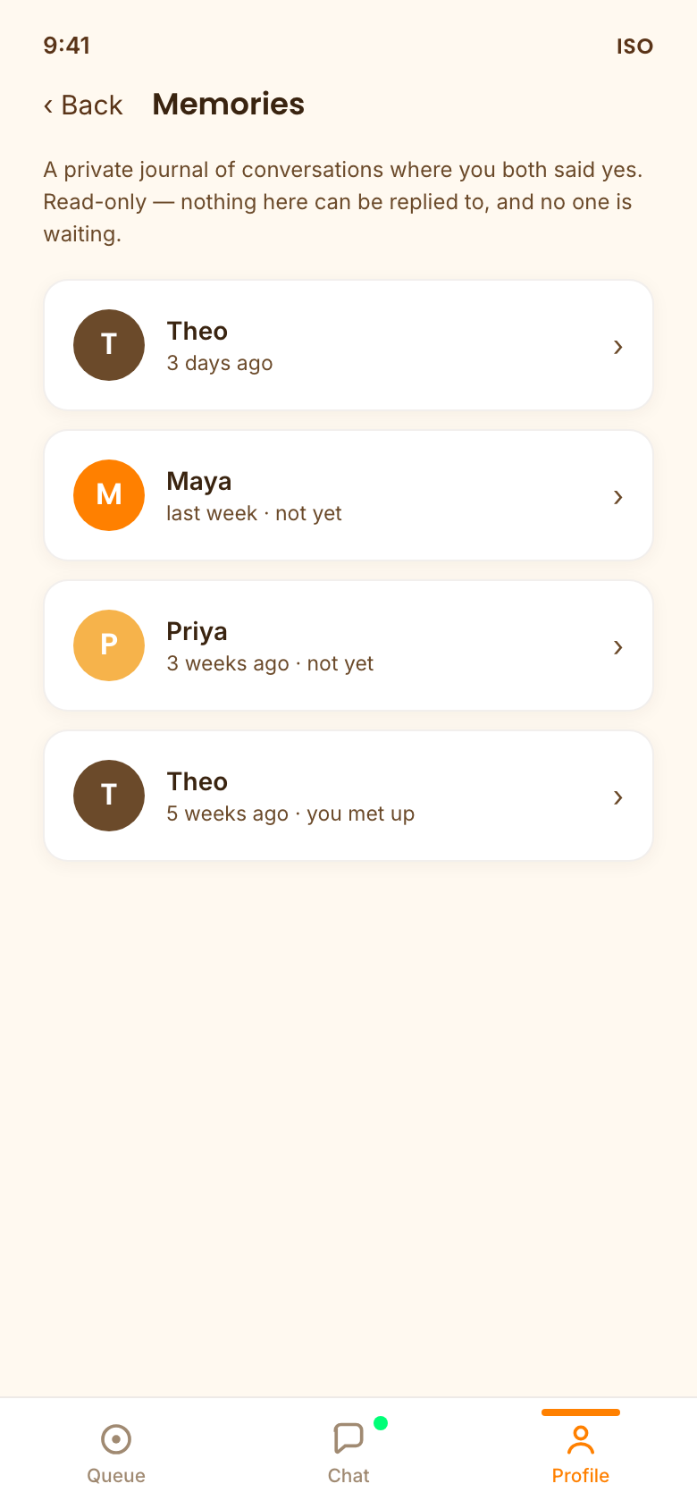
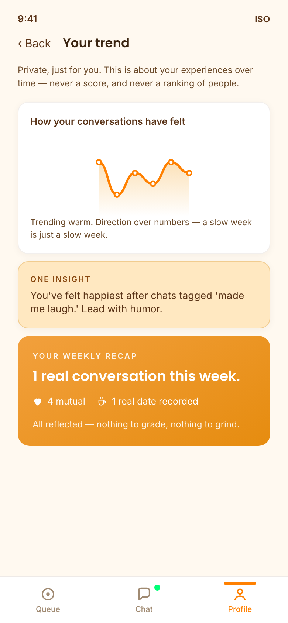
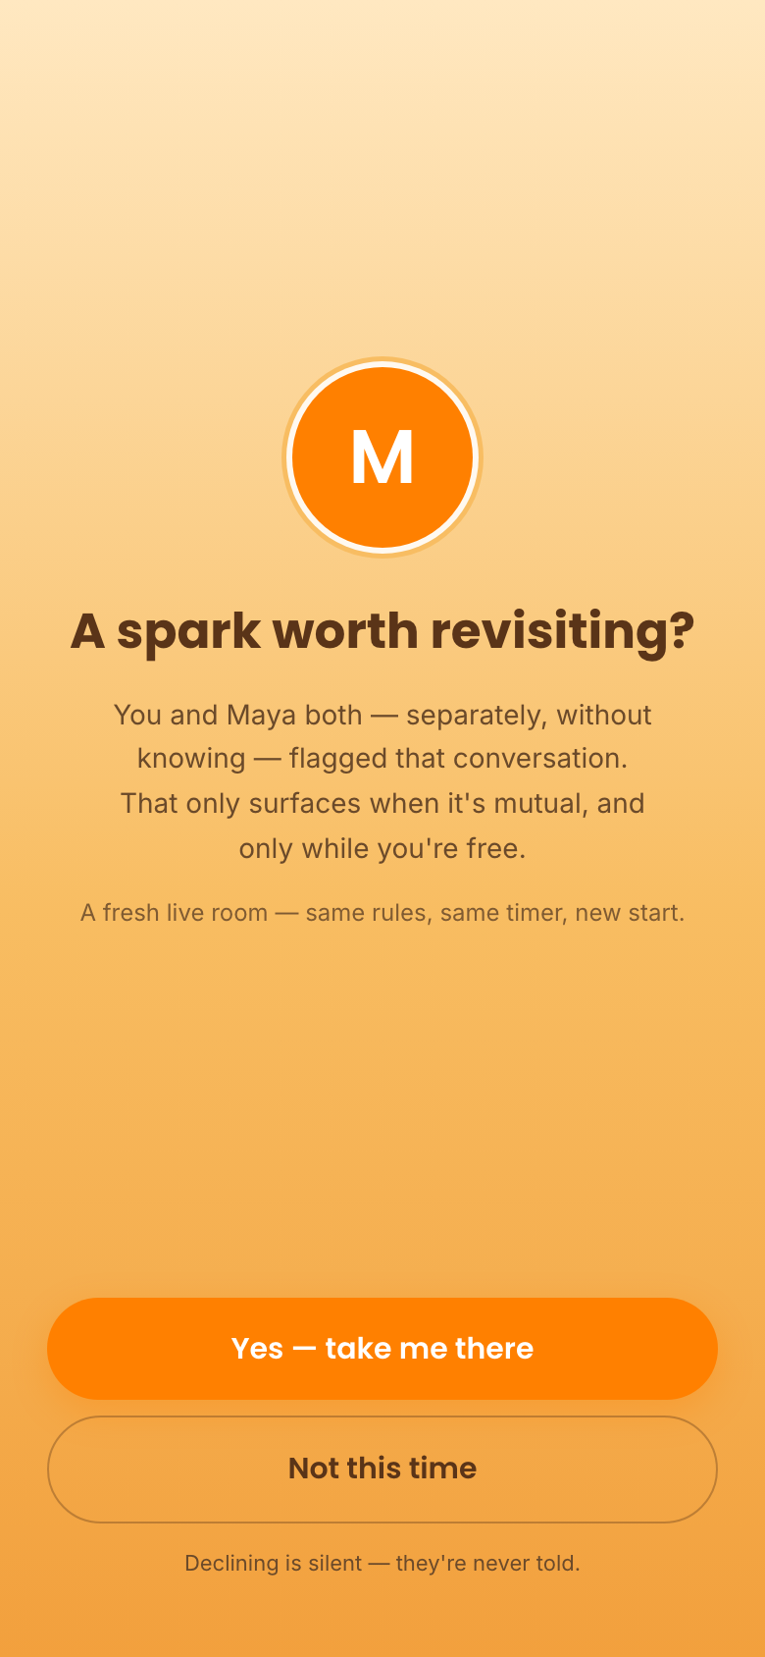
Remember it — without rebuilding the roster
Memories
Your trend + weekly recap
Revival
A read-only private journal of mutual conversations. No reply button exists. No unread counts. Wipe your side anytime.
A gentle, floor-bounded curve of how conversations felt — direction, not scores. It can't crash, and it never ranks people.
One private “I'd talk to them again” flag. Blind and double-opt-in: it only surfaces if both flagged, both free. Nobody can be re-rejected.
Notes:
Every reflective surface was designed so it structurally cannot become a roster: read-only, single-slot, blind, decaying.

Slide 9

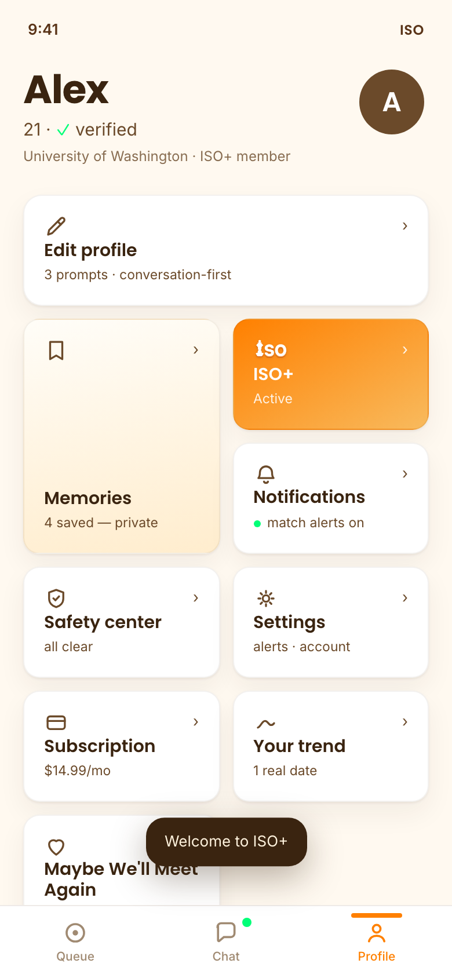
Designed like getting to know someone
one confident
orange
warm amber
ambience
cream
surfaces
green =
real · mutual
warm brown
ink
Loud thresholds, calm baseline — a color wave blooms from your fingertip at exactly five moments (enter queue, match, mutual yes, “we met,” clean close). Everything else stays quiet.
Slow arrivals, instant feedback — screens settle in reading order like walking into a room; every press answers in under 120ms.
Warm, round, unhurried — cream surfaces, pill buttons, springs with barely any bounce. Celebration is one green wave, never confetti.
Notes:
The motion system is tokenized — four named springs, five wave registers — so the app feels crafted, not generated. Full rationale lives in the design document.

Slide 10
Try it yourself
Live demo
pjeon18.github.io/iso-prototype — runs in any browser, no install
Source + docs
github.com/pjeon18/iso-prototype — PRD, build spec, design document, validation
Demo controls
add ?debug to the URL: force matches, pick personas, trigger revival, skip onboarding
one conversation at a time 🧡
Notes:
Links resolve once the repo is public: the live demo deploys via GitHub Pages from the same repository.

