Slide 1
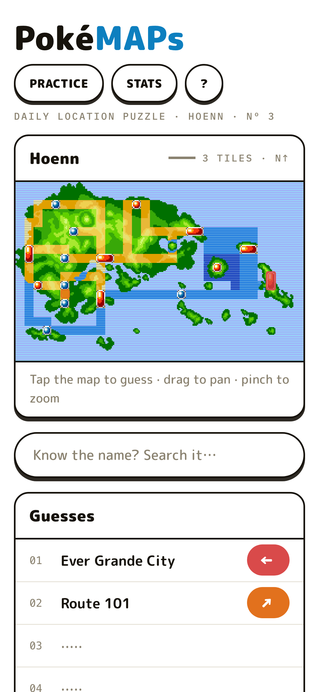

PRODUCT DESIGN CASE STUDY · 2026
A daily location-guessing puzzle played on the Pokémon games' own town maps — six escalating hints, direction-only feedback, one answer a day across five regions.
Paul Jeon — product · design · engineering
5
373
6
1
REGIONS
LOCATIONS
HINT TIERS
PUZZLE A DAY
pjeon18.github.io/pokemaps · github.com/pjeon18/pokemaps

Slide 2
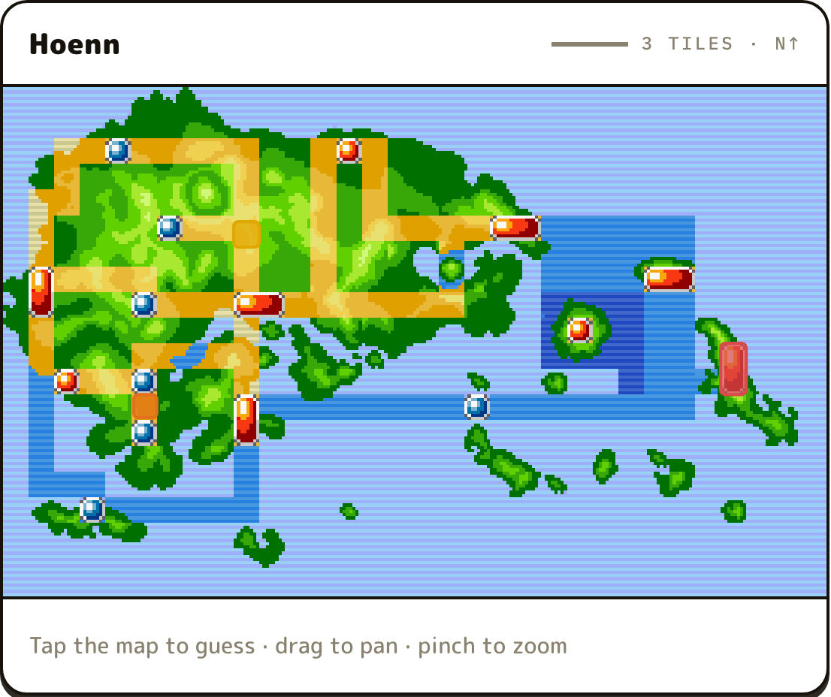
01 — THE CONCEPT
Wordle × GeoGuessr — on the games' own town maps.
Every day, one hidden location somewhere in the Pokémon world. You don't type a word — you tap the actual pixel town map. Wrong guesses answer back, and the hint ladder drops another rung.
01
TAP THE MAP
A guess is a place, not a word — every location is a click region on the real in-game map.
02
DIRECTION + HEAT
Feedback is an 8-way arrow and a warmth band. Never a number.
03
THE LADDER DROPS
THE HOENN SURVEY SHEET — LIVE BUILD
Each miss unlocks a broader hint, from habitat classification down to a photograph.

Slide 3
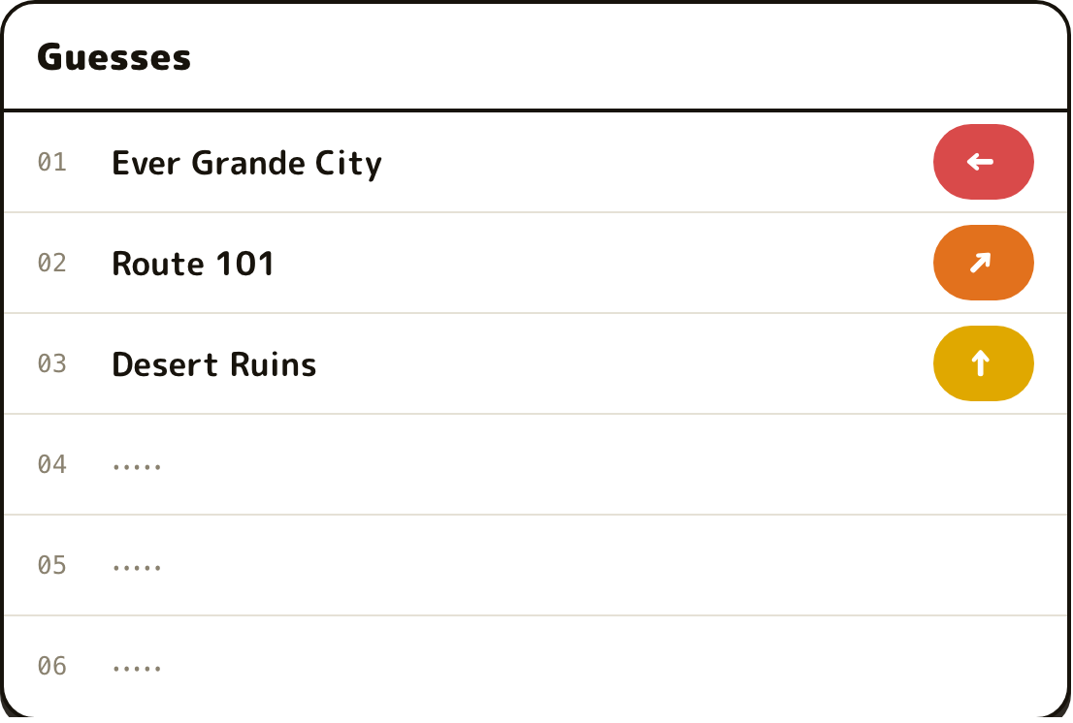
02 — DESIGN LANGUAGE
Field guide, turned up.
The interface plays a naturalist's survey kit: white pages, ink outlines, huge rounded type with the DS-menu energy of the games themselves. The chrome never competes with the pixel maps — it frames them.
DIRECTION + HEAT, NEVER DISTANCE
INK ON WHITE
SEMANTIC COLOR ONLY
LOUD TYPE, QUIET LABELS
Panels are white with 2.5px ink outlines and hard un-blurred drop shadows — menu boxes you could pick up.
Color appears only as information: proximity bands and one interactive blue. The pixel maps carry all the rest.
M PLUS Rounded 1c at display sizes does the talking; IBM Plex Mono survey labels whisper in the margins.

Slide 4
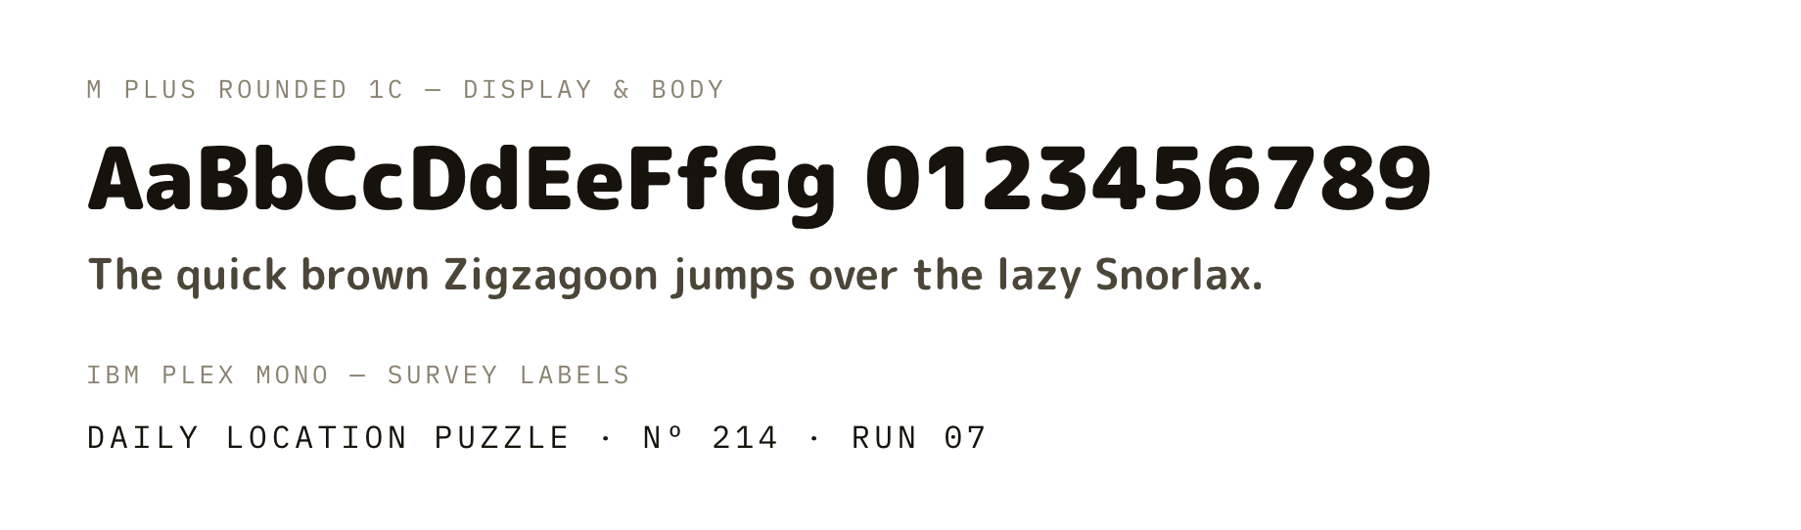
03 — TYPE & COLOR
One face for everything. Color as data.
WHY THIS FACE
M PLUS Rounded 1c is the free relative of FOT-NewRodin — the rounded face the games themselves use. IBM Plex Mono plays the instrument-panel labels.
INK
INTERACTIVE
HIT
WARM
MID
COLD
#17130C · chrome & type
#0D7FBF · the one blue
#1CA35E · found it
#E0A800 · getting close
#E2711D · in the region
#D94A4A · far away
Band colors are the game's information — the warmth of a guess. Nothing else in the chrome is allowed to have color.

Slide 5
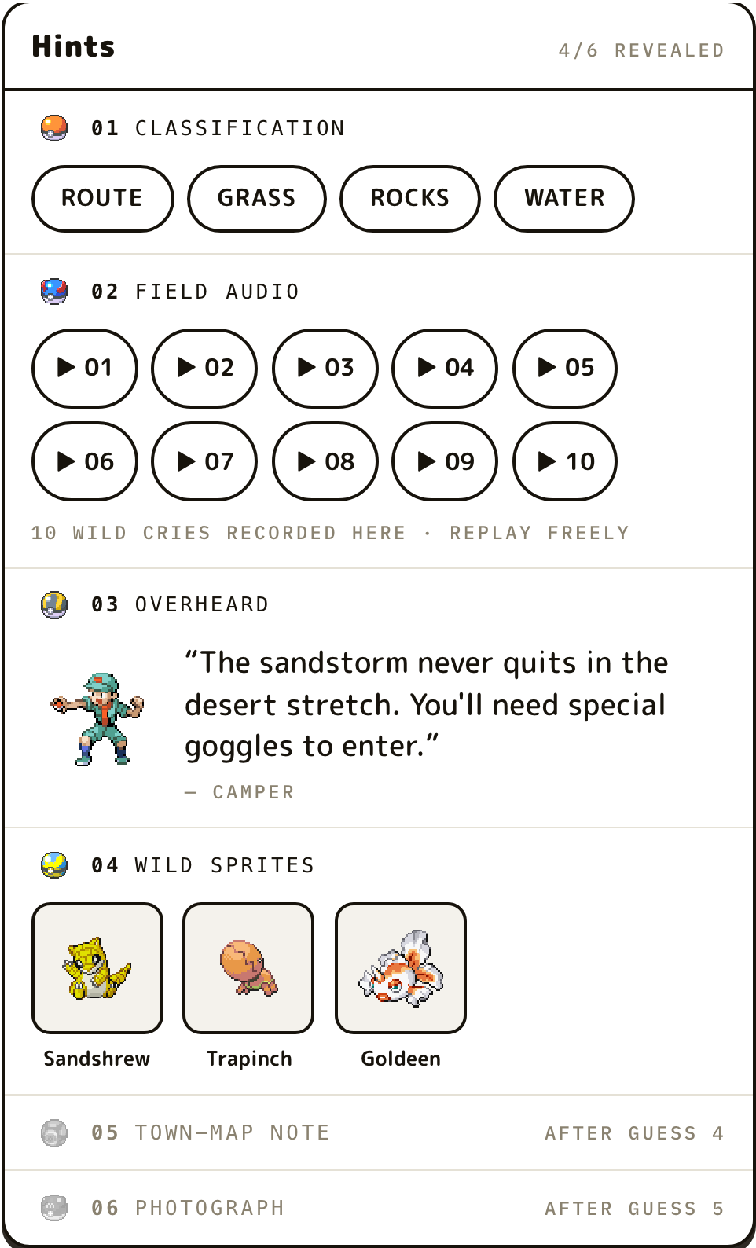
04 — THE HINT LADDER
Six hints, hardest first — priced in Poké Balls.
Rarer ball, bigger giveaway. The opener asks you to reason from habitat; the Master Ball simply shows you the place.
01
CLASSIFICATION
terrain and habitat chips only
02
FIELD AUDIO
every wild cry recorded in the area
03
OVERHEARD
a real NPC line — in-game class and name
04
WILD SPRITES
encounters, in that generation's own pixels
05
TOWN-MAP NOTE
the games' own map description
06
PHOTOGRAPH
an in-game screenshot, unblurred at the end

Slide 6
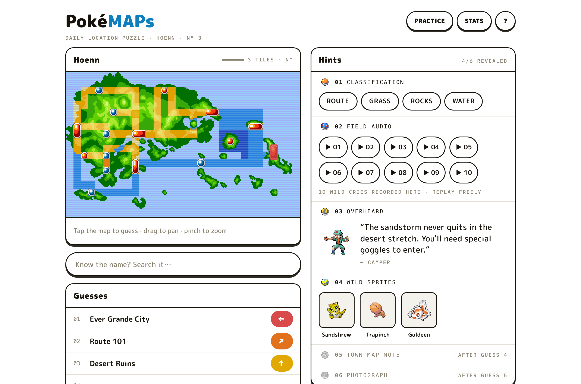
05 — GUESS FEEDBACK
Never a number.
A wrong guess answers with an 8-way arrow and a warmth band — enough to navigate by, never enough to triangulate with. Distance is computed internally in map tiles and stays there.
HIT
found it — the star
WARM
a few tiles out
MID
same corner of the map
COLD
wrong side of the region

Slide 7
06 — CONTENT PIPELINE
373 locations, zero runtime calls.
Everything is pulled, scraped, extracted, and verified at build time — then shipped as one static bundle. The live game never talks to a third party.
01
02
03
04
05
POKÉAPI
BULBAPEDIA
EXTRACTION
COVERAGE GATE
STATIC BUNDLE
encounter tables and cries, filtered per pack to era-correct game versions
trainer rosters, the games' own map descriptions, in-game screenshots — never anime art
click regions read from the games' highlight maps — three computer-vision methods across five generations
the build fails if any location can't fill its hint ladder — no half-authored puzzles ship
no backend, no accounts; state lives in localStorage on your device
3
5
0
extraction methods — ring detection, dot colors, palette-cluster diff
sprite eras — a Sandshrew in Hoenn looks like 2003
API calls at runtime — everything bundled, attributed, takedown-ready

Slide 8
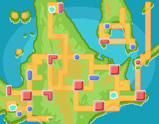
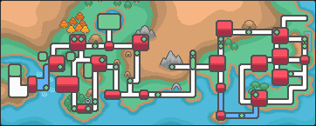
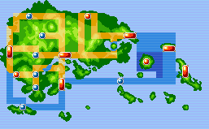
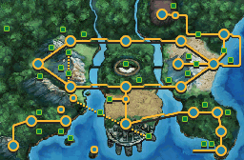
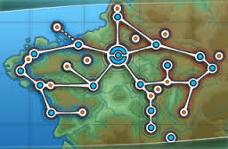
07 — REGION PACKS
Five regions, one daily schedule.
Sinnoh
Johto & Kanto
Hoenn
67 LOCATIONS · D/P/PT
99 LOCATIONS · HGSS
76 LOCATIONS · R/S/E
Unova
Kalos
77 LOCATIONS · BW + B2W2
54 LOCATIONS · XY
Each pack ships its own era's sprites, cries, and screenshots — the region looks and sounds like its generation.

Slide 9
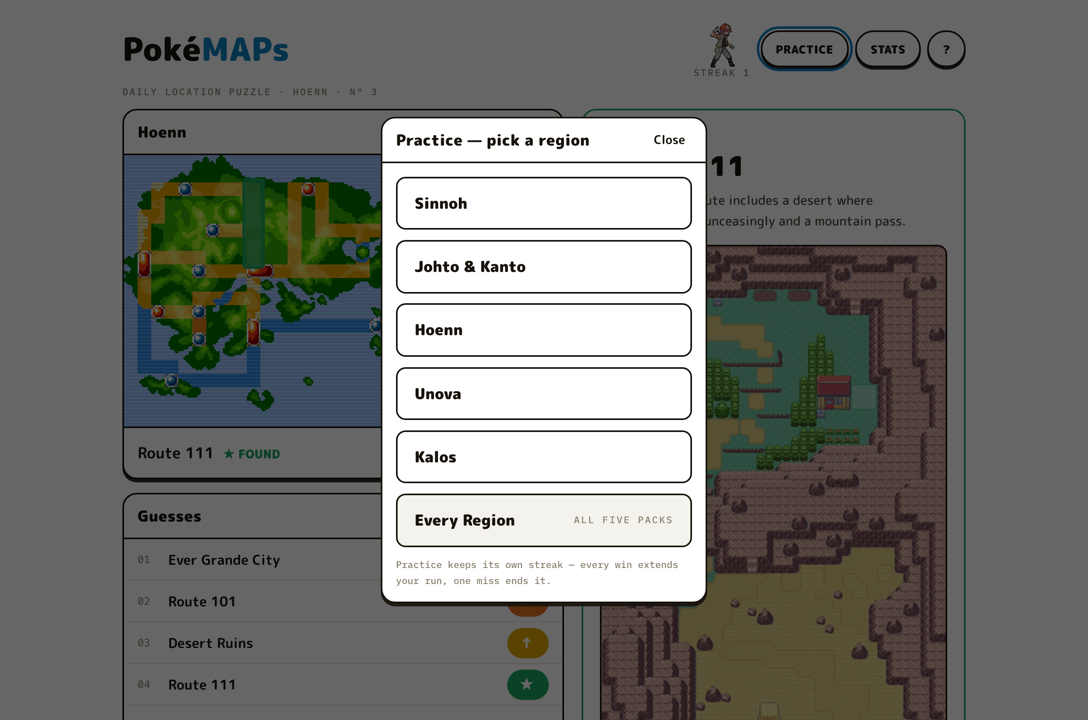









08 — RETENTION WITHOUT PRESSURE
Streaks as a gym gauntlet.
A daily streak climbs Sinnoh's gym-leader ladder — Roark travels with you at streak 1, Cynthia waits at the summit. Practice mode keeps its own run, per region or across every pack, and ends with a shareable result instead of a scold.
STREAK 1
THE SUMMIT
PRACTICE — EVERY REGION, ITS OWN RUN
THE GAUNTLET — COMPANIONS BY STREAK

Slide 10
09 — WHAT IT REFUSES TO DO
The values are visible in the interface.
NEVER MONETIZED
NO ACCOUNTS, NO BACKEND
No ads, no donations, no upsell. A fan project stays a fan project — the IP posture depends on it.
The app is static files. Your streak lives in your browser's localStorage and nowhere else.
DETERMINISTIC DAYS
QUIET ANALYTICS
Same date, same puzzle, same hint picks, worldwide. There is no randomness in the daily path.
No cookies, no tracking — anonymous page counts only, disclosed in the footer next to the attributions.
Play today's puzzle — pjeon18.github.io/pokemaps · github.com/pjeon18/pokemaps · Paul Jeon, 2026

