Slide 1



Uber trip analysis in the USA
Project made by:
Paweł Jerzyna
Piotr Grzyb
Szymon Lipkowski

Slide 2



Meet Our Team
Szymon Lipkowski
Piotr
Grzyb
Paweł
Jerzyna

Slide 3


Project concept
The project was based on the analysis of Uber trip data across the United States.
As part of the project, a series of visualizations were developed to illustrate relationships between selected variables and highlight key trends within the dataset.
Additionally, interactive filters were implemented to enable dynamic data exploration and allow users to refine the displayed information according to their specific analytical needs, providing deeper insights into the analyzed data.

Slide 4
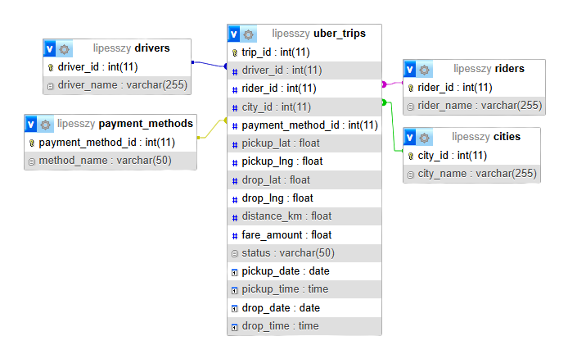
Dataset
The dataset comprised around 50,000 records of Uber trips conducted across the United States from 1st January till 2nd February 2023. The data were collected from ten major cities: Chicago, Dallas, Houston, Los Angeles, New York, Philadelphia, Phoenix, San Antonio, San Diego, and San Francisco.
Explenation of data
trip_id - the id of the trip
driver_id - the id of the Uber driver
driver_name - Name and Surname of the Uber driver
rider_id - the id of the passager
rider_name - Name and Surname of the passager
city_id - the id of the city
city_name - name of the City
payment_method_id - the id of the payment method
method_name - name of the payment method (Card/Wallet/UPI/Cash)
status - status of the ride (Cancelled/Completed/No-show)
distance_km - distance of the ride
fare_amount – the amount of the fare (the price paid for a trip or ride)
pickup_date – the date when the passenger was picked up
pickup_time – the time when the passenger was picked up
pickup_lat – the latitude of the pickup location
pickup_lng – the longitude of the pickup location
drop_date – the date when the passenger was dropped off
drop_time – the time when the passenger was dropped off
drop_lat – the latitude of the drop-off location
drop_lng – the longitude of the drop-off location

Slide 5

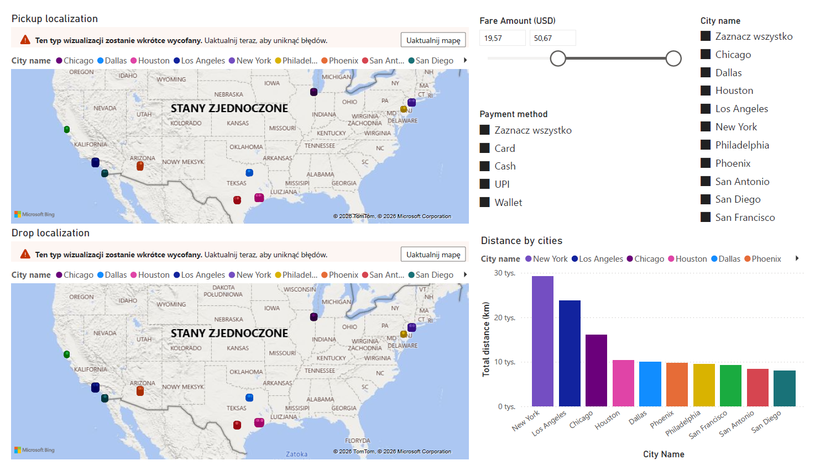
Visualisation, by the localization
Our database allowed us to analyse Uber journeys in the biggest US cities, taking into consideration the characteristics of said transfers such as:
city of origin
fare amount
payment method
travelled distance
pickup and drop localization
Said data is sufficient to perform different market analysis operations.

Slide 6
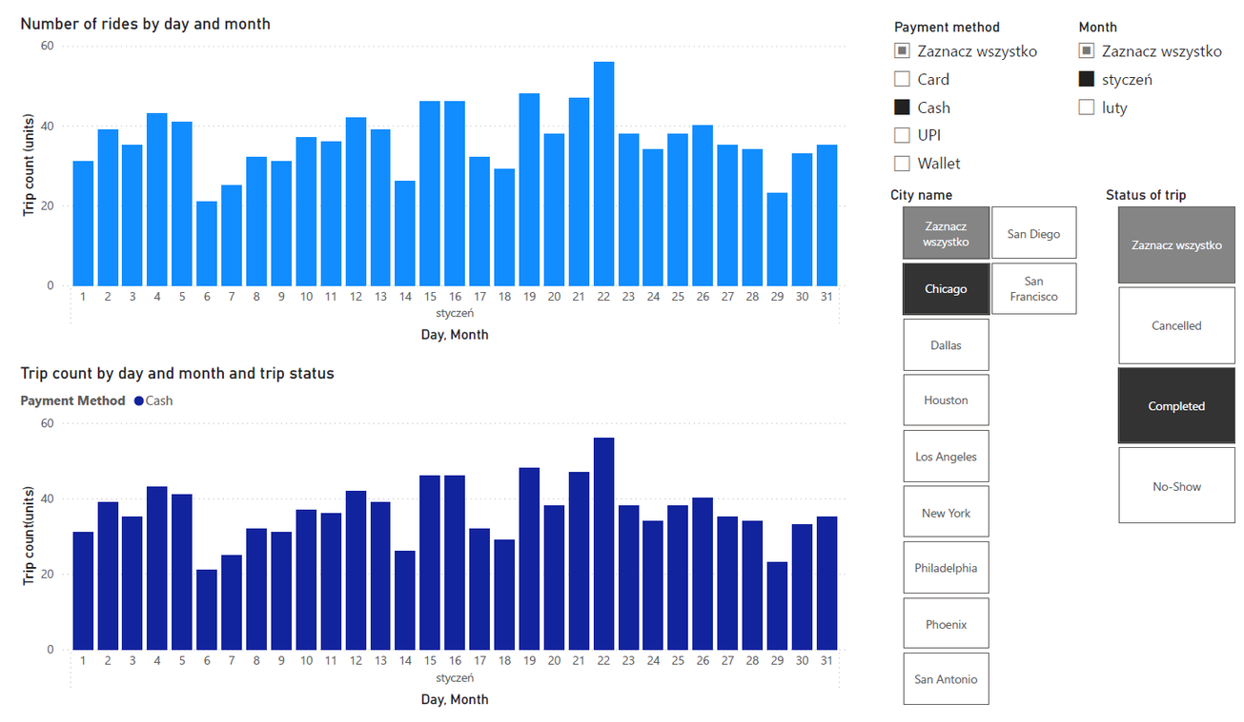
Time Series Analysis
Our work allows tracking demand for the service and customer behhaviour in the context of a chosen time period .
Status Classification
Trips are segmented into distinct operational outcomes: Completed, Cancelled, and No-show.
Temporal Overview - January
Practical implications
The shown figure allows for tracking the number of Uber trips in relation to two metrics:
day of the month
trip status
This visualization provides valuable insight into
how customer behaviour varies during the month. It tracks how the numer of trips of any given status varies in correspondence to holidays etc.

Slide 7
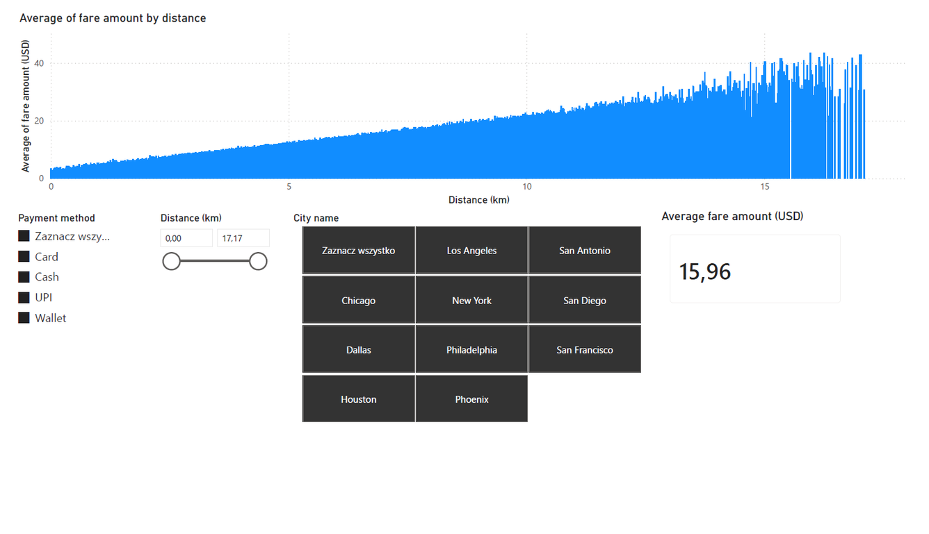
Fare vs. Distance Correlation
We can analyse the cost of a fare based on its length, with regard to the city of origin.
Our visualization allows for the analysis of multiple cities at once, which lets us determine the local as well as global statistics of Uber transportation prices in the US.
We are also able to examine customer behaviour, analysing the preferred payment methods in relation to the city of origin and trip distance.

Slide 8
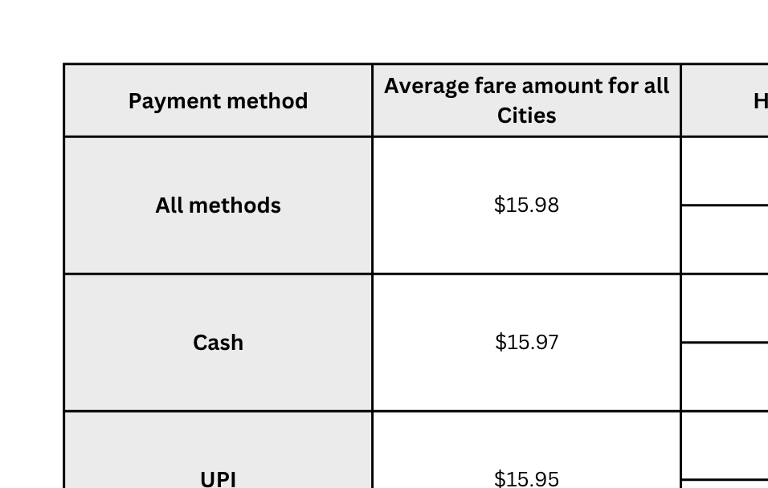
Interesting statistics

Slide 9
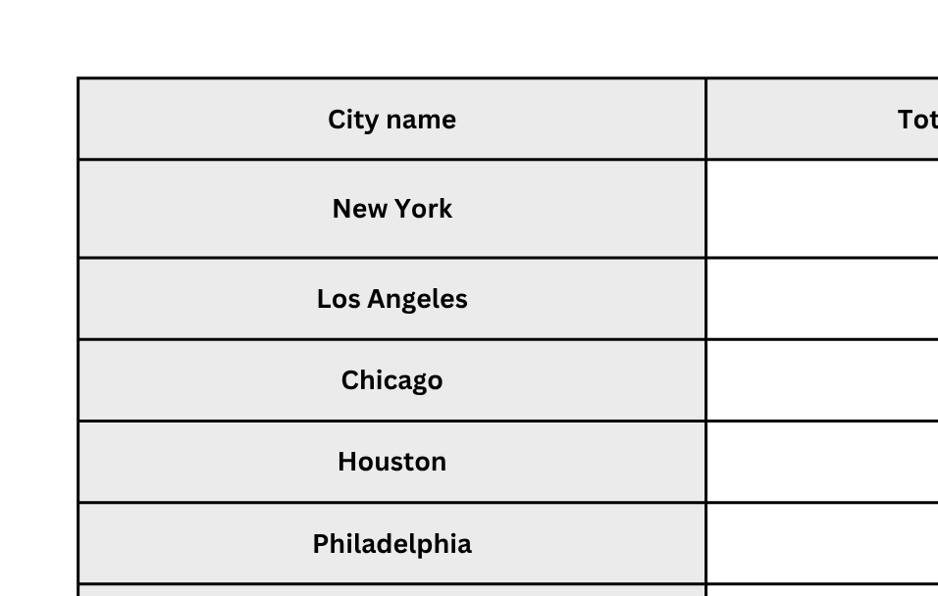
Interesting statistics

Slide 10
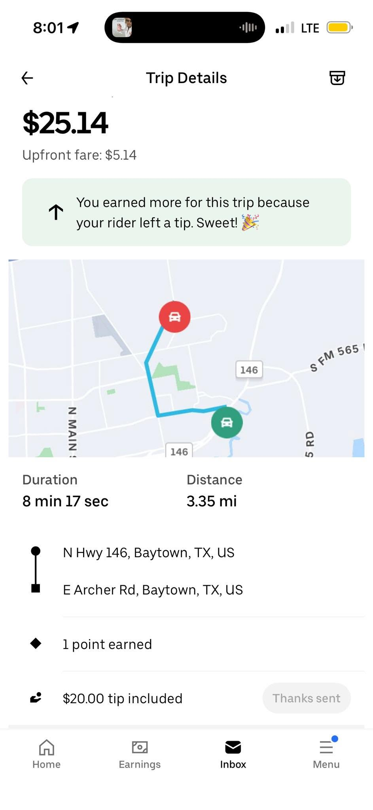

Thank You

