Slide 1
Paul Fenwick
Mastodon: @pjf@cloudisland.nz
Enshitification
How good platforms turn bad

Slide 2
Things used
to be better?

Slide 3

Notes:
It felt like the internet held such promise,

Slide 4
Not your
imagination

Slide 5
Google search
is worse
Bevendorff, Janek, Matti Wiegmann, Martin Potthast, and Benno Stein.
“Is Google Getting Worse? A Longitudinal Investigation of SEO Spam in Search Engines,”
https://downloads.webis.de/publications/papers/bevendorff_2024a.pdf

Slide 6
Amazon is
full of ads
Of the first five pages on a search for cat beds, 50% of results were ads.
Cory Doctorow, “How Monopoly Enshittified Amazon” November 28, 2022.
https://pluralistic.net/2022/11/28/enshittification/.

Slide 7
TikTok
no longer
"gets you"
Baker-White, Emily. “TikTok’s Secret ‘Heating’ Button Can Make Anyone Go Viral.”
Forbes. Accessed February 21, 2024.
https://www.forbes.com/sites/emilybaker-white/2023/01/20/tiktoks-secret-heating-button-can-make-anyone-go-viral/

Slide 8
Enshittification
💩

Slide 9

Cory
Doctorow
https://xkcd.com/345/
Notes:
Prolific Speaker and writer

Slide 10
Word of the year 2023
American Dialect Society, “2023 Word of the Year Is ‘Enshittification", January 5, 2024.
https://americandialect.org/2023-word-of-the-year-is-enshittification/.

Slide 11
1. Make a great
product

Slide 12
Facebook
2009

Slide 13
Connect with
friends

Slide 14
Find events

Slide 15
SELECT concat('http://www.facebook.com/event.php?eid=', eid), name
FROM event
WHERE
start_time > ? AND
start_time < ? AND eid IN (
SELECT eid
FROM event_member
WHERE uid IN (
SELECT uid
FROM group_member
WHERE gid = ?
)
)

Slide 16
Coded myself
a social life!

Slide 17
Now?

Slide 18
Endless Ads

Slide 19
Notifications
I don't care
about

Slide 20
Facebook
feels like a job

Slide 21
Google search
was amazing

Slide 22
Twitter was
less a trashfire

Slide 23
These were
good services

Slide 24
Users rightly
Flocked to them

Slide 25
You need
users for...

Slide 26
2. Make a great product...
for business customers

Slide 27
2. Make a great product...
for business customers

Slide 28
Amazon

Slide 29
Huge market

Slide 30
82% US households have Prime
Berthene, April. “82% of US Households Have an Amazon Prime Membership.”
Digital Commerce 360, July 11, 2019.
https://www.digitalcommerce360.com/2019/07/11/82-of-us-households-have-a-amazon-prime-membership/
Notes:
Estimated
Most prime users won't look anywhere else

Slide 31
Huge market
Cheap ads

Slide 32
Great for business!

Slide 33
LOTS of
business
partners

Slide 34
Which you
Need for...

Slide 35
3. Make a great product…
for shareholders

Slide 36
3. Make a great product…
for shareholders

Slide 37
3. Make a great product…
for Musk's ego

Slide 38
Maximum
💩ification

Slide 39
💩 for business

Slide 40
Amazon
45% of price
are sales fees
Cory Doctorow, “How Monopoly Enshittified Amazon” November 28, 2022.
https://pluralistic.net/2022/11/28/enshittification/.

Slide 41
💩 for customers

Slide 42
Amazon
"cat bed"
Fowler, Geoffrey A. “It’s Not Your Imagination: Shopping on Amazon Has Gotten Worse.”
Washington Post. Accessed February 21, 2024.
https://www.washingtonpost.com/technology/interactive/2022/amazon-shopping-ads/.

Slide 43
First page is 100% ads

Slide 44
First five pages
50% ads

Slide 45
4. Die?

Slide 46
Nobody wants to use it!

Slide 47
It should die

Slide 48
So why aren't they all dead?

Slide 49
Monopoly

Slide 50
Private monopolies are
ALWAYS bad

Slide 51
Switching
Costs

Slide 52
Your friends
are there

Slide 53
"Smart Devices"
You don't really own them

Slide 54
Solutions?

Slide 55
Strong
anti-trust

Slide 56
We broke apart
Standard Oil

Slide 57
We broke apart
Bell Telephones

Slide 58
We need to
break apart tech

Slide 59
Capitalism
only works
with competition

Slide 60
Anti-trust takes
a looooong
time

Slide 61
What can we
do now?

Slide 62
Right to exit

Slide 63
Strong
Interoperability
Notes:
Not just the tools the platform gives you
But the right to write your own tools, and to give those tools to others

Slide 64
Facebook
Scraped
MySpace
Doctorow, Cory. “An Audacious Plan to Halt the Internet’s Enshittification and Throw It Into Reverse.”
Medium, August 27, 2023.
https://doctorow.medium.com/an-audacious-plan-to-halt-the-internets-enshittification-and-throw-it-into-reverse-3cc01e7e4604

Slide 65
Try that now?
DMCA violation

Slide 66
5 yrs jail
$500,000 fine
First offence

Slide 67
Interop needs
to be sacred

Slide 68
Right to
source code

Slide 69
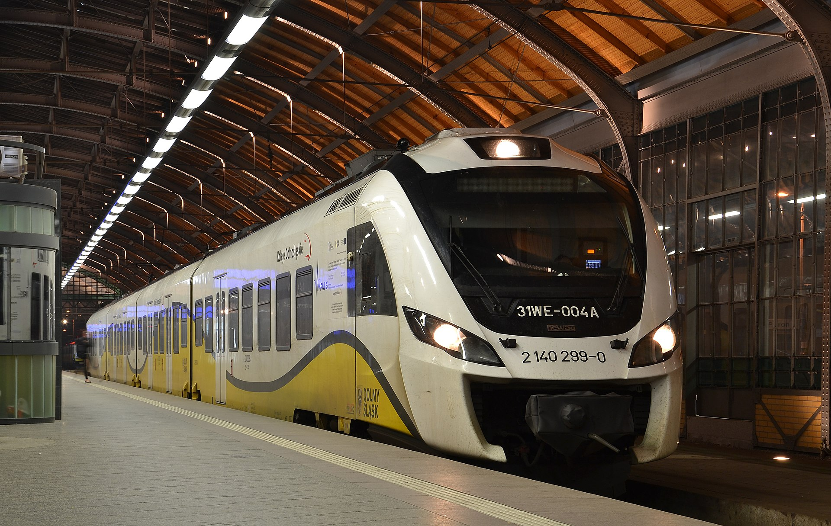
Photo CC-BY-SA: 4.0 Pudelek (Marcin Szala)

Slide 70
Newag
45WE trains

Slide 71
Made by Newag
Service by SPS

Slide 72
20,000 page
manual

Slide 73
Train does
not start

Slide 74
Other trains
Start failing
Notes:
In other towns, by the same manufacturer

Slide 75
Substantial
penalties
Notes:
Substantial penalties for not returning trains to service

Slide 76


Slide 77


Slide 78
check =
53.13845 < lat && lat < 53.13882 &&
17.99011 < long && long < 17.99837;

Slide 79
check1 = 53.13845 < lat && lat < 53.13882 && 17.99011 < long && long < 17.99837;
check2 = 53.14453 < lat && lat < 53.14828 && 18.00428 < long && long < 18.00555;
check3 = 52.17048 < lat && lat < 52.17736 && 21.53480 < long && long < 21.54437;
check4 = 49.60336 < lat && lat < 49.60686 && 20.70073 < long && long < 20.70840
&& (this->lock_function_test & 1);
check5 = 53.10244 < lat && lat < 53.10406 && 18.07817 < long && long < 18.08243;
check6 = 50.12608 < lat && lat < 50.12830 && 19.38411 < long && long < 19.38872;
check7 = 52.77292 < lat && lat < 52.77551 && 18.22117 < long && long < 18.22724;

Slide 80
check1 = 53.13845 < lat && lat < 53.13882 && 17.99011 < long && long < 17.99837;
check2 = 53.14453 < lat && lat < 53.14828 && 18.00428 < long && long < 18.00555;
check3 = 52.17048 < lat && lat < 52.17736 && 21.53480 < long && long < 21.54437;
check4 = 49.60336 < lat && lat < 49.60686 && 20.70073 < long && long < 20.70840
&& (this->lock_function_test & 1);
check5 = 53.10244 < lat && lat < 53.10406 && 18.07817 < long && long < 18.08243;
check6 = 50.12608 < lat && lat < 50.12830 && 19.38411 < long && long < 19.38872;
check7 = 52.77292 < lat && lat < 52.77551 && 18.22117 < long && long < 18.22724;

Slide 81
Sabotage

Slide 82
Ongoing
investigation

Slide 83
Tech that can't
be 💩ifed

Slide 84
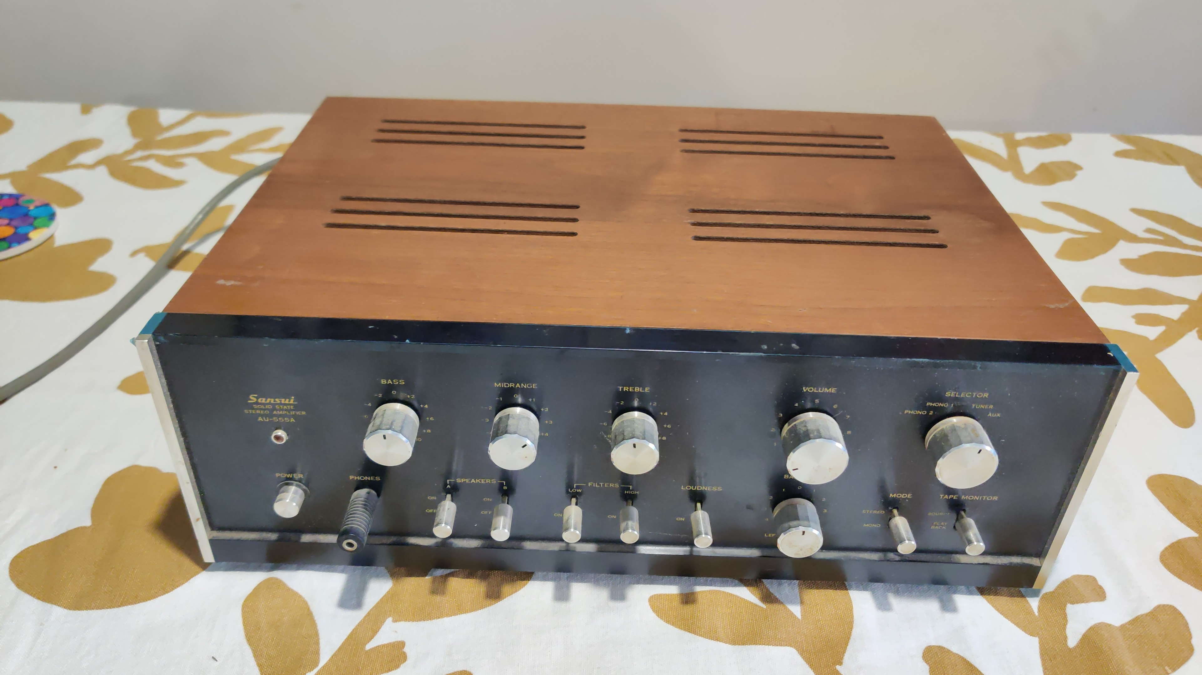

Slide 85
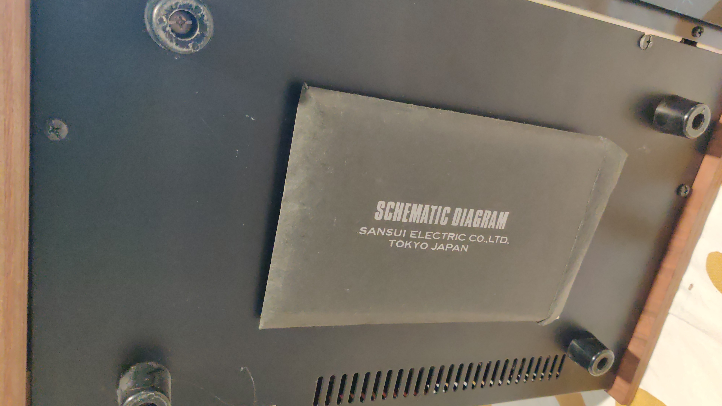

Slide 86
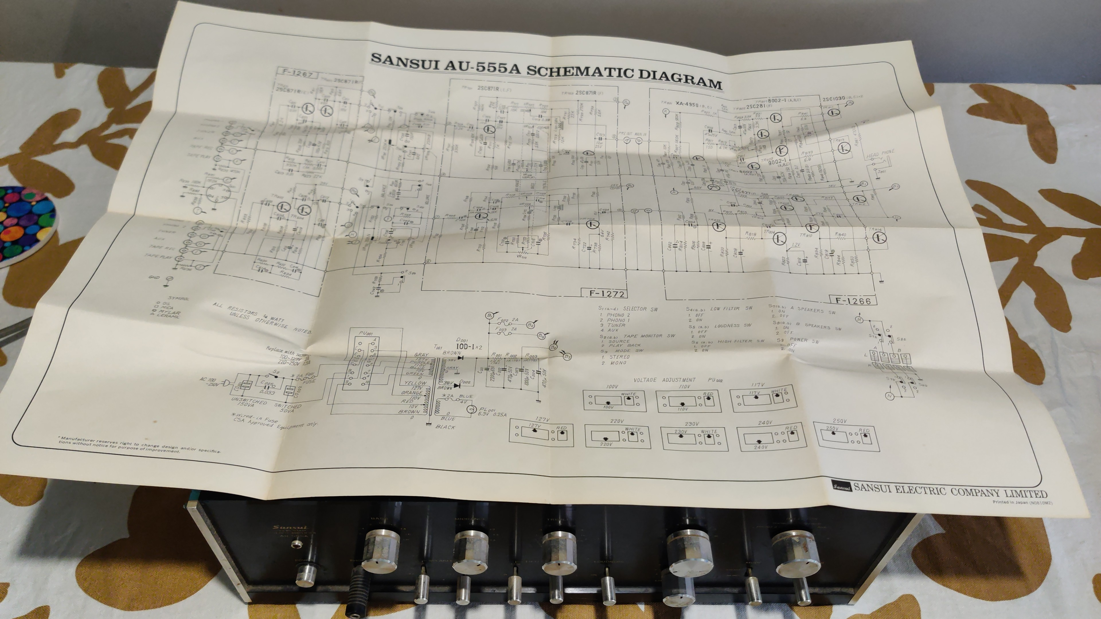

Slide 87
Right to Repair

Slide 88
Open Source

Slide 89
Use them

Slide 90
More info:
pluralistic.net

Slide 91
Thank you
Mastodon: @pjf@cloudisland.nz
These slides: github.com/pjf/talks/enshit

