Slide 1
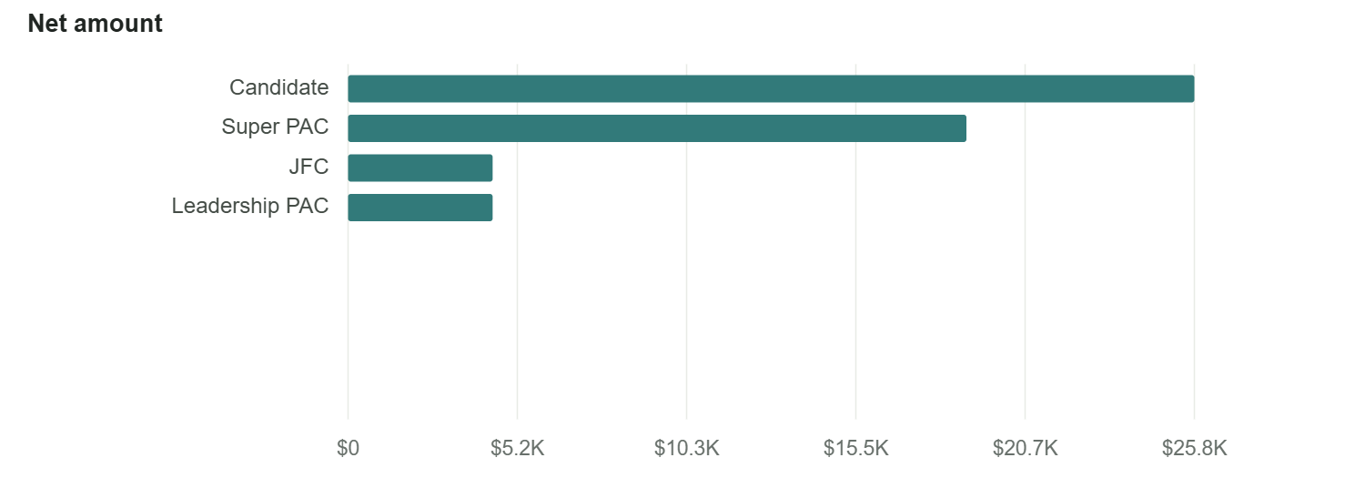
Published included receipts by Recipient category
Crypto · Published included receipts · Crypto Industry Spending Overview.xlsx · Workbook SHA256 88ea228457b8499d1ec27eeaba967f61505bde842ae0ecfe35c30791c23d66f6 · Analytical index 6ec6f3602f0a2cf5458d5d2e35d4d12a657a0a39a5b61b6900569475a2819abf · Query engine SHA256 a1a8ecddc9b2acea9f97c83b36793897aabae6b52510c9ac689158117d9d9b8b · Field semantics SHA256 dc565363a33698c167c1f9bd285884f6caccc22e9cecb43414b9c93e0aaa621f · Groups 1–4 of 4 · {"filters":[{"field":"company","op":"eq","value":"BINANCE US"}],"aggregate_filters":[]} · Tracked companies represented by the pinned report source. Collection completeness is not inferred.
Source: Crypto Industry Spending Overview.xlsx · SHA-256 88ea228457b8 · basis Published included receipts · exported September 14, 2026 from Mentat Chart Studio
MENTAT
Notes:
Published included receipts by Recipient category
Crypto · Published included receipts · Crypto Industry Spending Overview.xlsx · Workbook SHA256 88ea228457b8499d1ec27eeaba967f61505bde842ae0ecfe35c30791c23d66f6 · Analytical index 6ec6f3602f0a2cf5458d5d2e35d4d12a657a0a39a5b61b6900569475a2819abf · Query engine SHA256 a1a8ecddc9b2acea9f97c83b36793897aabae6b52510c9ac689158117d9d9b8b · Field semantics SHA256 dc565363a33698c167c1f9bd285884f6caccc22e9cecb43414b9c93e0aaa621f · Groups 1–4 of 4 · {"filters":[{"field":"company","op":"eq","value":"BINANCE US"}],"aggregate_filters":[]} · Tracked companies represented by the pinned report source. Collection completeness is not inferred.
Matches the workbook’s included receipts. Economic uniqueness remains unresolved; intermediary stages may overlap. All selected groups shown. Observed original giving remains provisional; supported giving is a subset, not a complete total. Known report person keys when available; otherwise reported name/state/ZIP identity. Distinct counts are not certified distinct people.
Source: Crypto Industry Spending Overview.xlsx · SHA-256 88ea228457b8 · basis Published included receipts · exported September 14, 2026 from Mentat Chart Studio
Console http://127.0.0.1:8826/

