Slide 1
Tree

Slide 2
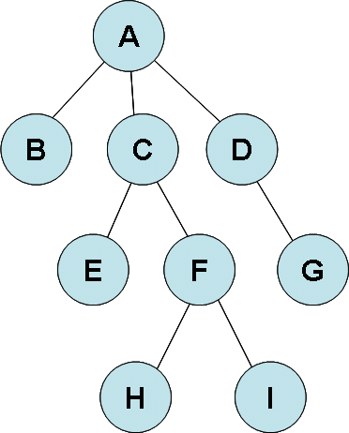
TREE
Degree of A
Degree of D:
Degree of the Tree
leaf :
Internal node :
children of A
children of F
Sibling
ancestor
ancestor of H:
ancestor of G :
descendant
A의 descendant
C의 descendant
level (cf. Level of A : 0)
BCD:
EFG:
HI

Slide 3

Binary Tree Representation
(1) a-b (2) a-b/c (3) (a-b)*c

Slide 4
Binary Tree Representation
0 | 1 | 2 | 3 | 4 | 5 | 6 | 7 | 8 | 9 | 10 | 11
- | a | b | - | c | d | - | - | - | - | e | f

Slide 5
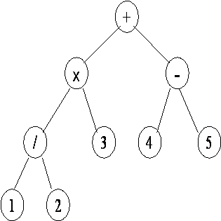
Array Representation of a Tree
0 | 1 | 2 | 3 | 4 | 5 | 6 | 7 | 8 | 9 | 10 | 11

Slide 6

Tree 표현
1 2
1 3
2 4
3 5
3 6
 | LeftChild | RightChild | 자녀수 | 부모 | level
0
1
2
3
4
5
6
2
2
3
1
0
4
1
1
1
5
6
1
1
2
1
2
2
3
2
3
2

