Slide 1

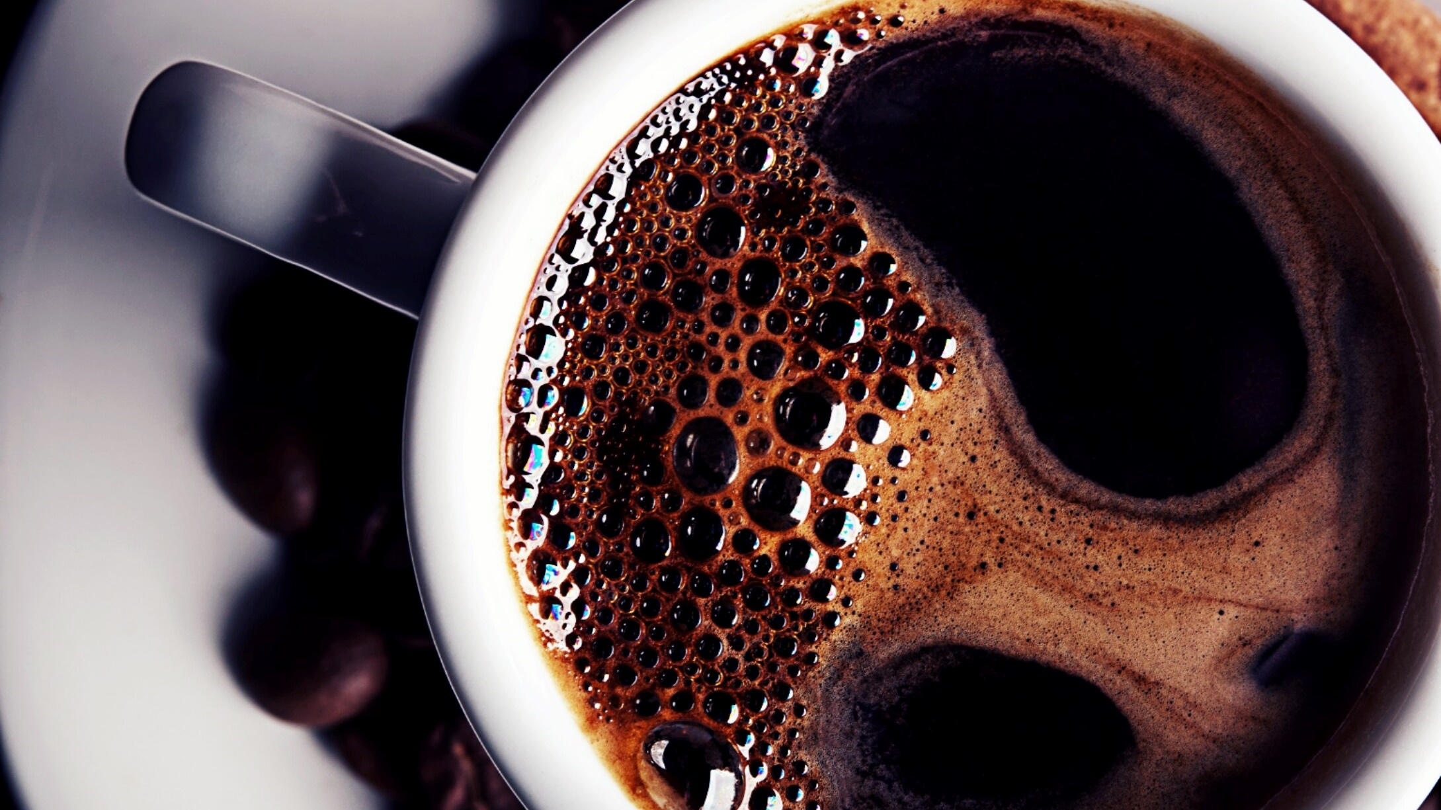
Random Forest
-b

Slide 2
Contents
Introduction to Random Forest
01
Introduction to Decision Trees
03
Random Forest in depth intuition
04
Classification using Random Forest. scikit-learn
05
Ensemble Techniques
02
Hyperparameter Tuning of Random Forest using Grid search and Randomized Search
06

Slide 3
Introduction to Random Forest
What is Random Forest?
Random forest in an ensemble of multiple decision trees, it works on the principal of ensemble technique.
Here we need to focus on two key terms :
What is an ensemble technique?
What is a decision tree

Slide 4
Ensemble Technique
Ensemble technique is a way to fine tune the system by grouping the model that performs the best, the group will perform better than the best individual model by reducing the bias, ensemble model generates the results which have low bias and low variance. There are two types of ensemble techniques
1.)Bagging: Used for random forest
2.)Boosting: AdaBoost, Gradient Boost,XGBoost
There is an election for the post of Governor for a candidate and the people of 5 counties votes, if there are 5 different model which have results of 1 and 0 , where 1 represent the candidate is selected from that county and 0 being person is rejected.

Slide 5

County Model | Result
Model 1 | 0
Model 2 | 1
Model 3 | 0
Model 4 | 1
Model 5 | 1
1

Slide 6
Introduction to the Decision Trees
Random forest is an ensemble of multiple Decision Tree
What is a Decision tree?
Decision tree is a tree like model, where each leaf or a node represent the class label while the branches represent the conjunction of features leading to class variable. It is used for both classification and Regression Problem(CART).
Let us see an example of the decision tree, where a bank has to give loan to someone , based on certain decisions to make.

Slide 7
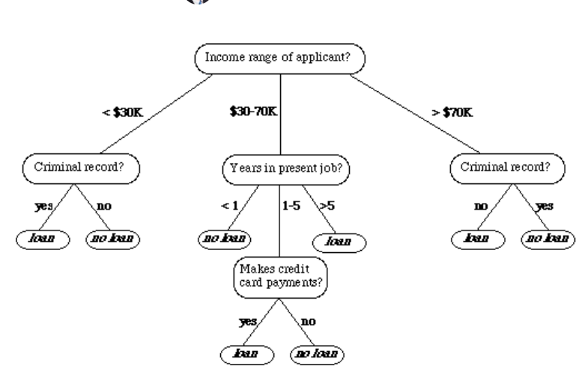

Slide 8
There are two things to be understood in decision tree.
Entropy and Information gain
Entropy: Measures the purity or measure of disorder of the split
Helps in selection of best attribute or the feature
Entropy value ranges from 0 -1 where 0 is the best case and 1 is the worst case scenario.
In case of 50/50 split entropy is always 1
We always split the feature with lower entropy first and then proceed.
H(s)= -p(+)log(p+) – p(-)log(p-)

Slide 9
Information gain tells us how important the attribute of feature vector is in other words information gain helps to determine the ordering of attributes in the node.
Gain(s,a) = H(s)- (sum(|sv|/s ) *H(sv)

Slide 10
Random Forest Indepth intution
As discussed previously Random Forest uses Bagging Technique which is also called as Bootstrap aggregation
Has Low Bias and Low variance
Solves the overfitting and Underfitting problems of the model
Is used for both classification and regression problems.
we will see with flow diagram how does the Random forest and bagging works tohether:

Slide 11
Data with M columns and D Rows
DT1(Base Learner 1)
RS+FS
DT2(Base Learner 2)
DT3(Base Learner 3)
RS+FS
0
1
1
1

Slide 12
Classification using Random Forest using sklearn library
In this Project, we will build and train a model using human cell records, and classify cells to whether the samples are benign or malignant.
We will use Jupyter Notebook to demonstrate the Project.

Slide 13
Hyperparameter Tuning of Random forest Parameters
Random Forest has multiple parameters to be tuned to obtain the best results.
Sklearn.ensemble.RandomForestClassifier class has different parameters to be trained on for classification model
https://scikit-learn.org/stable/modules/generated/sklearn.ensemble.RandomForestClassifier.html
Sklearn.ensemble.RandomForestRegressor has different parameters to be trained on for regression model
https://scikit-learn.org/stable/modules/generated/sklearn.ensemble.RandomForestRegressor.html
We will use Grid Search and Randomized Search CV to perform hyperparameter tuning.

