Slide 1
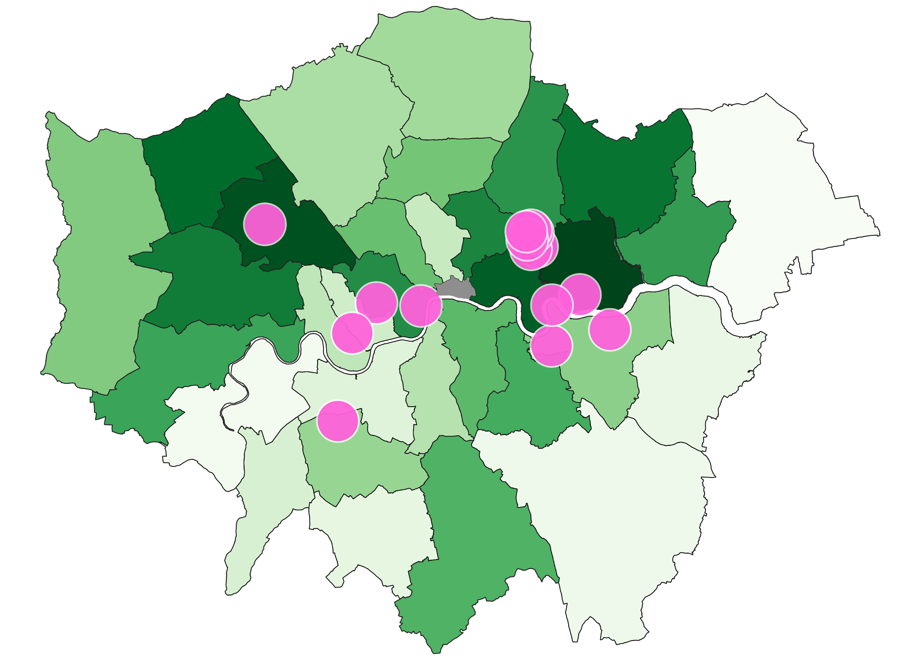
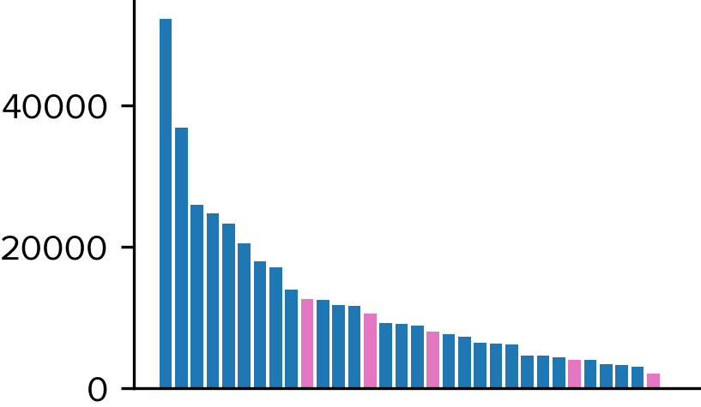
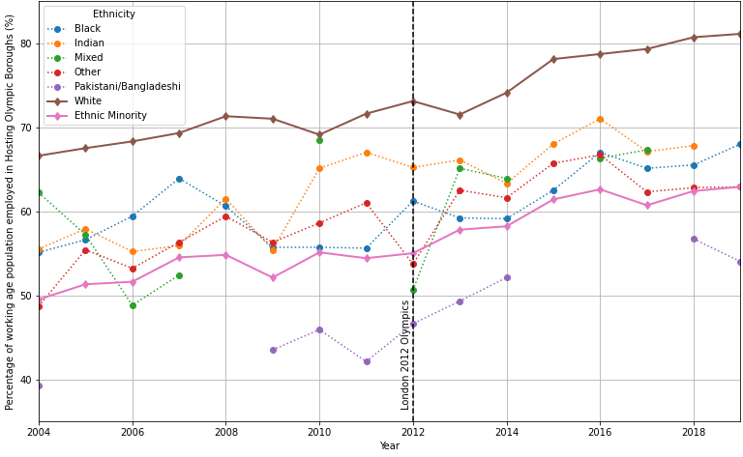
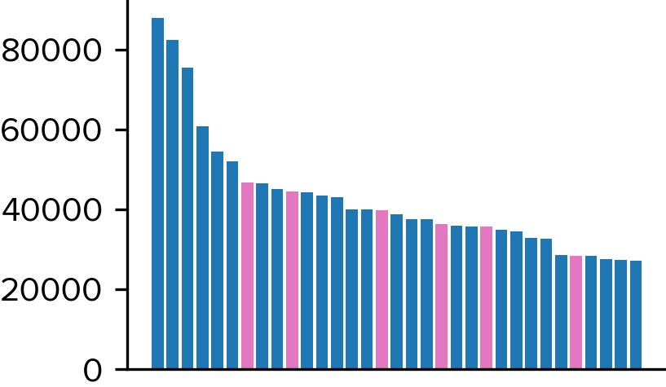
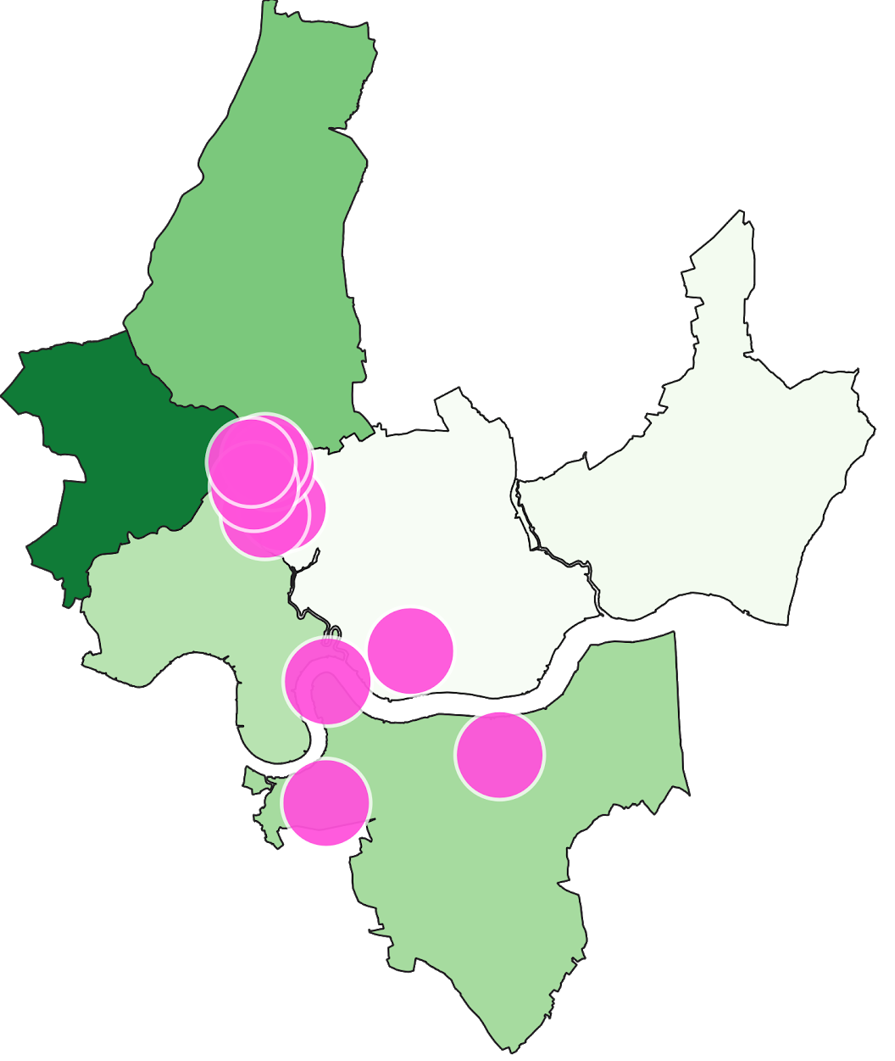
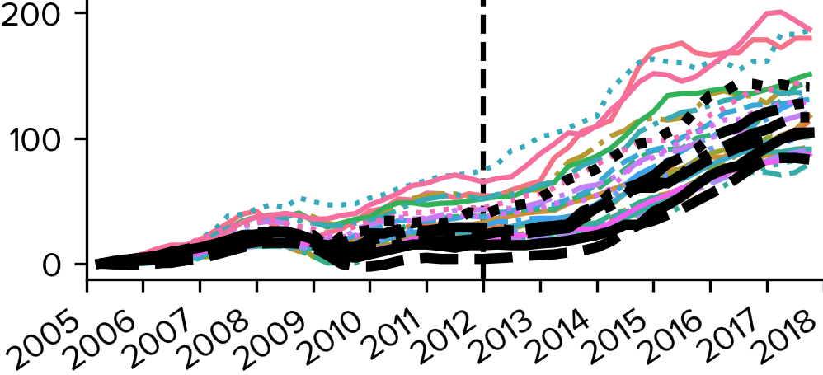
The Socioeconomic Impact of the 2012 Olympics in London
Highlights
House prices increased at a faster rate after the Olympics in host boroughs.
This suggests a positive socioeconomic effect on the borough as a whole, however low-income residents may find themselves unable to afford rent as a result, with many families being forced out.
The increase in employment of ethnic minorities is a positive change for these boroughs.
Team 21: Alp Aribal, Bertie Ellison-Wright, Pamelpreet Jhinger, Evonne Lee
Background
Hosting the Olympics games is often perceived to boost the economy of the host country. Due to the perceived benefits, it became increasingly competitive to host the Olympic games, resulting in soaring costs, and this coupled with scandals in past Olympics has led to skepticism about hosting the games. Hence, we will analyse the impact of the 2012 Olympics on London.
The more diverse host boroughs saw a greater increase in house price after the Olympics compared to before.
We found a significant increase in the proportion of ethnic minorities employed in London after the Olympics.
Data
We are using data on the ethnicities and house prices of the 33 London boroughs, focusing on the six boroughs which primarily hosted the games: Barking and Dagenham, Greenwich, Hackney, Newham, Tower Hamlets and Waltham Forest. The diagram below shows these boroughs and is shaded by % increase in house price from 2009-2015.
This map of the Olympic venues, with each borough shaded by % of BAME population, shows higher diversity in host boroughs.
Average house price increase per year in host boroughs (pink) was very low before the Olympics (top), and increased compared to other boroughs afterwards (bottom).
This graph shows the percentage of each ethnic group employed in the host boroughs before and after the Olympics.
% increase in house prices in each borough followed a similar trend, with host boroughs shown in black, and a vertical line indicating the Olympics..
Model
We looked at the trends in house prices and the proportion of ethnic minorities employed in boroughs before and after the Olympics, and used Student’s t-distribution to determine if there was significant change, without showing causality.
We found that both the proportion of ethnic minorities in employment and house prices in the more diverse host boroughs increased after London 2012.
Correlation vs Causation
Our findings only showed a correlational relationship, and there are too many factors affecting employment and house prices to determine whether the Olympics was the cause of any of these changes.
Notes:
Notes:
In Powerpoint, click View > Guides
Keep text within gutter guides.
Author list: Don’t split names onto two lines (e.g., “Jimmy [break] Smith”). If that happens, use a new line, unless you need the space. Bold the first names of anybody who’s presenting in person.
Intro/methods/result: Do not drop below font size 28, but if you have extra space, jack up the font size until the space is full.
Do not use color in the sidebars except in graphs/figures. It’ll pull attention from the center and slow interpretation for passersby.

