Slide 1
coding exercise

Slide 2
complete the following:
change the background of the webpage.
put a link to “link to linkedin” text above.
create a contact box (optional).
change the background color of the about me and skills “box”.
*if you have not done it yet, feel free to customize the page into your own liking – change james to your names, etc.

Slide 3
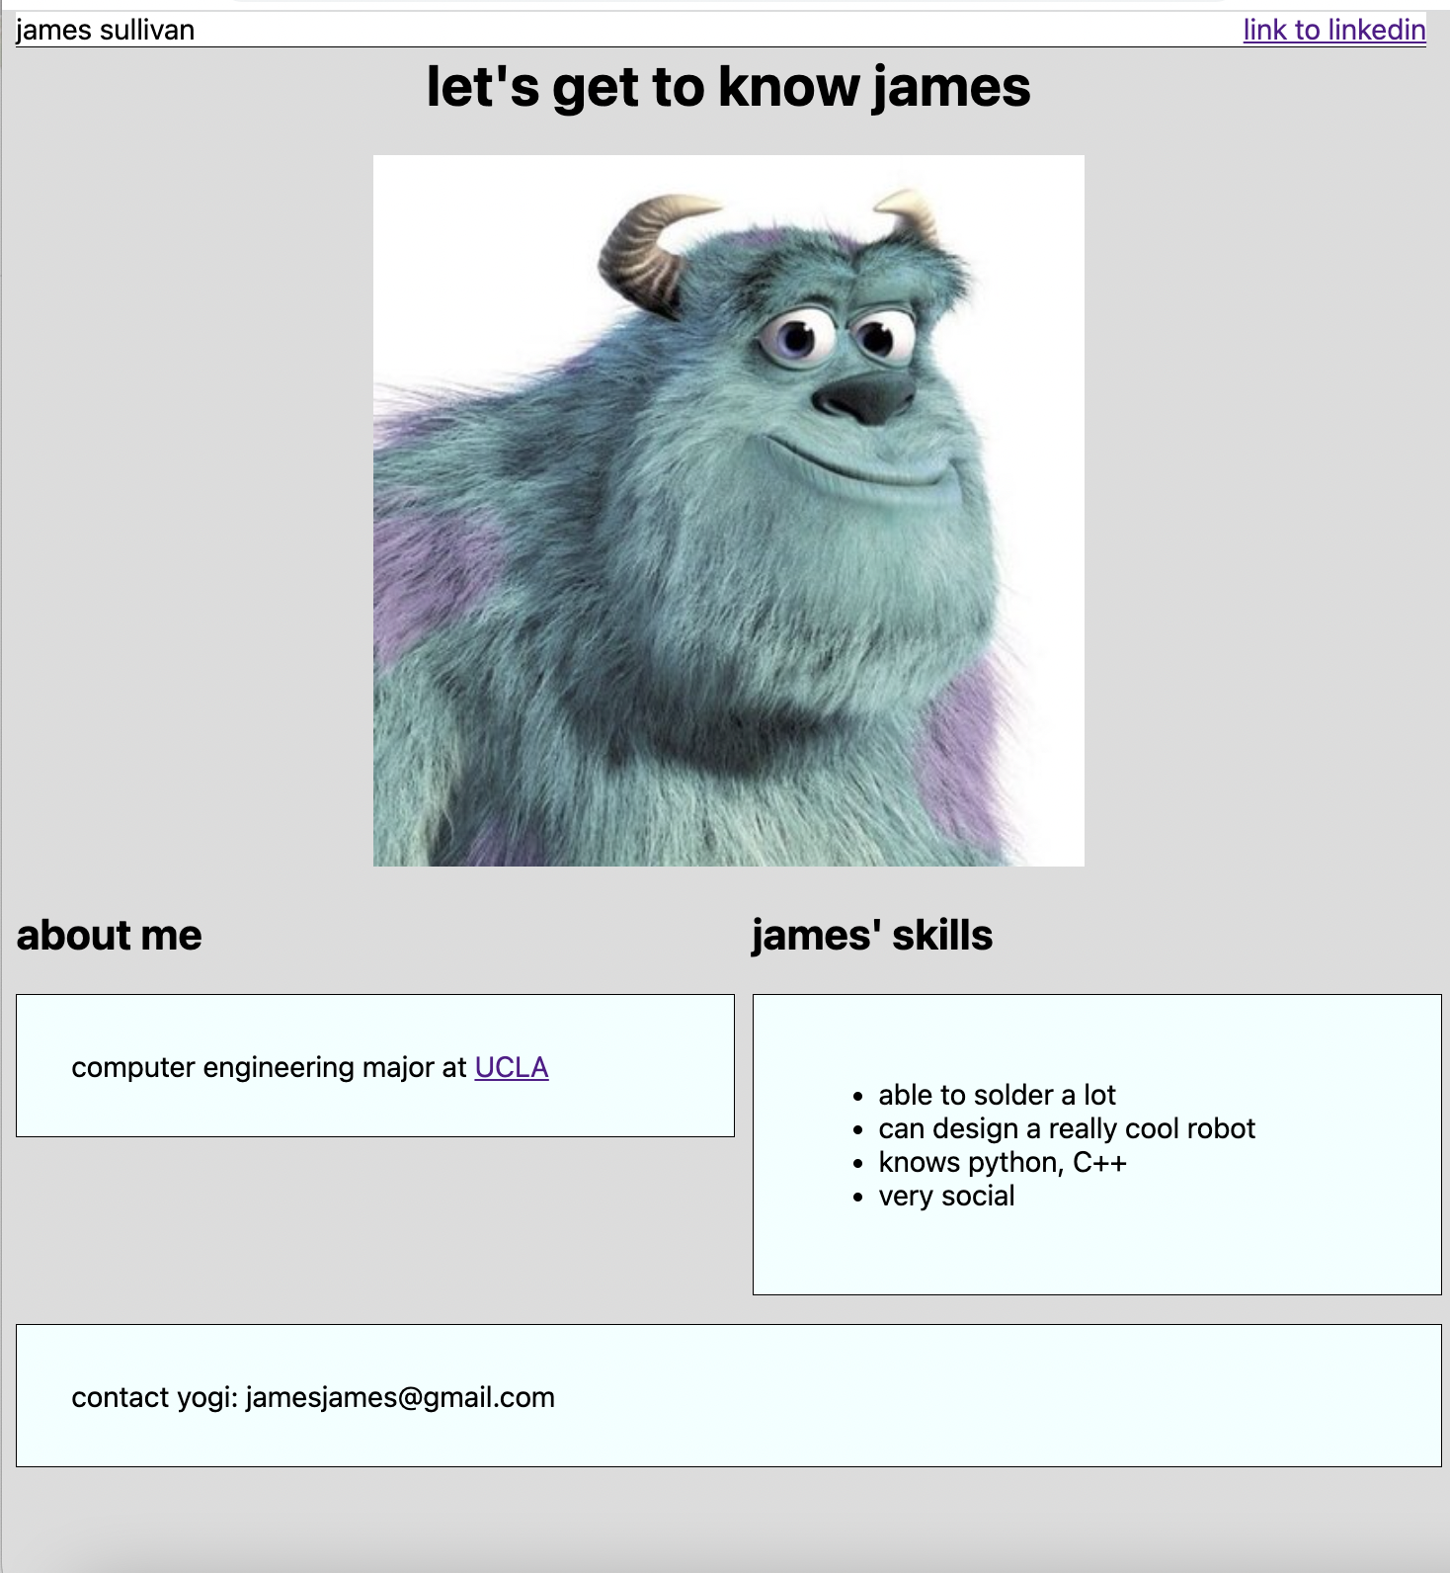
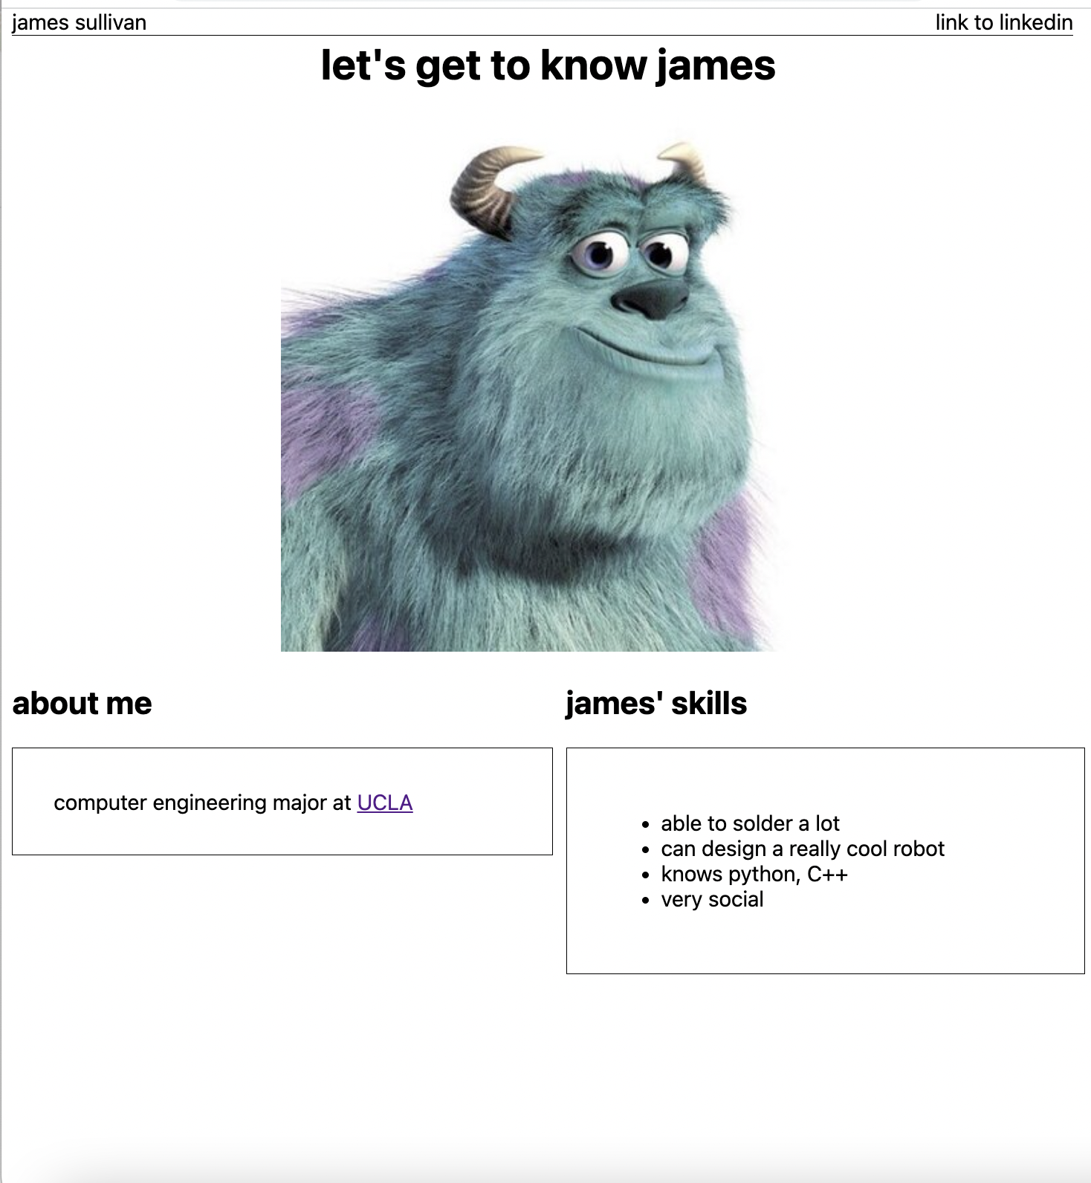

Slide 4
have fun!

