Slide 1
Inferring Demographic History of Faroese Mice
Peicheng Jing

Slide 2
Genome Sequencing Data
Unrelated Samples
  Nolsoy – 8
  Sandoy – 12
  Norway – 6 and 5/7
SNPs in selected intergenic regions
SFS based methods
  Dadi - Diffusion equation approximates small per-generation allele frequency change when Ne is large
  Fastsimcoal2 - a continuous-time coalescent simulator

Slide 3
SFS by Haplotype Caller

Slide 4
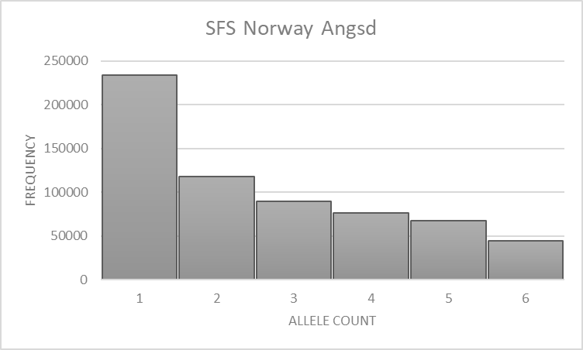
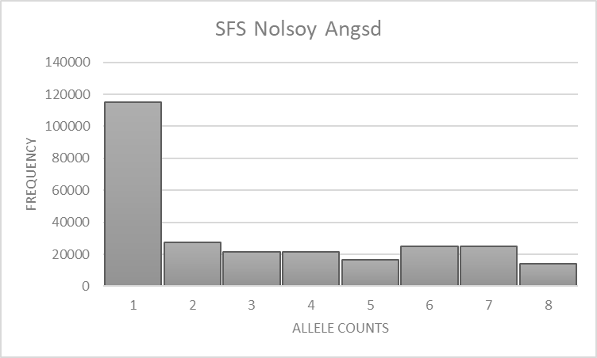
SFS by Angsd

Slide 5
Models
Na Na
Nb T3
Nc T2 Nib
Nm T1 Nm m1
m m2 Nif
Ni
Model #1 Model #2 (Emma’s)

Slide 6
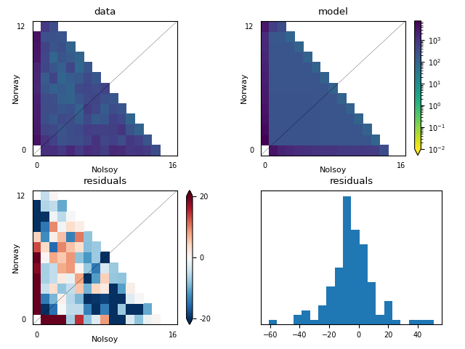
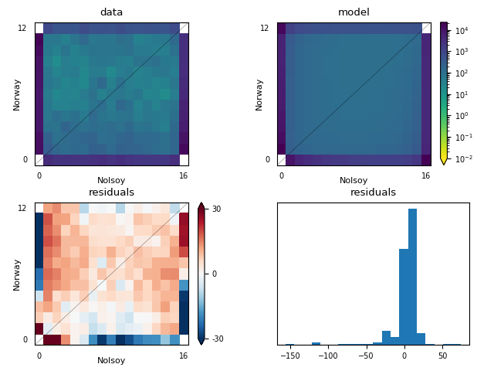
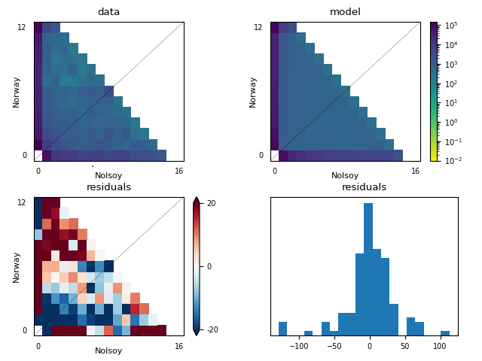
Dadi Residual Plots – Model #1
GATK GATK Polarized Angsd

Slide 7
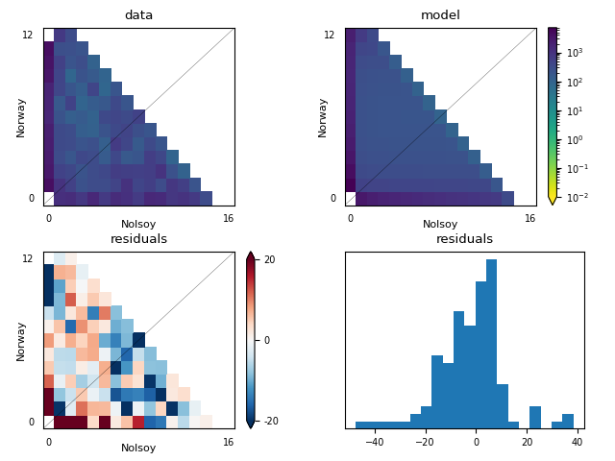
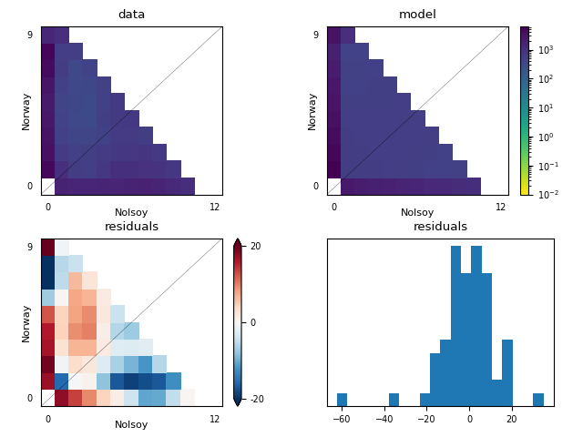
Dadi Residual Plots – GATK
Model #1 Model #2 Model #2 Projected

Slide 8
Best Runs - Dadi
Rep | NAnc | NBottle | TBottleS | TBottleE | NMain | NCol | TCol | NIsl | TIsl | Mig1 | Mig2
GATK–M1 | 38150 | 135054 | 70634 | 79631 | 5543 | 1423 | 5037 | 5702 | NA | 2.34e-10 | NA
Caroli–M1 | 134588 | 849344 | 568969 | 639169 | 22634 | 5476 | 39101 | 15422 | NA | 5.7e-7 | NA
Angsd–M1 | 849897 | 1014517 | 2385086 | 2610219 | 85819 | 7074 | 111100 | 268096 | NA | 3.0e-8 | NA
GATK–M2 | 50380 | 10007 | 24127 | NA | 5290 | 22269 | 22178 | 1504 | 1987 | 2.42e-5 | 6.41e-6
GATK–M2-P | 73889 | 2332 | 4193 | NA | 2232 | 26974 | 2057 | 743 | 1100 | 2.28e10 | 6.45e-9

Slide 9
Best Runs – Fastsimcoal2
Run | NAnc | NBot | TBot | Nmain | NIsland | NColonization | TColonization | Migration | MaxEstLhood | MaxObsLhood
Caroli_1 | 224927 | 6031 | 9785 | 1445 | 1329 | 236 | 9753 | 2.60E-04 | -514448 | -485927
Caroli_2 | 296297 | 7650 | 11226 | 2351 | 1221 | 188 | 6946 | 1.36E-04 | -514720 | -485927
Caroli_3 | 298206 | 1787 | 10437 | 1975 | 1298 | 306 | 7828 | 1.73E-04 | -514956 | -485927
GATK_1 | 996942 | 2689 | 15440 | 10476 | 11076 | 2935 | 13164 | 3.96E-05 | -147263 | -142784
GATK_2 | 531096 | 13489 | 19168 | 10181 | 11828 | 1815 | 18596 | 3.88E-05 | -147295 | -142784
GATK_3 | 544860 | 4752 | 21297 | 10294 | 11483 | 1394 | 20681 | 4.23E-05 | -147363 | -142784
Angsd_1 | 324923 | 9957 | 25830 | 13648 | 84899 | 501 | 8861 | 1.22E-06 | -1324041 | -1295819
Angsd_2 | 380592 | 15659 | 32120 | 13045 | 35570 | 711 | 9072 | 1.37E-06 | -1324055 | -1295819
Angsd_3 | 389642 | 15333 | 26352 | 10566 | 41242 | 462 | 6990 | 1.60E-06 | -1324111 | -1295819

Slide 10
Conclusions
Better convergence for Fastsimcol2
Different estimates with GATK or Angsd SFS
Try different models with dadi?
Suggestions?

