Slide 1
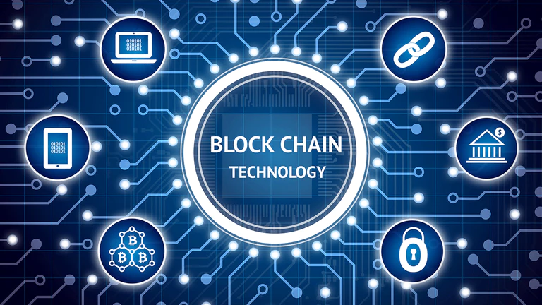
Blockchain theory and applications
Dr Loke K. S.

Slide 2
Course
IM6313701 區塊鏈理論與實務 Blockchain theory and applications
MA5104701 區塊鏈理論與實務 Blockchain theory and applications
Requirements: Basic programming skills.

Slide 3
Reference
Melanie Swan, Blockchain Blueprint for a New Economy, O’Reilly, 2015
Andreas Antonopoulos, Mastering Bitcoin – programming the open blockchain, 2017
Satoshi Nakamoto, Bitcoin: A Peer-to-Peer Electronic Cash System, 2009.

Slide 4
Course Syllabus
Part 1:
Bitcoin and Blockchain (6 weeks)
Lectures, Activities and Roleplay
Assessment : (1 week)
Class activities, Report and Presentation – Explain existing technology or an innovative application
Part 2:
Ethereum (3 week)
Lectures, Activities and Roleplay
Assessment: (1 week)
Class activities, Presentation – Explain existing technology or an innovative application
Part 3:
Smart contracts and Solidity (6 week)
Lectures and Coding
Assessment: (1 week)
Class activities, Report, Presentation and Project (Solidity prototype)

Slide 5
Part 1: Topics
Details on Bitcoin and Blockchain
Cryptography, Private Keys, Addresses
Byzantium Generals and Proof of Work.
Other Proof mechanism
Applications:
Providence, Supply Chain
Finance, Insurance, Commerce
Securitization : Property, Agriculture
Identity, Certificates and Intellectual Property Management
Government and Community

Slide 6
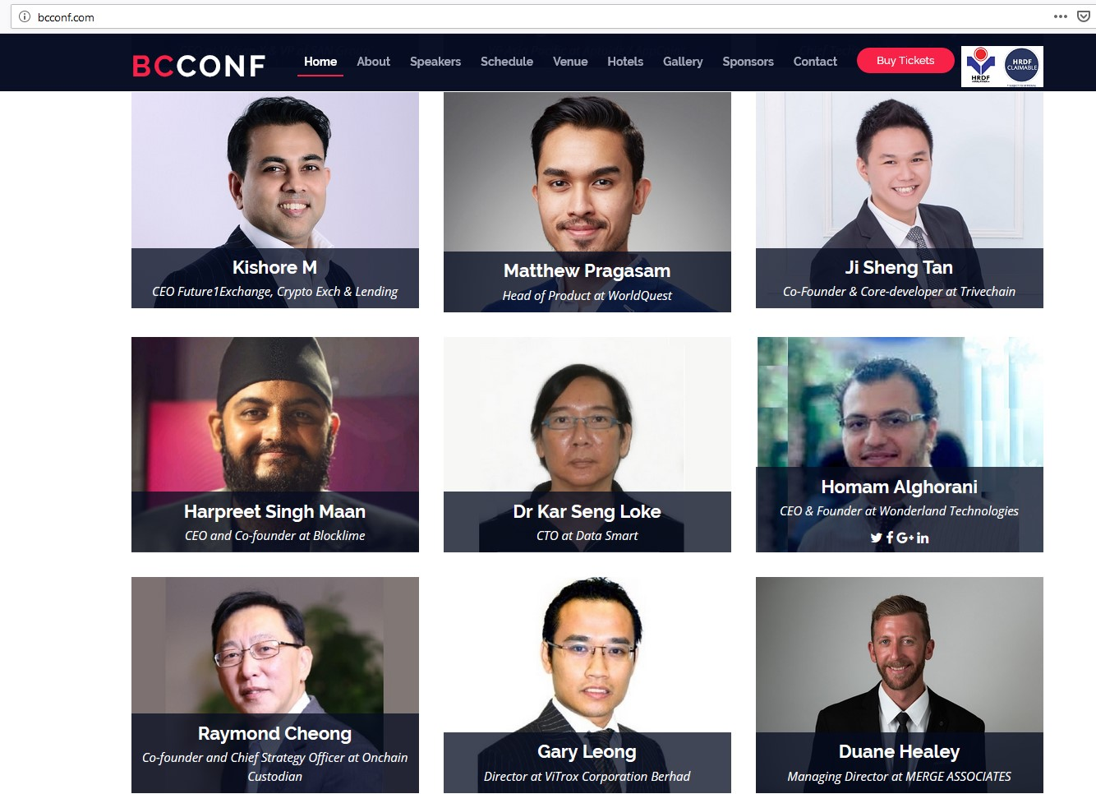
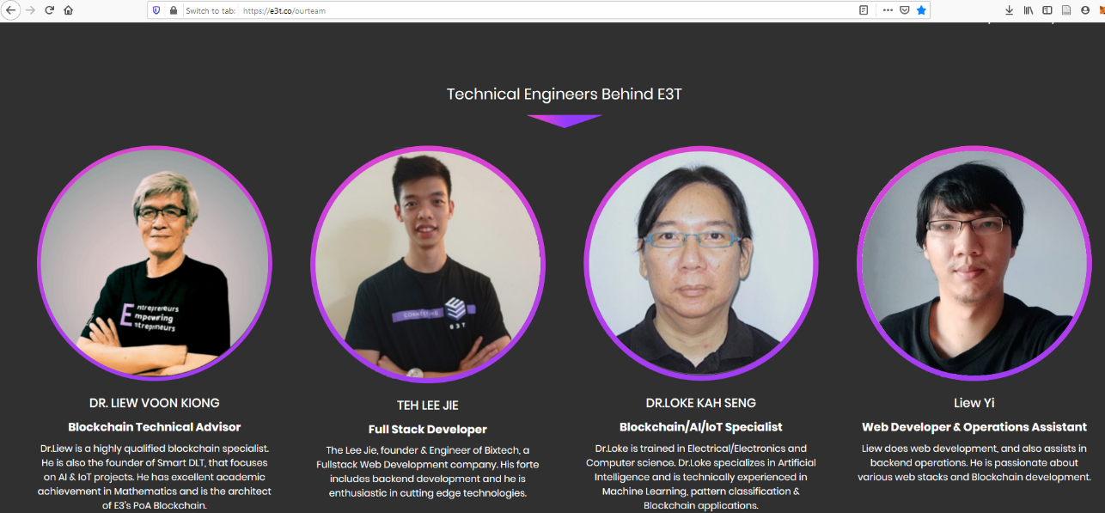
Some previous experience
Loke & Ong, Food Traceability and Prevention of Location Fraud using Blockchain, HTC 2020, 2020.
Loke, Concept Timestamping on Blockchain and Decentralization of Patents, iSCI 2019, CCIS 1122, pp. 639–648, 2019
Blog: https://btcblockchain.wordpress.com/
https://www.youtube.com/watch?v=CE8Q0CTkY3U

Slide 7
History
The white paper on bitcoin was published by Nakamoto Satoshi on October 31, 2008 .
Nakamoto Satoshi is a pseudo name for a person or a group.
Bitcoin.org registered in the same year.
Title of paper is: Bitcoin: A Peer-to-Peer Electronic Cash System.
The headline "The Times 03/Jan/2009 Chancellor on brink of second bailout for banks" was embedded into the first block to prove that the block (called Genesis block) was created on or after Jan 3, 2009.
source:http://bitcoin.stackexchange.com/questions/17040/who-created-the-bitcoin-blockchain?rq=1

Slide 8
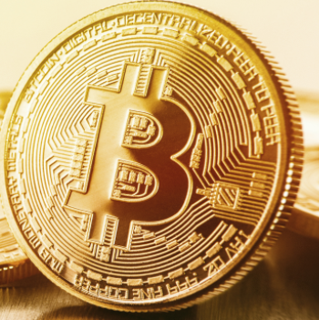
History
January 12, 2009 The first Bitcoin transaction.
The first transaction of Bitcoin currency, in block 170, takes place between Satoshi and Hal Finney, a developer and cryptographic activist.
Today's value: Bitcoin Exchange Rate - $56,000 USD ... 7 years ago $567.13 USD
source: http://historyofbitcoin.org/

Slide 9
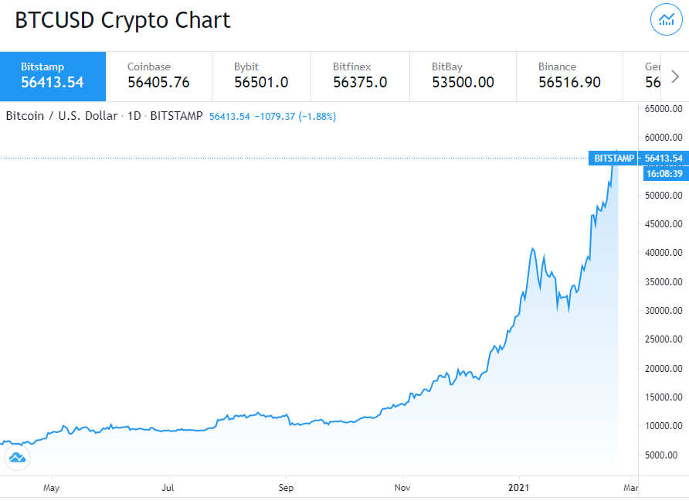
BTC-USD

Slide 10
What is Bitcoin?
(We will skip over the issues of what is considered money.)
Bitcoin are tokens of exchange transacted only electronically
Bitcoin is simply a means of sending and receiving numbers to and from "addresses"
Addresses are cryptographic public-keys (actually a hash of it)
It stores all transactions on a blockchain.

Slide 11
How it works?
The block chain essentially a public accounting ledger:
3/3/13 Sally found : $15.00
3/3/13 Sally -> Bob : $10.00
3/4/13 Bob -> Jimmy : $4.00
3/4/13 Sally -> Barb : $4.00
3/4/13 Jimmy -> Sally : $2.00
How much money does Sally have in her wallet?
Sally had $15, then gave $10 to Bob, then $4 to Barb, then was given $2 from Jimmy. Sally has $3 as of right now.
source: Modified from Levente Buttyan, Michael K. Reiter and Aviel D. Rubin

Slide 12
What is Bitcoin?
A purely peer-to-peer version of electronic cash that allows online payments to be sent directly from one party to another without going through a financial institution.
It solves the problem of double spending without using a central authority
It resolves the problem using cryptographic proof instead of trust (on a central authority)

Slide 13
Bitcoin and Blockchain
Bitcoin is digital cash. It is a digital currency that you can spend, or transfer funds that is not centrally administered.
Cryptocurrencies refers to the umbrella of digital cash that is broadly based on Bitcoin. There are hundreds of other “altcoin” (alternative coin) cryptocurrencies, like Litecoin and Dogecoin.
Blockchain refers to the underlying technology that runs Bitcoin

Slide 14
Blockchain
The blockchain is the public ledger of all Bitcoin transactions that have ever been executed.
It is constantly growing as miners add new blocks to it (every 10 minutes) to record the most recent transactions. The blocks are added to the blockchain in a linear, chronological order.
Each full node (i.e., every computer connected to the Bitcoin network using a client that performs the task of validating and relaying transactions) has a copy of the blockchain, which is downloaded automatically when the miner joins the Bitcoin network.
Source: Melanie Swan

Slide 15
Blockchain
The blockchain is seen as the main technological innovation of Bitcoin because it stands as a “trustless” proof mechanism of all the transactions on the network.
The blockchain is an innovative architecture for a new system that implements decentralized trustless transactions
The blockchain allows the disintermediation and decentralization of all transactions of any type between all parties on a global basis.

Slide 16
Blockchain
The blockchain can be used for any form of asset registry, inventory, and exchange, including every area of finance, economics, and money; hard assets (physical property); and intangible assets (votes, ideas, reputation, intention, health data, etc.).
A blockchain is quite literally like a giant spreadsheet for registering all assets, and an accounting system for transacting them on a global scale that can include all forms of assets held by all parties worldwide

Slide 17
Sending Money
To send money
you need to have an bitcoin address
Private key that is stored in a wallet
Being a digital currency means that cryptocurrency is a sequence of numbers and the ownership of this sequence is transferred from one person to another with no third-parties involved.
Wallet software is the software you run on your own computer to manage your Bitcoin
There is no centralized “account” registration
The private key is used to access the coin associated with that address from any Internet-connected computer.

Slide 18
Overview
All mining computers in a P2P fashion receive transactions for verification
These computers compete to have the right to insert these transactions into the blockchain thereby legitimizes it.
Computer adds this ‘block’ to the ‘blockchain’ in the order that the ‘block’ arrived.
The winner broadcasts his proof to the rest of the network, which checks that proof and verifies it before queuing the ‘block’ to complete the transaction.
All other computers adds the same block to their own copy of blockchain

Slide 19
Smart and Trustless
The trustless networks feature of blockchain technology is a key enabler in the context of smart property and smart contracts.
Making property smart allows it to be traded with much less trust.
This reduces fraud and mediation fees, but more importantly affords a much greater amount of trade to take place that otherwise would never have happened, because parties do not need to know and trust each other. For example, it makes it possible for strangers to lend you money over the Internet

Slide 20
Properties
Peer to Peer – decentralized – means no centralized servers. All computers in the bitcoin network can communicate with each other.
Trustless – This is the innovation to solve the double spending problem. Again this is solved without centralized servers.
The double spending problem can be easily solved if you have a trusted authority who keep tracks of all spending.
But would you trust any authority all the time? Should you trust any authority all the time?
Immutability : Hard to undo records added to blockchain

Slide 21
Double Spending
Being a digital currency means that cryptocurrency is a sequence of numbers and the ownership of this sequence is transferred from one person to another with no third-parties involved.
The fundamental issue with digital coin is that it can be reused again.
Because cryptocurrencies are only in digital form, it can be duplicated easily
All digital assets can be copied – that is one of fundamental properties of being digital.

Slide 22
Precursor to Bitcoin
Digicash (by David Chaum, 1989) : not decentralized but untraceable transactions
B-money (by Wei Dai, 1998) : proposed proof of work using the hashcash cost-function. His proposal very similar to Satoshi’s. Satoshi’s paper expands on his ideas into a complete working system
Bitgoid (by Nick Szabo)

Slide 23
Proof of work
Where a one-way function is prohibitively difficult to compute backwards, a secure benchmark function ideally comes with a specific cost, measured in compute cycles, to compute backwards.
More on this later and later.

Slide 24
Legality of Blockchain
Many states have laws in place that define blockchain, smart contracts, and cryptocurrency. Many of these laws state that the blockchain record can be used as evidence in court because of its immutability.
Blockchain evidence have been used in courts in the USA, China, Azerbaijan, the United Kingdom and Italy.
See Blockchain Evidence and Courts – A cross-jurisdictional analysis (blockgeeks.com)

Slide 25
Innovations
The blockchain can be used for any form of asset registry, inventory, and exchange, including for tangible, intangible assets, finance, economics, and money.
Hard assets (physical property) such as a home, car, bicycle, or computer
Intangible assets such as votes, ideas, reputation, intention, health data, information, stock shares, reservations, or copyrights (e.g., books, music, illustrations, and digital fine art). See: Loke, Concept Timestamping on Blockchain and Decentralization of Patents, iSCI 2019, CCIS 1122, pp. 639–648, 2019
Concept Timestamping on Blockchain and Decentralization of Patents | SpringerLink

Slide 26
Applications: Medical Records
BurstIQ provides end-to-end data rights management, indisputable chain of custody, granular ownership and revocable consent, and advanced security in the healthcare space using their proprietary BurstChain.
BurstIQ’s big data blockchain contracts help patients and doctors securely transfer sensitive medical information.

Slide 27
Applications: Education Certificates
OpenCerts is an online platform based on the blockchain technology that offers an easy way to issue, check and verify academic certificates. It provides a common standard for the issuance of digital certificates along with their validation and verification.
The project is an initiative by the Government of Singapore
Currently, 18 educational institutions in Singapore have implemented this system and now students will receive blockchain-based digital certificates starting from the year 2019
https://www.ranosys.com/education-technology-solutions

Slide 28
Applications: Music
Mediachain uses smart contracts to get musicians the money they deserve. By entering into a decentralized, transparent contract, artists can agree to higher royalties and actually get paid in full and on time. Streaming giant Spotify acquired Mediachain in April 2017.
A music blockchain would be a single place to publish all information about who made what song, without having to trust a third-party organization, enabling distributed consensus without needing to trust a central authority.
A unique ID and attribution will be attached to the song.

Slide 29
Applications: Property
Propy is a global real estate marketplace with a decentralized title registry system. The online marketplace uses blockchain to make title issuance instantaneous and even offers properties that can be purchased using cryptocurrency.
During the transaction process, every step is recorded on a smart contract. For example, when a signature is received via DocuSign, it is added to the blockchain as an immutable record. No one can ever delete that from the blockchain.
When the title report is received showing proof of ownership, a hash is created and added to the blockchain. When the deed is recorded, another hash of the PDF is made, along with the stamp that it’s recorded, and added to the blockchain. In a few years, if there is ever a question on a transaction, the hash of each document can be checked to verify accuracy

Slide 30
Applications: Supply Chain
There is a need for having transparency to supply chains using blockchain that not only identifies counterfeits .
Blockverify is a “Blockchain Based Anti-Counterfeit Solution.” Its function is to identify counterfeits and offers a non-duplicate environment

Slide 31
Applications: Online Commerce
OpenBazaar is a free blockchain-based marketplace that offers zero restrictions to their users without no platform fees, and at the same time earn cryptocurrency. The users can create their own store, sell their items and reach a new audience.

Slide 32
Applications: Journalism
Civil is a blockchain project that is aimed towards journalists. It is a marketplace where journalism can sustain and flourish in the right direction. The project aims to fix the loopholes in the current journalism practice and incentivize collaborative behavior than the competition.
Civil set out to decentralize how the news is vetted, how journalism is funded, and how we stay informed as a society

Slide 33
Applications
Resource:
Blockchain Applications: 62 Killer Ideas You Can Do (2021) (connectbit.com)
25 Blockchain Applications & Use Cases You Should Know | Built In
Blockchain Applications for the Real World (Blockgeeks Guide)

Slide 34
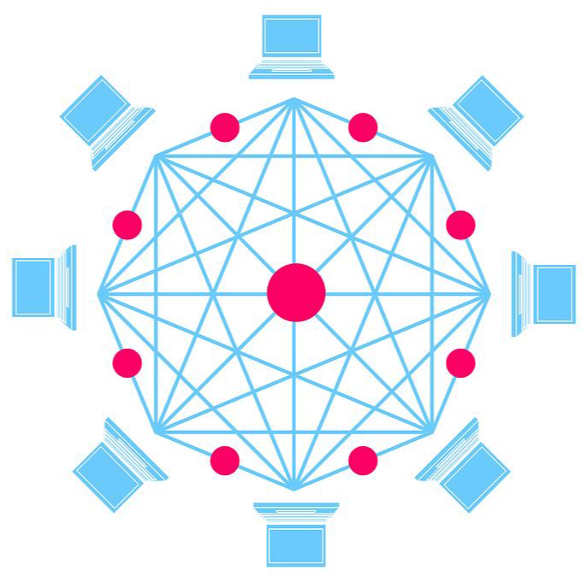
Key Concepts
Peer 2 Peer
Trustless
Solves
Double Spending
Decentralized
immutable

Slide 35
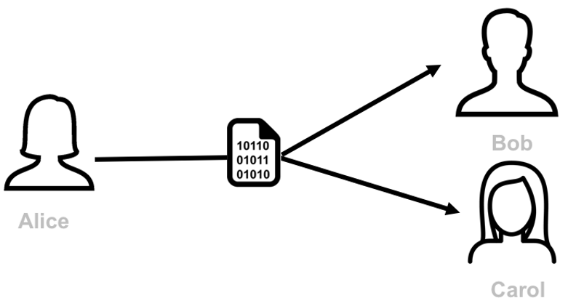
What is Double-Spending
Suppose A pays B $1.
If $1 is a physical cash then the actual object is passed to B, and A no longer have it. A can’t re-use or re-spend the $1.
But if $1 is digital stored as a series of numbers, then we can’t be sure that A have not kept another copy of it. If A has another copy then A can double spend the $1 already given to B.

Slide 36
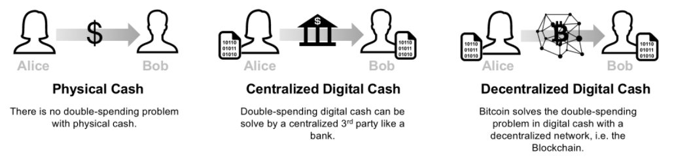
What is Double-Spending
One way to solve this is to have a thrusted 3rd party (e.g. bank, trustee, etc) that tracks all the transactions.
The third party is responsible for managing a centralized ledger that keeps track of and validates all the transactions in the network.
Another way is to invent a digital token that can’t be duplicated, just like physical cash. This seems to be a harder problem.

Slide 37
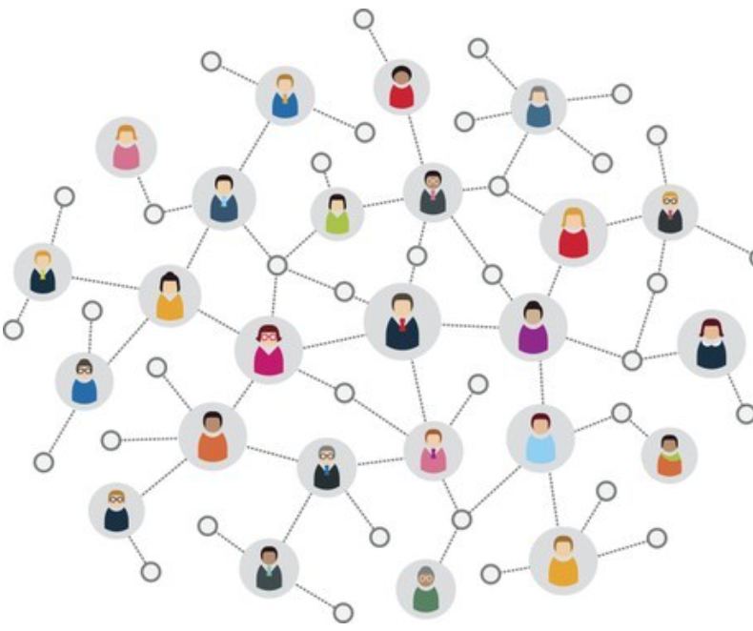
What is Bitcoin?
Bitcoin is the decentralized solution for the Double-Spending Problem

Slide 38
Bitcoin
Distributed: The ledger is replicated across a number of computers, rather than being stored on a central server. Any computer with an internet connection can download a full copy of the blockchain.
Cryptographic: Cryptography is used to make sure that the sender owns the bitcoin that she's trying to send, and to decide how the transactions are added to the blockchain.
Immutable: The blockchain can be changed in append only fashion. In other words, transactions can only be added to the blockchain but cannot be deleted or modified.
Uses Proof of Work (PoW): A special type of participants in the network called miners compete on searching for the solution to a cryptographic puzzle that will allow them to add a block of transactions to Bitcoin’s blockchain. This process is called Proof of Work and it allows the system to be secure (more on this later).

Slide 39
Bitcoin
Sending bitcoin money goes as follows:
Step 0 (one-time effort): Create a bitcoin wallet that stores the cryptographic keys that identifies the user. It also has the address of the owner of the wallet.
Step 1: Send a transaction to the recipient bitcoin address. This transaction together with other transactions are broadcast to the entire bitcoin network.
Step 2: Out of all the miner, one miner will confirm the transaction block.
Step 3. This block is broadcast to all miners and confirmed by them. Once confirmed all blockchain are synchronized.

Slide 40
Centralization and Decentralization
The openness of the blockchain, which allows anyone to view Bitcoin transactions both past and present
The goals of the third party can diverge from the goals of the users of the system.
No Third-Party Seizure
Decentralized decision making can be extended into public sphere and government, and so on. Why not do away with centralized government?

