Slide 1
Transactions

Slide 2
Reference
Grokking Bitcoin, Kalle Rosenbaum, Manning Publications, 2019
Mastering Bitcoin- Programing the Open Blockchain, 2nd Ed, Andreas Anotonopoulos, O’Reilly, 2017.

Slide 3
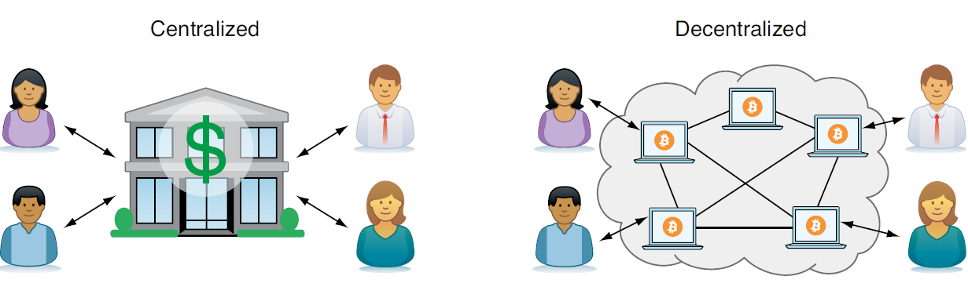
Introduction
Bitcoin is decentralized and permissionless

Slide 4
Decentralized
With a decentralized system such as Bitcoin, which has several thousands of nodes spread around the globe, it’s extremely hard to control who uses the system and how.
No matter where or who they are, or to whom they’re sending money, the Bitcoin system will treat all users equally.
The Bitcoin system has no central point that can be exploited to censor payments, deny users service, or seize funds.

Slide 5
Permissionless
Bitcoin is permissionless, which means you don’t need to ask anyone for permission to participate.
Anyone with a computer and an internet connection can set up a Bitcoin node and take an active role in the Bitcoin network—no questions asked, no registration required.
Changing the rules of Bitcoin is nearly impossible without broad consensus. If a node doesn’t obey the rules, the rest of the nodes will ignore it.

Slide 6
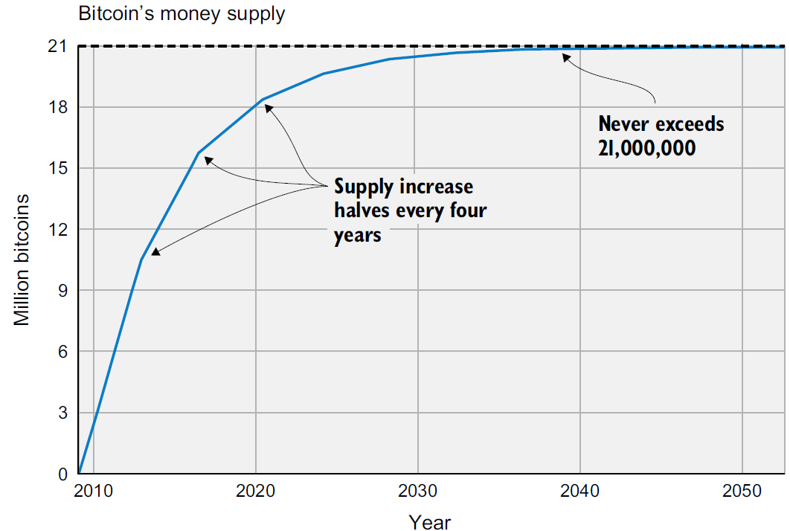
Fixed Supply
Bitcoin’s money supply won’t exceed 21 million bitcoins

Slide 7
Overview
In bitcoin, there are no coins, no senders, no recipients, no balances, no accounts, and no addresses.
All those things are constructed at a higher level for the benefit of the user, to make things easier to understand.

Slide 8
Overview
Alice creates and signs a transaction that moves 1 bitcoin from her to Bob. She then sends the transaction to the Bitcoin network.
The computers in the network—the Bitcoin nodes—check that Alice actually has the money to spend and that the transaction is authentic. They then pass the transaction to their neighbors, called peers.
Each computer updates its own copy of the Bitcoin blockchain, or the ledger, with the new payment information.
The network notifies Bob that he has received 1 bitcoin.

Slide 9
Overview
The block explorer application can show a transaction from e.g. Alice’s “address” to Bob’s “address.”
This is a much simplified view of what is contained in a transaction.
However what is shown in the explorer is constructed by the block explorer and is not actually in the transaction.
The high-level constructs we see in the various bitcoin application user interfaces do not actually exist in the bitcoin system

Slide 10
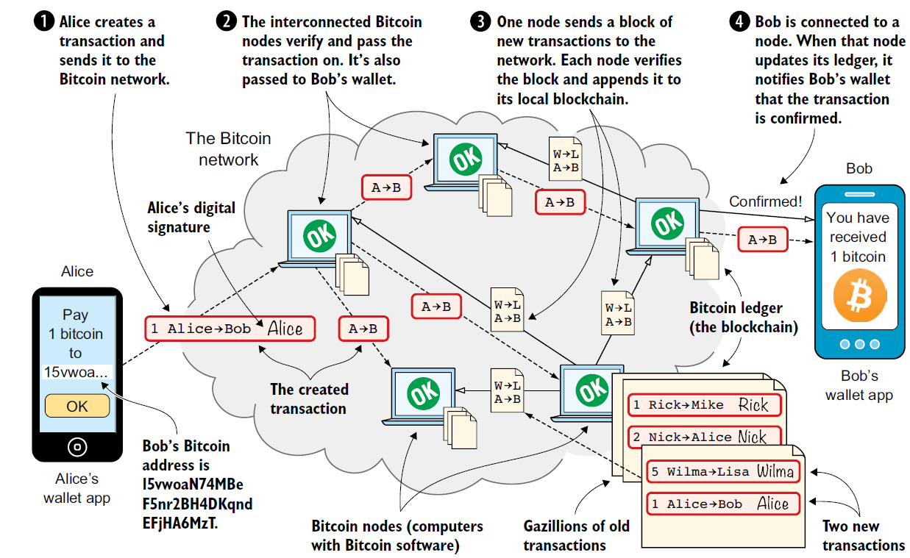

Slide 11
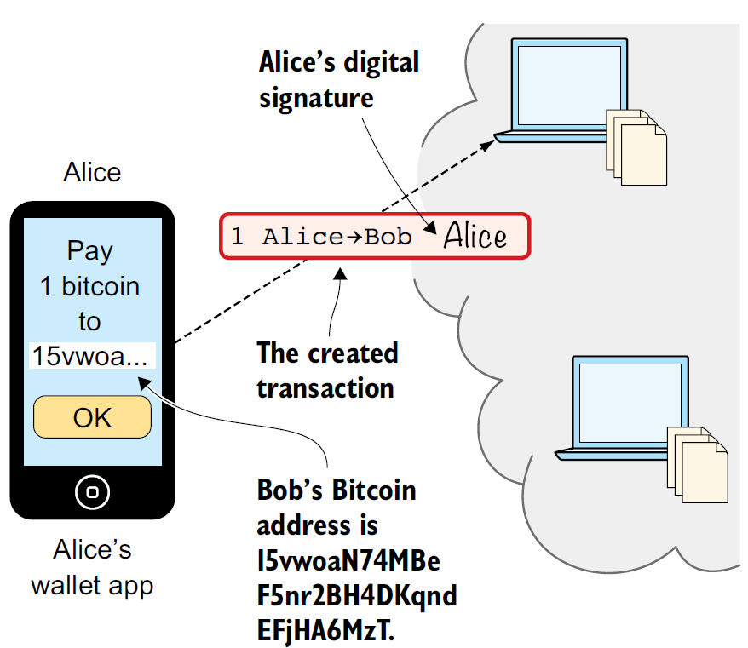
Step 1 Transactions
The Bitcoin transaction is a piece of data specifying The amount to move (1 bitcoin)
The Bitcoin address to move the money to (Bob’s Bitcoin address, 15vwoaN74MBeF5nr2BH4DKqndEFjHA6MzT)
A digital signature (made with Alice’s private key)
The digital signature is created from the transaction and a huge secret number, called a private key, that only Alice has access to.
The result is a digital signature that only the private key’s owner could have created.

Slide 12
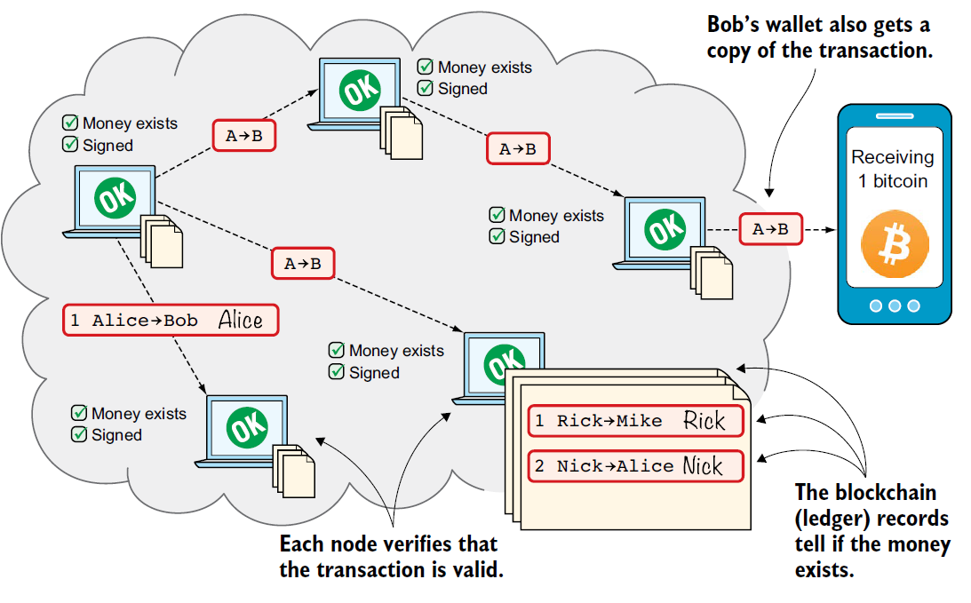
Step 2: Bitcoin Network

Slide 13
Step 2: Bitcoin Network
Each such node checks that the transaction is valid and passes it on to its peers.
It does this by consulting its local copy of the blockchain and verifying that
The bitcoin that Alice spends exists.
Alice’s digital signature is valid.

Slide 14
Step 2: Bitcoin Network
If all checks pass, a node forwards the transaction to its peers in the Bitcoin network.
This is known as relaying. Alice’s transaction will shortly have traveled the entire network while each node verifies it along the way

Slide 15
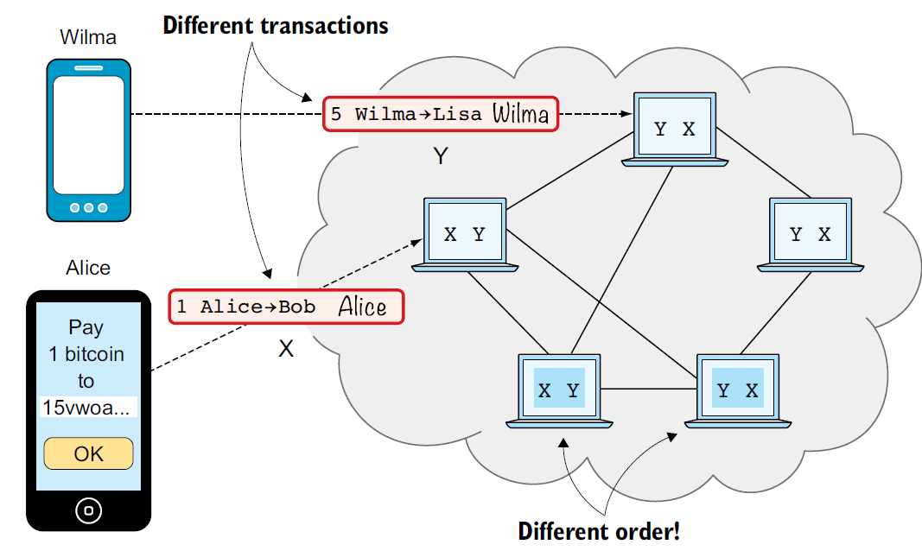
Step 3: Blockchain
Transactions arrive in different orders at different nodes, the different nodes would differ.

Slide 16
Step 3: Blockchain
To coordinate the ordering of transactions, one node takes the lead, saying “I want to add these two transactions to the blockchain in the order Y, X!”
This message is sent out on the network by that leader and copied by all

Slide 17
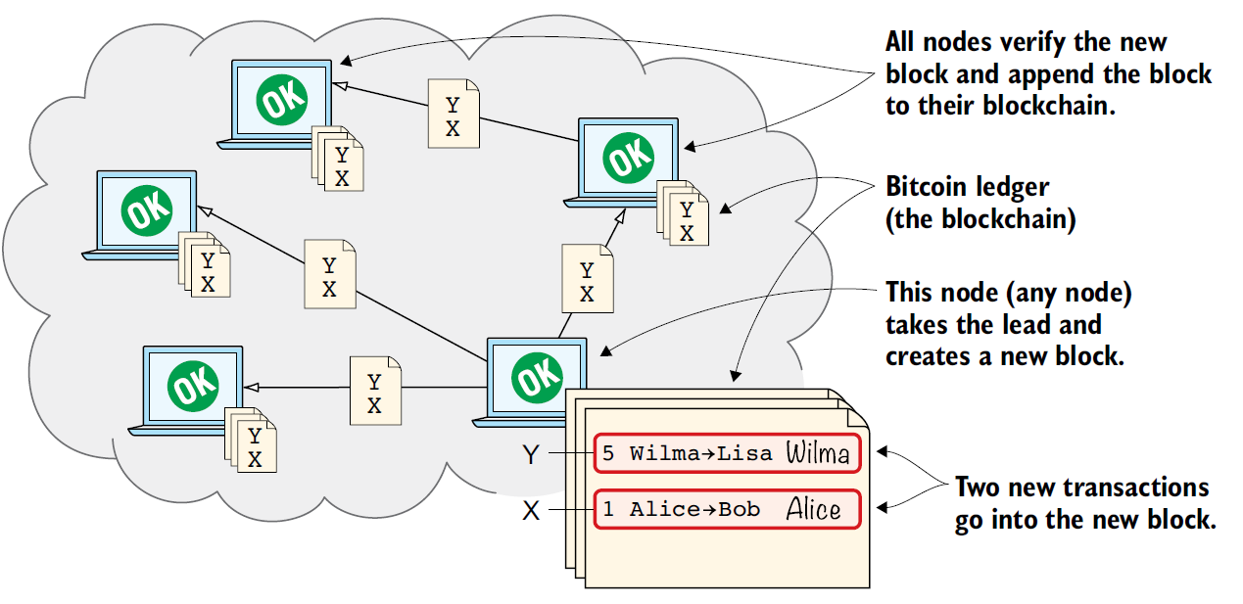

Slide 18
Step 3: Blockchain
As nodes see this block, they update their copy of the blockchain according to the message and pass the block on to their peers. Alice’s transaction was one of the transactions in the block and is now part of the blockchain.
The node that takes the lead is rewarded with newly minted bitcoins and transaction fees paid by the transactions it includes in the block.

Slide 19
Step 4: Wallets
Bob’s wallet is connected to some of the nodes in the Bitcoin network. When a transaction concerning Bob is added to the blockchain, the nodes that Bob’s wallet is connected to will notify Bob’s wallet.
The wallet will then display a message to Bob that he received 1 bitcoin. Alice also uses

Slide 20
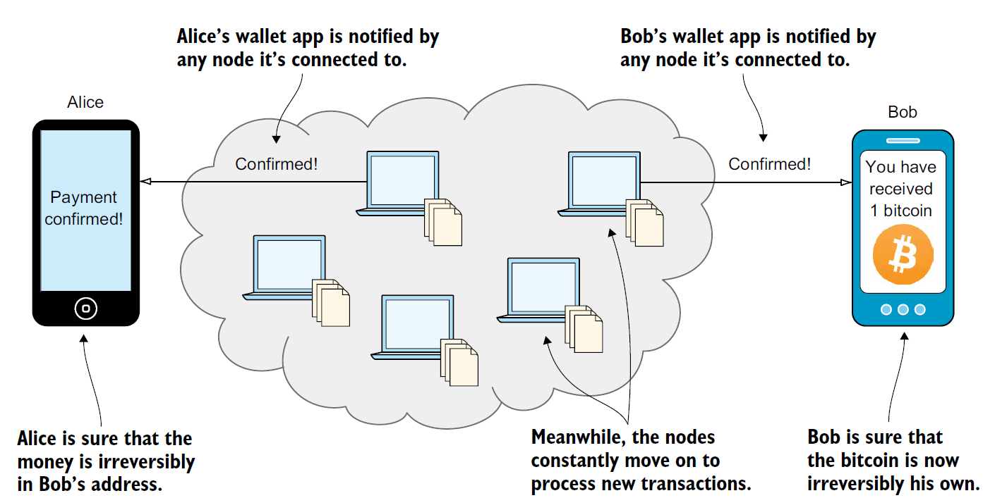

Slide 21
Transaction output
The fundamental building block of a bitcoin transaction is a transaction output.
Transaction outputs are indivisible chunks of bitcoin currency, recorded on the blockchain, and recognized as valid by the entire network.
Bitcoin full nodes track all available and spendable outputs, known as unspent transaction outputs, or UTXO.

Slide 22
Wallet and UXTO
When we say that a user’s wallet has “received” bitcoin, what we mean is that the wallet has detected a UTXO that can be spent with one of the keys controlled by that wallet.
Thus, a user’s bitcoin “balance” is the sum of all UTXO that user’s wallet can spend and which may be scattered among hundreds of transactions and hundreds of blocks.
The concept of a balance is created by the wallet application

Slide 23
Wallet and UXTO
The wallet calculates the user’s balance by scanning the blockchain and aggregating the value of any UTXO the wallet can spend with the keys it controls.
Most wallets maintain a database or use a database service to store a quick reference set of all the UTXO they can spend with the keys they control.

Slide 24
UXTO
UTXO are the outputs of a transaction that have not been spent. they represent all the bitcoins that are available to be spent - they are all bitcoins that are in circulation.
A UTXO is the amount of digital currency remaining after a cryptocurrency transaction is executed.
An output can have any arbitrary value, once created it is indivisible – up to 8 decimal points (called a satoshi)
This is an important characteristic of outputs that needs to be emphasized: outputs are discrete and indivisible units of value, denominated in integer satoshis.

Slide 25
UXTO
Transactions move value from transaction inputs to transaction outputs.
UXTO is an unspent output that can only be consumed in its entirety by a transaction.

Slide 26
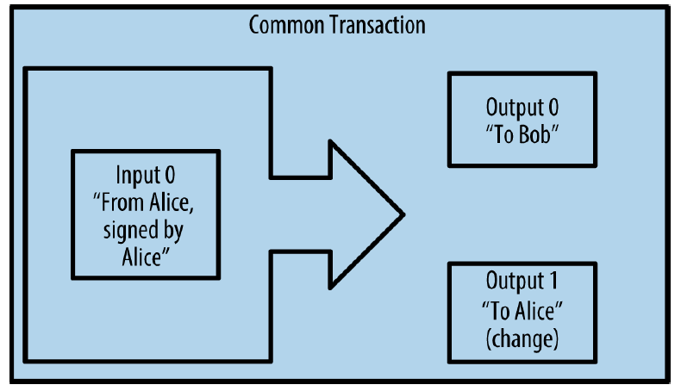
Common Transaction Forms
The most common form of transaction is a simple payment from one address to another, which often includes some “change” returned to the original owner.
This type of transaction has one input and two outputs

Slide 27
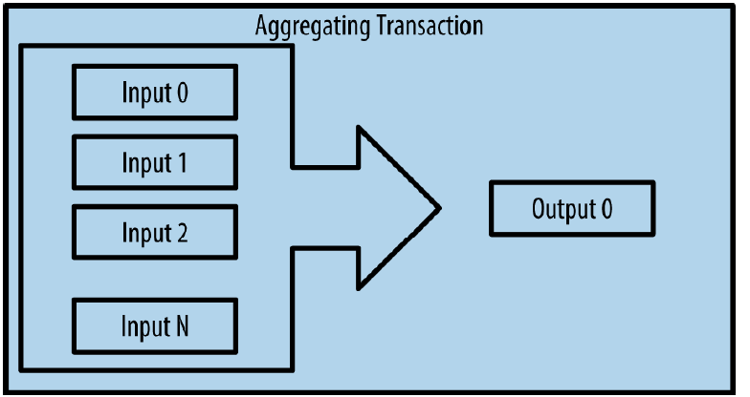
Common Transaction Forms
This represents the real-world equivalent of exchanging a pile of coins and currency notes for a single larger note

Slide 28
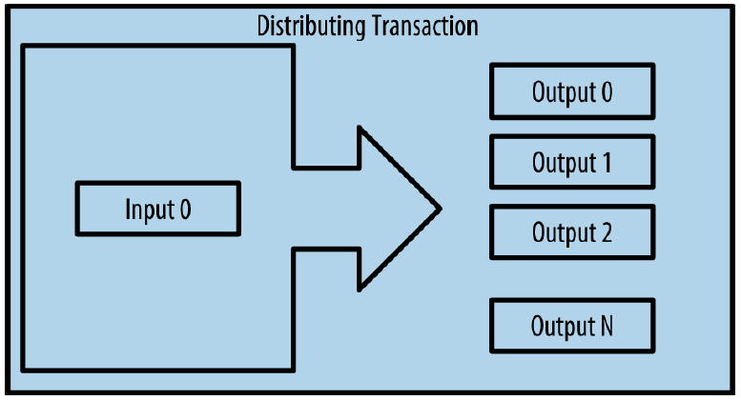
Common Transaction Forms
This type of transaction is sometimes used by commercial entities to distribute funds, such as when processing payroll payments to multiple employees

Slide 29
UXTO
If an UTXO is larger than the desired value of a transaction, it must still be consumed in its entirety and change must be generated in the transaction.
In other words, if you have a UTXO worth 20 bitcoin and want to pay only 1 bitcoin, your transaction must consume the entire 20-bitcoin UTXO and produce two outputs: one paying 1 bitcoin to your desired recipient and another paying 19 bitcoin in change back to your wallet.
As a result of the indivisible nature of transaction outputs, most bitcoin transactions will have to generate change.

Slide 30
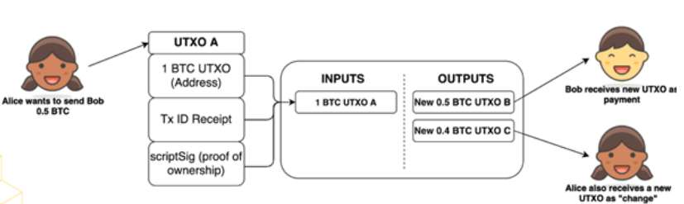
UXTO

Slide 31
Coinbase
The exception to the UXTO output and input chain is a special type of transaction called the coinbase transaction
This transaction is placed there by the “winning” miner and creates brand-new bitcoin payable to that miner as a reward for mining.
This special coinbase transaction does not consume UTXO
It has a special type of input called the “coinbase.” This is how bitcoin’s money supply is created during the mining process

Slide 32
Simplified Model
Suppose the ledger stores the transactions in this manner:
Does Alice have the 15 coins that she’s trying to transfer to David?
Create 25 coins and credit to Alice_{ASSERTED_BY_MINERS}
Transfer 17 coins from Alice to Bob_{SIGNED(ALICE)}
Transfer 8 coins from Bob to Carol_{SIGNED(BOB)}
Transfer 5 coins from Carol to Alice_{SIGNED(CAROL)}
Transfer 15 coins from Alice to David_{SIGNED(ALICE}

Slide 33
Simplified Model
To figure this out, you’d have to track every transaction affecting Alice back in time to determine whether her net balance when she tries to transfer 15 coins to David is greater than 15 coins.
This would require extra house keeping

Slide 34
Simplified Model
Because of these drawbacks, Bitcoin doesn’t use an account-based model.
Bitcoin uses a ledger that just keeps track of transactions as inputs and outputs
You can think of the inputs as coins being consumed (created in a previous transaction) and the outputs as coins being created.
Each transaction has a unique identifier. Outputs are indexed beginning with 0, so we refer to the first output as “output 0.”

Slide 35
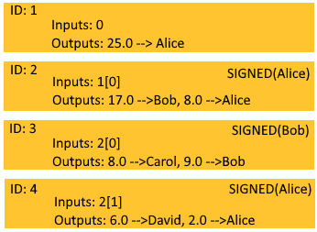
Transaction based Ledger
We have 4 UXTO transactions here each with an id.
Transaction 1 has no inputs because this transaction creates new coins that goes to Alice. This is a coinbase transaction from a mining operation, so no signature required.

Slide 36
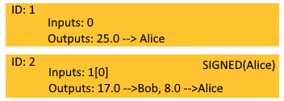
Transaction based Ledger
In transaction 2 Alice send some coins to Bob.
The transaction has to refer to the previous transaction id and output as the source of the coins.
Alice’s transaction also specifies 2 outputs: 17 coins to Bob and 8 coins to Alice (as change).

Slide 37
Transaction based Ledger
Change addresses are used because transaction output must be utilized as whole, you can’t subdivide it.

Slide 38
Transaction based Ledger
To check that Alice has the amount to spend, we only need to lookup the transaction output that was referred to.
In this case Transaction 1 output 0.
We don’t need to scan for all the transactions from beginning.

Slide 39
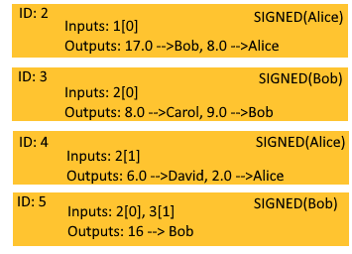
Transaction based Ledger
Transaction 5: Bob consolidating two transactions into 1 output is actually not valid!!

Slide 40
Double Spending
it’s easy to enforce a no-double-spending rule by looking up the previous transaction output in the UTXO set.
If the input of a new transaction is using a transaction output that’s not in the UTXO set, that’s an attempt at a double-spend or a nonexistent output and thus invalid

Slide 41
Bitcoin Scripts
A transaction output can be redeemed by signing with the correct key.
The transaction output would specify that it can be redeemed by the signature from the owner of address X.
Recall the address is a hash of the public key.

Slide 42

Digital Signature: Recap
The message John wants to sign is, “Lisa, please move 10CT to Cafe. /John”. The signing function will hash this message with SHA256, whose output is a 256-bit number. This hash value is then encrypted with John’s private key. The result is a digital signature that looks like this:

Slide 43
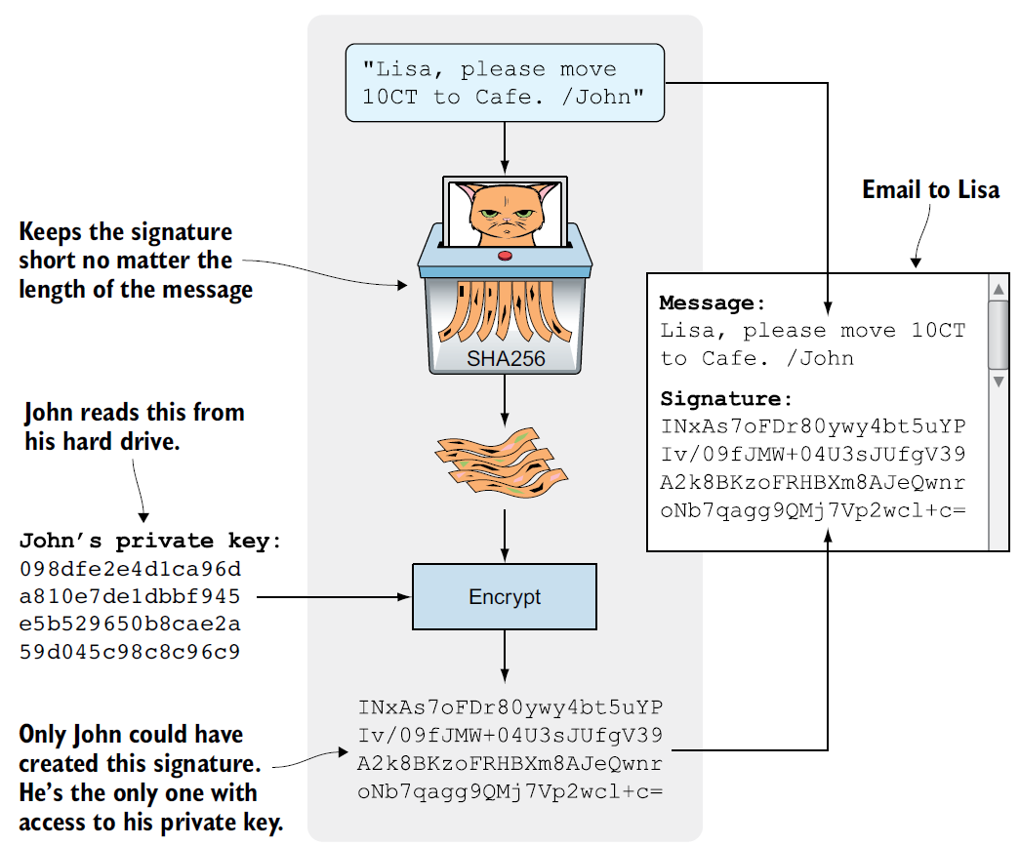

Slide 44
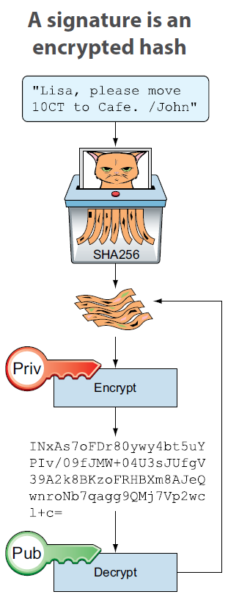
Digital Signature
A digital signature is an encrypted hash

Slide 45
Digital Signature: Recap
The digital signature is an private key encrypted hash of a message.
If John had used another private key to sign with or a slightly different message, the signature would have looked completely different

Slide 46
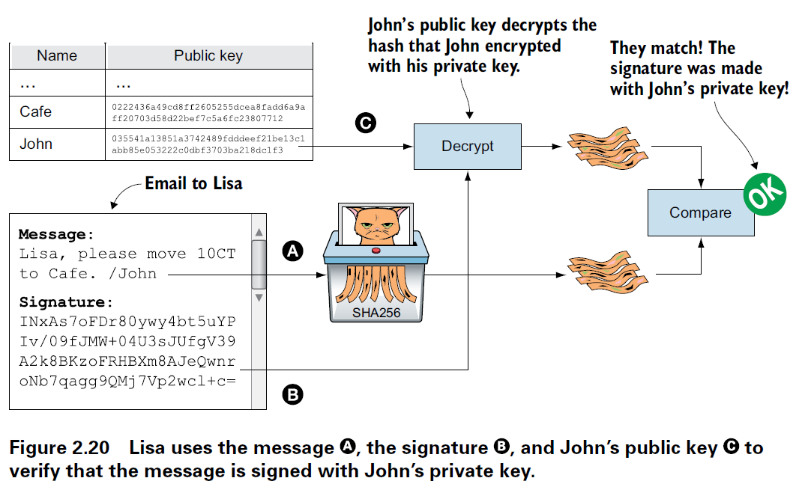

Slide 47
Digital Signature
A digital signature serves three purposes in bitcoin
The signature proves that the owner of the private key, who is by implication the owner of the funds, has authorized the spending of those funds.
The proof of authorization is undeniable called non-repudiation.
The signature proves that the transaction (or specific parts of the transaction) have not and cannot be modified by anyone after it has been signed.

Slide 48
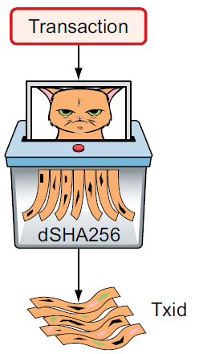
Transactions (again, with more details)
The transaction’s txid is its double SHA256 hash.
John’s wallet has created a new transaction. It has two inputs and two outputs.

Slide 49
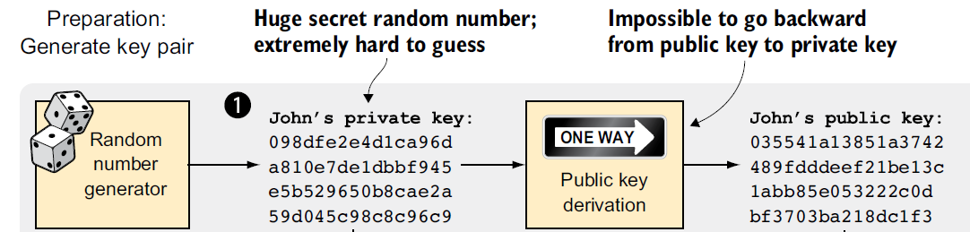
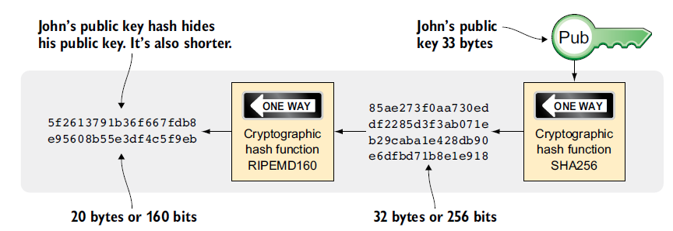


Public Key Hash (PKH)

Slide 50
Public Key Hash (PKH)
Actual Bitcoin addresses add a few more stages to this PKH.
A Bitcoin address is a converted PKH—that is, it’s a PKH written in a way more suitable for human users and safe against spelling errors.

Slide 51
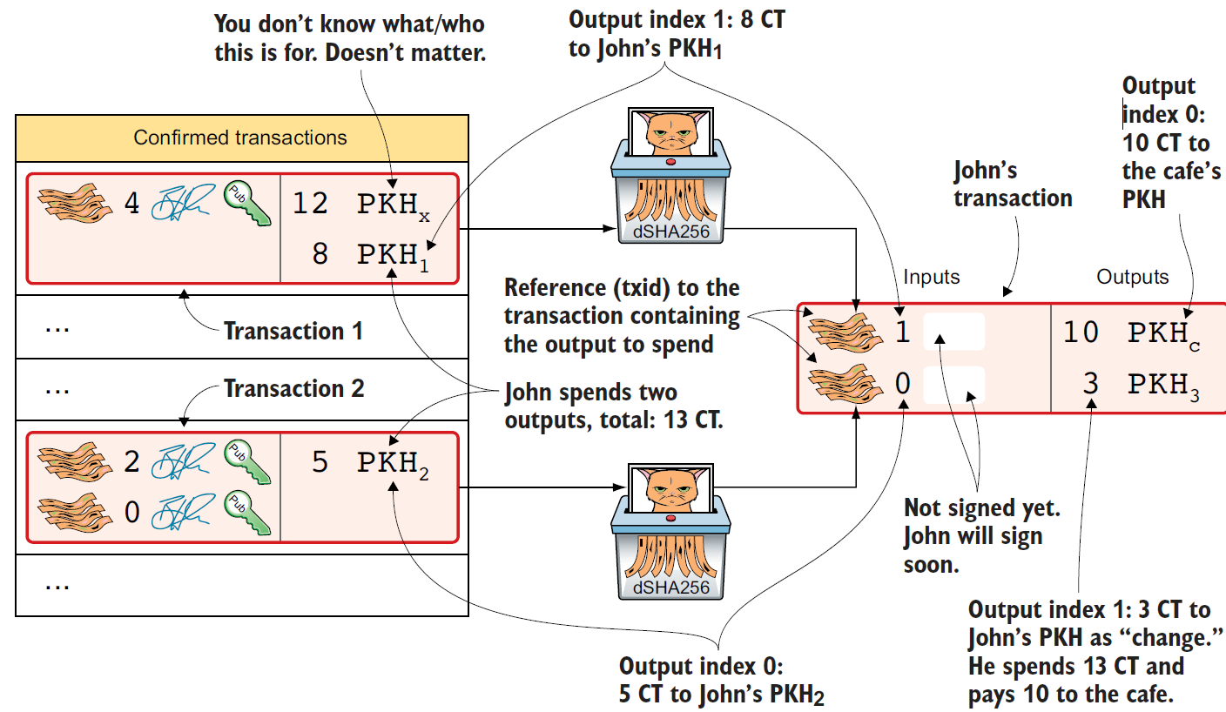
CT refers to the coin name
PKH refers to Public Key Hash which is the address.

Slide 52
Transaction Inputs
The inputs specify which transaction outputs to spend. John has two UTXOs, one with 8 CT and one with 5 CT.
The unspent outputs belong to two previous transactions, transaction 1 and transaction 2, that paid money to John. Now, John wants to spend these UTXOs.

Slide 53
Transaction Inputs Reference
A transaction input references a previous transaction using the previous transaction’s transaction ID (txid).
The transaction’s txid is its double SHA256 hash.
It’s called a transaction ID because this hash is often used to refer to the transaction

Slide 54
Transaction Output
A transaction output contains an amount and a PKH.
John’s transaction has two outputs.
The output at index 0 pays 10 CT to PKH_{C} – another recipient
The output at index 1 pays 3 CT back to one of John’s own keys, PKH₃.
In reality, the output contains a computer program that will verify the signature in the spending input.

Slide 55
Transactions (again, with more details)
The transaction is now created, but it isn’t yet signed. Anyone could have created this transaction because it’s based completely on public information
But only John will be able to sign this transaction, because only he has the private keys corresponding to PKH1 and PKH2.

Slide 56
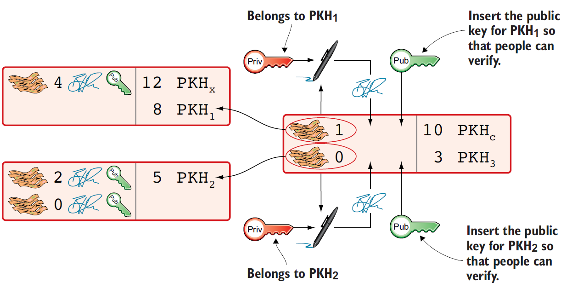
Transactions (again, with more details)

Slide 57
Signing the Transaction
John clicks OK in his wallet to approve signing the transaction.
The wallet now needs to make two signatures, one for PKH1 and one for PKH2.
This is because John must prove he has both the private key for PKH1 and the private key for PKH2.
Because the PKH can only be generated from the private/public key.

Slide 58
Signing the Transaction
Each input needs to be signed individually.
The private key corresponding to PKH1 must be used to sign the input at index 0 because that input spends money addressed to PKH1.
Similarly, the private key corresponding to PKH2 must be used for the signature of the input at index 1 because it spends money addressed to PKH2.

Slide 59
Signing the Transaction
John’s wallet must explicitly add the corresponding public key to the input so that others can verify them.
The signature in input 0 that spends money from PKH1 needs to be verified with the public key from which PKH1 was generated.
Similarly, input 1 gets the public key corresponding to PKH2

Slide 60
Signing the Transaction
Each signature will commit to the entire transaction, which means the signing algorithm will hash the entire transaction, excluding signatures.
If anything changes in the transaction, any signature made for this transaction will become invalid

Slide 61
Confirming the Transaction
Need to Check the Following:
The transaction spends outputs of transactions that actually exist in the blockchain and that they aren’t already spent by some other transaction.
The total value of the transaction outputs doesn’t exceed the total value of the transaction inputs. Otherwise, the transaction would create new money out of thin air.
The signatures are correct.

Slide 62
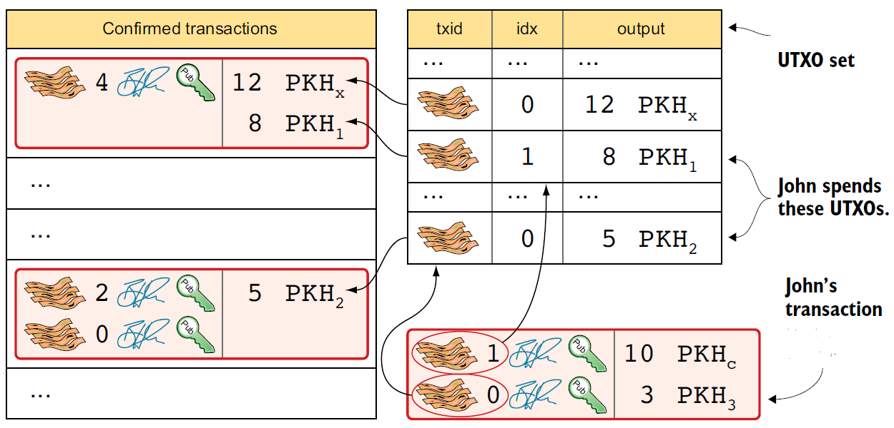
Check output of a transaction is unspent

Slide 63
Checking UXTO
The entire UXTO set is consulted and referenced against the current UXTO (John’s transaction)
For each input in John’s transaction, check if all spent outputs are present in the UTXO set
Then no double-spend attempt or spending of nonexistent coins is detected.

Slide 64
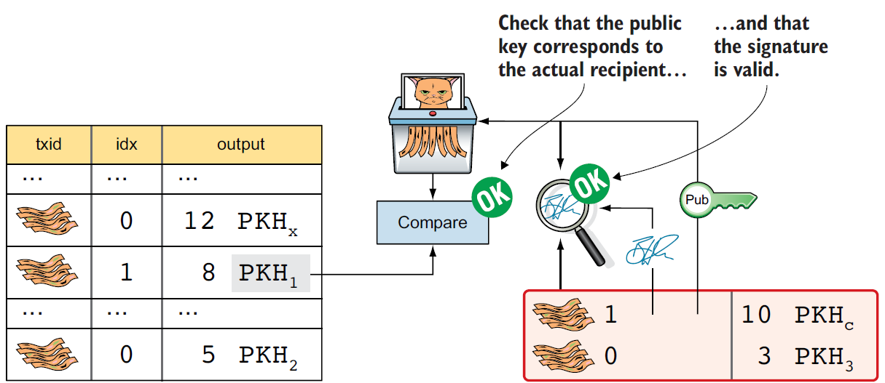
Checking Signature

Slide 65
Checking Signature
The PKH from the first input is checked against the hash of the public key in the transaction.
The signature in the input is verified using the public key.

Slide 66
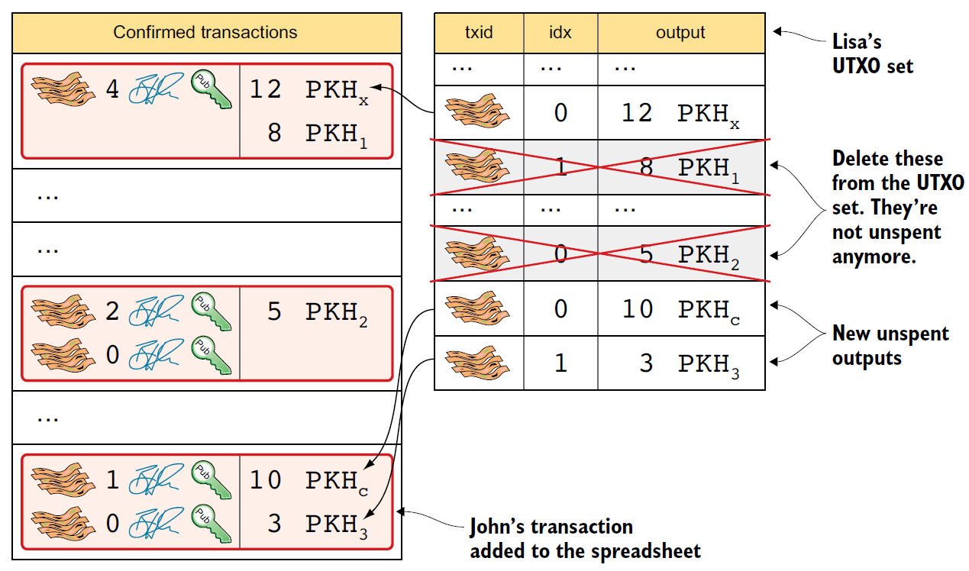
Remove spent UXTO

Slide 67
Anyone can verify
As the transactions are store in the blockchain, anyone can verify it by re-creating a UXTO set and work through all transactions.
These verifiers are full nodes.

Slide 68
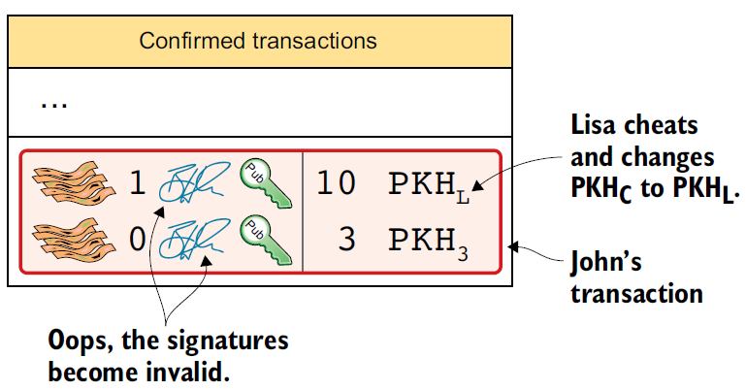
Fraud

