Slide 1
Transaction Scripts
Loke k.s.

Slide 2
Plan
Lectures on Scripts and Transactions
Scripts.docx – hands-on Script simulator
Role-play
Quiz

Slide 3
Reference
Grokking Bitcoin, Kalle Rosenbaum, Manning Books, 2019.
Mastering Bitcoin, Andreas M. Antonopoulos, O’Reilly, 2017
https://learnmeabitcoin.com/technical/
http://royalforkblog.github.io/2014/11/20/txn-demo/
https://developer.bitcoin.org/devguide/transactions.html

Slide 4
Transactions
Bitcoin transactions are a bit like bank checks.
Bank checks display a bank account number, which reveals where the about-to-be-transferred funds come from, they have a “payee” field, which identifies the recipient of the transferred funds, and they have a signature

Slide 5
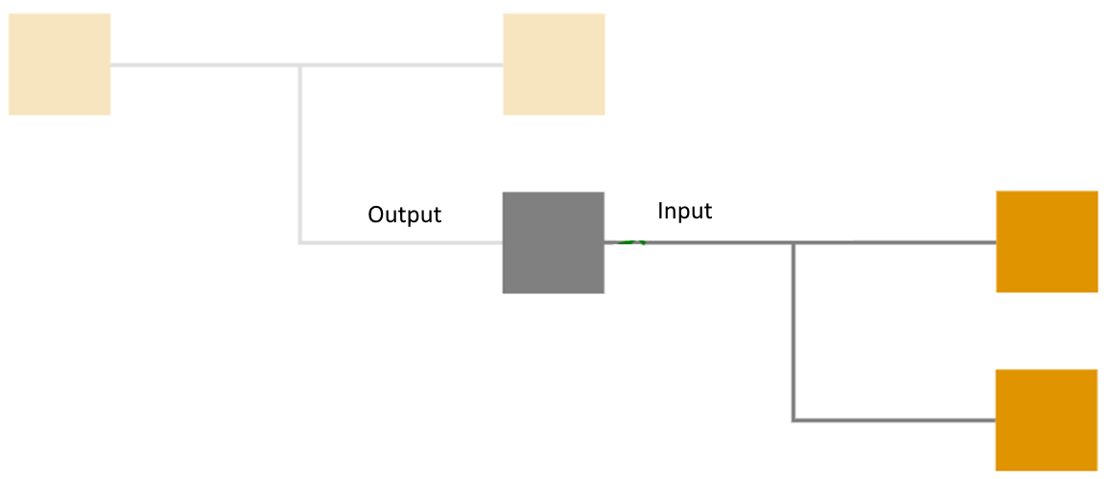
Transactions
Bitcoin transactions are composed of 2 lists:
a list of “outputs”, each output says:
how much bitcoin is transferred
who receives the bitcoin transfer
a list of “inputs”, each input includes:
a reference to a past output
a “signature” which proves the transaction creator is authorized to spend that output

Slide 6
Transaction Scripts
A transaction also contain a computer program called Script
Script is simple, stack-based, and processed from left to right. It is intentionally not Turing-complete, with no loops.
A script is essentially a list of instructions recorded with each transaction that describe how the next person wanting to spend the Bitcoins being transferred can gain access to them
The script contains instructions on how to verify that the spending is authentic. If the program runs and terminates with TRUE, then the transaction is authentic.

Slide 7
Transaction Scripts
Using a programming language, Script, in the transactions makes them very flexible.
If the transactions didn’t use a programming language, all use cases would have to be invented up front.
The ability to write a computer program inside a transaction is useful for various use cases.
Script language lets people come up with new use cases

Slide 8
Transaction Scripts
Script is a mini programming language used as a locking mechanism for outputs.
A locking script is placed on every output.
An unlocking script must be provided to unlock an output (i.e. when you’re using it as an input).
If a full script (unlocking + locking) is valid, the output is “unlocked” and can be spent.
When a node receives the spending transaction, it will combine both of these scripts together and run them

Slide 9
Transaction Scripts
Script is a very basic programming language. It consists of two types of things:
Data - For example; public keys and signatures.
OPCODES - Simple code operations that operate on the data.
A locking script is placed on every output you create in a transaction
An unlocking script must be provided for every input you want to spend in a transaction
An unlocking script is a script that “solves,” or satisfies, the conditions placed on an output by a locking script and allows the output to be spent

Slide 10
Transaction Scripts
Every bitcoin validating node will validate transactions by executing the locking and unlocking scripts together.
Each input contains an unlocking script and refers to a previously existing UTXO.
The validation software will copy the unlocking script, retrieve the UTXO referenced by the input, and copy the locking script from that UTXO.
The unlocking and locking script are then executed in sequence. The input is valid if the unlocking script satisfies the locking script conditions

Slide 11
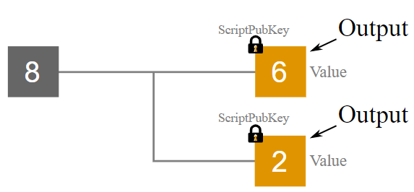
Transaction Outputs
Outputs are packages of bitcoins created in a bitcoin transaction.
Each output has a lock, which means that they can only be used as an inputs in a future transaction by people who can unlock them.
ScriptPubKey is a script that locks the output. These locking scripts prevent other people from using these outputs as inputs in another transaction (i.e. spending them).

Slide 12
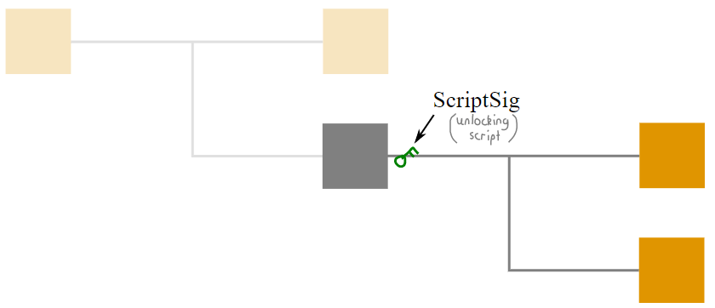
Transaction Inputs
An input is what you call an output when you’re spending it in a transaction.
An input connects to outputs with an unlocking script called ScriptSig
if an unlocking script that satisfies the locking script is provided, the transaction will be accepted.

Slide 13
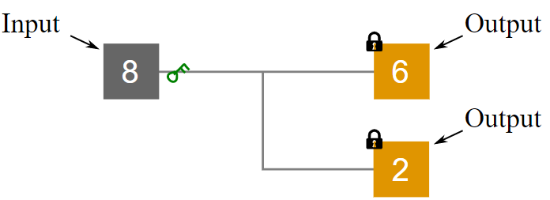
Transaction Script
Inputs: TXID, VOUT, ScriptSig (unlocking script)
Outputs: Value, ScriptPubKey (locking script)

Slide 14
Script
The scriptPubKey part of the program stipulates exactly what the spending transaction needs to provide to spend the output. The only way to spend an output is to provide a signature script that makes the program finish with an TRUE on top of the stack.
In previous example, the only acceptable signature script is a valid signature followed by the public key corresponding to the PKH in the pubkey script.
You can create different types of locks with different combinations of OPCODES.

Slide 15
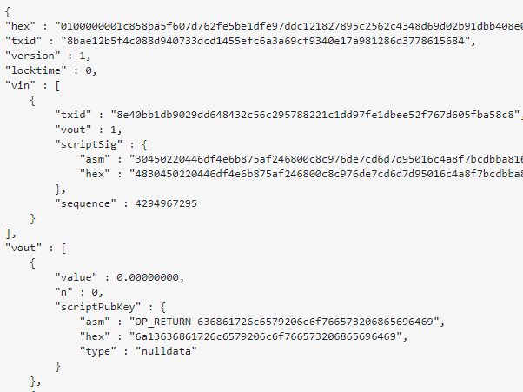
Raw Transaction

Slide 16
Terminating conditions
Transactions are valid if the top result on the stack is TRUE (noted as {0x01}), any other nonzero value, or if the stack is empty after script execution.
Transactions are invalid if the top value on the stack is FALSE (a zero-length empty value, noted as {})

Slide 17
Script Execution
Bitcoin’s scripting language is called a stack-based language because it uses a data structure called a stack.
A stack allows two operations: push and pop.
Push adds an item on top of the stack.
Pop removes the top item from the stack.
Operations on a stack can only act on the topmost item

Slide 18
Script Execution
The scripting language executes the script by processing each item from left to right.
Numbers (data constants) are pushed onto the stack. Operators push or pop one or more parameters from the stack, act on them, and might push a result onto the stack.
For example, OP_ADD will pop two items from the stack, add them, and push the resulting sum onto the stack.

Slide 19
Script Execution
The script contain opcodes which are instructions, example:
OP_DUP
OP_ADD
OP_SUB
OP_MUL
OP_DUP: duplicates the data on the top of the stack
OP_HASH160: computes the hash of the data on the top of the stack and replace it with the result
OP_EQUALVERIFY: verifies if the first two data on the top of the stack are equals. If so, these two data are removed
OP_CHECKSIG: checks the digital signature using the public key and returns true or false whether the signature verifies or not
Opcode reference: https://en.bitcoin.it/wiki/Script

Slide 20
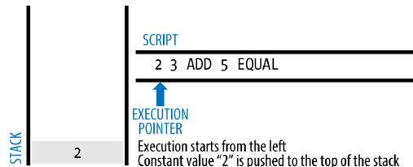
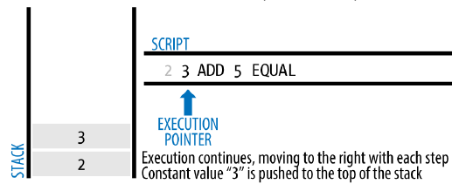
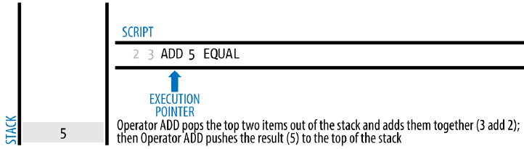
Sample Script

Slide 21
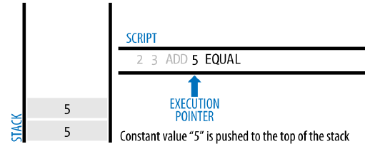
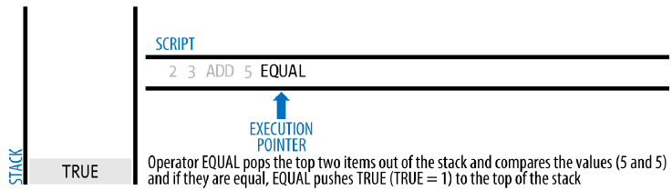
Sample Script

Slide 22
Try This
2 7 OP_ADD 3 OP_SUB 1 OP_ADD 7 OP_EQUAL
Try validating the preceding script yourself using pencil and paper. When the script execution ends, you should be left with the value TRUE on the stack.
The OP_ADD, OP_SUB and OP_EQUAL operate on the two data at the top of the stack

Slide 23
Simple Locking Script
Use part of the previous arithmetic example script as the locking script:
3 OP_ADD 5 OP_EQUAL
which can be satisfied by a transaction containing an input with the unlocking script:
2
The validation software combines the locking and unlocking scripts and the resulting script is:
2 3 OP_ADD 5 OP_EQUAL
when this script is executed, the result is OP_TRUE, making the transaction valid.

Slide 24
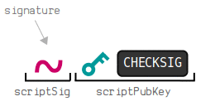
Pay to Pubkey (P2PK)
P2PK (Pay To Pubkey) is a script pattern that locks an output to a public key.
ScriptPubKey: is a lock just contains a public key and a CHECKSIG opcode. They are instructions to be followed to unlock.
ScriptSig : contains a valid signature for unlocking
The output is unlocked when the public key matches the signature

Slide 25
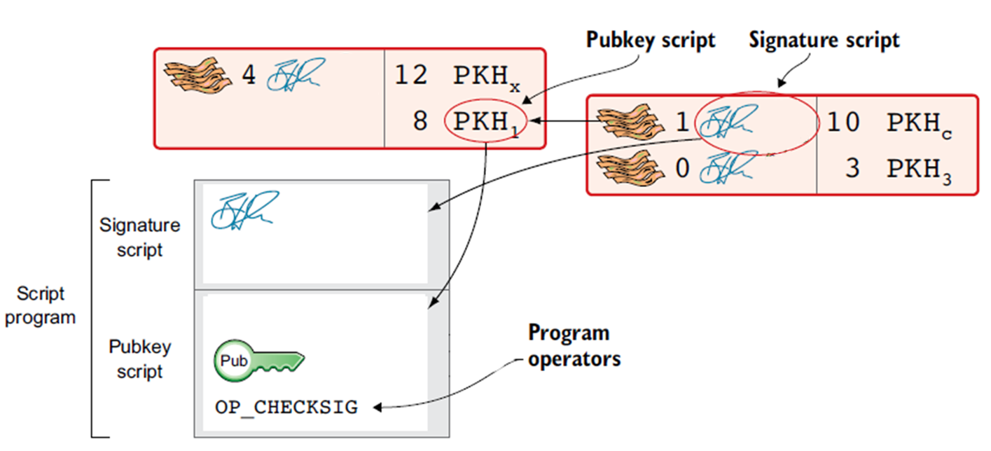
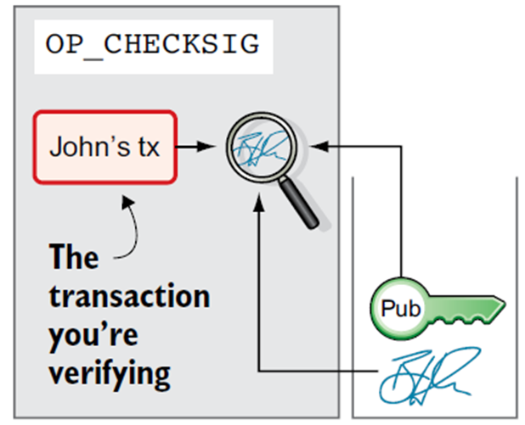
Pay to Pubkey (P2PK)

Slide 26
Pay to Pubkey (P2PK)

Slide 27
Pay to Pubkey (P2PK)
When the script runs, the CHECKSIG opcode compares the signature against the public key, and pushes a 1 on to the stack if it is valid.

Slide 28
To Verify Signature
To verify the signature, one must have the signature, the serialized transaction, and the public key (that corresponds to the private key used to create the signature).
Essentially, verification of a signature means “Only the owner of the private key that generated this public key could have produced this signature on this transaction.”
The signature verification algorithm takes the message (a hash of the transaction or parts of it), the signer’s public key and the signature
It returns TRUE if the signature is valid for this message and public key.

Slide 29
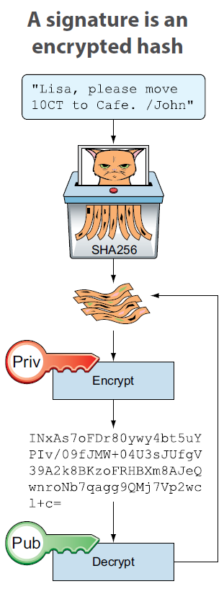
Digital Signature
A digital signature is an encrypted hash

Slide 30
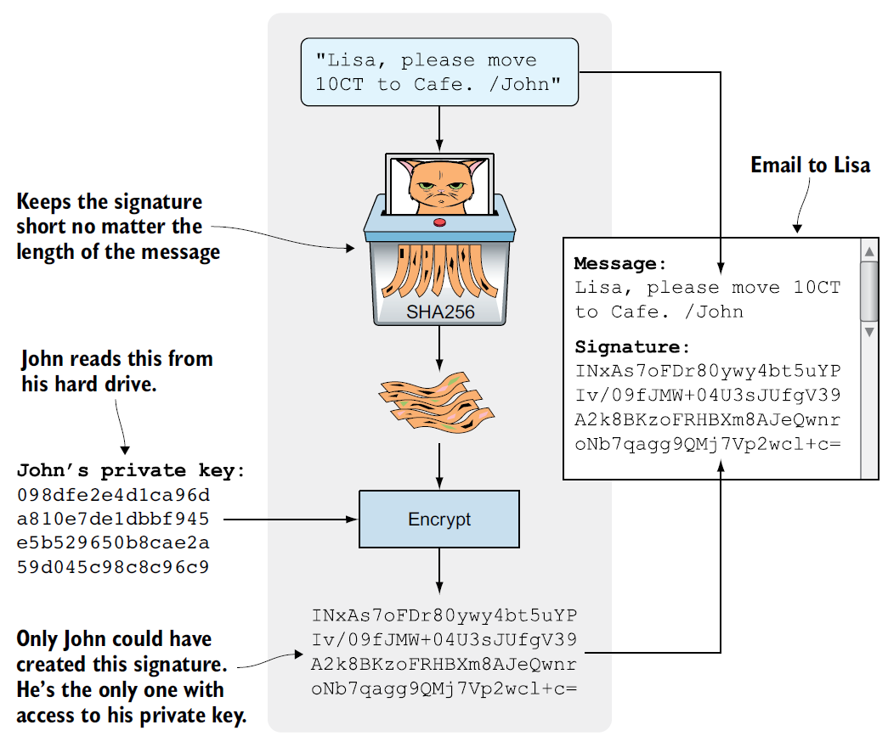

Slide 31
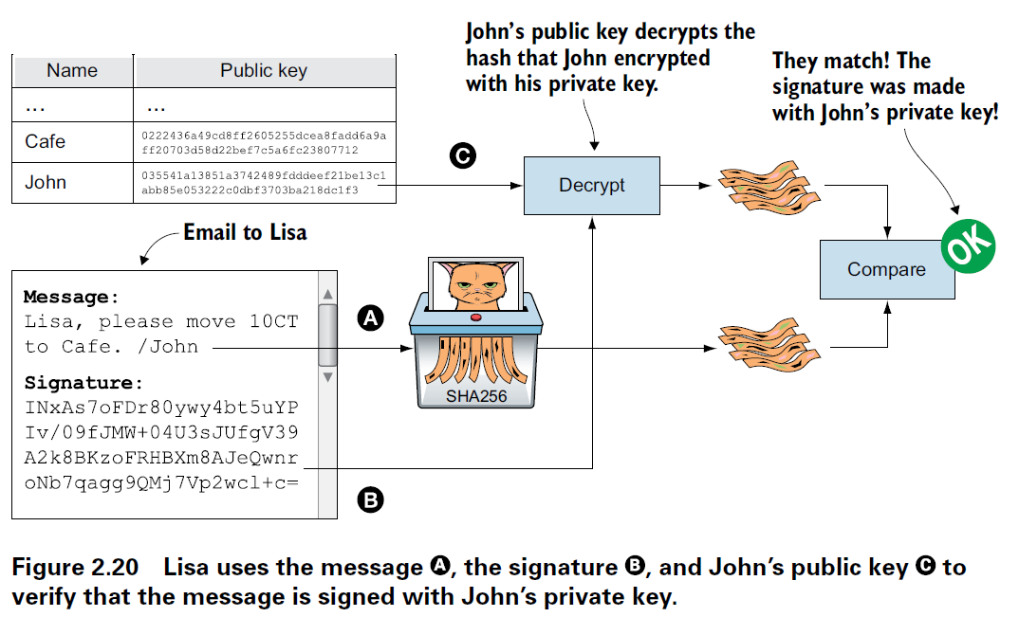

Slide 32
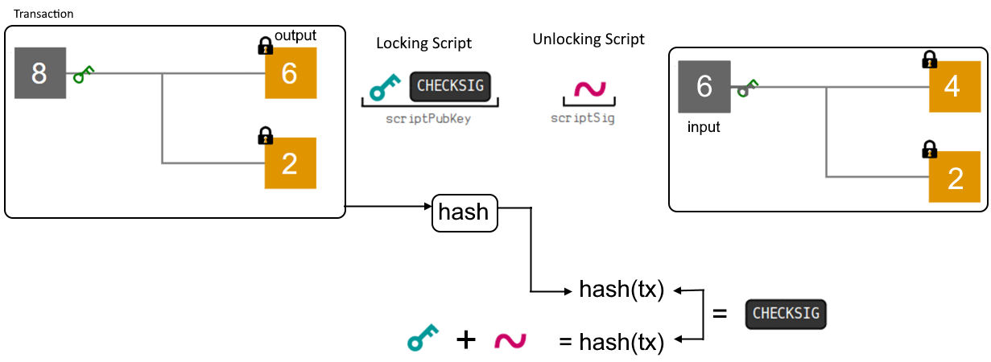
Pay to Pubkey (P2PK)

Slide 33
Pay-to-Public-Key-Hash (P2PKH)
The vast majority of transactions processed on the bitcoin network spend outputs locked with a Pay-to-Public-Key-Hash or “P2PKH” script. This hides the public key with its hash.
These outputs contain a locking script that locks the output to a public key hash, more commonly known as a bitcoin address.
An output locked by a P2PKH script can be unlocked (spent) by presenting a public key and a digital signature created by the corresponding private key
Every time you send bitcoins to an address that starts with a 1 you are creating a P2PKH locking script.

Slide 34
Pay-to-Public-Key-Hash (P2PKH)
OP_DUP — duplicates the top item in the stack,
OP_HASH160 — hashes top-most item on the stack twice — once with SHA-256 and then with RIPEMD-160,
OP_EQUALVERIFY — takes two top-most items on the stack and checks if they are equal, if not the entire script execution fails,
OP_CHECKSIG — verifies if the current transaction is signed by the correct key (the private key that corresponds to the public key that was hashed earlier).

Slide 35
Pay-to-Public-Key-Hash (P2PKH)
This is the default locking script used when you make a standard bitcoin transaction

Slide 36
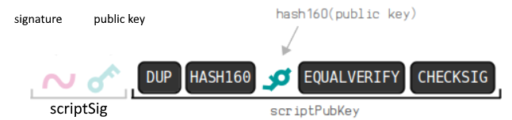
Pay-to-Public-Key-Hash (P2PKH)
When executed, this combined script will evaluate to TRUE if, and only if, the unlocking script matches the conditions set by the locking script.
In other words, the result will be TRUE if the unlocking script has a valid signature from the private key that corresponds to the public key hash set

Slide 37
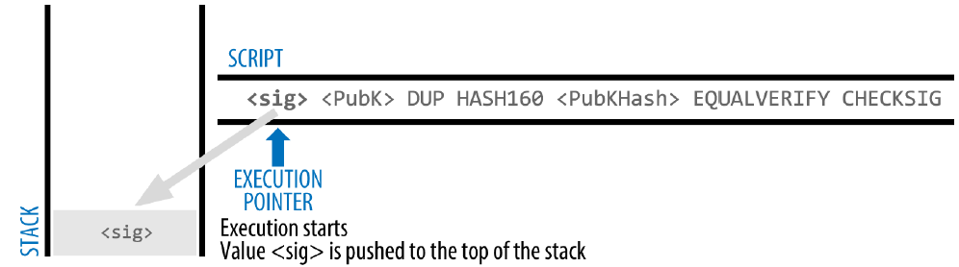
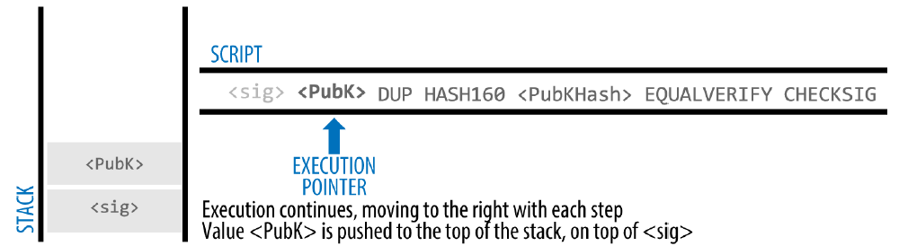
Pay-to-Public-Key-Hash (P2PKH)

Slide 38
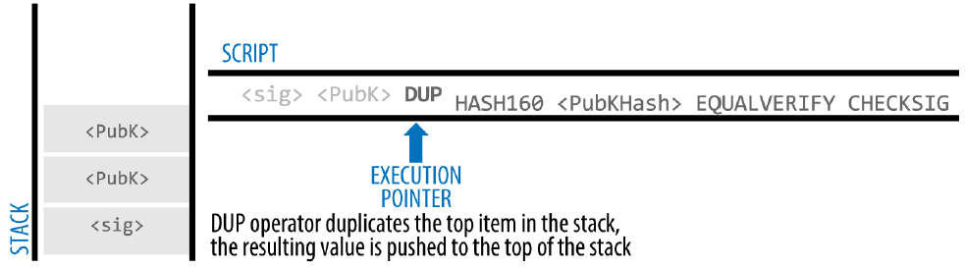
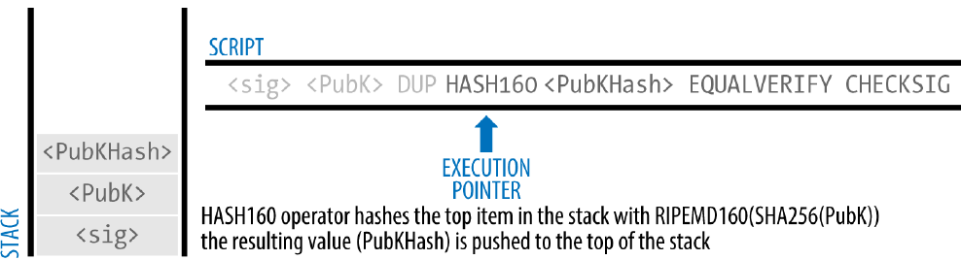
Pay-to-Public-Key-Hash (P2PKH)

Slide 39
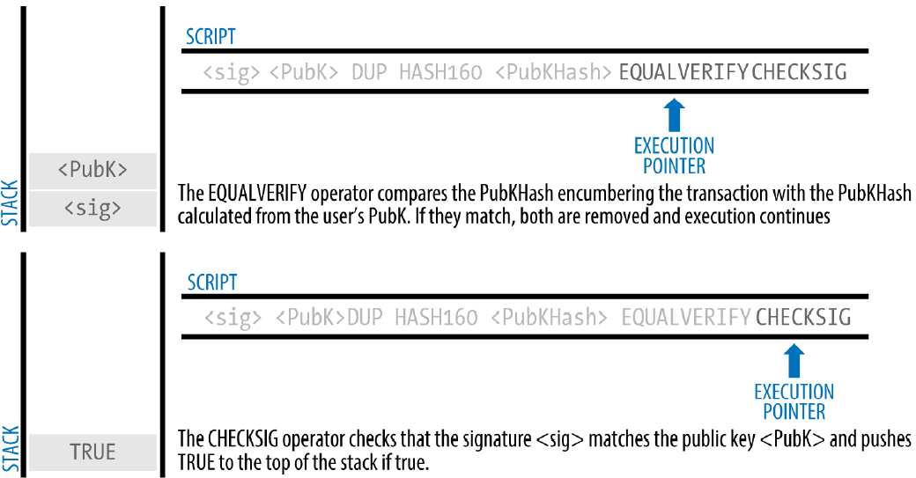
Pay-to-Public-Key-Hash (P2PKH)

Slide 40
Pay-to-Public-Key-Hash (P2PKH)

Slide 41
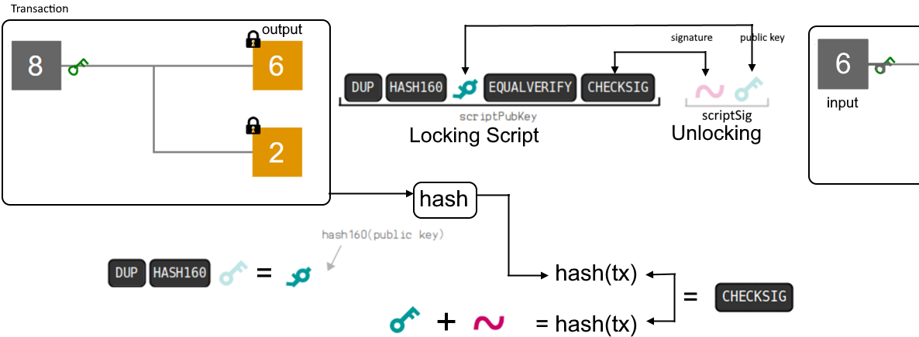
Pay-to-Public-Key-Hash (P2PKH)

Slide 42
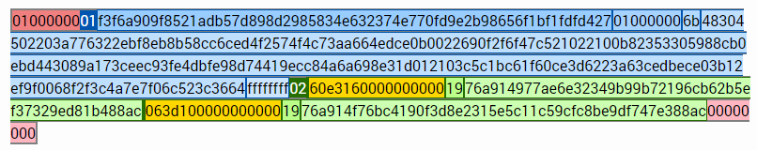
P2PKH - Example
Transaction ID
http://royalforkblog.github.io/2014/11/20/txn-demo/

Slide 43
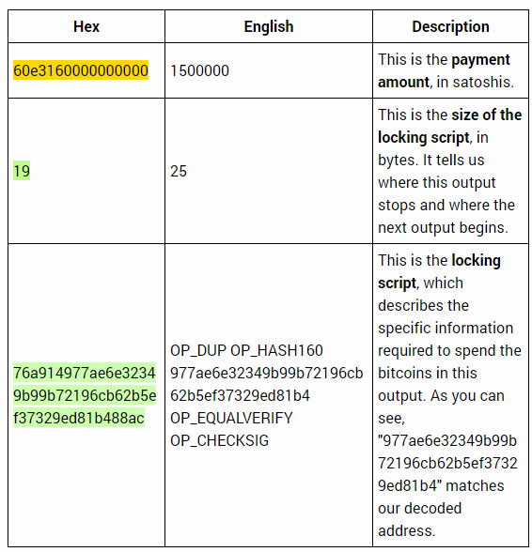


P2PKH - Example

Slide 44
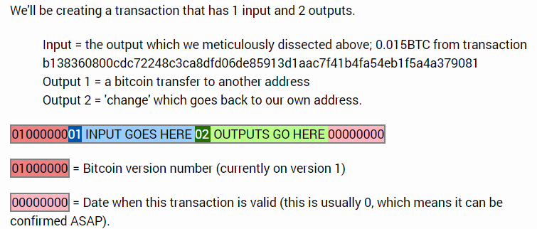
P2PKH – Example – Create a new transaction

Slide 45
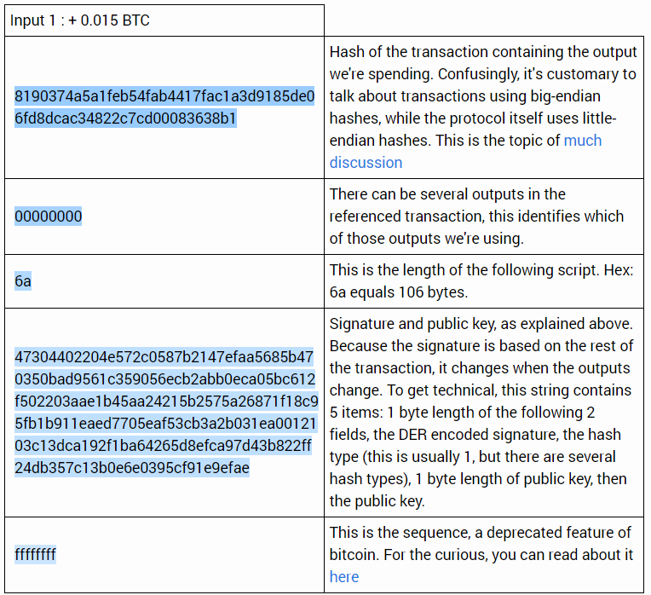
P2PKH

Slide 46
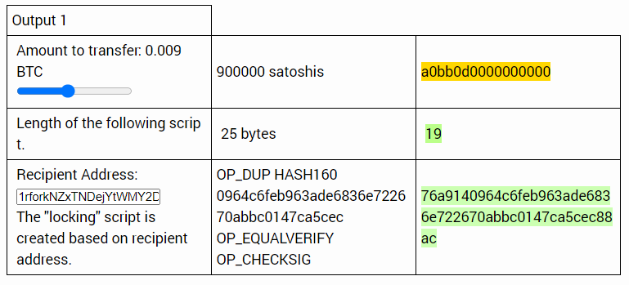
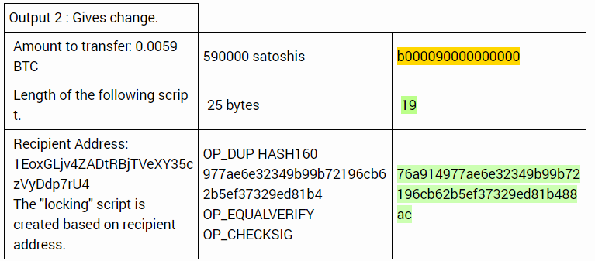
P2PKH

Slide 47
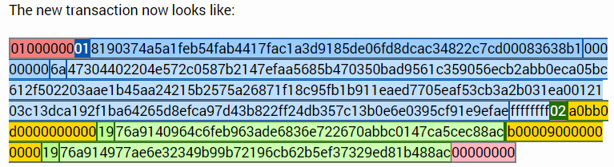
P2PKH

Slide 48
Multisignature
Multisignature scripts set a condition where N public keys are recorded in the script and at least M of those must provide signatures to unlock the funds.
This is also known as an M-of-N scheme, where N is the total number of keys and M is the threshold of signatures required for validation.
For example, a 2-of-3 multisignature is one where three public keys are listed as potential signers and at least two of those must be used to create signatures for a valid transaction to spend the funds.

Slide 49
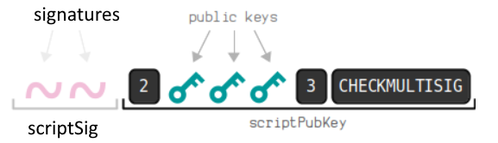
Pay to Multisig - P2MS
P2MS is a script pattern that allows you to lock bitcoins to multiple public keys, and require signatures for some (or all) of those public keys to unlock it.

Slide 50
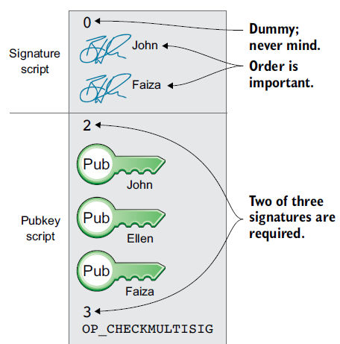
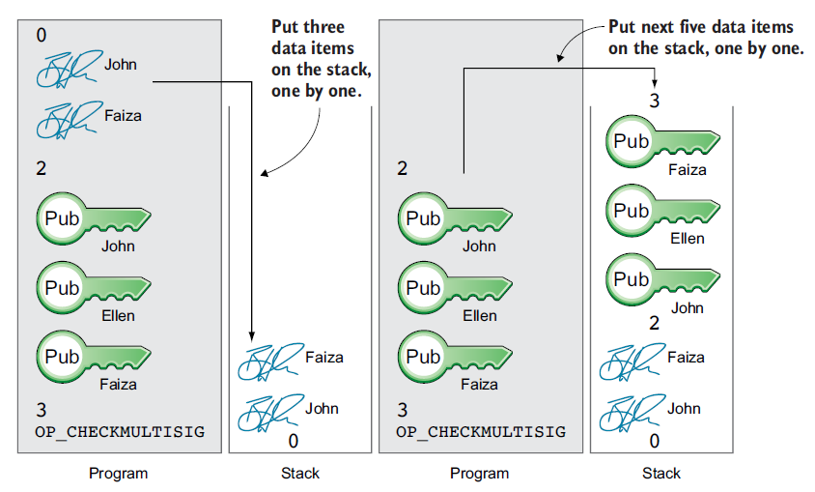
P2MS

Slide 51
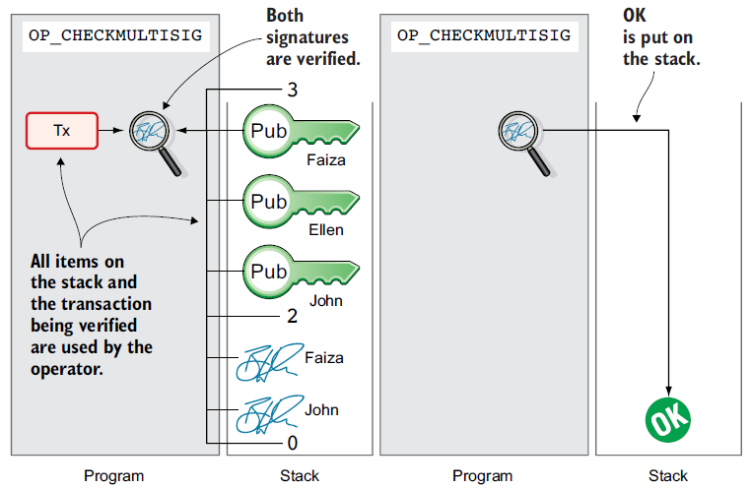
P2MS

Slide 52
P2MS

Slide 53
P2MS - BUG
There is a bug in CHECKMULTISIG’s execution that requires a slight workaround
Because of this an extra superfluous OP_0 is placed at the start of scriptSig
Because this bug became part of the consensus rules, it must now be replicated forever.

Slide 54
P2MS - ESCROW
Using the OP_CHECKMULTISIG operator instead of the OP_CHECKSIG in the output script allows creating transactions that need several keys to unlock funds.
A classic example is an escrow where a trusted third party (broker) is used between the merchant and the client to secure funds.

Slide 55
P2MS - ESCROW
A transaction is set up that requires two keys out of three (merchant, client and a trusted party) to move coins.
If a good is delivered then the merchant and the client agree to move funds to the merchant’s account.
If the merchant fails to send the good, the client and the trusted party move funds back to the client.
You can watch: https://www.coursera.org/lecture/cryptocurrency/applications-of-bitcoin-scripts-Vu5eX

Slide 56
Pay-to-Script-Hash (P2SH)
Pay-to-Script-Hash (P2SH) was introduced in 2012 as a powerful new type of transaction that greatly simplifies the use of complex transaction scripts.
It allows you to lock bitcoins to the hash of a script, and you then provide that original script when you come unlock those bitcoins.
P2SH hides the script program. The sender then makes a payment to that hash and leaves it up to the recipient to provide the script later, when the recipient wants to spend the money.
You can put just about any custom locking script you want as the redeem script

Slide 57
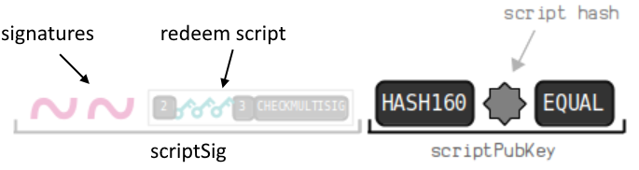
Pay-to-Script-Hash (P2SH)
The unlocking script then contains your original custom locking script (the “redeem script”), preceded by the data/opcodes needed to unlock it. redeemScript is a data item that contains a program.
In the unlocking script, the redeem script is a P2MS locking script itself, and the preceding signature is what’s needed to unlock it.

Slide 58
Pay-to-Script-Hash (P2SH)
A P2SH script is executed in two parts:
Standard Execution - The redeem script is hashed, and is then checked that it is equal the script hash in the locking script.
Redeem Script Execution - This is the special part. The redeem script is deserialized and ran as if it were a locking script.

Slide 59
Redeem Script
You can put just about any custom locking script you want as the redeem script

Slide 60
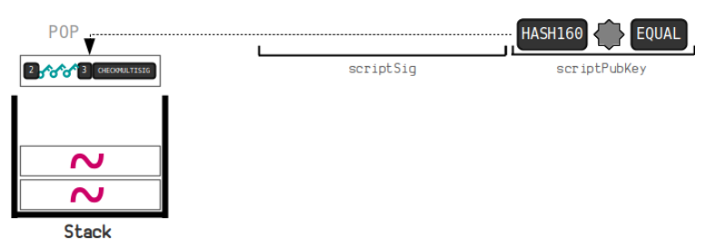
Pay-to-Script-Hash (P2SH
Standard Execution

Slide 61
Pay-to-Script-Hash (P2SH)
Redeem Script Execution

Slide 62
Pay-to-Script-Hash (P2SH)

Slide 63
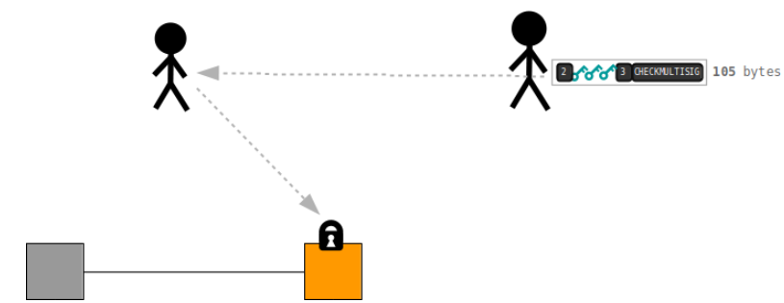
Why do we have P2SH?
Because it makes it easier to share complex locking scripts with other people.
Before P2SH, if you wanted a complex locking script (e.g. P2MS) placed on your bitcoins, you would have to give the person “sending” you those bitcoins the entire locking script

Slide 64
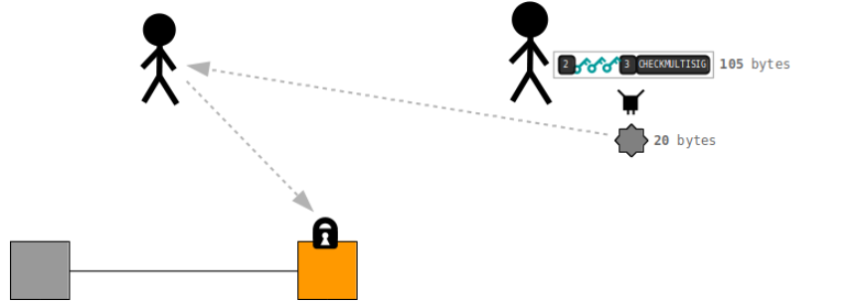
Why do we have P2SH?
But with P2SH, instead of giving someone an entire locking script, you can essentially just give them a hash of your script instead
You provide your original script when you unlock the bitcoins later on.

Slide 65
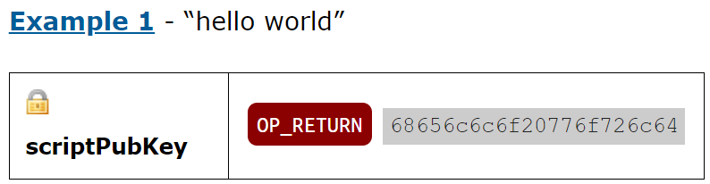
OP_RETURN
This operation allows data to be inserted into the blockchain at the same marks the transaction as invalid.
This makes the transaction unspendable and excluded to UTXO set so that it would not be cluttering other spendable outputs, and reducing network cost.

Slide 66
Summary

Slide 67
Timelocks
Timelocks are restrictions on transactions or outputs that only allow spending after a point in time.
Bitcoin has had a transaction-level timelock feature from the beginning.
It is implemented by the nLocktime field in a transaction. Two new timelock features were introduced in late 2015 and mid-2016 that offer UXTO level timelocks
Timelocks are useful for postdating transactions and locking funds to a date in the future.
More importantly, timelocks extend bitcoin scripting into the dimension of time, opening the door for complex multistep smart contracts

