Slide 1

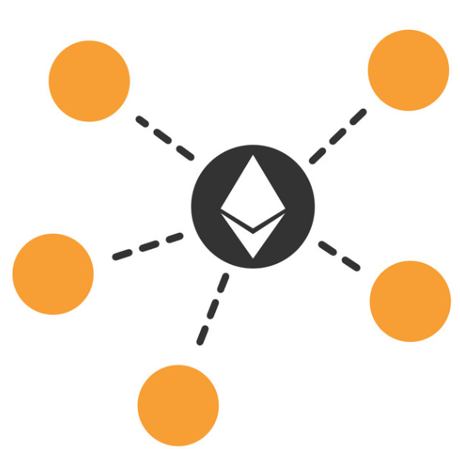


Ethereum
Loke KS

Slide 2
Reference
https://ethereum.org/en/developers/docs/
https://ethereum.org/en/whitepaper/

Slide 3
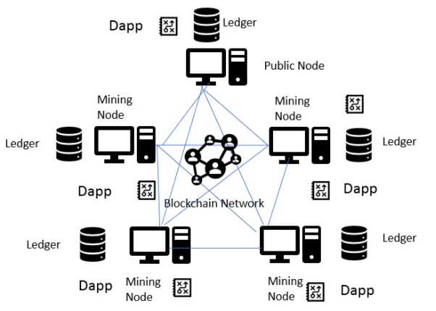
Ethereum

Slide 4

Introduction
Ethereum is a network of peer to peer software clients with a global shared replicated persistent memory that is accessible by all clients.
The intent of Ethereum is to build a new consensus-based system with a foundational layer that enables arbitrary automation through smart contracts.
This essentially means the Ethereum is a programmable blockchain. The persistent memory consists of the Ethereum blockchain and the transaction state database.
Unlike the bitcoin, Ethereum records the resultants states of all transactions, therefore there is another layer of data storage

Slide 5
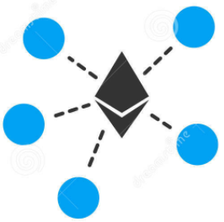
Introduction
Ethereum is a multiple single instance computer running on all peer computers.
All the clients run on local computers with each processing the same transactions.
The mining operation packs the transactions into a block and subsequently inserted into the blockchain.
This blockchain shared by all Ethereum peers through their own local copy.

Slide 6
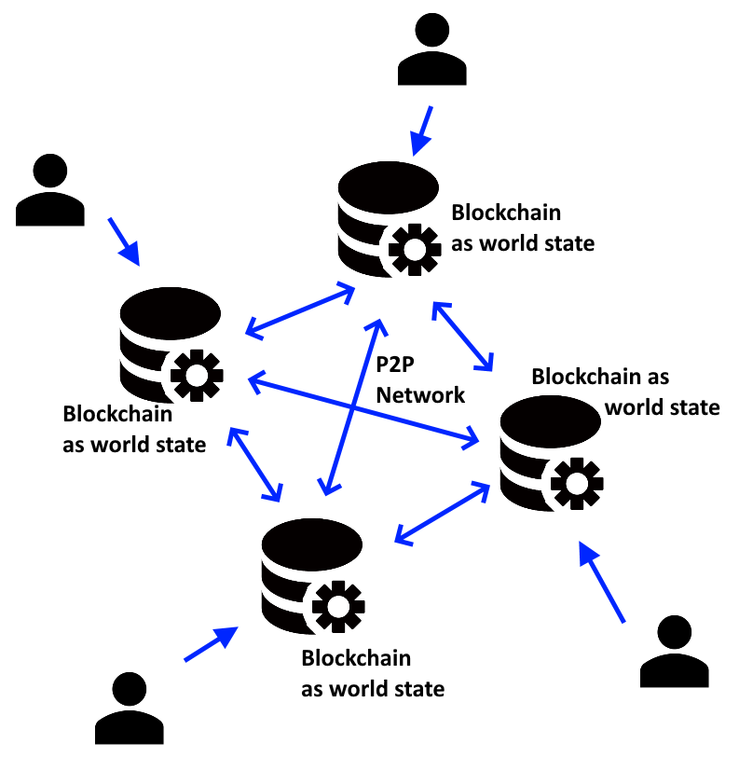
Introduction
The blockchain stores the global transactions and smart contracts.
Smart contracts are programming code that runs in the sandboxed Ethereum clients.

Slide 7
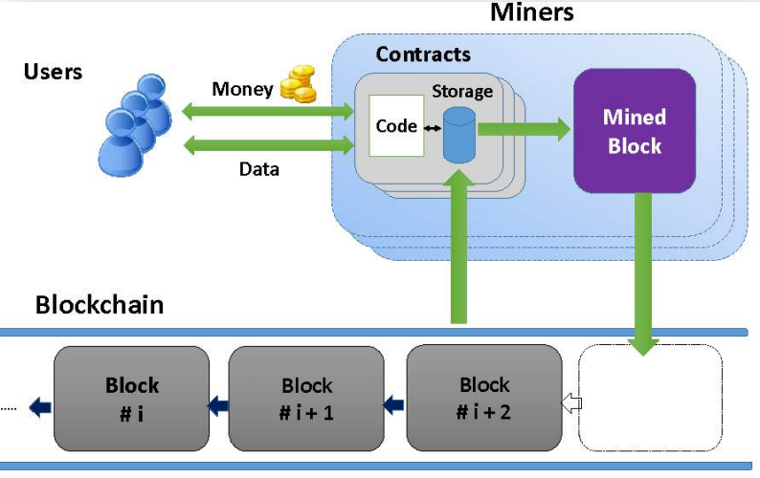
Overview

Slide 8

Global Computer
Sometimes Ethereum is referred to the as a global computer, implying it is a running as a single global computer.
This is not true. All transactions are local, and nodes only coordinate to determine block consensus
Nodes do not cooperate on computation, so it is not a single computer but replicated database running on different computers independently.
It is a redundant singleton machine having the same shared state at each node

Slide 9

Shared State Global Computer
The shared state in the Ethereum blockchain is stored in the associated key-value storage (State, Transaction, Receipt and Storage Trie).
All persistent data (i.e. blockchain and storage) in each node is exactly synchronized, meaning they store the same information.

Slide 10
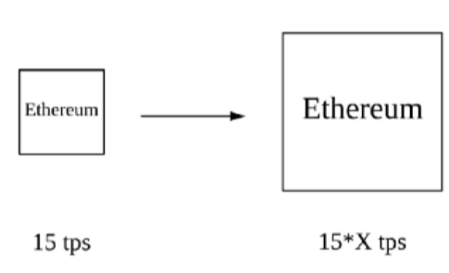
Layer 1 Scaling
Layer 1 is the base consensus layer of the Ethereum protocol
Layer 1 scaling solutions increase Ethereum’s transaction throughput by increasing the capacity of the base blockchain
These changes require hard fork.

Slide 11
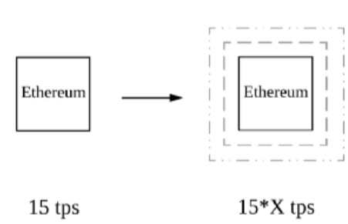
Layer 2 Scaling
Layer 2 refers to systems built on top of layer 1
Layer 2 scaling solutions increase Ethereum’s effective transaction throughput by performing some operations off chain
These solutions do not typically require a hard fork, they are implemented as smart contracts.
Eg. Rollups, State Channels, Plasma, Sidechains
https://ethereum.org/en/developers/docs/layer-2-scaling/

Slide 12
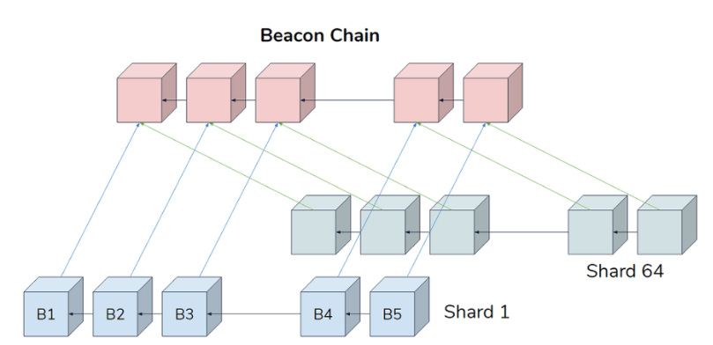
Beacon Chain
In Eth 2.0, the Beacon Chain will be introduced.
The Beacon Chain will conduct or coordinate the expanded network of shards and stakers. It can't handle accounts or smart contracts.
The Beacon Chain will introduce proof-of-stake to Ethereum.

Slide 13
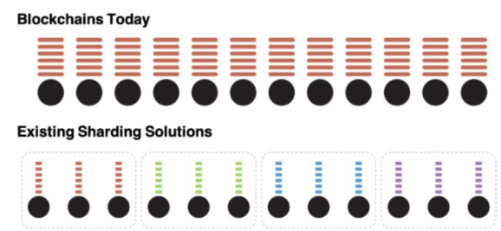
Sharding
https://ethos.dev/beacon-chain/
Sharding is the term for horizontally partitioning a database.
A shard chain has a subset of nodes processing it. Virtual miners, validators, are assigned to shards, and only process and validate transactions in that shard (chain).
Shards will increase the capacity of the network and improve transaction speed by extending the network to 64 blockchains.
Eventually the Ethereum Mainnet will be a shard within the Beacon chain.

Slide 14
Mining Nodes
Mining nodes (not all nodes are mining nodes) maintain a transaction pool where all transactions placed before they are evaluated.
Once a transaction is verified it waits in the mempool. Miners will pick transaction from the mempool to be included in the next block.
These nodes will pack the transactions, validate them, and put them in a block.
Each of the mining nodes will compete to solving a cryptographic puzzle, the first node that completes the puzzle will insert the block into the blockchain and broadcast to all the nodes. This the Proof of Work.

Slide 15
Mining Nodes
The rest of the nodes will verify the winning node results then add to their own copy of the blockchain.
Only the winning node have the right to insert a block into the blockchain.
Mining can be said is a computational process of selecting (nominating) a block to be part of the existing blockchain.
However in Ethereum 2.0, Proof of Work will be replaced by Proof of Stake.

Slide 16
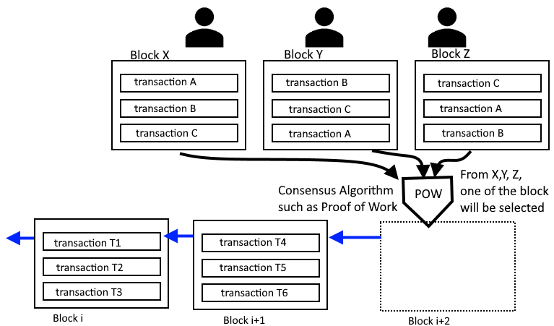
Mining Nodes
The block selected to be inserted into the blockchain is determined by a consensus algorithm. Blocks X,Y and Z are candidate blocks of which one will be chosen to be inserted into the blockchain.

Slide 17
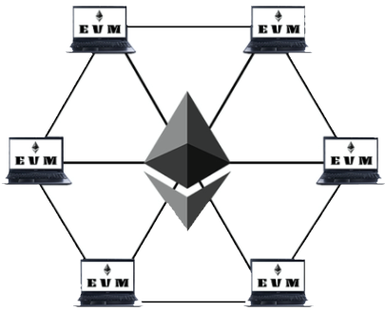
Ethereum Virtual Machine
The Ethereum client runs the Ethereum Virtual Machine (EVM).
The EVM is an interpreter for the Ethereum instruction set that is in the smart contracts.
The EVM is a software-based interpreter for the Ethereum instruction set that is used in the smart contracts.
The job of the EVM is run the smart contracts and update the blockchain and associated databases.
The EVM is completely sandboxed, i.e. totally isolated such that the code running within it has no access to the Internet, filesystem, or other external processes.

Slide 18
Ethereum Virtual Machine
Each Ethereum client (node) runs a local copy of the EVM to validate contract execution and records the changing states of the transactions on the Ethereum blockchain and database.
Applications that run on EVM are called smart contracts.
Smart contracts are Turing complete - the code used to write smart contracts have the equivalent expressiveness and power of any Turing machine.
A Turing machine is any machine that can execute any algorithms.
EVM programs are fully deterministic – this means it produces the same result each time it is run.

Slide 19
Ethereum Virtual Machine
EVM runs bytecode that higher-level programs can compile to, e.g. it can run solidity programs.
The EVM instruction set or opcodes is kept simple to simplify implementation and coding.
All instructions operate on 256-bit words and on byte arrays.
The EVM is a stack-based machine instead of a register machine that is found on most general-purpose computers

Slide 20
Ethereum Virtual Machine
When a user uploads a smart contract through a node, it is propagated throughout the Ethereum network and stored in the Ethereum blockchain.
Every node runs the same program and verifies that the outputs are the same. This is the trustless part.

Slide 21
Ethereum Accounts
There are two different types of accounts in Ethereum: externally owned accounts (EOAs) and contract accounts.
Both types of accounts are identified by a 20-byte Ethereum address and share the same address space.
Both accounts are equally treated by the EVM.

Slide 22
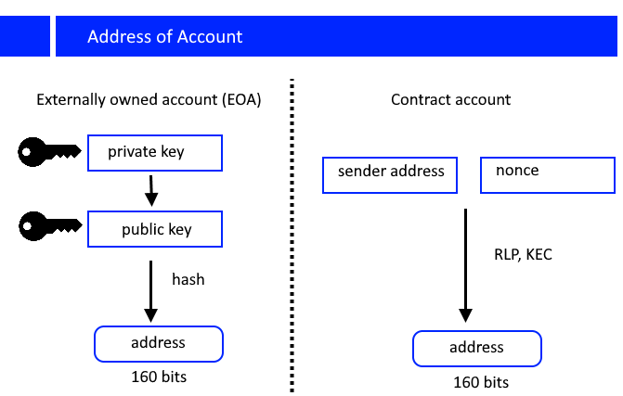
Ethereum Accounts

Slide 23
Ethereum Accounts
An Ethereum account contains four fields:
The nonce, a counter used to make sure each transaction can only be processed once
The account's current ether balance
The account's contract code, if present
The account's storage (empty by default)

Slide 24
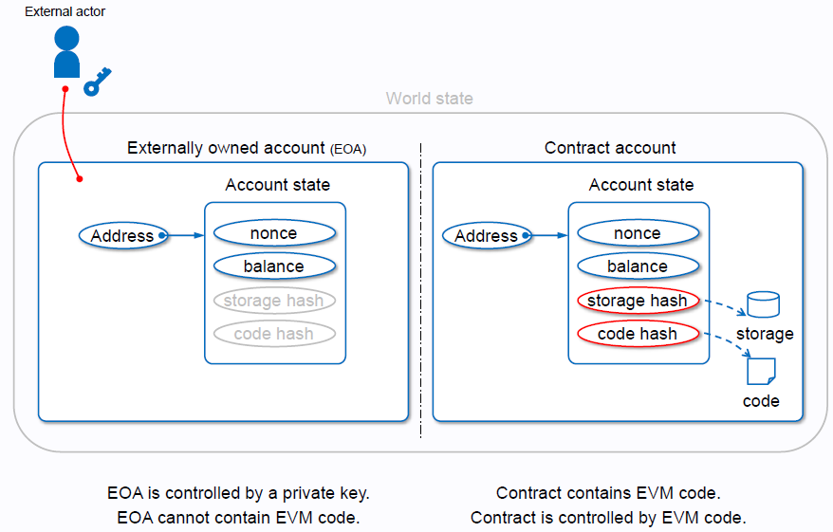
Ethereum Accounts

Slide 25
Contract Accounts
Contract accounts are controlled by program code (also commonly referred to as “smart contracts”) that is executed by the Ethereum Virtual Machine.
Contract accounts has no private key so cannot initiate transaction.
The address of a contract is determined at the time the contract is created.
It is derived from the EOA account that created it and the number of transactions sent from that address (so-called the account “nonce”).

Slide 26
EOA and Contract Accounts
The private key enables private control over access to any ether in the account and over any authentication the account needs when using smart contracts. They are the unique piece of information needed to create digital signatures, required to sign transactions to spend any funds in the account.
Contracts Accounts (Smart Contracts) are controlled by their code.
Unlike EOAs, there are no public or private keys associated with a smart contract. Smart contracts are not backed by a private key, but by their inherent code. We can say that they “own themselves”.

Slide 27
Contract Execution
All smart contracts in Ethereum are executed, ultimately, because of a transaction initiated from an EOA.
A contract is created by sending a transaction to an empty address with code as data - that will cause a new account to be created.
The address of a contract is determined at the time of its creation.
The address is derived from the address of the initiator and its transaction count number (account “nonce”).

Slide 28
Account Storage
Every account has a persistent storage that can be used to store key-value maps.
The key-value maps 256-bit words to 256-bit words to store things like derived calculations.
Each account has an account balance that stores the value of ether (in “wei”) belonging to the account.
This value can be modified by sending or receiving transactions.

Slide 29
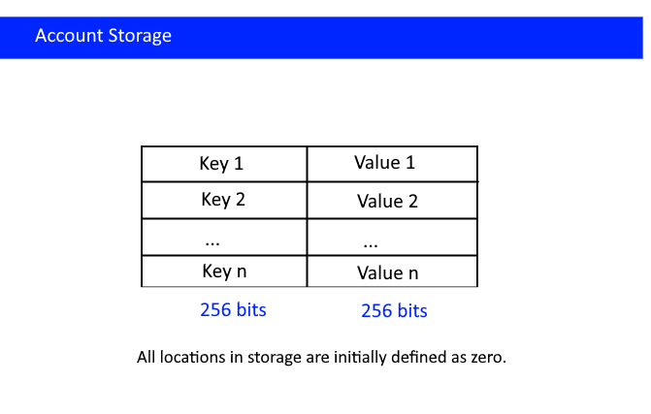
Account Storage
Storage is a key-value store that maps 256-bit words to 256-bit words.

Slide 30
Account Storage
EOAs are simple accounts without any associated code
Contract accounts have additional storage to store the smart contract code and data.
Contract accounts can have at most one Smart Contract associated, once deployed cannot change

Slide 31
EOA
EOAs are controlled by users, often via software such as a wallet application that is external to the Ethereum platform.
Ownership of EOAs is established through digital private keys (public and private key pairs) and is indexed by Ethereum addresses.
The address of the EOA is determined from the public key.

Slide 32
Ethereum Address
Each Ethereum account would have a unique address.
Ethereum addresses are unique identifiers that are derived from public keys or contracts using the Keccak-256 one-way hash function.
Ethereum addresses are hexadecimal numbers, identifiers derived from the last 20 bytes of the Keccak-256 hash of the public key.

Slide 33
Transactions
The term "transaction" is used in Ethereum to refer to the signed data package that stores a message to be sent from an externally owned account.
A transaction specifies what state changes are to be made, and it is sent to any node in the network.

Slide 34
Messages
Since contracts can’t sign, it can’t send a transaction, but it can send messages.
A message is like a transaction, except it is produced by a contract and not an external actor.
Messages are virtual objects that are never serialized and exist only in the Ethereum execution environment.
Contracts can also send ether and invoke functions in other contracts, but this mechanism is properly called a “message.”

Slide 35
Transactions
A message sent by a contract differs from a true transaction in two ways: it does not include a cryptographic signature, and it is not included directly in the blockchain.
Rather, it is part of the side effects of the original transaction that was sent to the contract from an externally owned account.
In simpler terms, a transaction can contain a message or is contract creation (which is not a message).
A message call can be between two accounts (via transactions), or between two contracts.

Slide 36
Transactions
A transaction consists of a message that is sent from one account to another account (which might be the same or empty).
A valid transaction will be recorded in the blockchain and associated databases (i.e. transaction trie).
Transactions must execute in entirety or else it will be rejected completely.
To make any change to the Ethereum blockchain, a transaction must be sent.
Based on Ethereum’s rules of consensus, the network then agrees that the transaction is a valid one, and it is included in a block that is added to the blockchain.

Slide 37
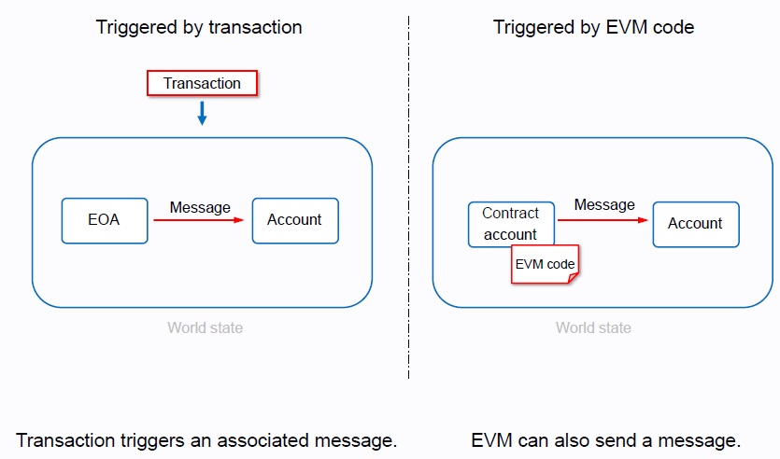
Transactions & Message

Slide 38
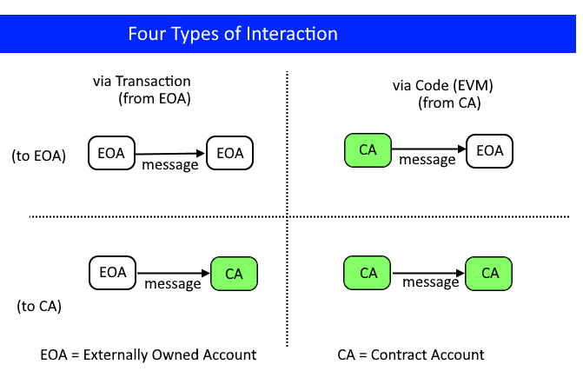
Transactions & Message
Message: Data (as a set of bytes) and Value (specified as Ether) that is passed between two Accounts, either through the deterministic operation of an Autonomous Object or the cryptographically secure signature of the Transaction

Slide 39
Transactions
A transaction contained two fields: value (ether) and data (payload).
Transactions can have both value and data, only value, only data, or neither value nor data.
When a transaction contains a value, this is equivalent to sending a payment. If the recipient account is EOA then the balance of the recipient account will increase. If the recipient account is a contract, then the EVM will execute the function named in the data payload of the transaction.
If there is no data payload in the transaction or the function named does not exist, the EVM will call a fallback function. If the fallback function is a payable function, then the ether will be received by the contract account.

Slide 40
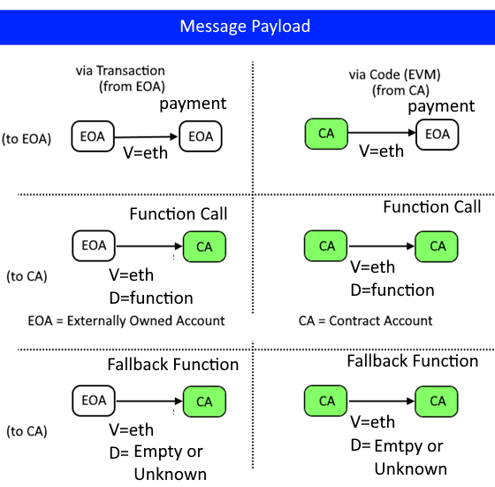
Transactions

Slide 41
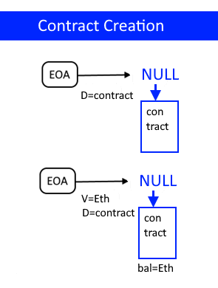
Contract Creation
If the destination address is set to null, a new contract would be created.
If the value field contains a number, then the new contract would have a starting balance as well.
When a contract is created it will be assigned a contract account address that is based on the EOA address and a nonce.
The payload of a contract creation is taken to be the EVM bytecode. The output data of the execution of the bytecode is permanently stored as the code of the contract.

Slide 42
Smart Contracts
Smart Contracts are programming code that runs within the EVM.
Contracts are created either by other transactions (by setting destination address to null) or by another contract (via opcode).
A contract is a collection of code (its functions) and data (its state) that resides at a specific address on the Ethereum blockchain.
Contracts can call other contracts or send Ether to non-contract accounts by the means of message calls.
Every transaction consists of a top-level message call which in turn can create further message calls.

Slide 43
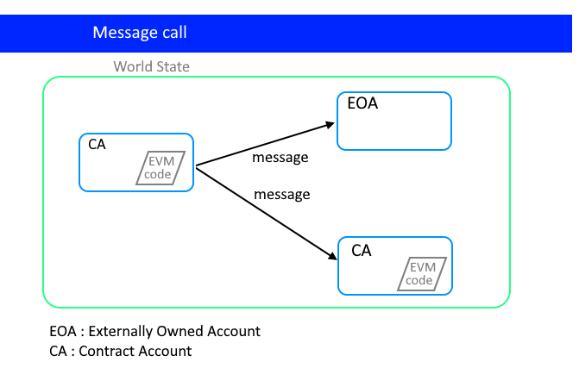
Contract calls
Contracts in EVM can send messages to other accounts.

Slide 44
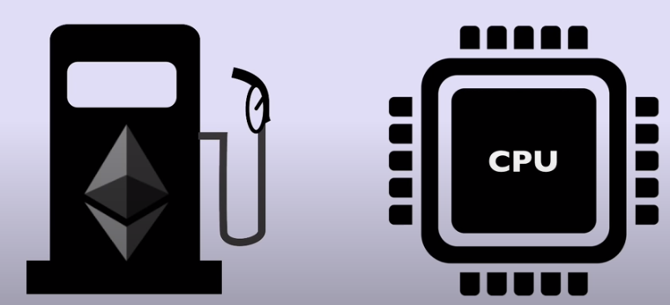
Gas
Because the smart contracts are Turing complete, arbitrary programs may run on it including programs that may not halt.
In an effort to limit code execution each transaction that executes code (smart contracts) would have to pay certain charges called gas.
Gas is consumed according to the amount of work done by the EVM.
The more steps or more complex the code, more gas is required.
When the EVM executes a transaction, the gas is gradually depleted.
If the gas is used up before completion an exception will be triggered, and all modifications will be reverted.

Slide 45
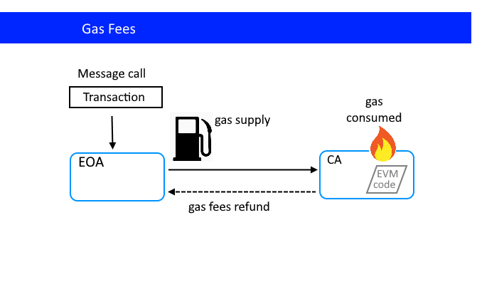
Gas
All computation in Ethereum is subject to gas fees.

Slide 46

Gas
The gas determines the extent of complexity of smart contract code that is being submitted.
If the gas is below the complexity, the code won’t run. In order to really deter highly complex code and code that won’t halt, gas has a price set to it.
Therefore, before any smart contract code can run, the transaction must be setup to pay gas price multiplied by gas used. This amount is given to miners.
If the total price is less than what is expected, the miner may elect to reject running it. A higher priced gas smart contract will have higher priority of running.

Slide 47
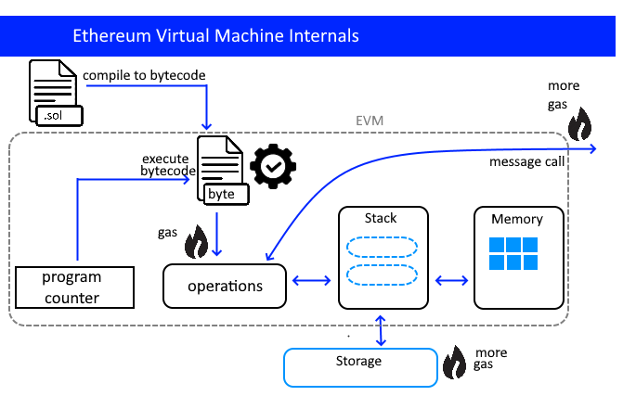
EVM Internals

Slide 48
Persistent Structure
Ethereum can be viewed as transactional state machine with persistent states.
What this means is that Ethereum when an all or nothing transaction occur; it changes the state of the Ethereum environment, and those changes are stored in a persistent structure.
Transactions are initiated by EOA that changes the some Ethereum account states. These account states are stored within Ethereum.
This is different from Bitcoin which does not store account states (i.e. balance).

Slide 49
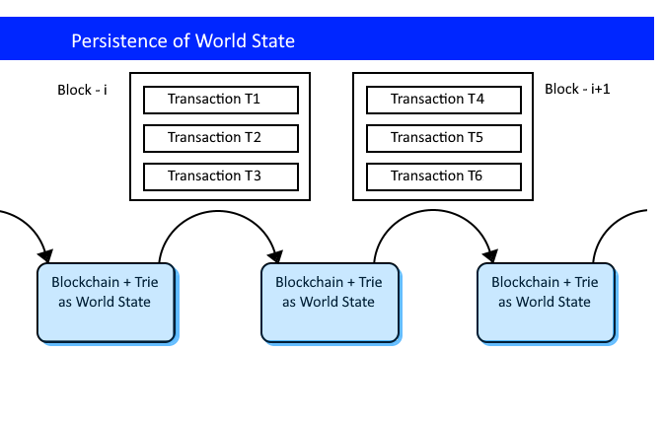
Persistent Structure

Slide 50
Persistent Structure
The persistent structure of Ethereum does not consist solely of the blockchain.
It also includes 4 different trie structure that stores the Ethereum world state.
These tries are stored in a key-value database such as leveldb (used in the geth client) or rocksdb (used in parity client).
Each block in the blockchain is made up of a header and body. The body stores the root node of the 3 trie – state trie, transaction trie and receipt trie
A trie is a tree structure that is used for fast access to key-value pair.

Slide 51
State Machine
Bitcoin uses a distributed ledger to store transactions in the blockchain.
Ethereum instead of a distributed ledger is a distributed state machine.
Ethereum's state is a large data structure which holds not only all accounts and balances, but a machine state, which can change from block to block according to a pre-defined set of rules, and which can execute arbitrary machine code.
The specific rules of changing state from block to block are defined by the EVM.

Slide 52
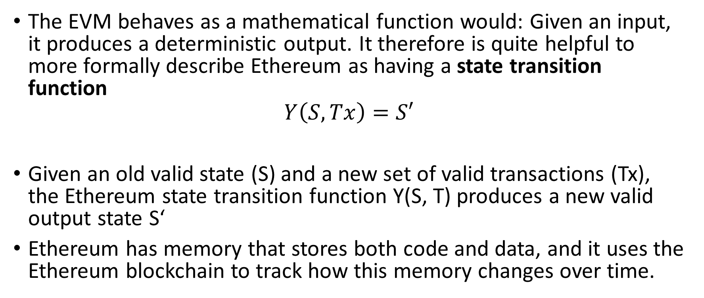
State Transition Function
The EVM behaves as a mathematical function would: Given an input, it produces a deterministic output. It therefore is quite helpful to more formally describe Ethereum as having a state transition function
$$Y\left(S,Tx\right)=S′$$
Given an old valid state (S) and a new set of valid transactions (Tx), the Ethereum state transition function Y(S, T) produces a new valid output state S‘
Ethereum has memory that stores both code and data, and it uses the Ethereum blockchain to track how this memory changes over time.

Slide 53
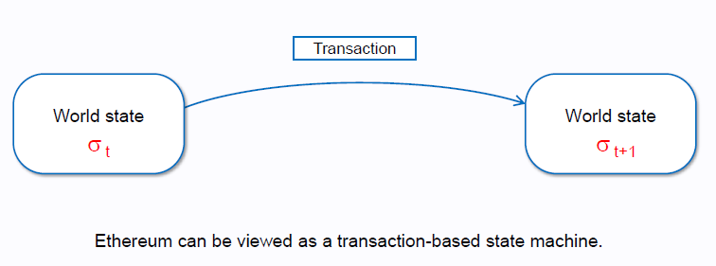
State
In the context of Ethereum, the state is an enormous data structure called a modified Merkle Patricia Trie, which keeps all accounts linked by hashes and reducible to a single root hash stored on the blockchain.

Slide 54
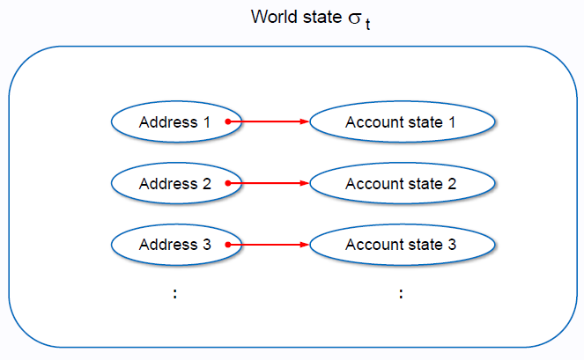
World State

Slide 55
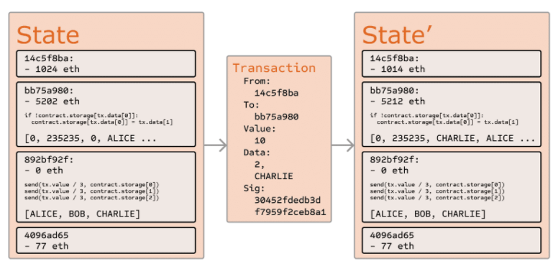
Ethereum State Transition Function

Slide 56
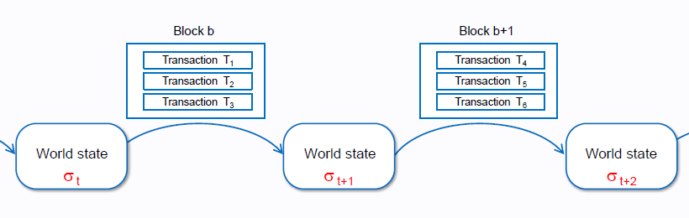
State Chain
Ethereum as a state chain

Slide 57
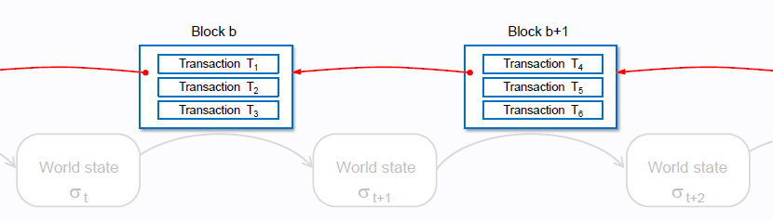
Block Chain
Ethereum can also be seen as a chain of blocks, so it is BLOCKCHAIN

