Slide 1
HALF-BRIDGE CLLC BIDIRECTIONAL CONVERTER
NAME: PAMBALI JITHENDRA
ROLL.NO: 244102106

Slide 2
CONTENT
INTRODUCTION
CIRCUIT DIAGRAM
KEY COMPONENTS
CIRCUIT PARAMETERS
WORKING
CALCULATION OF PARAMETERS
EQUIVALENT CIRCUITS
SIMULINK MODE
SIMULINK RESULTS
APPLICATIONS
CONCLUSION

Slide 3
INTRODUCTION
The CLLC Half-Bridge Bi-Directional Converter is a power electronics topology used for efficient energy transfer between DC power sources and loads. It operates in both step-up and step-down modes with minimal energy loss.
It utilizes resonance to achieve low-loss and high-frequency operation.
Bidirectional DC-DC converters are essential in applications such as renewable energy systems, electric vehicle charging stations, and energy storage systems, enabling efficient energy management and enhancing the integration of sustainable energy sources.

Slide 4
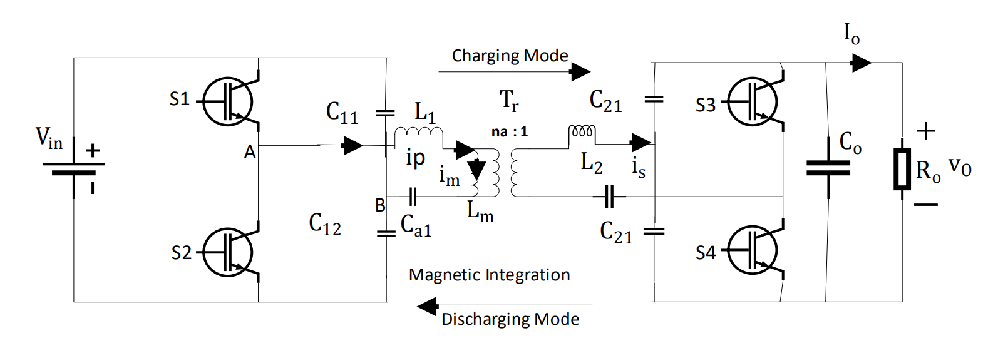
CIRCUIT DIAGRAM

Slide 5
KEY COMPONENTS OF CIRCUIT
Half-bridge configuration with two switches (MOSFETs or IGBTs).
Resonant tank comprising inductors (L1, L2) and capacitors (C1, C2).
High-frequency transformer for isolation and voltage transformation.
Control circuits for PWM modulation and feedback.
Load-side rectifiers for DC output.
Supports bi-directional power flow.

Slide 6
CIRCUIT PARAMETERS
The most important parameters of an CLLC converter for controlling the output voltage of the converter are
1. Resonant inductor Lr
2. Resonant capacitor Cr
3. Magnetizing Inductor Lm
The final objective is to STEPUP the regulated voltage from 100 V to 400 V. The transformer’s turn ratio is N1 : N2 , which is selected to be 100/400 ,will act as the step upstage.

Slide 7
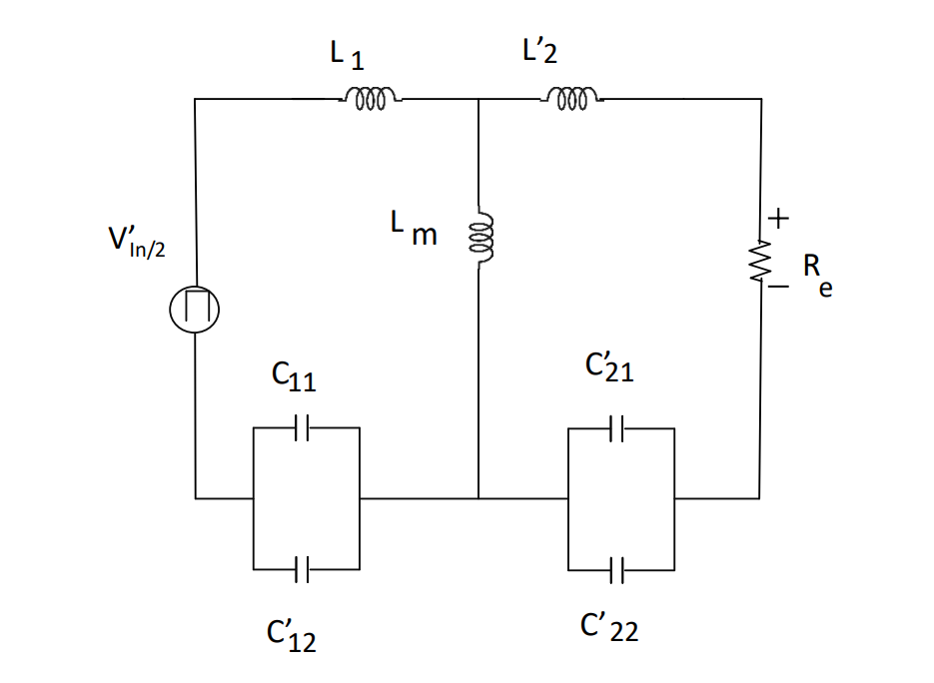
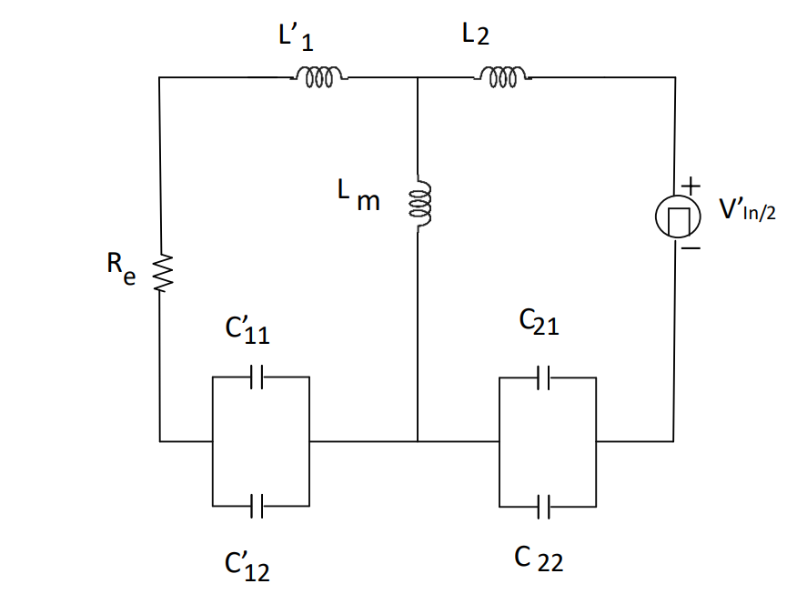
WORKING
DISCHARGING MODE
CHARGING MODE
power flows from the DC link to the battery
Switches S1 and S4 will turn ON
power flows from the battery to the DC link
Switches S2 and S3 will turn ON

Slide 8
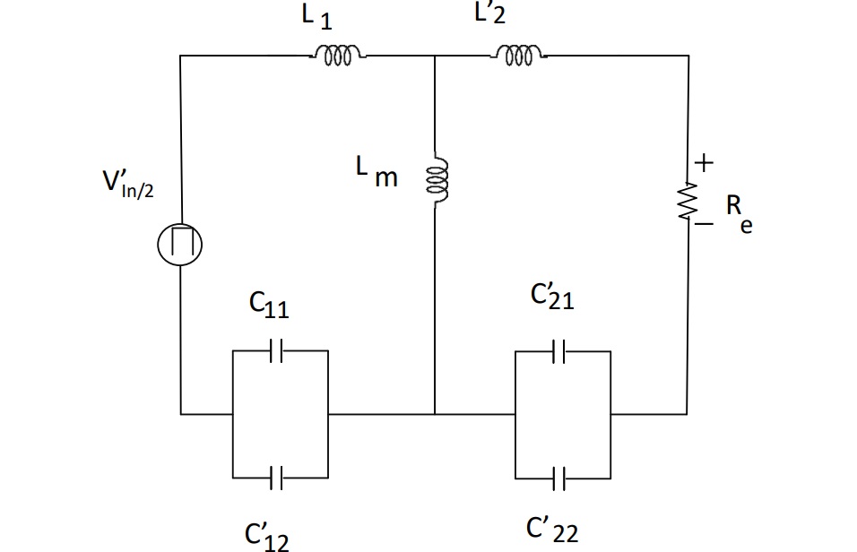
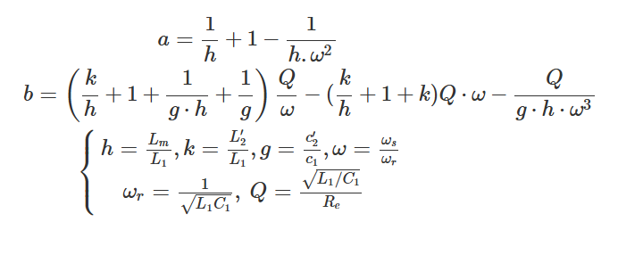

EQUIVALENT CIRCUIT IN CHARGING MODE
$→G_charging = |H(s)| = |V_out / V_in| = (1 / n) ∗ (1 / sqrt(a^2 + b^2))$

Slide 9

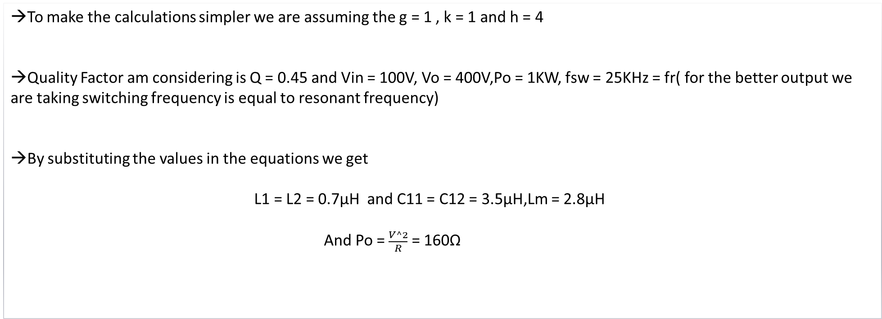
CALCULATION OF PARAMETERS(IN CHARGING MODE)
→To make the calculations simpler we are assuming the g = 1 , k = 1 and h = 4
→Quality Factor am considering is Q = 0.45 and Vin = 100V, Vo = 400V,Po = 1KW, fsw = 25KHz = fr( for the better output we are taking switching frequency is equal to resonant frequency)
→By substituting the values in the equations we get
L1 = L2 = 0.7µH and C11 = C12 = 3.5µH,Lm = 2.8µH
And Po = $\frac{V^2}{R}$ = 160Ω

Slide 10
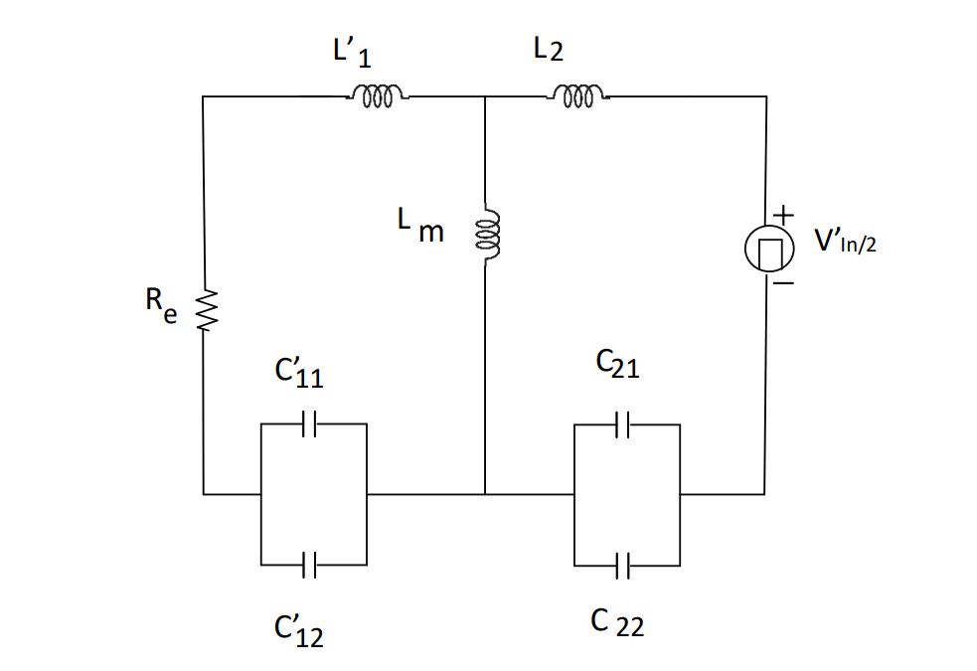
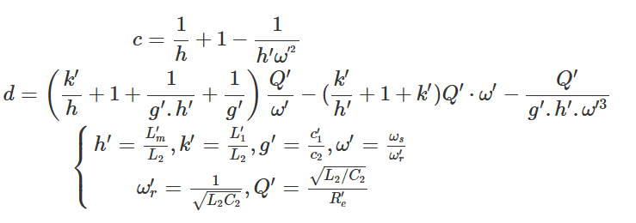
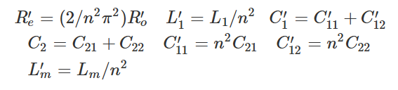

EQUIVALENT CIRCUIT IN DISCHARGING MODE
$$G_charging = |H(s)| = |V_out / V_in| = ( n) ∗ (1 / sqrt(c^2 +d^2))$$
Parameters can be calculated as:

Slide 11

(IN DISCHARGING MODE)
With the same L and C values, the discharging mode will have the same resonant frequency as the charging mode has which means,
W’r = Wr
k’ = k; g = g’; h = h’
Hence we can see the change in the Quality factor , after calculation we get Q’ = 0.138
And after calculating we get,
C21 = C22 = 39µF ,L’m = 0.7µH
CALCULATION OF PARAMETERS

Slide 12
BASIC OPERATION
1. Resonance: Energy is transferred through the resonant tank at a specific frequency.
2. Bi-Directional Flow: Operates in step-up (boost) or step-down (buck) mode.
3. Switching: Half-bridge switches operate alternately to excite the resonant tank.
4. Isolation: Transformer isolates primary and secondary sides for safety.
5. Control: Feedback ensures efficient mode transition and voltage regulation.

Slide 13
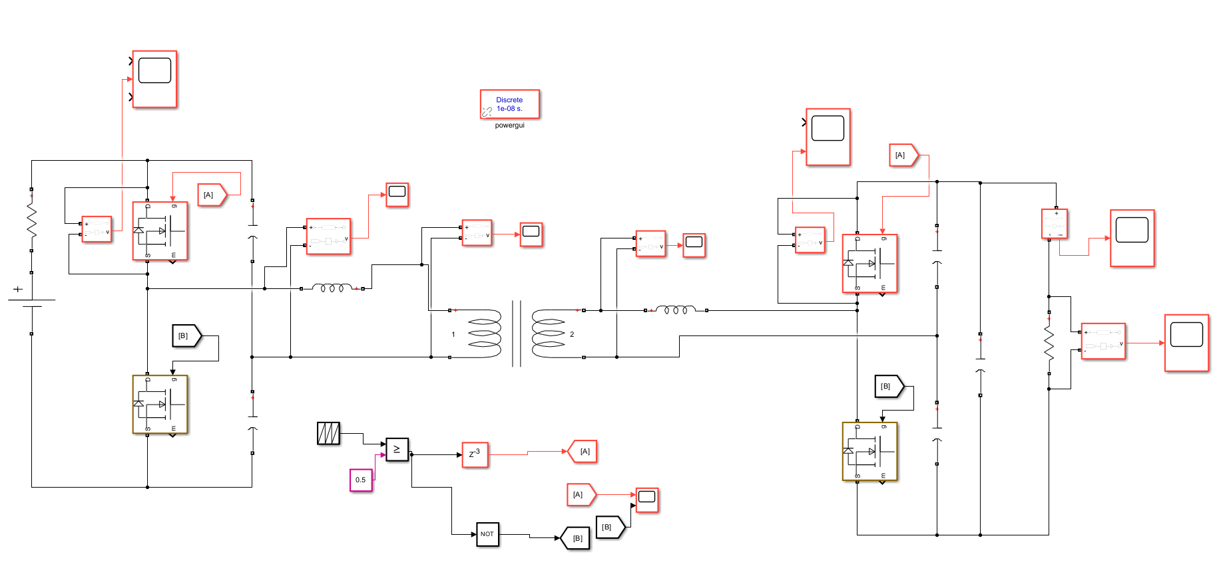
SIMULINK MODEL

Slide 14
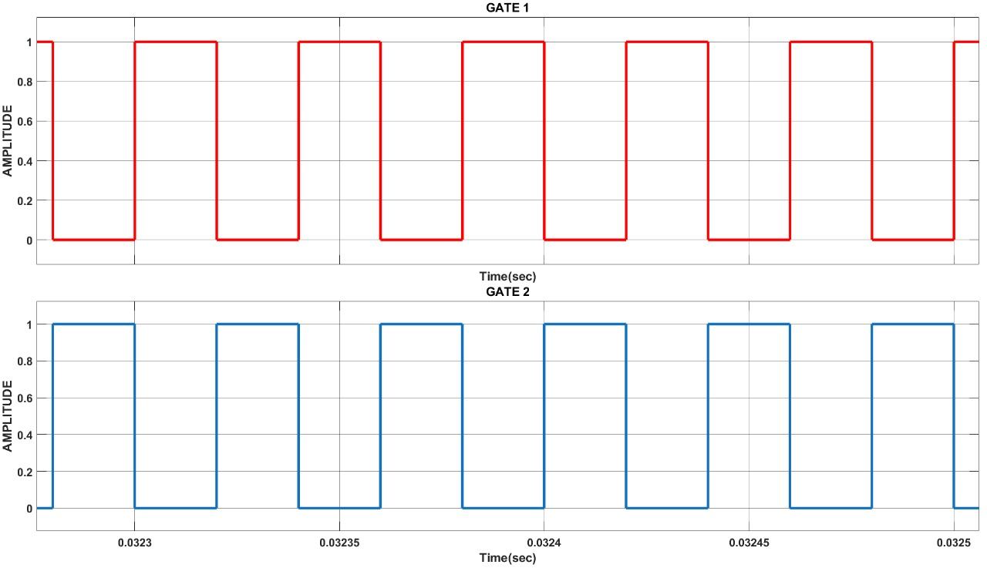
SIMULATION RESULTS
GATE PULSE

Slide 15
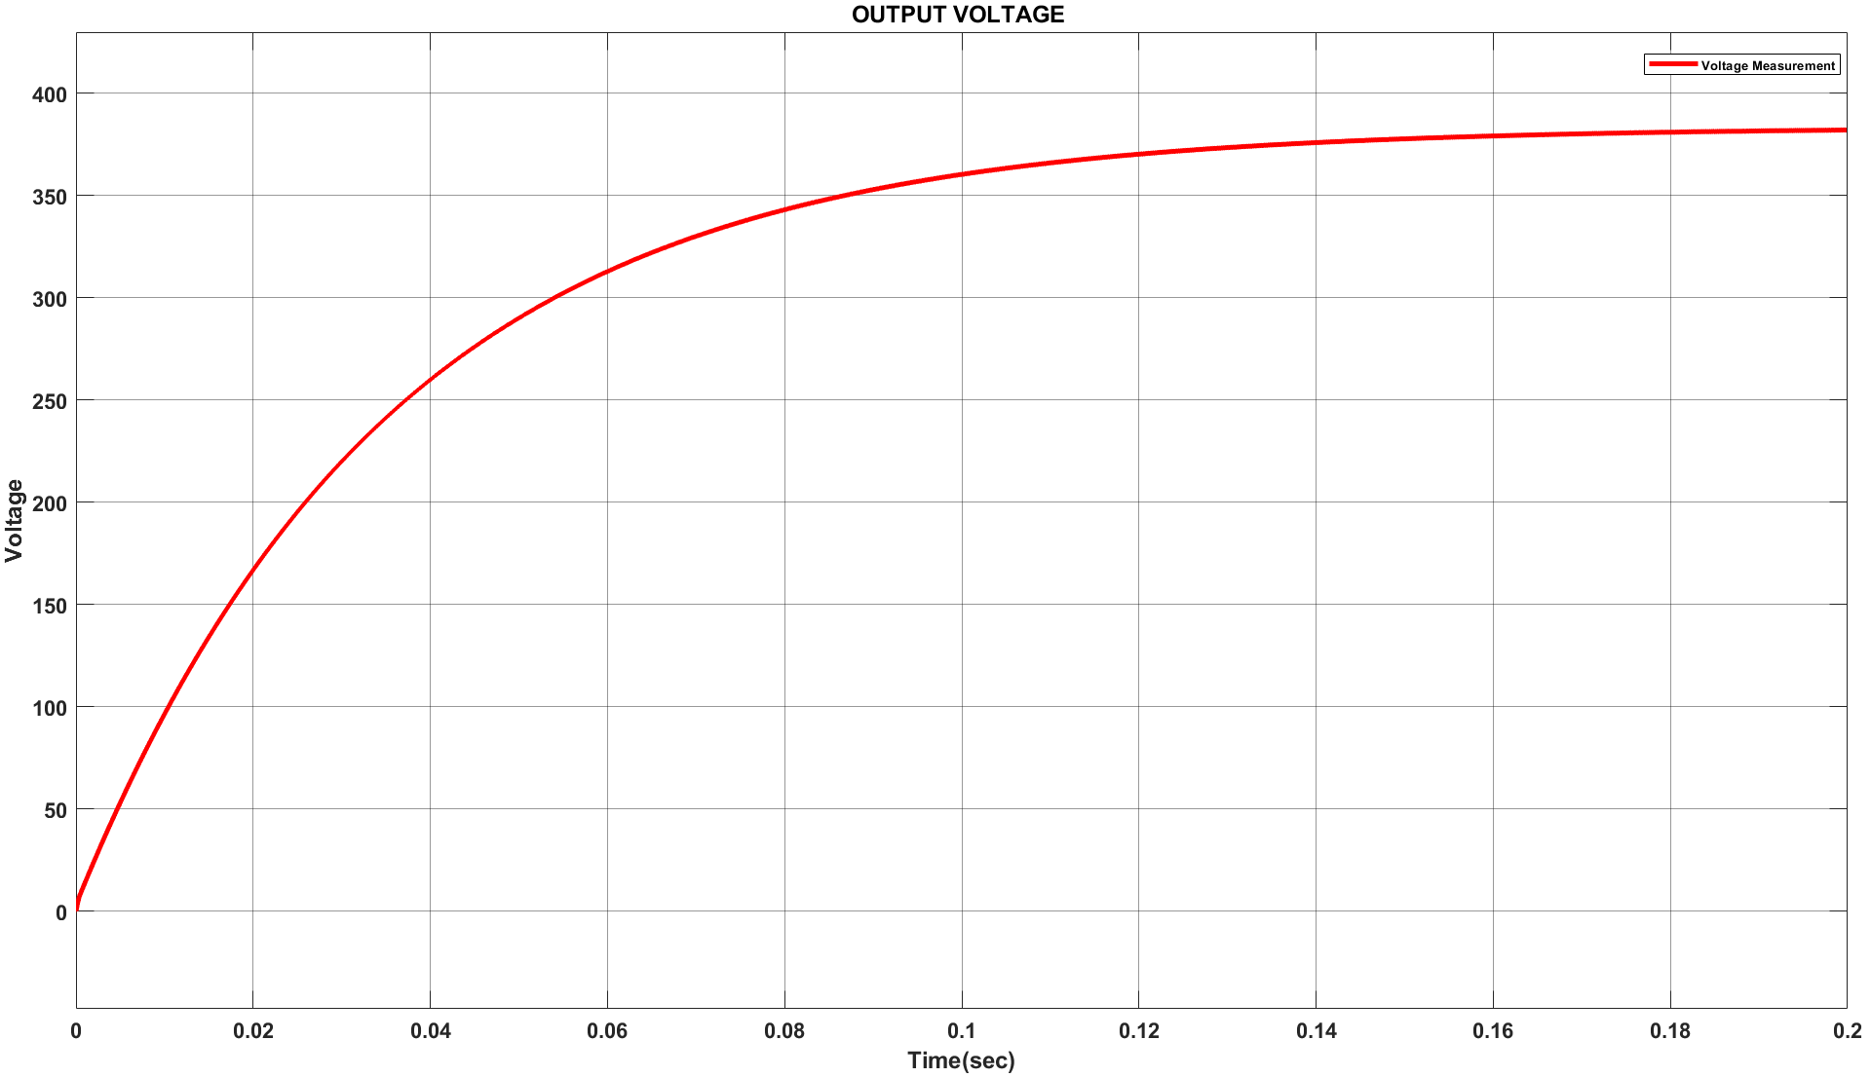
SIMULATION RESULTS
OUTPUT VOLTAGE

Slide 16
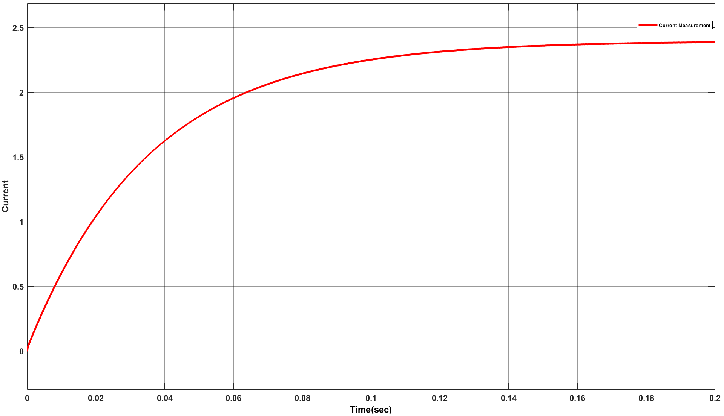
SIMULATION RESULTS
OUTPUT CURRENT

Slide 17
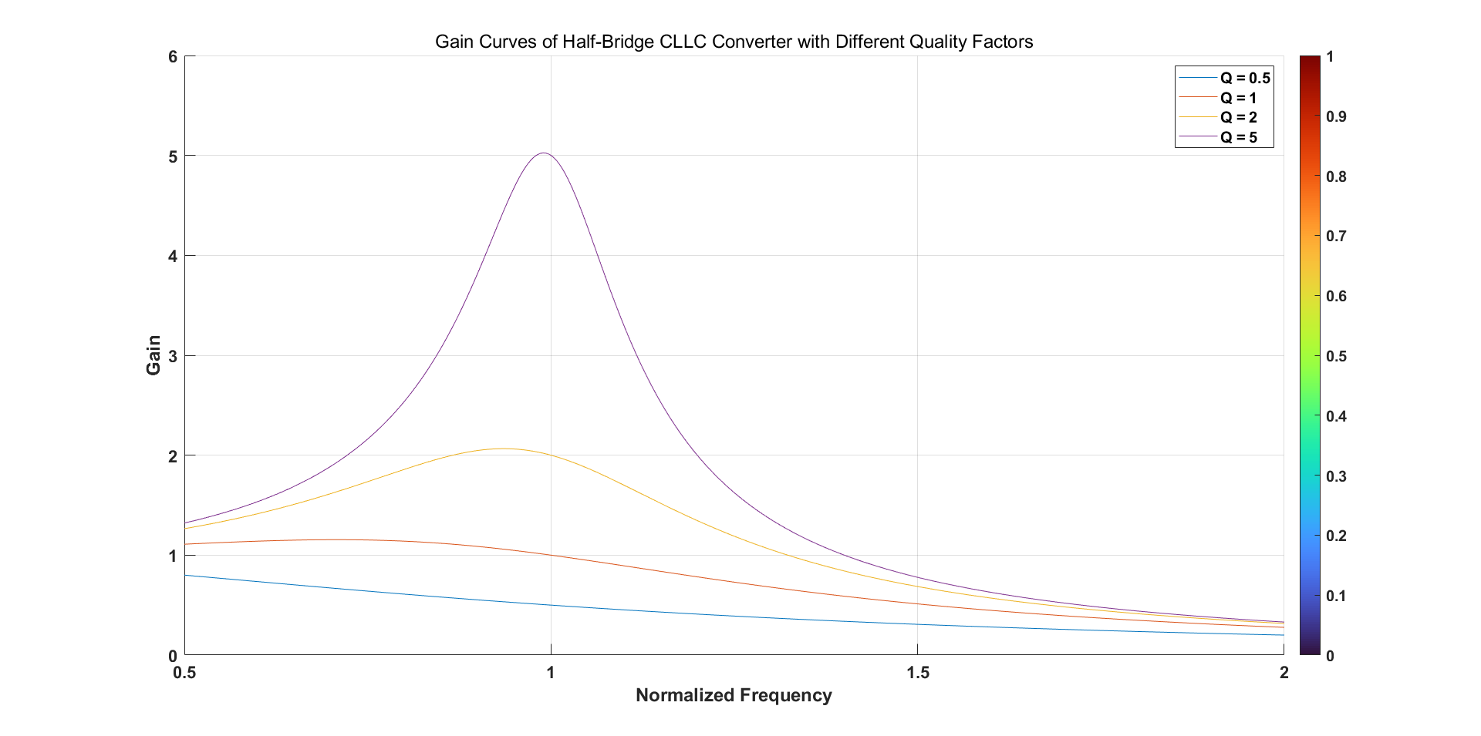
GAIN CURVES
→The resonant tank of the Half-Bridge CLLC circuit can present inductive or capacitive depending on the operating frequency. The resonant network is inductive when the slope is negative

Slide 18
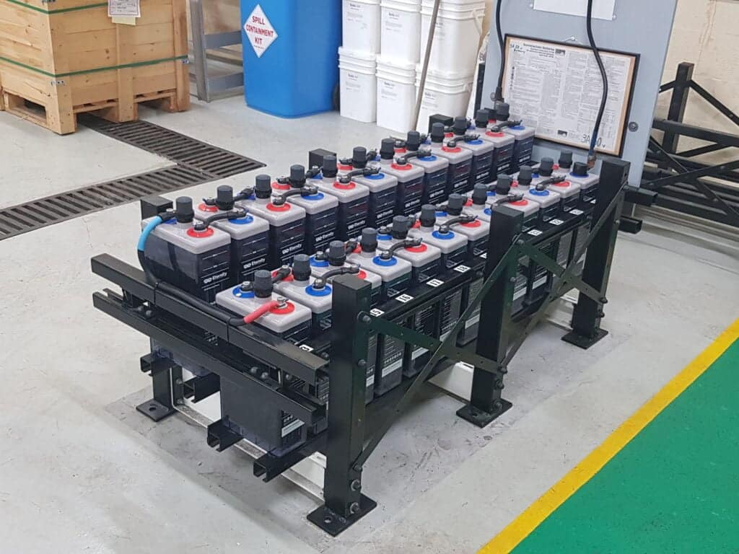
APPLICATIONS IN ENERGY STORAGE SYSTEMS
Strength in Versatility
The Half Bridge CLLC converter supports multiple applications, enhancing energy transfer efficiency across various energy storage systems, including renewable energy and electric vehicle charging.
Opportunity for Innovation
Advancements in semiconductor materials and transformer technology present opportunities for improving the efficiency and compactness of Half Bridge CLLC converters in energy storage applications

Slide 19
ADVANTAGES OF HALF-BRIDGE CLLC CONVERTER
High Operational Efficiency
Lower Component Stress
The half-bridge CLLC converter achieves superior efficiency through soft-switching techniques, significantly lowering energy losses during operation and enhancing overall system performance in energy-intensive applications.
By minimizing voltage stress on power switches, the half-bridge CLLC design reduces the likelihood of component failure, leading to increased reliability and longevity of the converter system.

Slide 20
CONCLUSION
The Half-bridge CLLC resonant converter successfully achieves high efficiency by minimizing switching losses through resonant operation, making it suitable for high frequency, high-power applications.
I got the approximately right output as compared to calculated value. However, as it is a open loop simulation model there will be some deviated from the desired output.
Hence, Half- Bridge cllc converter Simulink model is successfully implemented .

Slide 21
REFERNCES
[1] Ruijia Cai, Yundong Ma, Ruiran Dai, Zhiqiang Zhao, Peng Wang, and Pengfei Wang. An any-cellto-any-cell equalization based on half-bridge cllc converters for lithium-ion battery strings. In 2022 IEEE Energy Conversion Congress and Exposition (ECCE), pages 01–06, 2022.
[2] Kuo-Yuan Lo, Shin-Yue Chen, and You-Xuan Guo. Design of an interleaved half-bridge cllc resonant ac-ac converter. In 2022 International Power Electronics Conference (IPEC-Himeji 2022- ECCE Asia), pages 1494–1498, 2022.
[3] Hsuan-Yu Yueh, Jing-Yuan Lin, Haung-Jen Chiu, Chen-Yen Chu, Yu-Chen Chang, and Sih-Yi Lee. Three-level bi-directional half-bridge cllc resonant converter for dc micro-grid. In 2019 10th International Conference on Power Electronics and ECCE Asia (ICPE 2019 - ECCE Asia), pages 1904–1909, 2019.
[4] Chunjiang Zhang, Pengcheng Li, Zhizhong Kan, Xiuhui Chai, and Xiaoqiang Guo. Integrated halfbridge cllc bidirectional converter for energy storage systems. IEEE Transactions on Industrial Electronics, 65(5):3879–3889, 2018.

Slide 22
THANK YOU

