Slide 1
EigenFace
Patrick Kirby
Travis Honaker

Slide 2
Goals
Perform SVD on faces and reconstruct them
Find the minimum number of vectors needed to have recognizable face created.
Determine if two images (or faces) are similar

Slide 3
Why Python?
Thought it would be interesting to try the same project using a different language
The syntax of both Python and Matlab are very similar
See if the both languages produce similar results
Notes:
Go into our background with more python based coding rather than matlab

Slide 4
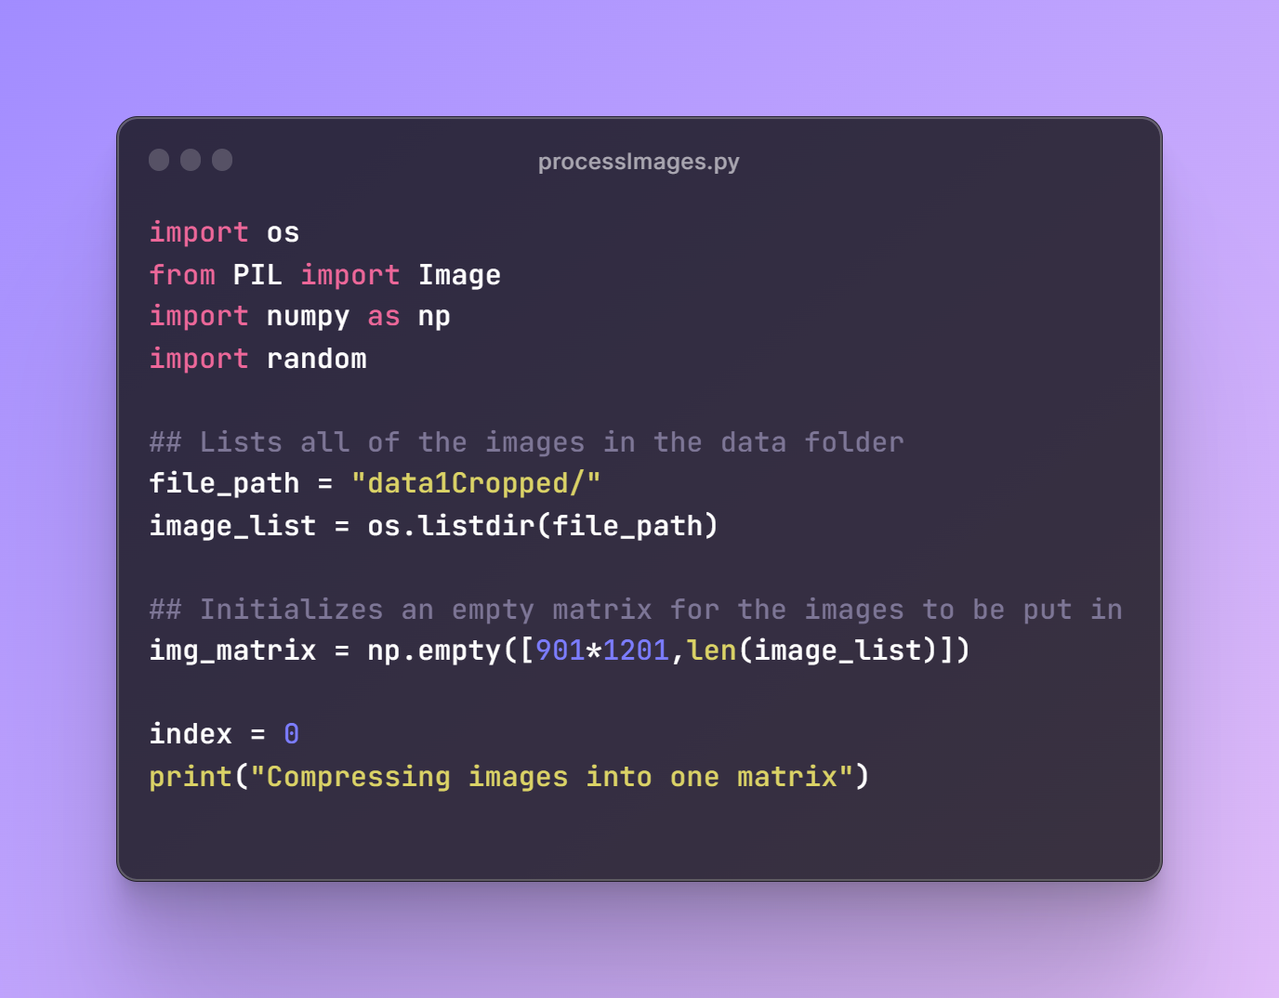
Step #1 - Loading images

Slide 5
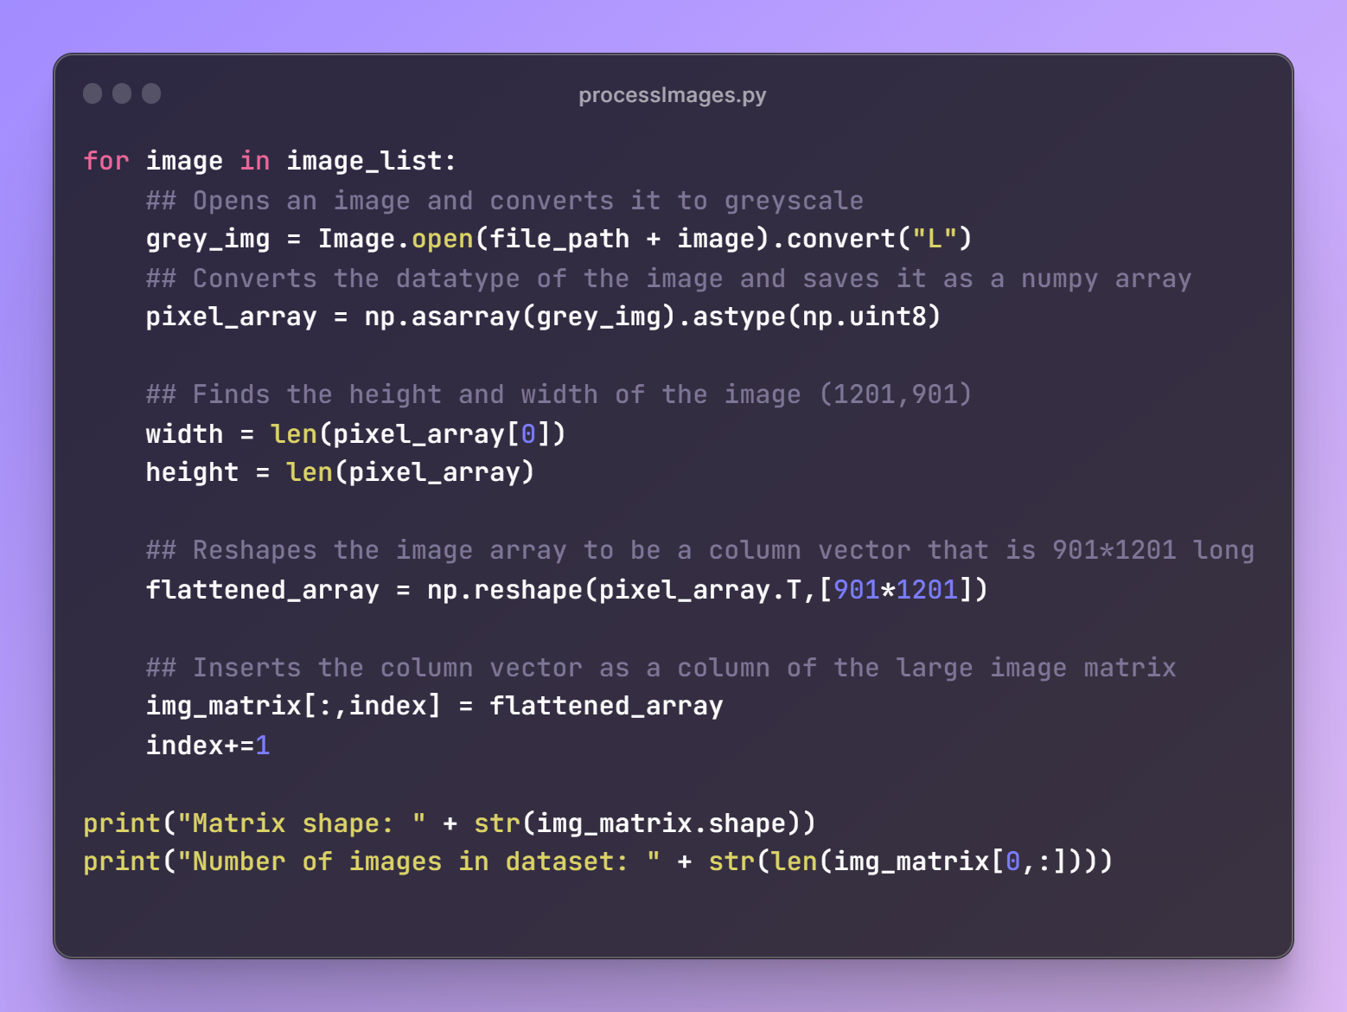
Step #2 - Reshape and combine images

Slide 6
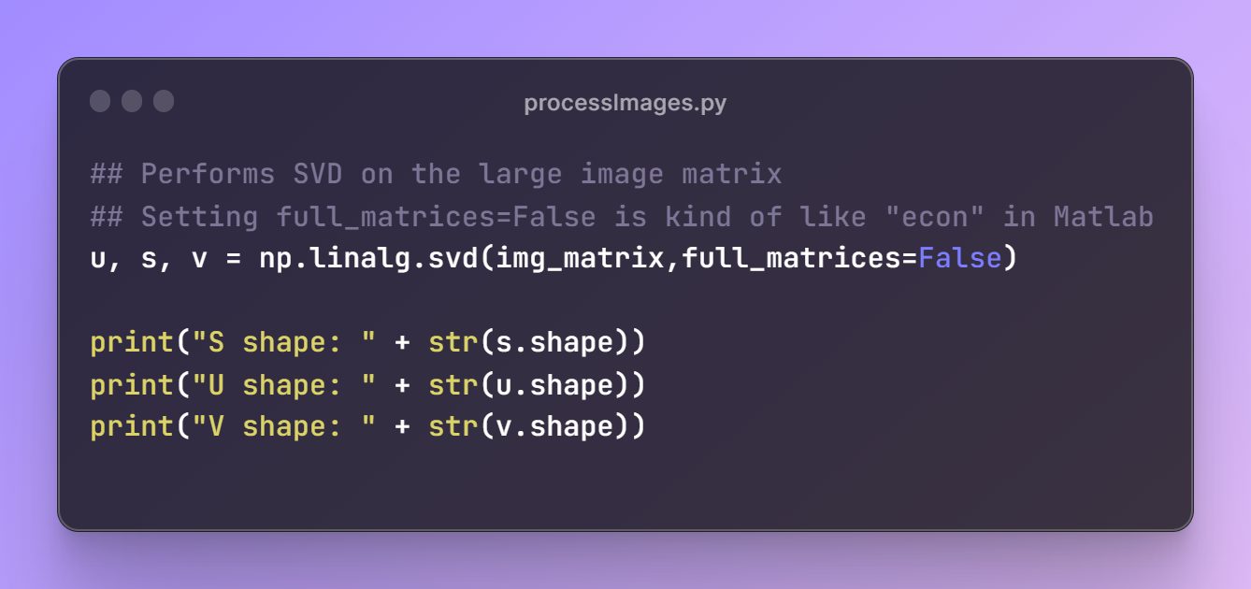
Step #3 - SVD

Slide 7
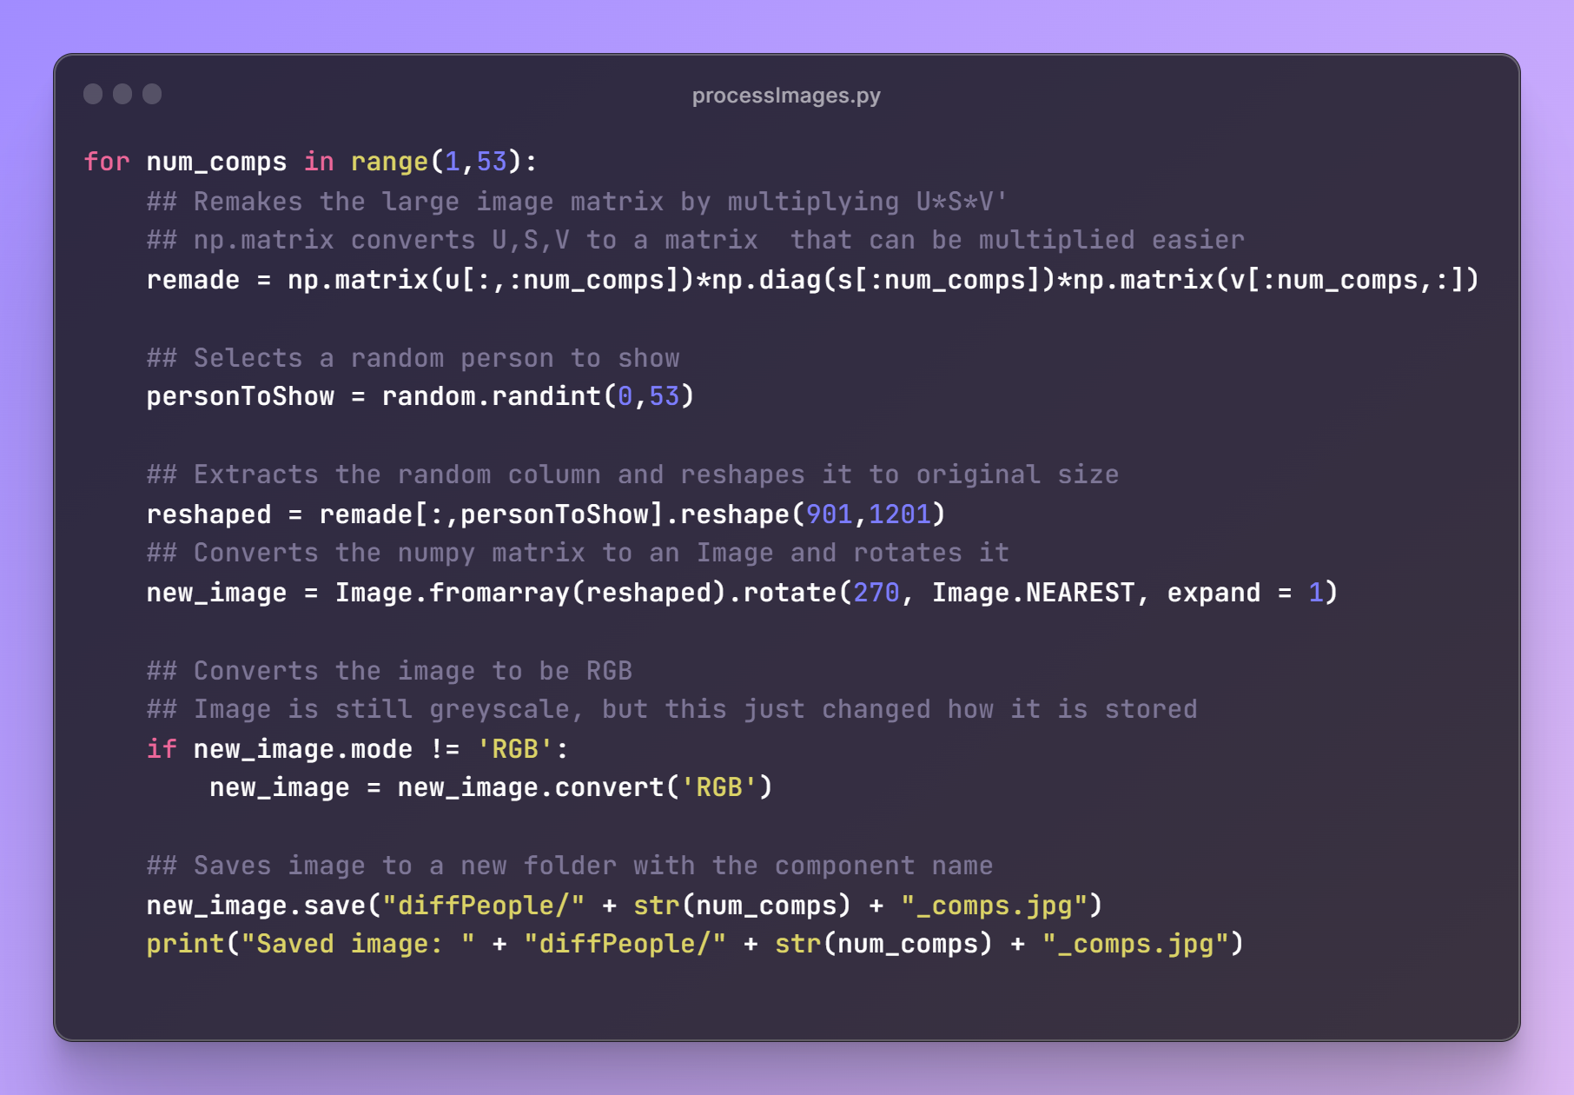
Step #4 - Reconstruct faces

Slide 8
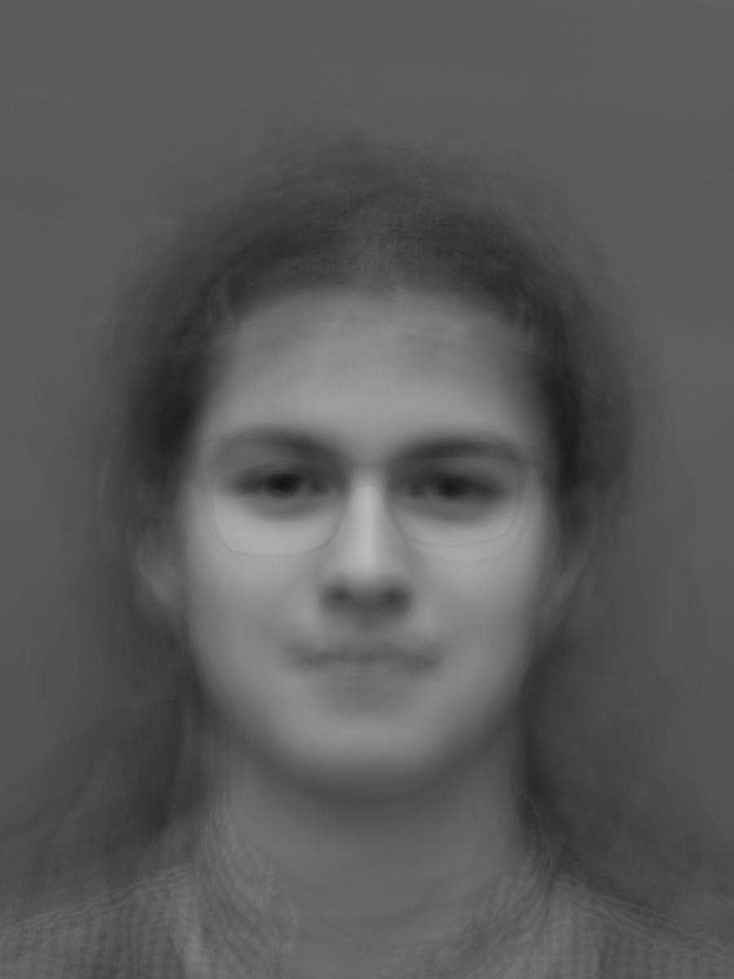
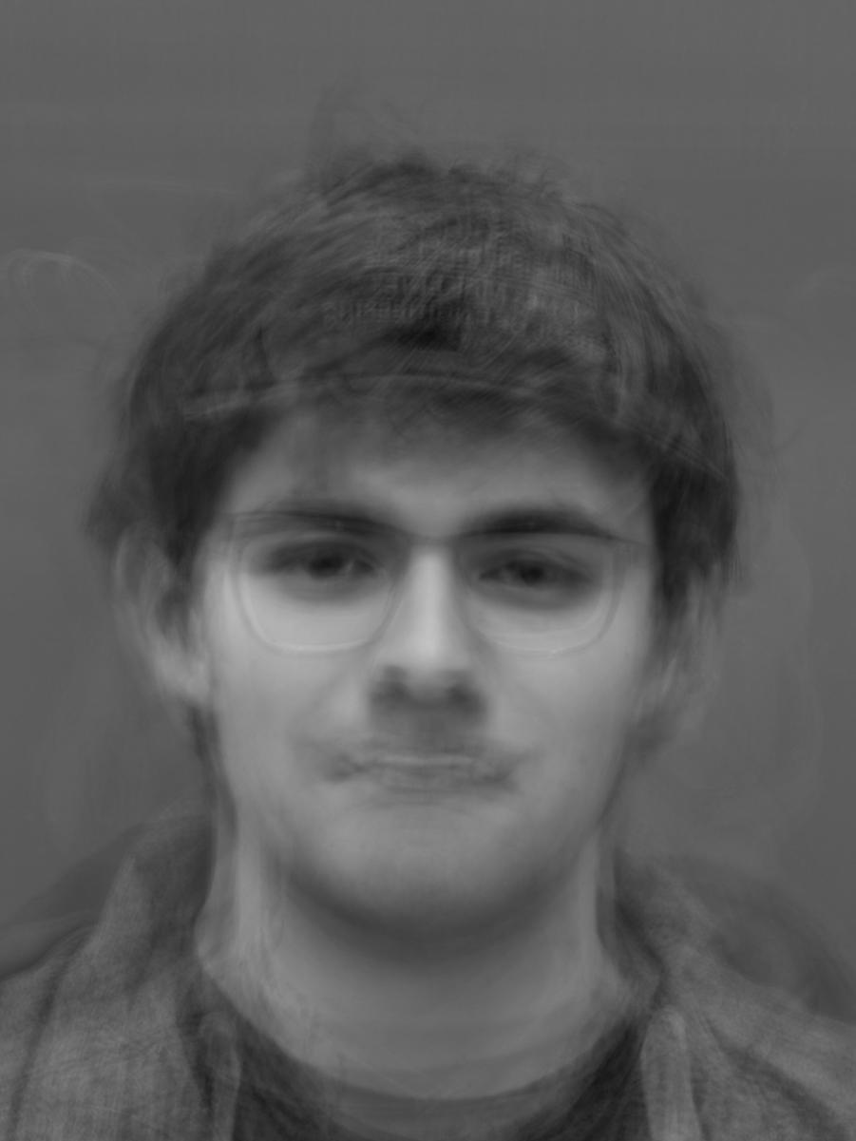
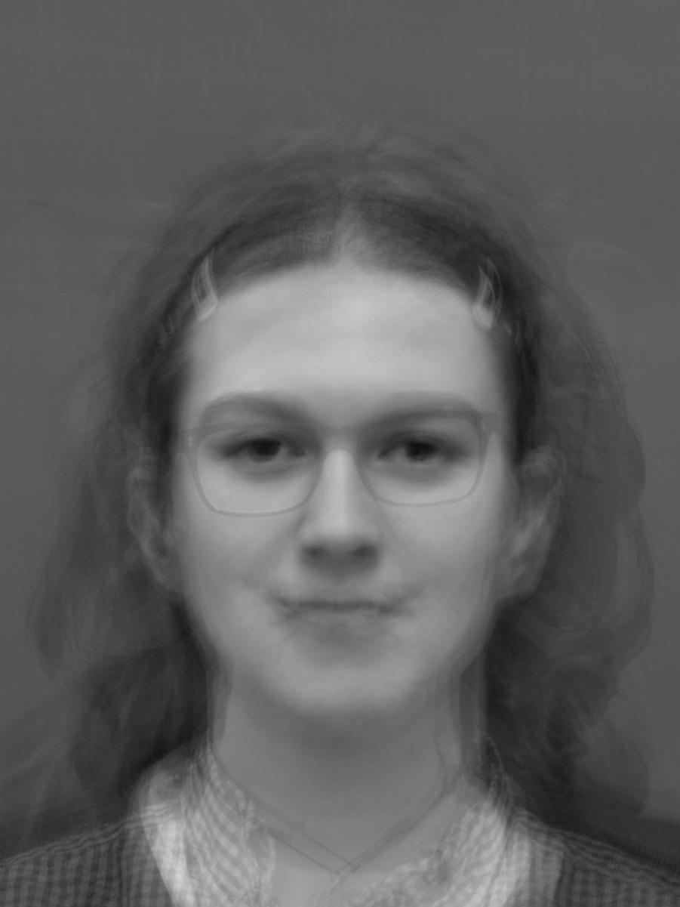
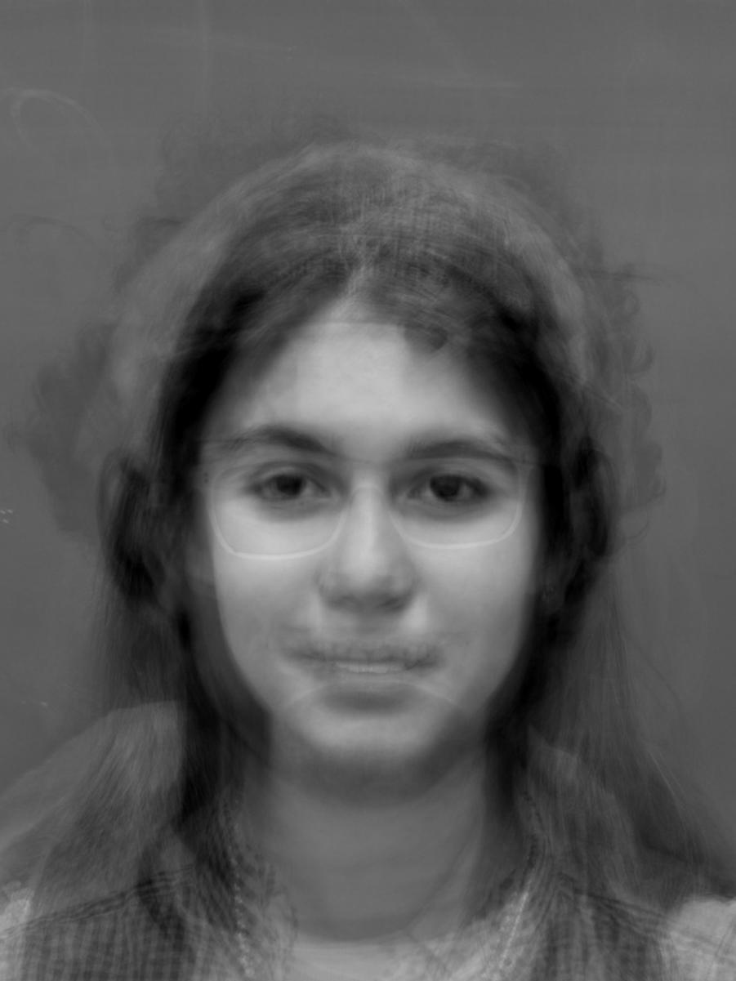
Results
2 components
4 components
6 components
8 components

Slide 9
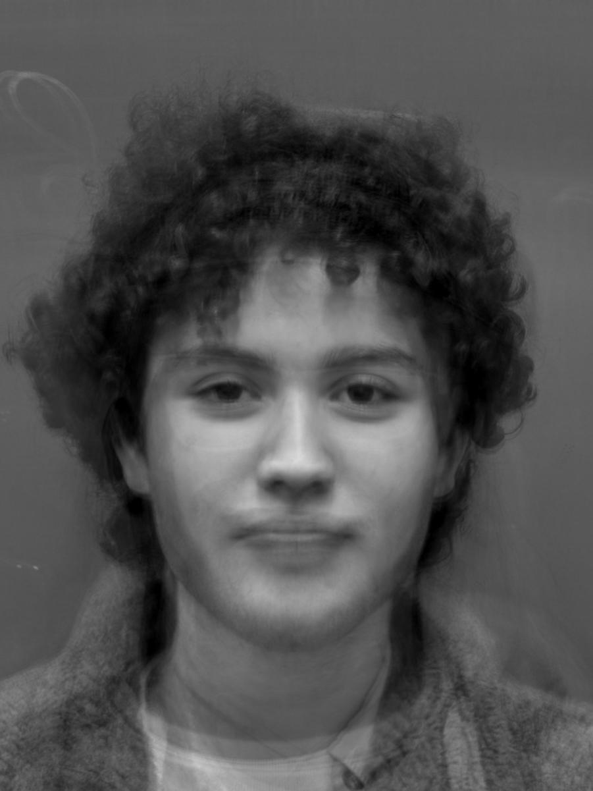
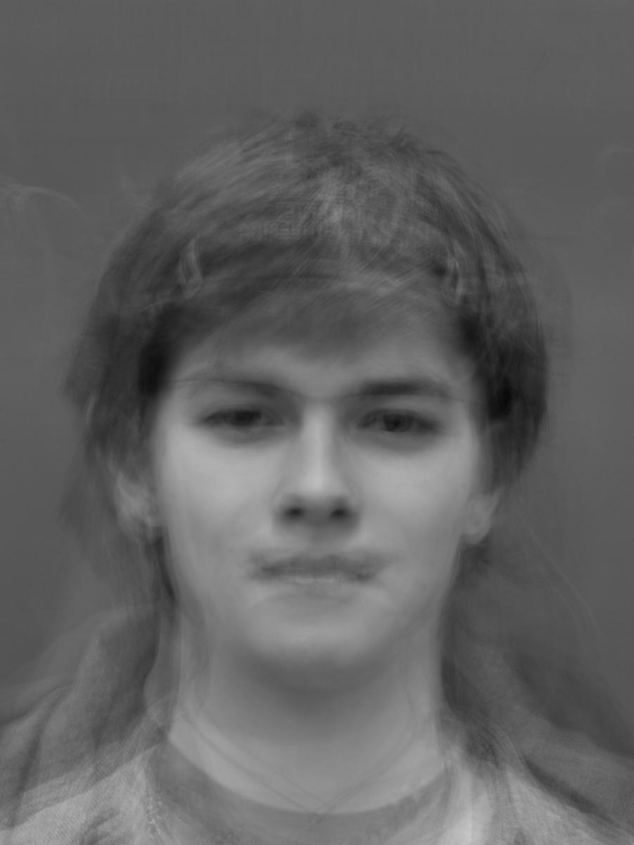
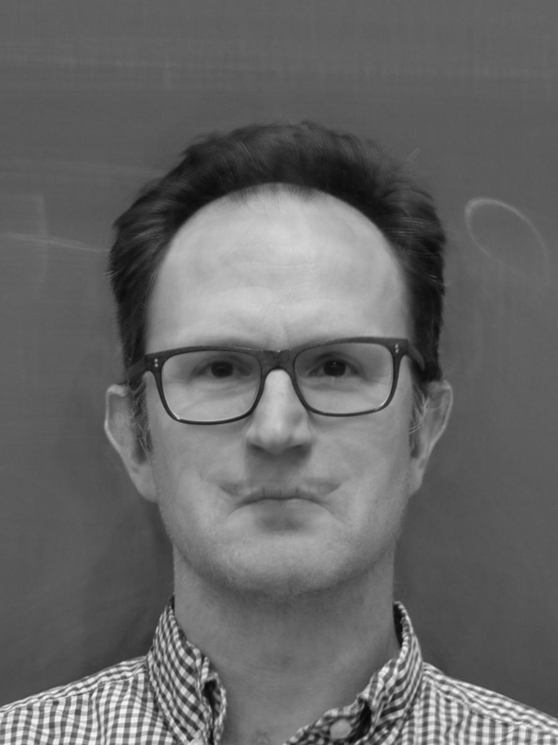
More results
10 components
12 components
14 components

Slide 10
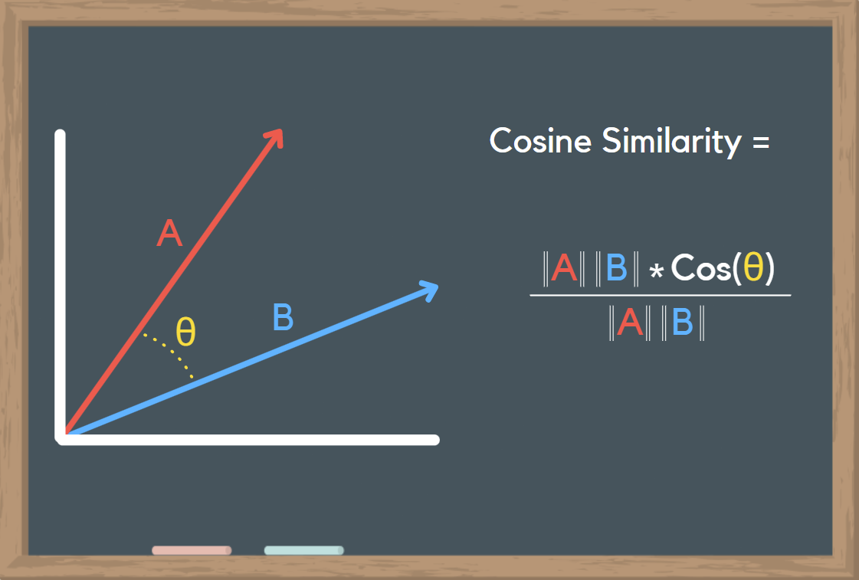
Aim #2 - Image similarity
https://towardsdatascience.com/what-is-cosine-similarity-how-to-compare-text-and-images-in-python-d2bb6e411ef0
Notes:
Discuss why the similarity for 2 images is pretty high standardly, this is due to similar background, aspect ratio, and things like that.

Slide 11
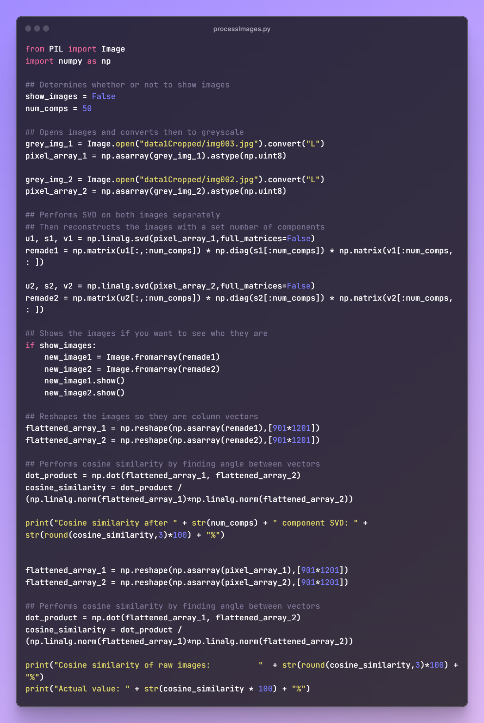
How we did it

Slide 12
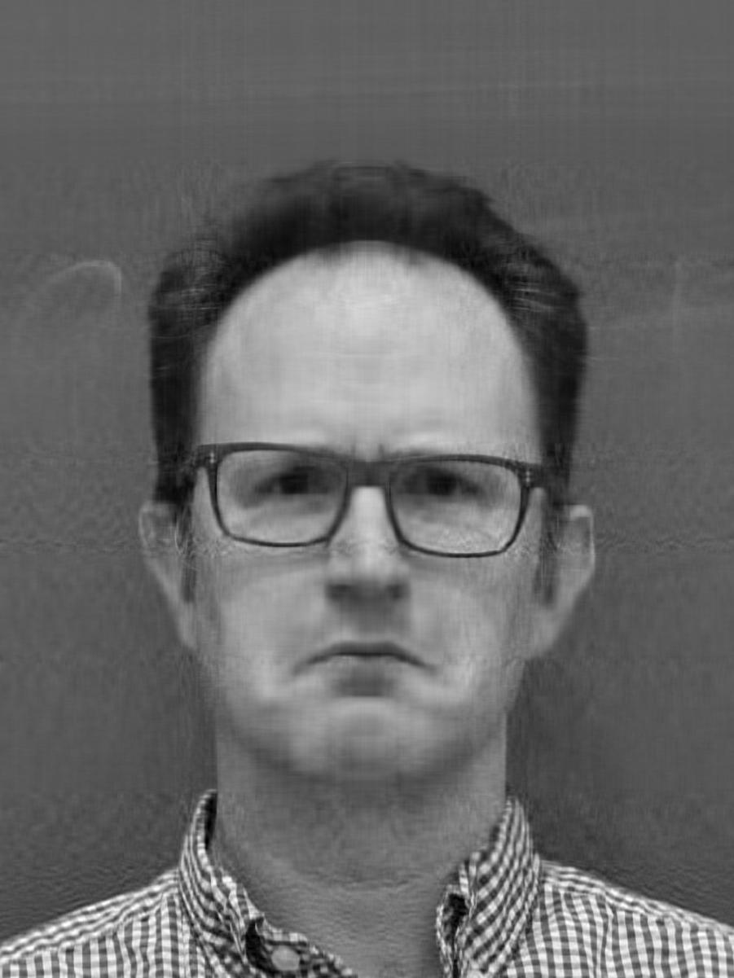
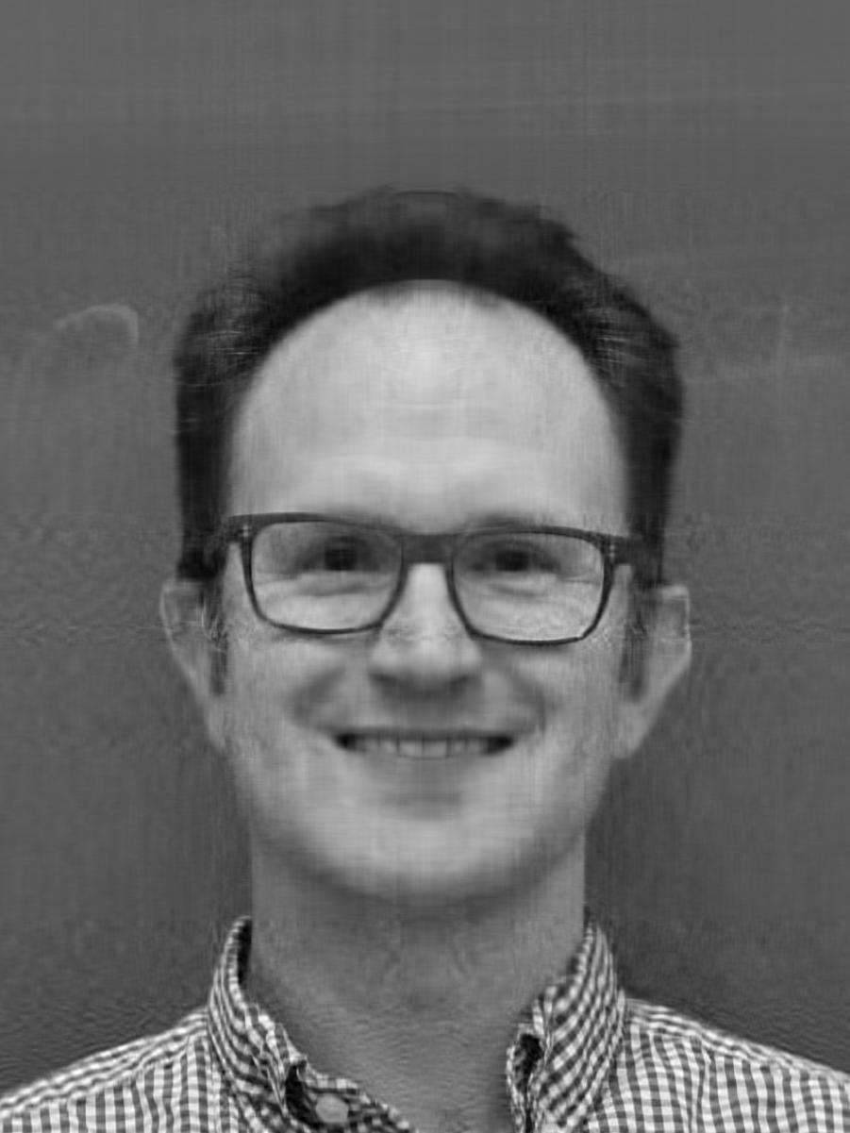
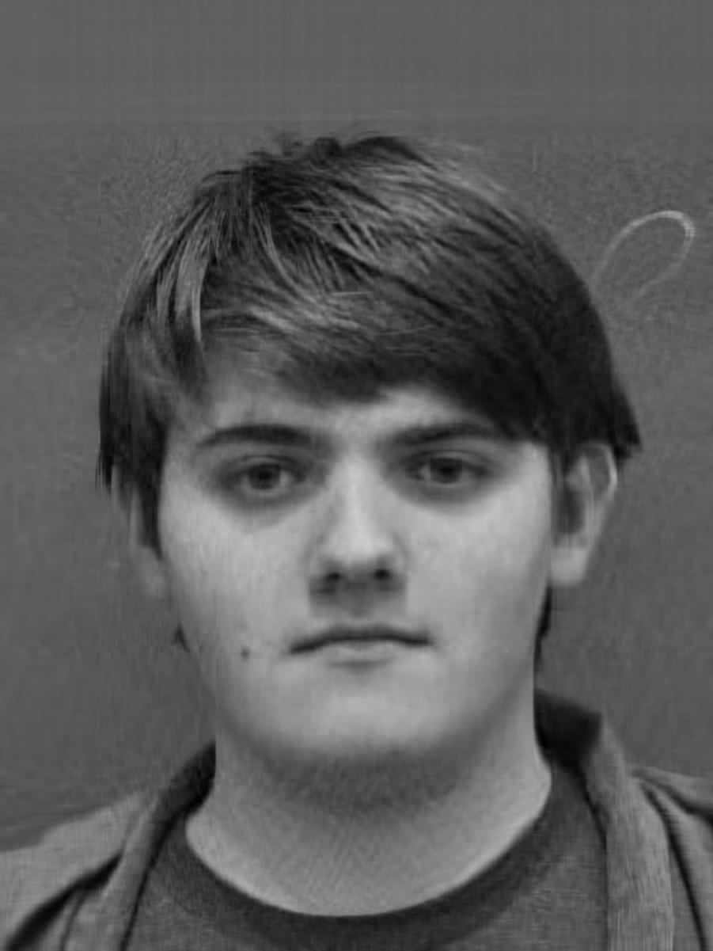
Cosine similarity results
Similarity after 50 component SVD: 99.4%
Similarity of raw images: 0.0%
Actual value: 1.1070876547300715e-06%
Similarity after 50 component SVD: 90.6%
Similarity of raw images: 0.0%
Actual value: 3.8374440403492704e-07%

Slide 13
Thank you
Questions?
Check out our code and images:
https://github.com/pjkirby31/EigenFace

