Slide 1

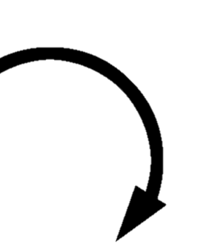

light panel
light panel

Slide 2


Take pictures of plants on left side
Both panels are on the same side now
light panel
light panel
Turn this wheel to pull left panel to the right side

Slide 3
Turn this wheel to pull left panel back to left side
light panel
light panel

Slide 4
light panel
light panel
Turn this wheel to pull right panel to left side

Slide 5
Take pictures of plants on right side
light panel
light panel
Turn this wheel to pull right panel to left side
Truck drives to right panel

Slide 6
light panel
light panel
Turn this wheel to pull right panel back to right side
Truck can now move onto next section

