Slide 1
Property | Property abbreviation | Model | Training Set | Test Set
Atmospheric hydroxylation rate | AOH | Regression | 516 | 176
Bioconcentration factor | BCF | Regression | 469 | 157
Biodegradability half-life | BioHL | Regression | 112 | 38
Boiling point | BP | Regression | 4077 | 1358
Henry's Law constant | HL | Regression | 441 | 150
Fish biotransformation half-life | KM | Regression | 405 | 136
Octanol-air partition coefficient | KOA | Regression | 202 | 68
Soil adsorption coefficient | KOC | Regression | 545 | 184
Octanol-water partition coefficient | logP | Regression | 10537 | 3513
Melting point | MP | Regression | 6486 | 2167
Readily biodegradable | RB | Classification | 1197 | 411
Vapor pressure | VP | Regression | 2034 | 679
Water solubility | WS | Regression | 3158 | 1066

Slide 2
Property | Property abbreviation | mlr | pls | svm | knn | boosted trees
Atmospheric hydroxylation rate | AOH | 0.7636 | 0.7362 | 0.8367 | 0.7877 | 0.7972
Bioconcentration factor | BCF | 0.0668 | 0.0398 | 0.7690 | 0.6916 | 0.8085
Biodegradability half-life | BioHL | 0.7812 | 0.8044 | 0.7594 | 0.7520 | 0.7329
Boiling point | BP | 0.8978 | 0.8875 | 0.9487 | 0.8829 | 0.9535
Henry's Law constant | HL | 0.7380 | 0.7241 | 0.6592 | 0.6898 | 0.7564
Fish biotransformation half-life | KM | 0.6738 | 0.7177 | 0.7433 | 0.6596 | 0.7855
Octanol-air partition coefficient | KOA | 0.9713 | 0.9686 | 0.9357 | 0.9148 | 0.9727
Soil adsorption coefficient | KOC | 0.7750 | 0.8040 | 0.7810 | 0.7195 | 0.8145
Octanol-water partition coefficient | logP | 0.8125 | 0.8098 | 0.9052 | 0.8546 | 0.9234
Melting point | MP | 0.6849 | 0.6656 | 0.7841 | 0.7253 | 0.8106
Readily biodegradable | RB | ………. classification ……….
Vapor pressure | VP | 0.8834 | 0.8823 | 0.9385 | 0.8662 | 0.9327
Water solubility | WS | 0.8317 | 0.8315 | 0.8770 | 0.8113 | 0.8924

Slide 3
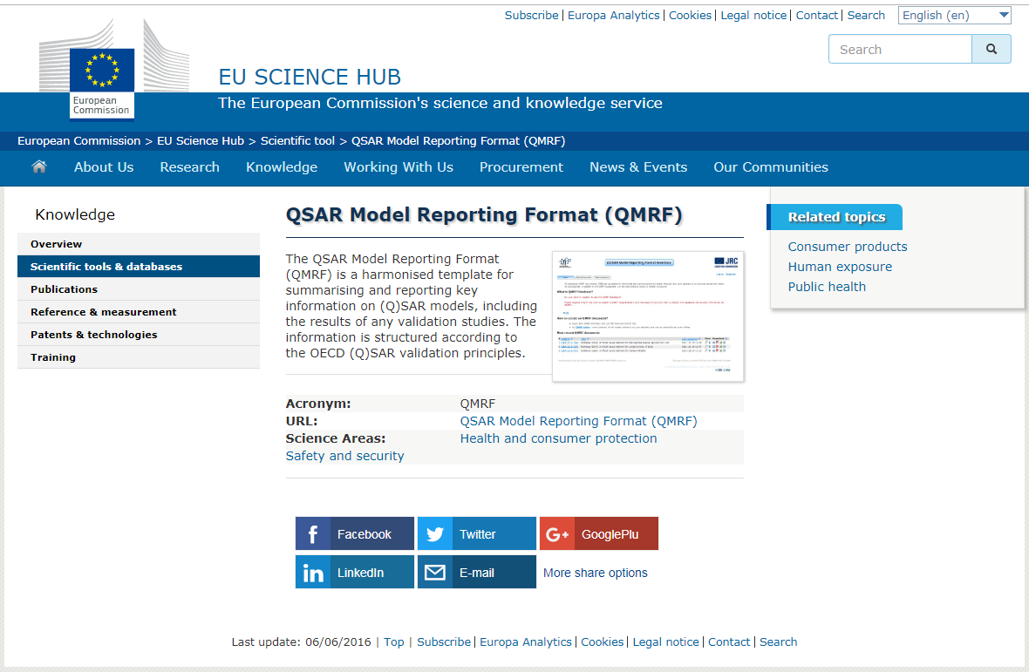

Slide 4
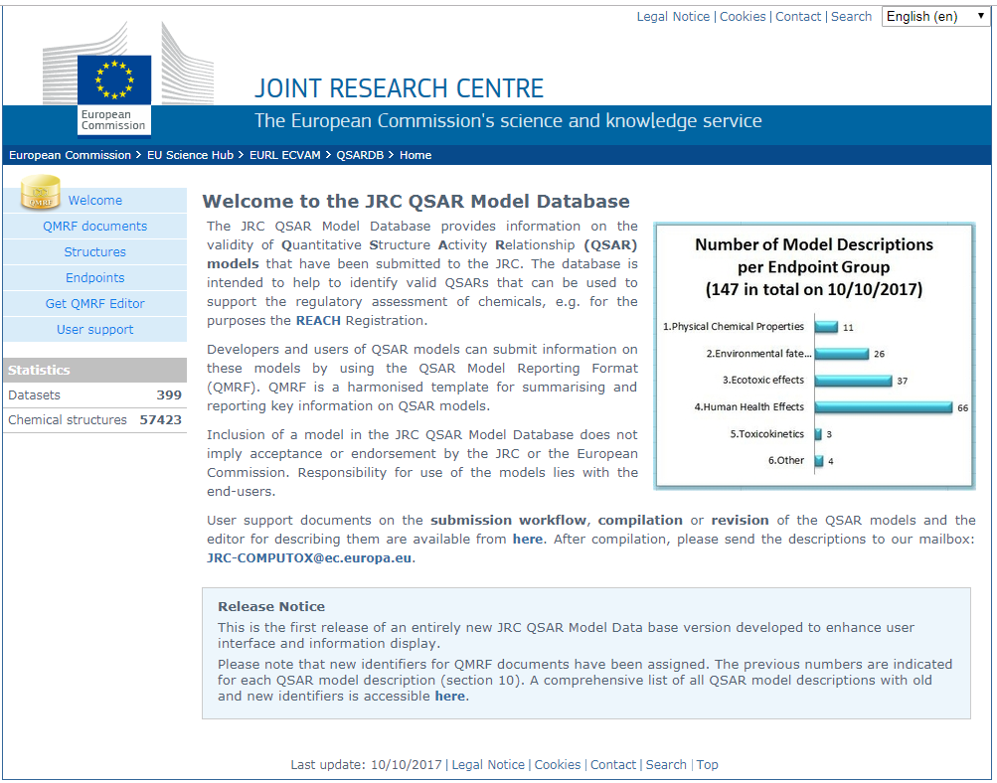

Slide 5
