Slide 1
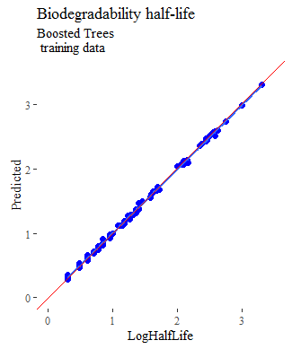
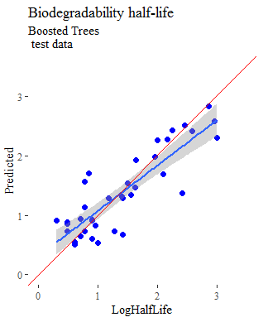
Property | Property abbreviation | Model | Number of Molecules
Atmospheric hydroxylation rate | AOH | Regression | 692
Bioconcentration factor | BCF | Regression | 626
Biodegradability half-life | BioHL | Regression | 150
Boiling point | BP | Regression | 5435
Henry's Law constant | HL | Regression | 591
Fish biotransformation half-life | KM | Regression | 541
Octanol-air partition coefficient | KOA | Regression | 270
Soil adsorption coefficient | KOC | Regression | 729
Octanol-water partition coefficient | logP | Regression | 14050
Melting point | MP | Regression | 8653
Readily biodegradable | RB | Classification | 1608
Vapor pressure | VP | Regression | 2713
Water solubility | WS | Regression | 4224
Build predictive models for each of 13 targets of environmental interest
Data is taken from the publicly available PHYSPROP database
The modeling procedure was developed based on the five Organization for Economic Cooperation and Development (OECD) principles for QSAR models:
defined endpoint
unambiguous algorithm
defined applicability domain
appropriate measures for goodness-of-fit, robustness, and predictivity
mechanistic interpretation, if possible

