Slide 1
Loader
[Software System]
Loads a data file.
Server
[Software System]
Serves a Solution to Problem
transport
udp
Json Loader
[Software System]
Converts from Json format to Native format
XML Loader
[Software System]
Converts from XML format to Native format
Cache
[Container: Online In-memory datastore]
tcp
Client
[Software System]
Runs the messages from the
Native Loader
[Software System]
Loads the Native Library Components System
handler

Slide 2
events
server
client
transport
udp
json
xml
tcp
native
cache
handler

Slide 4
GRIDLABD CORE
GRIDLABD CLASS
XML
JSON
NATIVE
MODE
CLIENT
SERVER
EVENTS
CACHE
TRANSPORT
TCP
UDP
NETWORK

Slide 5
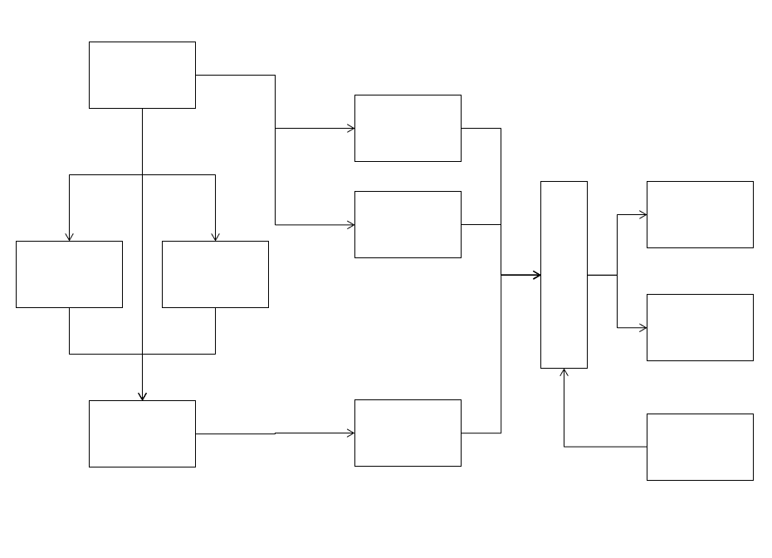

Slide 6
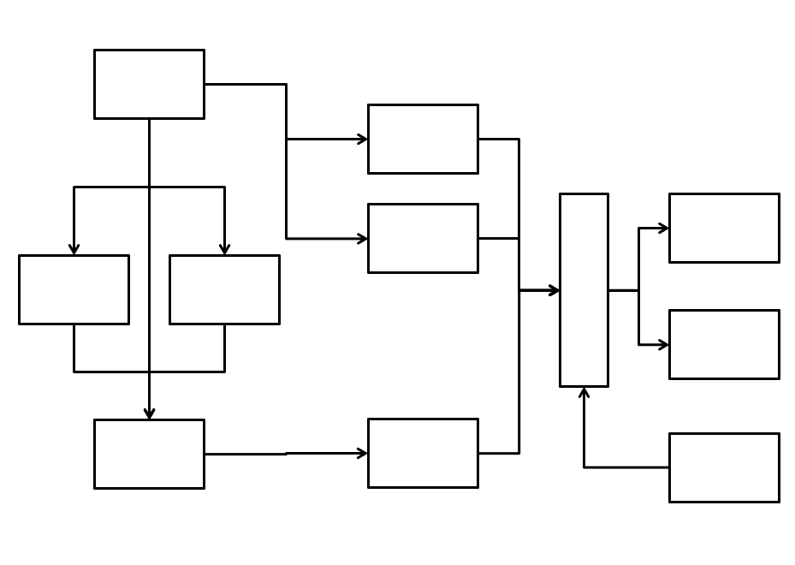

Slide 7
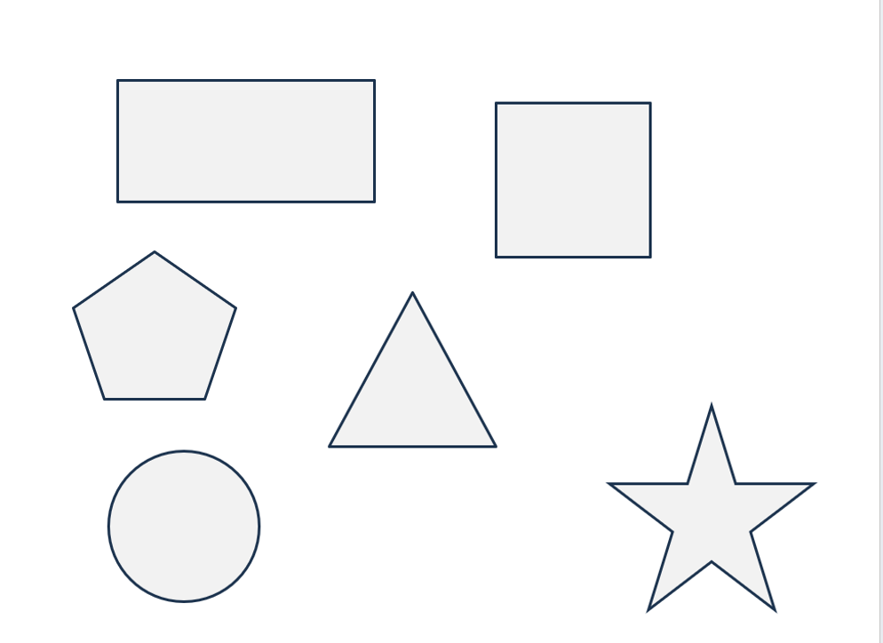

Slide 8
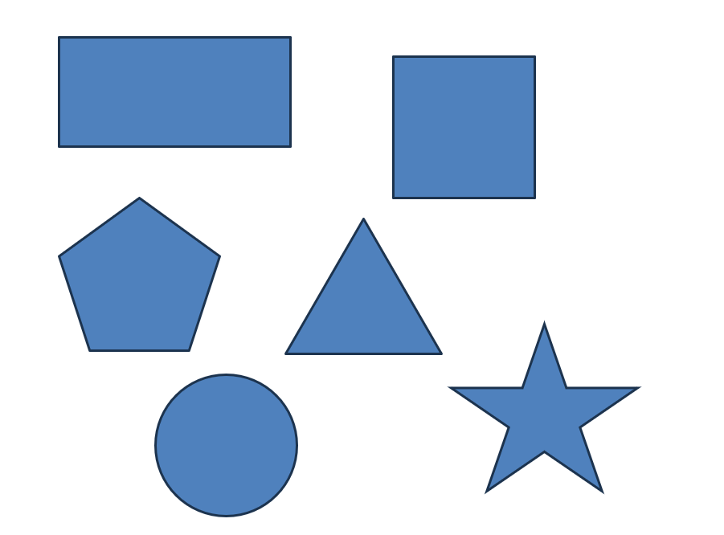

Slide 9


Slide 10


Slide 11


Slide 12


Slide 13
