Slide 1
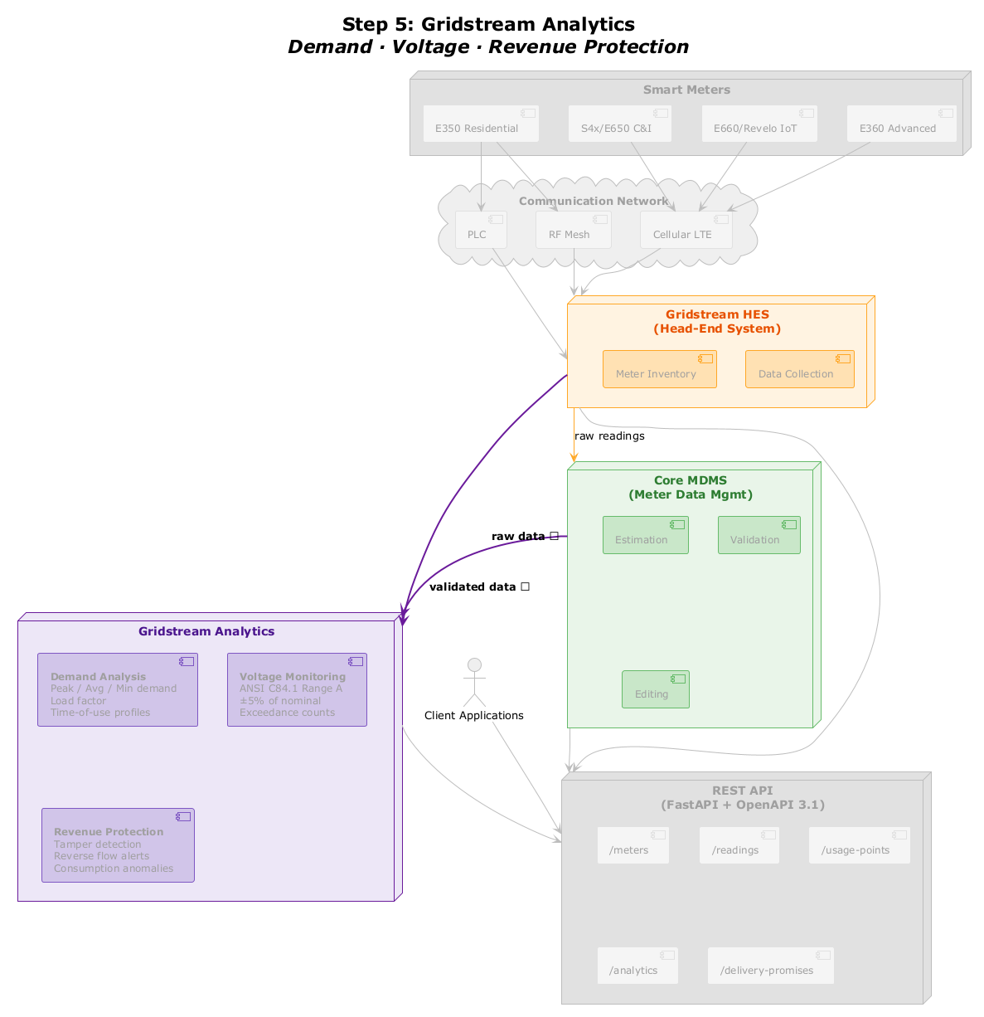
Step 5: Gridstream Analytics
Smart Meters
E350 Residential
S4x/E650 C&I
E660/Revelo IoT
E360 Advanced
Communication Network
PLC
RF Mesh
Cellular LTE
Gridstream HES
[(Head-End System)]
Meter Inventory
Data Collection
Core MDMS
[(Meter Data Mgmt)]
raw readings
Estimation
Validation
raw data →
Gridstream Analytics
Demand Analysis
[Peak / Avg / Min demand]
Load factor Time-of-use profiles
Voltage Monitoring
[ANSI C84.1 Range A]
±5% of nominal Exceedance counts
Client Applications
validated data →
Editing
REST API
[(FastAPI + OpenAPI 3.1)]
Revenue Protection
[Tamper detection]
Reverse flow alerts Consumption anomalies
/meters
/readings
/usage-points
/analytics
/delivery-promises

