Slide 1
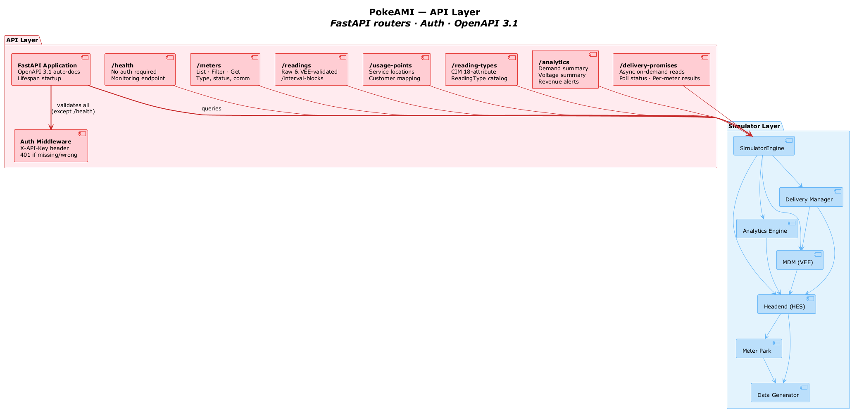
PokeAMI — API Layer
API Layer
FastAPI Application
[OpenAPI 3.1 auto-docs]
Lifespan startup
/health
[No auth required]
Monitoring endpoint
/meters
[List · Filter · Get]
Type, status, comm
/readings
[Raw & VEE-validated]
/interval-blocks
/usage-points
[Service locations]
Customer mapping
/reading-types
[CIM 18-attribute]
ReadingType catalog
/analytics
[Demand summary]
Voltage summary Revenue alerts
/delivery-promises
[Async on-demand reads]
Poll status · Per-meter results
validates all (except /health)
queries
Simulator Layer
Auth Middleware
[X-API-Key header]
401 if missing/wrong
SimulatorEngine
Delivery Manager
Analytics Engine
MDM (VEE)
Headend (HES)
Meter Park
Data Generator

