Slide 1
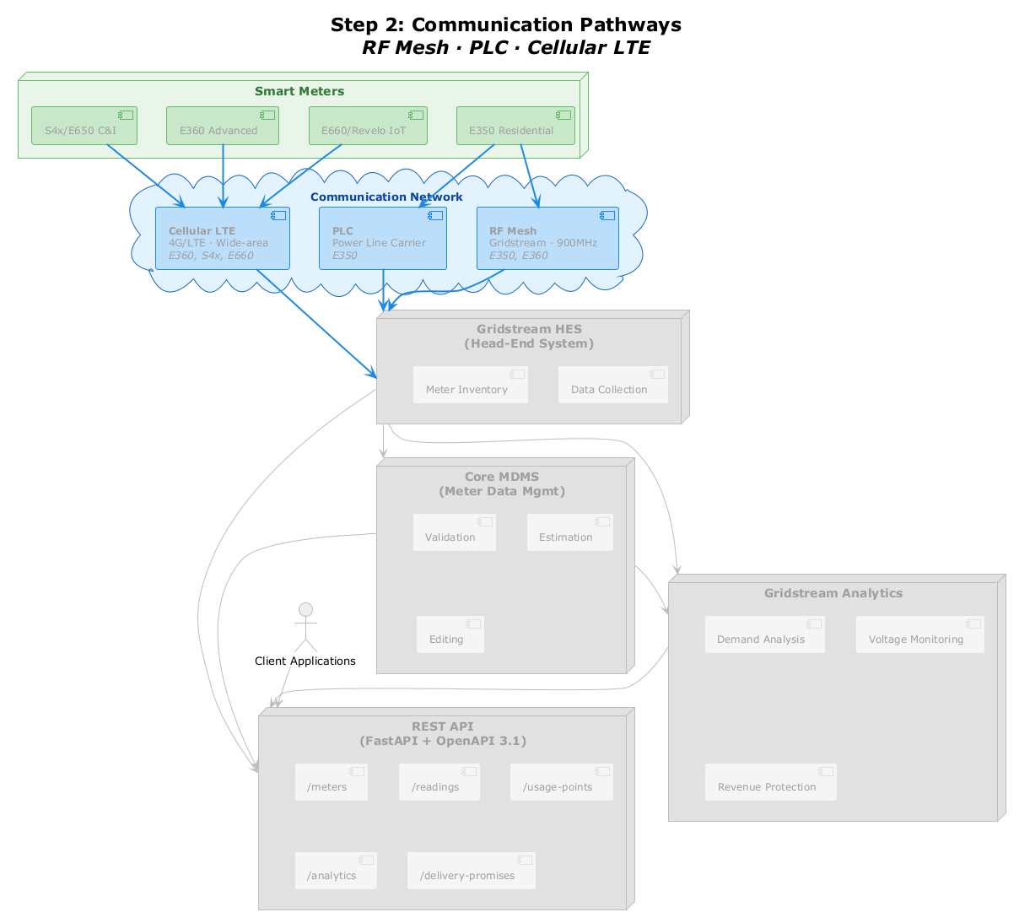
Step 2: Communication Pathways
Smart Meters
S4x/E650 C&I
E360 Advanced
E660/Revelo IoT
E350 Residential
Communication Network
Cellular LTE
[4G/LTE · Wide-area]
E360, S4x, E660
PLC
[Power Line Carrier]
E350
RF Mesh
[Gridstream · 900MHz]
E350, E360
Gridstream HES
[(Head-End System)]
Meter Inventory
Data Collection
Core MDMS
[(Meter Data Mgmt)]
Validation
Estimation
Gridstream Analytics
Client Applications
Editing
Demand Analysis
Voltage Monitoring
REST API
[(FastAPI + OpenAPI 3.1)]
/meters
/readings
/usage-points
Revenue Protection
/analytics
/delivery-promises

