Slide 1
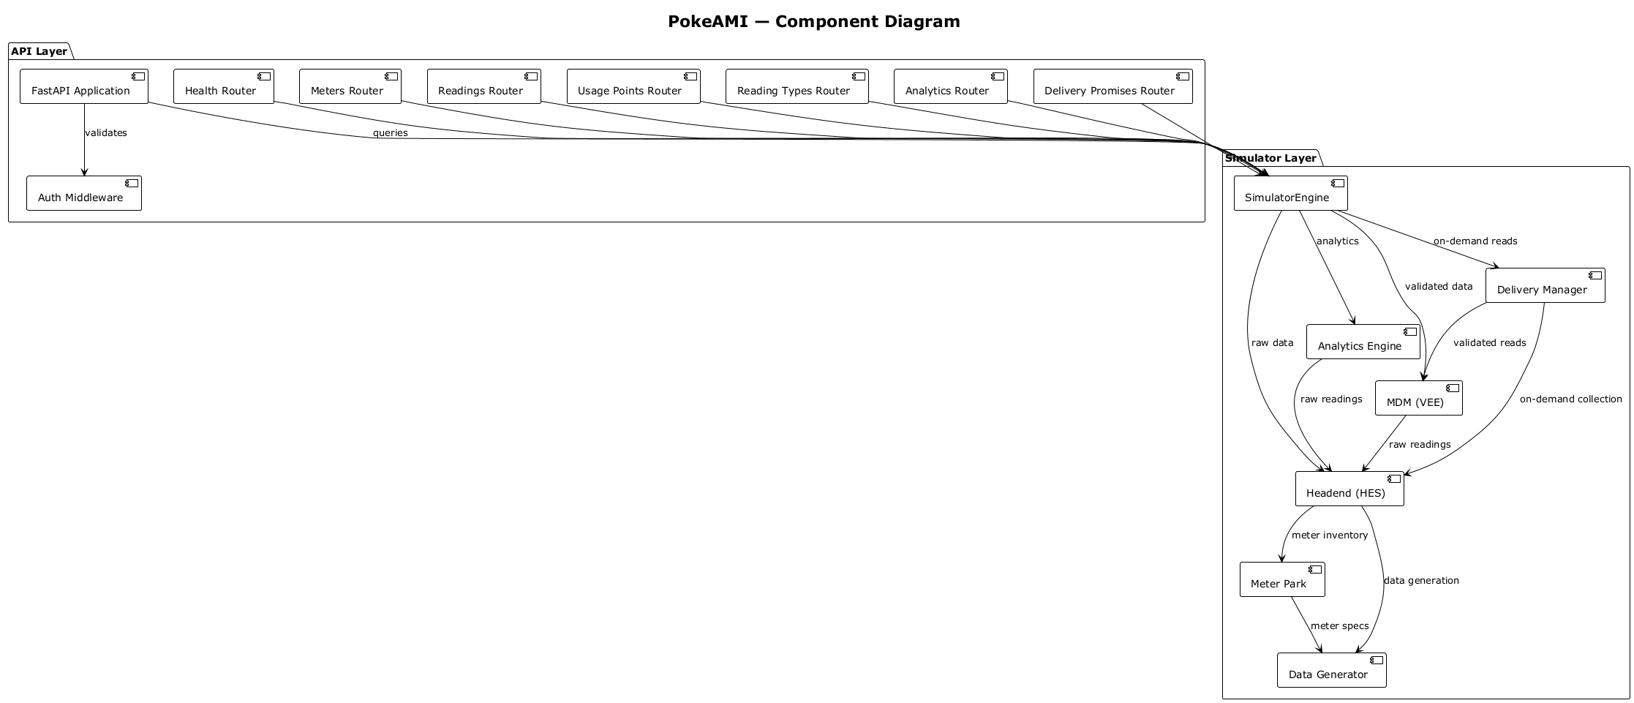
PokeAMI — Component Diagram
API Layer
FastAPI Application
Health Router
Meters Router
Readings Router
Usage Points Router
Reading Types Router
Analytics Router
Delivery Promises Router
validates
queries
Simulator Layer
Auth Middleware
SimulatorEngine
on-demand reads
analytics
Delivery Manager
validated data
Analytics Engine
raw data
validated reads
on-demand collection
MDM (VEE)
raw readings
raw readings
Headend (HES)
meter inventory
Meter Park
data generation
meter specs
Data Generator

