Slide 1
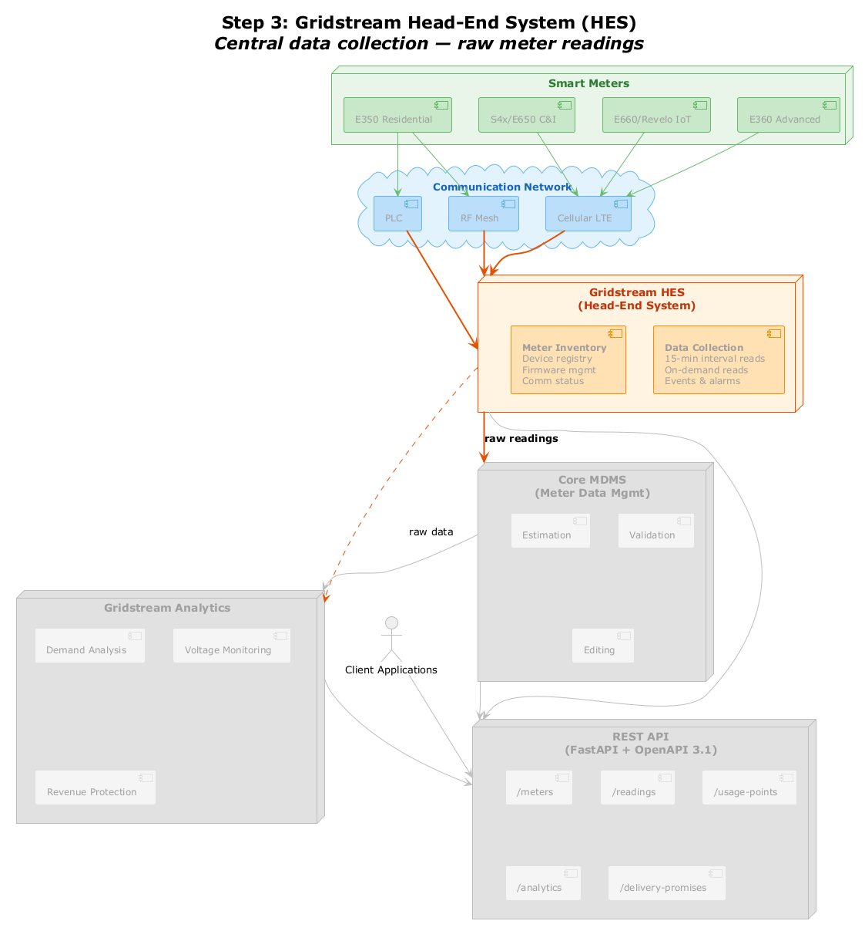
Step 3: Gridstream Head-End System (HES)
Smart Meters
E350 Residential
S4x/E650 C&I
E660/Revelo IoT
E360 Advanced
Communication Network
PLC
RF Mesh
Cellular LTE
Gridstream HES
[(Head-End System)]
Meter Inventory
[Device registry]
Firmware mgmt Comm status
Data Collection
[15-min interval reads]
On-demand reads Events & alarms
raw readings
Core MDMS
[(Meter Data Mgmt)]
raw data
Estimation
Validation
Gridstream Analytics
Demand Analysis
Voltage Monitoring
Client Applications
Editing
REST API
[(FastAPI + OpenAPI 3.1)]
Revenue Protection
/meters
/readings
/usage-points
/analytics
/delivery-promises

