Slide 1
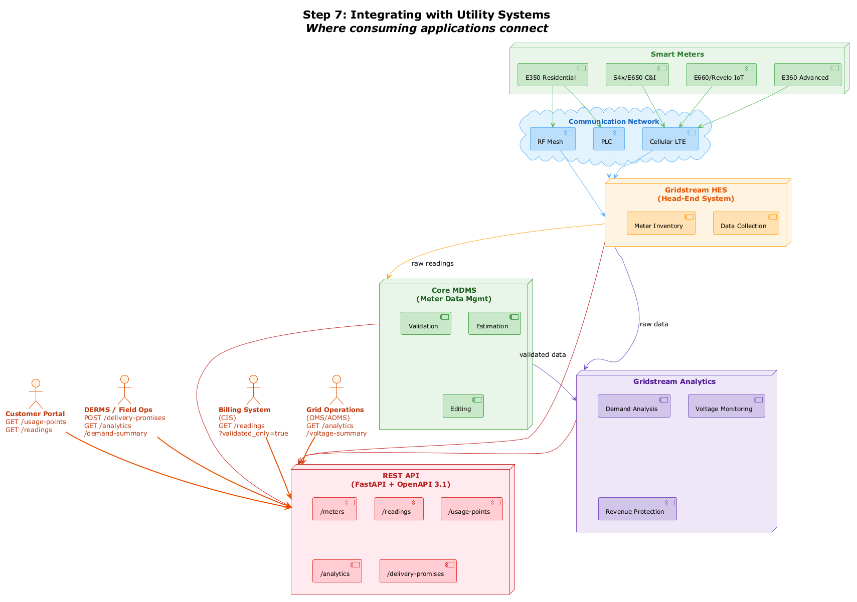
Step 7: Integrating with Utility Systems
Smart Meters
E350 Residential
S4x/E650 C&I
E660/Revelo IoT
E360 Advanced
Communication Network
RF Mesh
PLC
Cellular LTE
Gridstream HES
[(Head-End System)]
Meter Inventory
Data Collection
Core MDMS
[(Meter Data Mgmt)]
raw readings
Validation
Estimation
raw data
Customer Portal
[GET /usage-points]
GET /readings
DERMS / Field Ops
[POST /delivery-promises]
GET /analytics /demand-summary
Billing System
[(CIS)]
GET /readings ?validated_only=true
Grid Operations
[(OMS/ADMS)]
GET /analytics /voltage-summary
Gridstream Analytics
Editing
validated data
Demand Analysis
Voltage Monitoring
REST API
[(FastAPI + OpenAPI 3.1)]
/meters
/readings
/usage-points
Revenue Protection
/analytics
/delivery-promises

