Slide 1
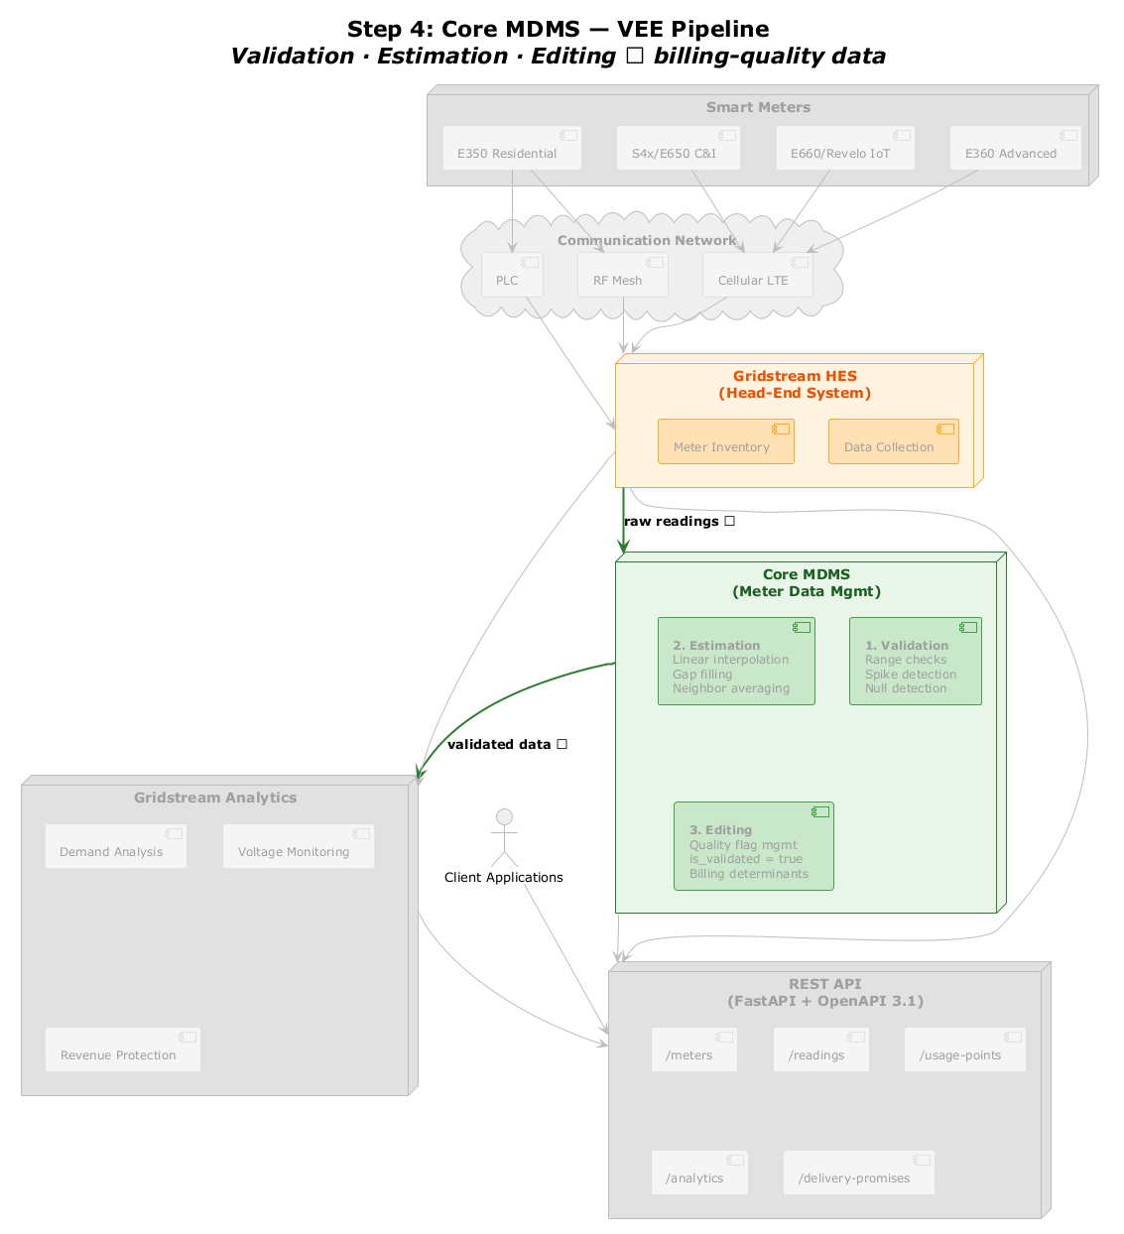
Step 4: Core MDMS — VEE Pipeline
Smart Meters
E350 Residential
S4x/E650 C&I
E660/Revelo IoT
E360 Advanced
Communication Network
PLC
RF Mesh
Cellular LTE
Gridstream HES
[(Head-End System)]
Meter Inventory
Data Collection
Core MDMS
[(Meter Data Mgmt)]
raw readings →
2. Estimation
[Linear interpolation]
Gap filling Neighbor averaging
1. Validation
[Range checks]
Spike detection Null detection
Gridstream Analytics
Client Applications
3. Editing
[Quality flag mgmt]
is_validated = true Billing determinants
Demand Analysis
Voltage Monitoring
validated data →
REST API
[(FastAPI + OpenAPI 3.1)]
Revenue Protection
/meters
/readings
/usage-points
/analytics
/delivery-promises

