Slide 1
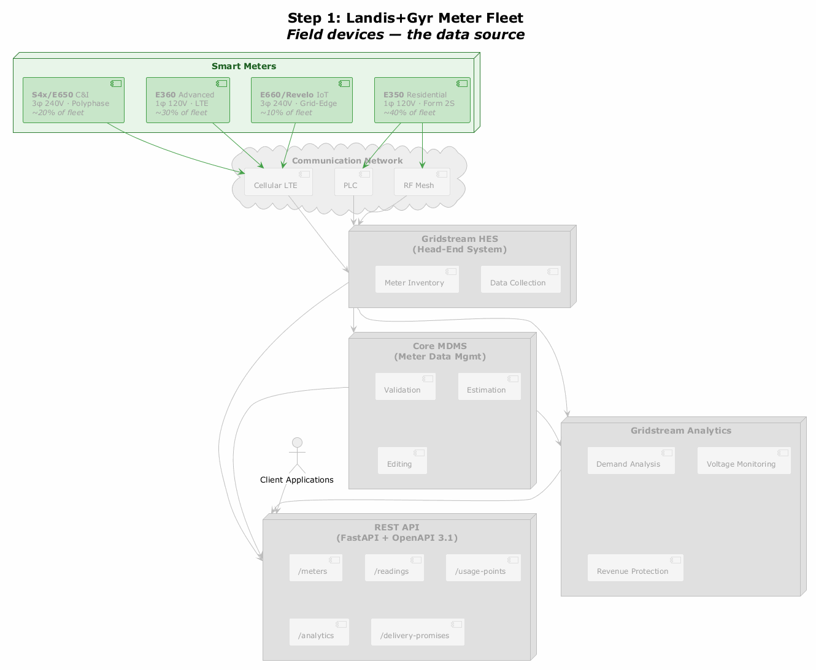
Step 1: Landis+Gyr Meter Fleet
Smart Meters
S4x/E650
[C&I]
3φ 240V · Polyphase ~20% of fleet
E360
[Advanced]
1φ 120V · LTE ~30% of fleet
E660/Revelo
[IoT]
3φ 240V · Grid-Edge ~10% of fleet
E350
[Residential]
1φ 120V · Form 2S ~40% of fleet
Communication Network
Cellular LTE
PLC
RF Mesh
Gridstream HES
[(Head-End System)]
Meter Inventory
Data Collection
Core MDMS
[(Meter Data Mgmt)]
Validation
Estimation
Gridstream Analytics
Client Applications
Editing
Demand Analysis
Voltage Monitoring
REST API
[(FastAPI + OpenAPI 3.1)]
/meters
/readings
/usage-points
Revenue Protection
/analytics
/delivery-promises

