Slide 1
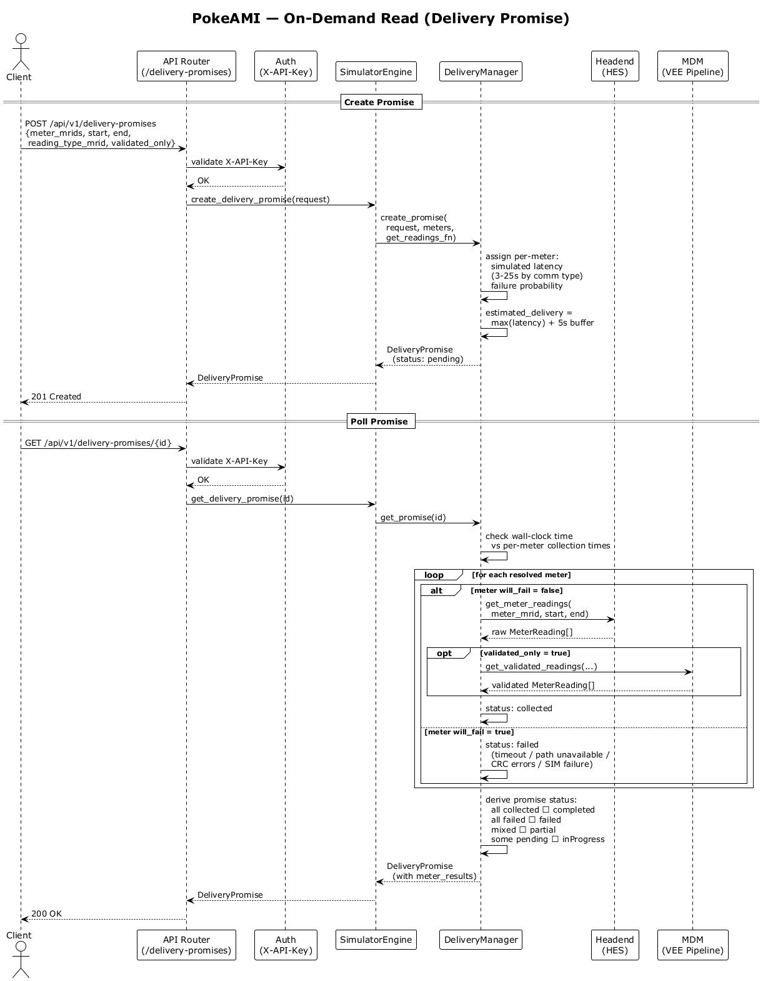
PokeAMI — On-Demand Read (Delivery Promise)
API Router (/delivery-promises)
Auth (X-API-Key)
SimulatorEngine
DeliveryManager
Headend (HES)
MDM (VEE Pipeline)
Create Promise
POST /api/v1/delivery-promises {meter_mrids, start, end, reading_type_mrid, validated_only}
validate X-API-Key
OK
create_delivery_promise(request)
create_promise( request, meters, get_readings_fn)
assign per-meter: simulated latency (3-25s by comm type) failure probability
estimated_delivery = max(latency) + 5s buffer
DeliveryPromise
DeliveryPromise (status: pending)
201 Created
Poll Promise
GET /api/v1/delivery-promises/{id}
validate X-API-Key
OK
get_delivery_promise(id)
get_promise(id)
check wall-clock time vs per-meter collection times
loop
[for each resolved meter]
alt
[meter will_fail = false]
get_meter_readings( meter_mrid, start, end)
opt
raw MeterReading[]
[validated_only = true]
get_validated_readings(...)
validated MeterReading[]
status: collected
[meter will_fail = true]
status: failed (timeout / path unavailable / CRC errors / SIM failure)
derive promise status: all collected → completed all failed → failed mixed → partial some pending → inProgress
DeliveryPromise
DeliveryPromise (with meter_results)
200 OK
API Router (/delivery-promises)
Auth (X-API-Key)
SimulatorEngine
DeliveryManager
Headend (HES)
MDM (VEE Pipeline)

