Slide 1
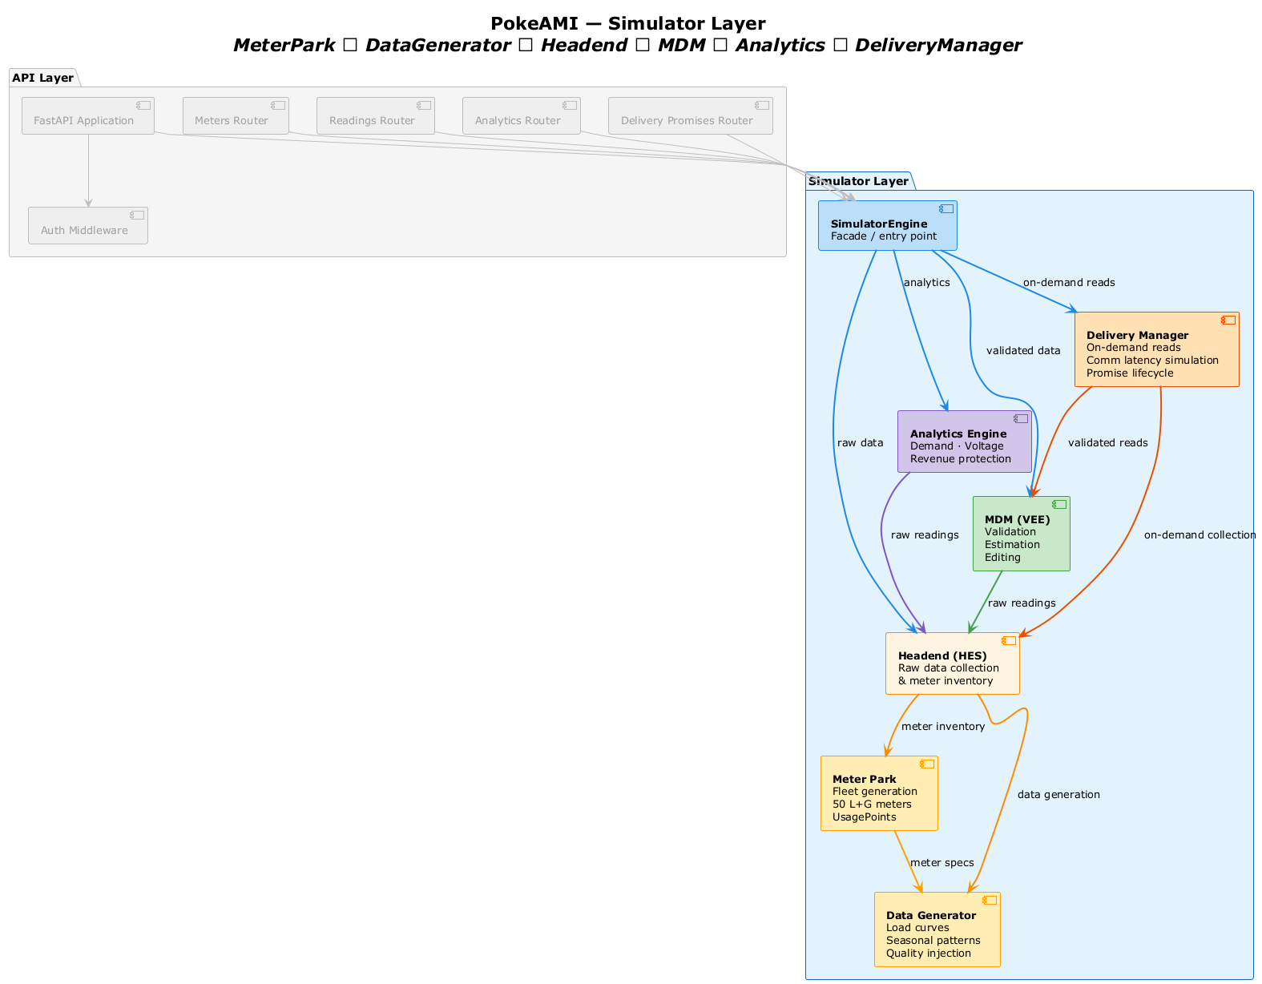
PokeAMI — Simulator Layer
API Layer
FastAPI Application
Meters Router
Readings Router
Analytics Router
Delivery Promises Router
Simulator Layer
Auth Middleware
SimulatorEngine
[Facade / entry point]
on-demand reads
analytics
Delivery Manager
[On-demand reads]
Comm latency simulation Promise lifecycle
validated data
Analytics Engine
[Demand · Voltage]
Revenue protection
raw data
validated reads
MDM (VEE)
[Validation]
Estimation Editing
on-demand collection
raw readings
raw readings
Headend (HES)
[Raw data collection]
& meter inventory
meter inventory
Meter Park
[Fleet generation]
50 L+G meters UsagePoints
data generation
meter specs
Data Generator
[Load curves]
Seasonal patterns Quality injection

