Slide 1
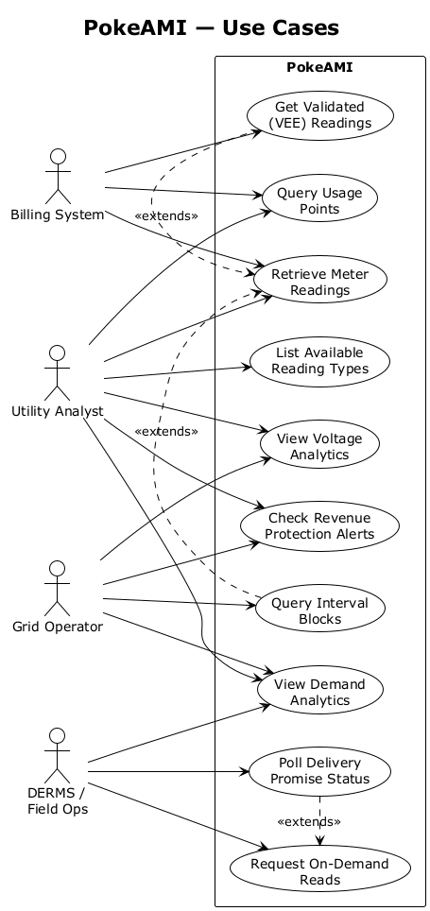
PokeAMI — Use Cases
PokeAMI
Get Validated
[(VEE) Readings]
Billing System
Query Usage
[Points]
«extends»
Retrieve Meter
[Readings]
Utility Analyst
List Available
[Reading Types]
View Voltage
[Analytics]
«extends»
Check Revenue
[Protection Alerts]
Grid Operator
Query Interval
[Blocks]
View Demand
[Analytics]
DERMS /
[Field Ops]
Poll Delivery
[Promise Status]
«extends»
Request On-Demand
[Reads]

