Slide 1
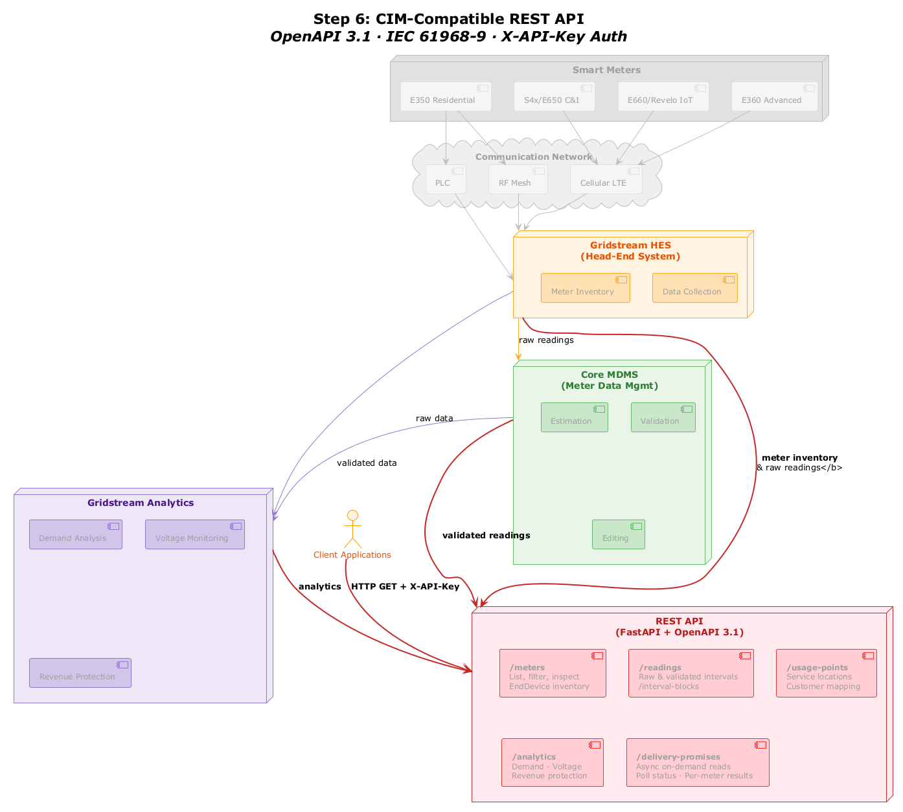
Step 6: CIM-Compatible REST API
Smart Meters
E350 Residential
S4x/E650 C&I
E660/Revelo IoT
E360 Advanced
Communication Network
PLC
RF Mesh
Cellular LTE
Gridstream HES
[(Head-End System)]
Meter Inventory
Data Collection
Core MDMS
[(Meter Data Mgmt)]
raw readings
Estimation
Validation
raw data
Gridstream Analytics
meter inventory & raw readings</b>
Demand Analysis
Voltage Monitoring
Client Applications
Editing
validated data
validated readings
REST API
[(FastAPI + OpenAPI 3.1)]
HTTP GET + X-API-Key
analytics
/meters
[List, filter, inspect]
EndDevice inventory
/readings
[Raw & validated intervals]
/interval-blocks
/usage-points
[Service locations]
Customer mapping
Revenue Protection
/analytics
[Demand · Voltage]
Revenue protection
/delivery-promises
[Async on-demand reads]
Poll status · Per-meter results

