Slide 1
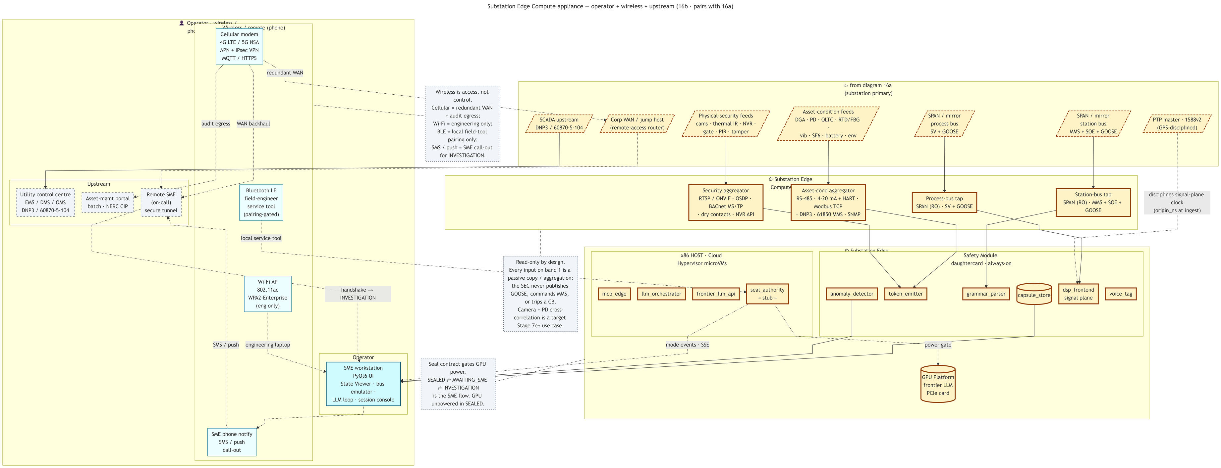
👤 Operator · wireless / phone · upstream
Wireless / remote (phone)
Cellular modem 4G LTE / 5G NSA APN + IPsec VPN MQTT / HTTPS
redundant WAN
⇦ from diagram 16a (substation primary)
Wireless is access, not control. Cellular = redundant WAN + audit egress; Wi-Fi = engineering only; BLE = local field-tool pairing only; SMS / push = SME call-out for INVESTIGATION.
"SCADA upstream DNP3 / 60870-5-104"
"Corp WAN / jump host (remote-access router)"
"Physical-security feeds cams · thermal IR · NVR · gate · PIR · tamper"
"Asset-condition feeds DGA · PD · OLTC · RTD/FBG · vib · SF6 · battery · env"
"SPAN / mirror process bus SV + GOOSE"
"SPAN / mirror station bus MMS + SOE + GOOSE"
"PTP master · 1588v2 (GPS-disciplined)"
audit egress
WAN backhaul
Upstream
Bluetooth LE field-engineer service tool (pairing-gated)
⚙ Substation Edge Compute · Inputs
Utility control centre EMS / DMS / OMS DNP3 / 60870-5-104
Asset-mgmt portal batch · NERC CIP
Remote SME (on-call) secure tunnel
Security aggregator RTSP / ONVIF · OSDP · BACnet MS/TP · dry contacts · NVR API
Asset-cond aggregator RS-485 · 4-20 mA + HART · Modbus TCP · DNP3 · 61850 MMS · SNMP
Process-bus tap SPAN (RO) · SV + GOOSE
Station-bus tap SPAN (RO) · MMS + SOE + GOOSE
disciplines signal-plane clock (origin_ns at ingest)
local service tool
⚙ Substation Edge Compute · enclosure
Read-only by design. Every input on band 1 is a passive copy / aggregation; the SEC never publishes GOOSE, commands MMS, or trips a CB. Camera + PD cross-correlation is a target Stage 7e+ use case.
x86 HOST · Cloud Hypervisor microVMs
Safety Module daughtercard · always-on
handshake → INVESTIGATION
Wi-Fi AP 802.11ac WPA2-Enterprise (eng only)
mcp_edge
llm_orchestrator
frontier_llm_api
seal_authority « stub »
anomaly_detector
token_emitter
grammar_parser
capsule_store
dsp_frontend signal plane
voice_tag
SMS / push
engineering laptop
Operator
mode events · SSE
power gate
SME workstation PyQt6 UI State Viewer · bus emulator · LLM loop · session console
Seal contract gates GPU power. SEALED ⇄ AWAITING_SME ⇄ INVESTIGATION is the SME flow. GPU unpowered in SEALED.
GPU Platform frontier LLM PCIe card
SME phone notify SMS / push call-out

