Slide 1
Coordinate Transformations
2D Coordinate Systems
1

Slide 2
2D Coordinate Systems
Before maps can be drawn, the positions, or co-ordinates, of the mapped points must all be in one single co-ordinate system. Thus if more than one co-ordinate systems are involved, they would need to be converted. To do that, one usually retains one co-ordinate system and converts all the positions which refer to all the other co-ordinate systems, to make them refer to the required system. This conversion is called a co-ordinate transformation.
2

Slide 3
2D Coordinate Systems
A 2-D co-ordinate system consists of an origin, two axes that intersect at that origin and either one or two scale factors. Examples of 2-D co-ordinate systems include: the UTM co-ordinate system, the co-ordinate systems on a digitizer, scanner and aerial photograph.
3

Slide 4
2D Coordinate Systems
ORIGIN
For the two dimensional system, the origin is defined by specifying its two co-ordinates (X₀, Y₀) for example, one along the first axis and the other along the second axis. These two co-ordinates are arbitrary but they are often taken to be equal to zero.
4
origins

Slide 5
2D Coordinate Systems
ORIENTATION
If the two axes are at right angles to each other, the system is called an orthogonal co-ordinate system. In rare cases, the angle between them is something other than 90 degrees. In this case the system is called a non-orthogonal system. If the axes are orthogonal, then defining the orientation of one axis would automatically define that of the other. Therefore only one angle is needed to define the orientation of a 2-D orthogonal co-ordinate system. If, however, the axes are non-orthogonal, then defining the orientation of one axis would not define the orientation of the other since the angle between them is unknown. Therefore two angles are needed to define the orientation of a 2-D non-orthogonal co-ordinate system; the orientation of the first axis and the angle between the axes.
5

Slide 6
2D Coordinate Systems
orientation

Slide 7
2D Coordinate Systems
SCALE
If a unit distance has the same length along the X as well as the Y axis, we say that the co-ordinate system has a homogeneous scale. In that case, knowing the distance of one line defines the scale of the system uniquely, no matter in which direction that distance extends. If, however, a unit length along the X axis is different from a unit length along the Y axis, then the 2-D system possesses two scale factors; S_{x} and S_{y} for example.

Slide 8
2D Coordinate Systems
The possible permutations for the definition of the 2-D co-ordinate system are therefore
TYPE OF 2-D SYSTEM
NUMBER OF PARAMETERS REQUIRED
SYSTEM
ORIGIN
ORIENTA-TION
SCALE
2-d non-orthogonal non-homogeneous scale
2
2
2
2-d non-orthogonal homogeneous scale
2
2
1
2-d orthogonal non-homogeneous scale
2
1
2
2-d orthogonal homogeneous scale
2
1
1

Slide 9
2D Coordinate Systems
DEFINING THE PARAMETERS
ORIGIN
The origin is usually arbitrarily defined. For example, the origin of a digitiser or a scanner is taken to be in one of its four corners and that of an aerial photograph system is usually at the intersection of the tic marks.

Slide 10
2D Coordinate Systems
ORIENTATION
The orientation may be either arbitrary or physically meaningful, A chain line and offsets is an example of an arbitrary orientation in a co-ordinate system. In this situation, the surveyor chooses one line, usually a boundary line to be an axis of the system and then defines the other axis as being orthogonal to it. A physically meaningful choice of orientation may be the axis of a digitiser or a scanner co-ordinate system being parallel to its two edges. The axes of the UTM system are also attached in some way to the actual north-south direction on the Earth surface.

Slide 11
2D Coordinate Systems
SCALE
The scale factor must be defined or may be determined by computing from known distances on the projection and the corresponding distances on the ground.

Slide 12
2-D Conformal Coordinate Transformation
2-D CONFORMAL TRANSFORMATION
A 2-D conformal transformation is a scale homogeneous, orthogonal transformation requiring 4 parameters – 1 scale, 1 orientation, 2 translations
Consider a line AB on 2 superimposed coordinate systems
The coordinates of the points A and B are known on both systems
E_{B}
B
Coordinate system 2
N_{B}
R
A
Coordinate system 1

Slide 13
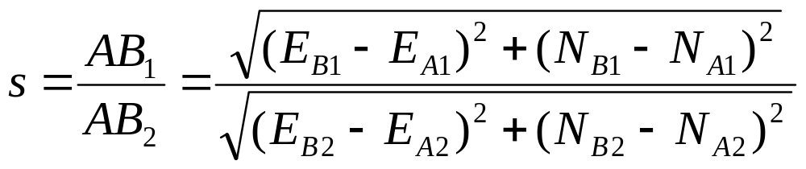
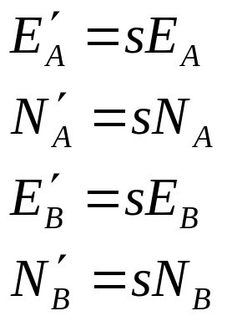
2-D Conformal Coordinate Transformation
The scale or units of measurement on the 2 systems are different.
To transform from system 1 to system 2 the scale must be found
The scaled coordinates of the points in coordinate system 1 to coordinate system 2 are:
Any point on system 1 can be scaled to system 2

Slide 14
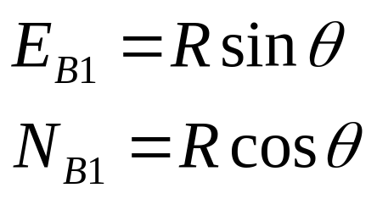
2-D Conformal Coordinate Transformation
The orientation of the 2 systems are different
Coordinate system 2
E_{B}
B
N_{B}
R
θ
Coordinate system 1
A
Consider point B

Slide 15
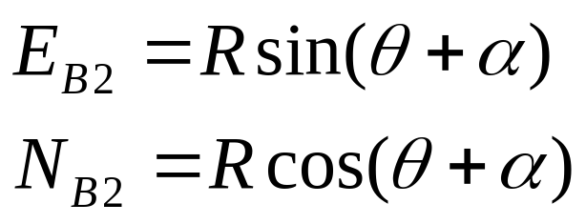
2-D Conformal Coordinate Transformation
On coordinate system 2 the same point B
Coordinate system 2
B
E_{B}
N_{B}
α
θ
R
A
Coordinate system 1

Slide 16
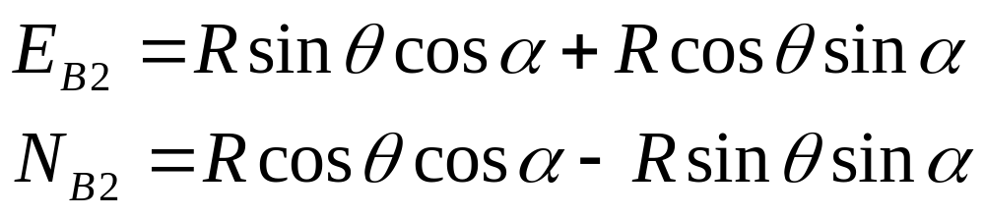
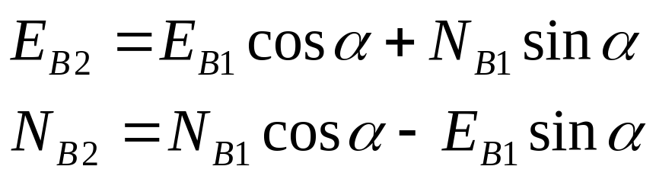
2-D Conformal Coordinate Transformation
Expanding using sum of sines and cosines
since

Slide 17
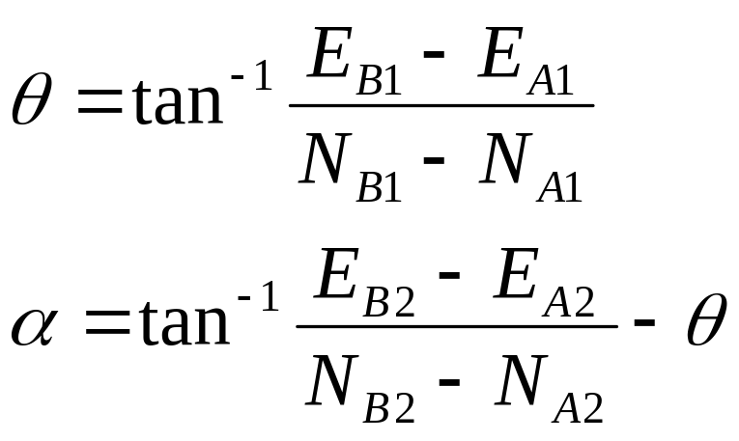
2-D Conformal Coordinate Transformation
The angles θ and α can be found by

Slide 18
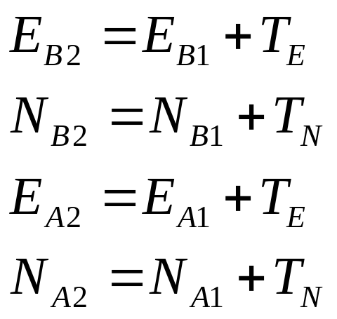
2-D Conformal Coordinate Transformation
A translation is required since the origin of the 2 systems are different
Consider the situation where the origins are shifted
B
Coordinate system 1
X₀, Y₀ (T_{E}, T_{N})
Coordinate system 2
(0, 0)

Slide 19
2-D AFFINE TRANSFORMATION
Unique and Least Squares Solutions

Slide 20
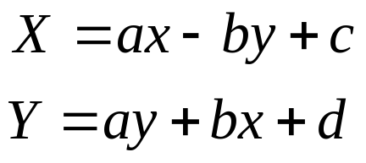
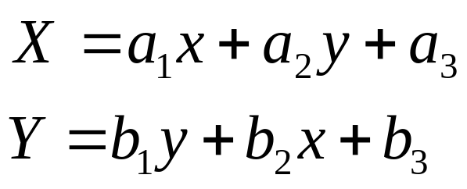
2-D Affine Transformation
2-D Conformal transformations include 2 parameters for change in origin (or translation), 1 parameter for change in orientation and 1 parameter for change in scale.
2-D affine transformations include 2 parameters for change in origin, 2 parameters for change in scale and 2 parameters for change in orientation.
The form of the 2-D conformal transformation equations was reduced to:
The form of the 2-D affine transformation equations is reduced to the form:

Slide 21
2-D Affine Transformation
The usual application of the 2-D affine transformation equations (as it was with the 2-D conformal equations) is when the parameters are first determined by utilizing known co-located points and then the equations with the known parameters included are applied to points known on one system to transform them to the other system.
Three co-located points are required from which 6 equations can be derived in order to determine the 6 parameters uniquely

Slide 22
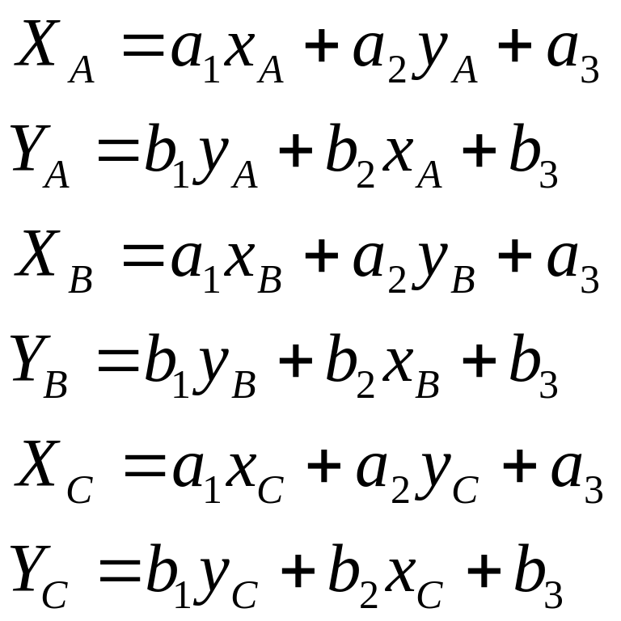
2-D Affine Transformation
For 3 co-located points, the equations are:

Slide 23
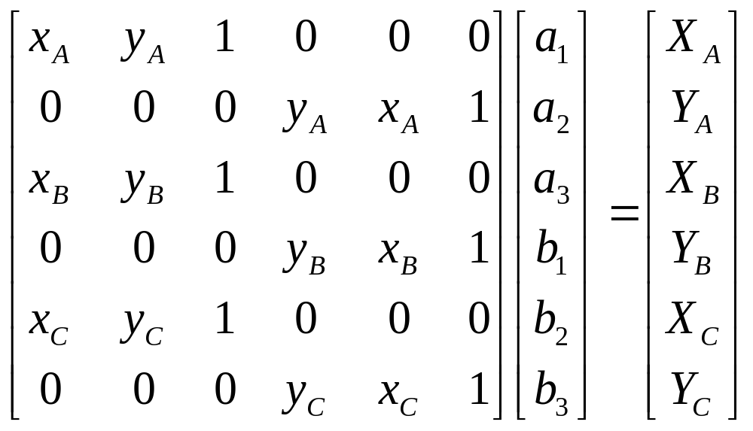
2-D Affine Transformation
These equations are of the linear equation form:
_{m}A^{n} _{n}X¹ = _{m}L¹
Where there are m equations and n unknowns and m = n so that:

Slide 24
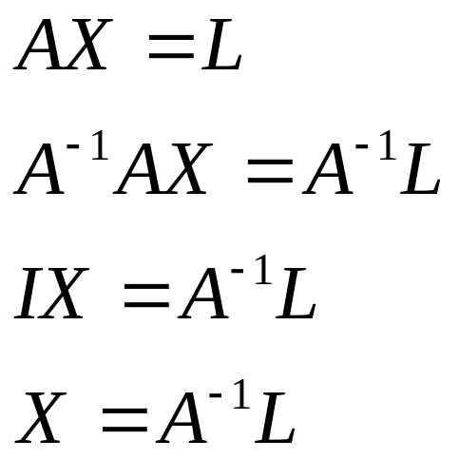

2-D Affine Transformation
The parameters can therefore be determined using matrix methods:
And other points may be transformed using matrix methods:

Slide 25
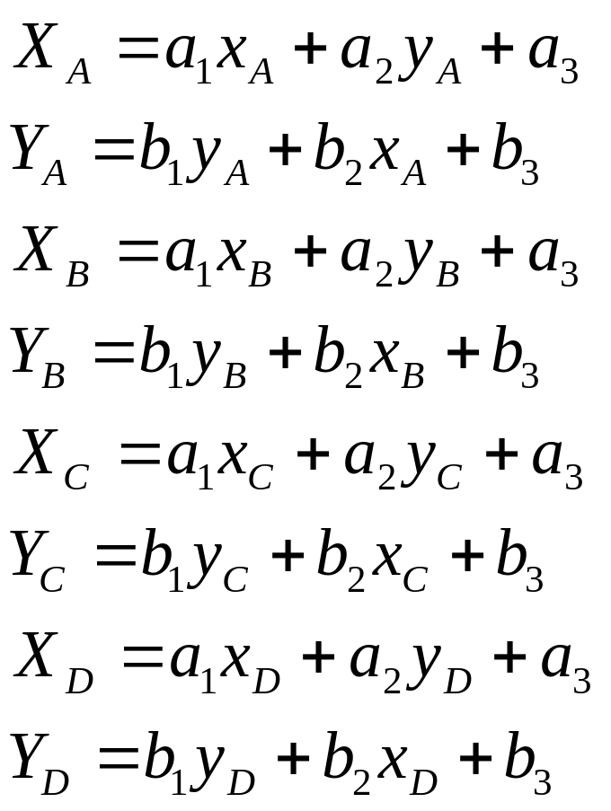
2-D Affine Transformation
When there is redundant information or more than 3 points are known on both systems, least squares may be used. For example if 4 points are known on both systems:
1) From the measurement equations:

Slide 26
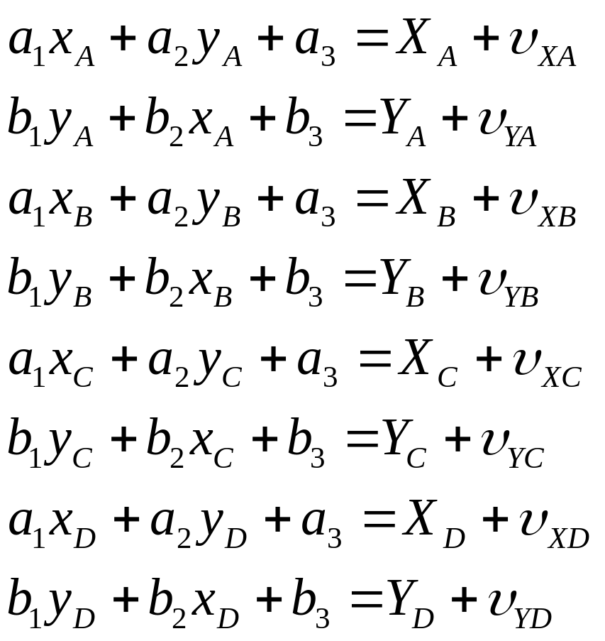
2-D Affine Transformation
2) Form the observation equations:

Slide 27
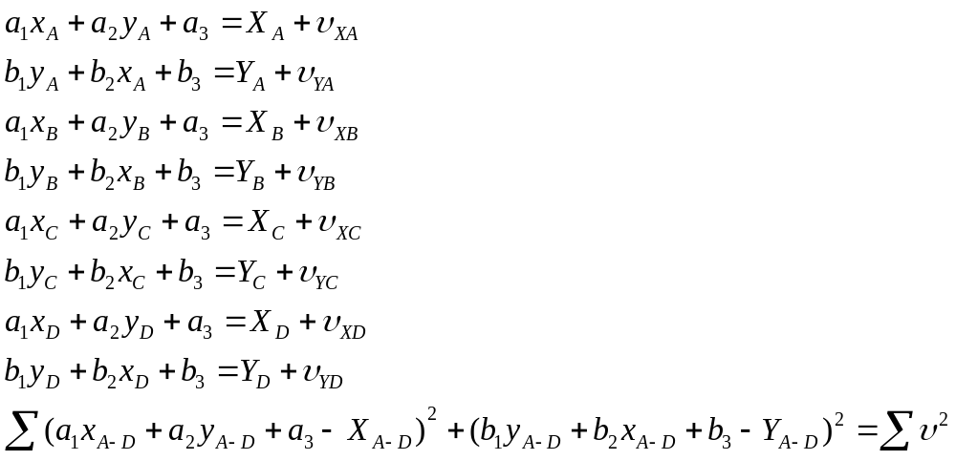
2-D Affine Transformation
3) Square the residuals and sum:

Slide 28
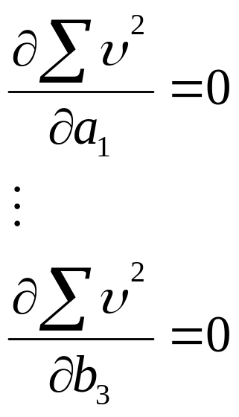
2-D Affine Transformation
4) Take partial differentials with respect to each unknown and equate to zero:
Normal equations
5) Solve simultaneously to obtain unique values for the unknowns

Slide 29
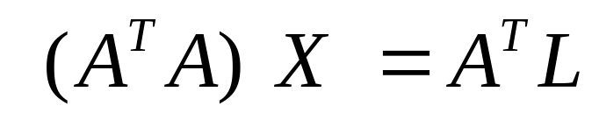
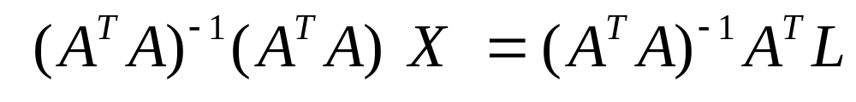
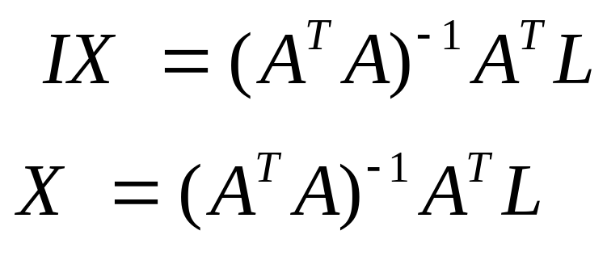
2-D Affine Transformation
It was shown previously that the normal equations can be formed directly using matrix methods:

Slide 30
2-D Affine Transformation
Example Wolf and Dewitt (2000)
Point | Comparator coord x mm | Comparator coord y mm | Calibrated coords X mm | Calibrated coords Y mm
Fiducial A | 228.170 | 129.730 | 112.995 | 0.034
Fiducial B | 2.100 | 129.520 | -113.006 | 0.005
Fiducial C | 115.005 | 242.625 | 0.003 | 112.993
Fiducial D | 115.274 | 16.574 | -0.012 | -113.000
1 | 206.674 | 123.794
2 | 198.365 | 132.856
3 | 91.505 | 18.956

Slide 31
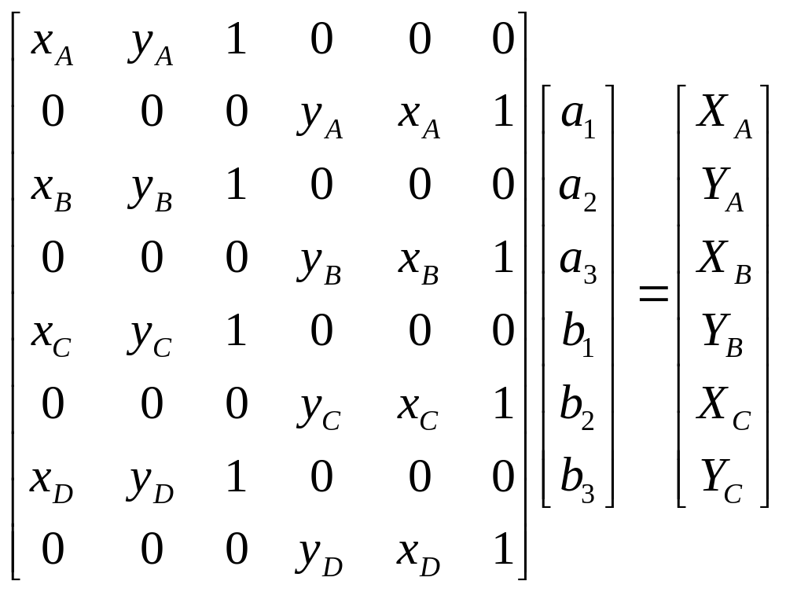
2-D Affine Transformation

Slide 32
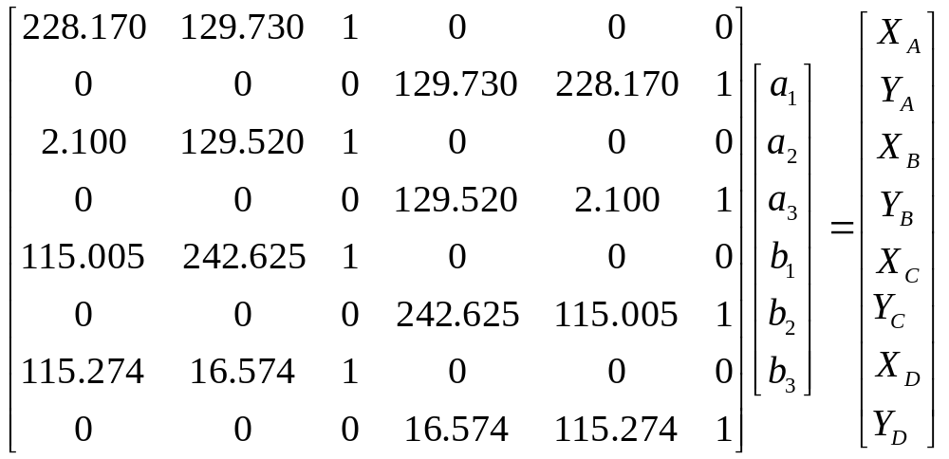
2-D Affine Transformation
AX = L

Slide 33
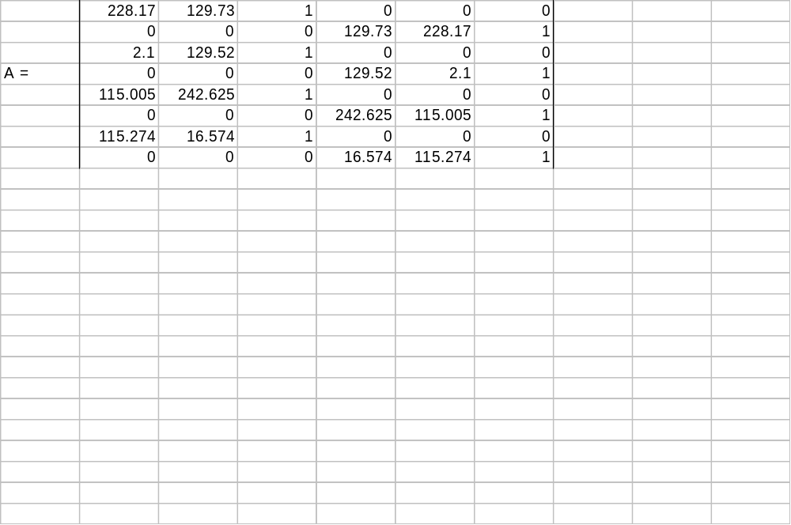
2-D Affine Transformation

Slide 34
Conformal Coordinate Transformations
Conformal Transformation Example

Slide 35
Conformal Transformation Example
Four parameter co-ordinate transformation
The co-ordinates of two points A and B are listed in Table 1 for two separate co-ordinate systems e-n (an outdated system) and E-N (the revised system). A point C has co-ordinates on the old system of e = 15,362.88 ft. and n = 14622.70 ft.
i) calculate the co-ordinates of point C on the E-N system
POINT
e (ft.)
n (ft)
E (m)
N (m)
A
16,719.24
12,164.51
538,712.09
203,683.60
B
18,975.69
13,192.83
539,151.00
204,298.92

Slide 36
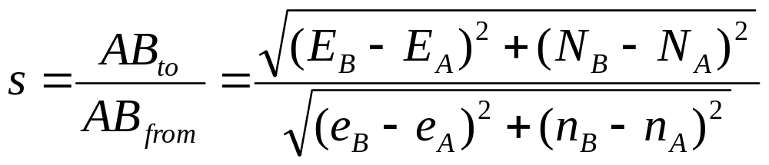
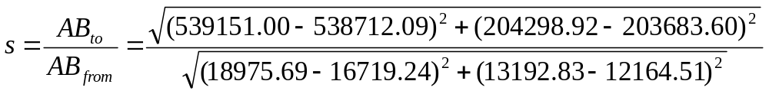
Conformal Transformation Example
SCALE
= 0.30479 or 0.3048 (the factor used to convert feet to meters)

Slide 37
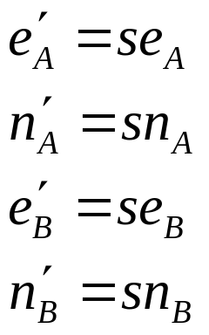
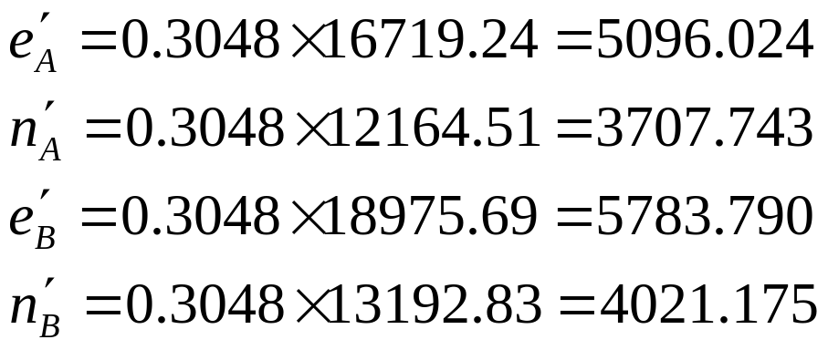
Conformal Transformation Example

Slide 38
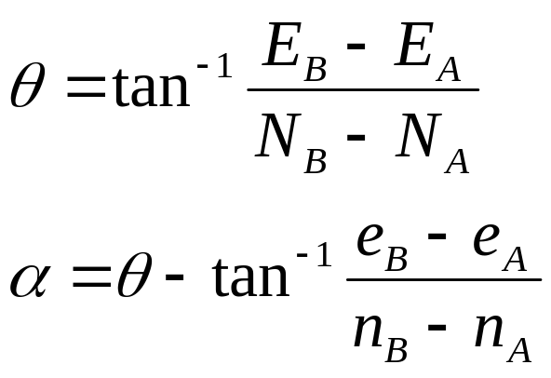
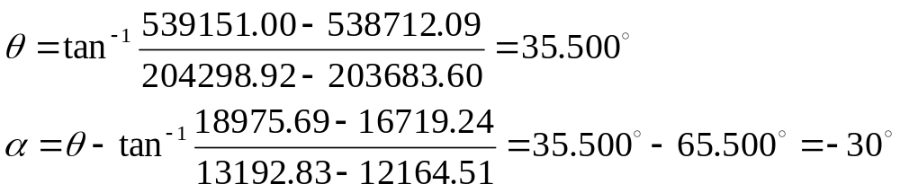
Conformal Transformation Example
ROTATION
θ
A
System 2
α
System 1

Slide 39
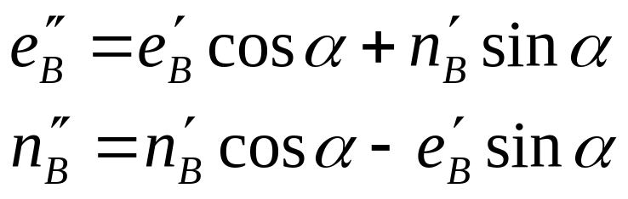
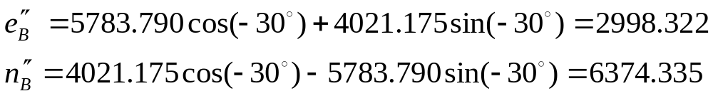
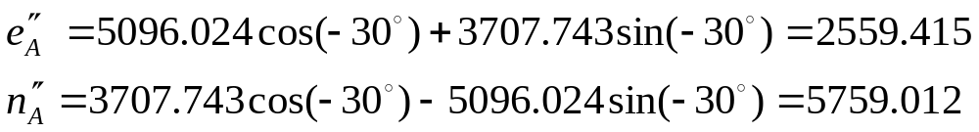
Conformal Transformation Example

Slide 40
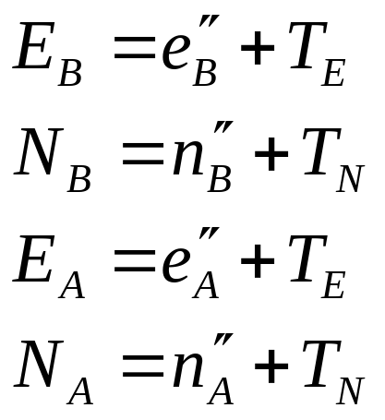
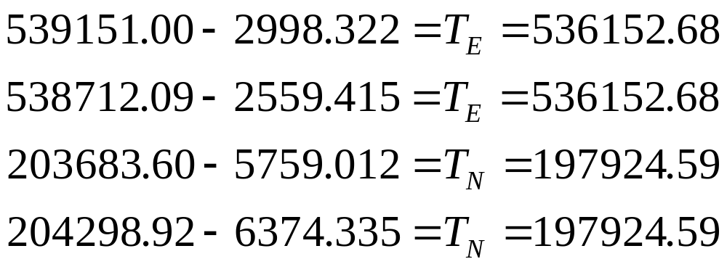
Conformal Transformation Example
TRANSLATION

Slide 41
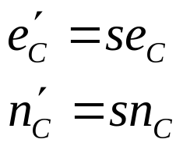
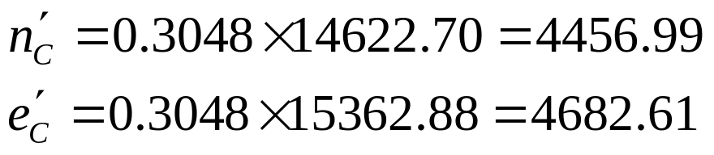
Conformal Transformation Example
Now that the parameters are known, other coordinated points such as point C can be transformed:
e = 15,362.88 ft. and n = 14622.70 ft.
C scaled coords:

Slide 42
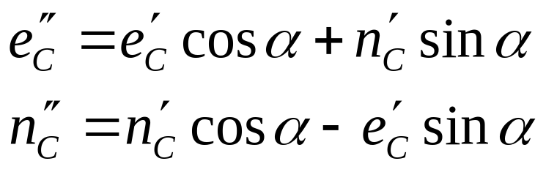
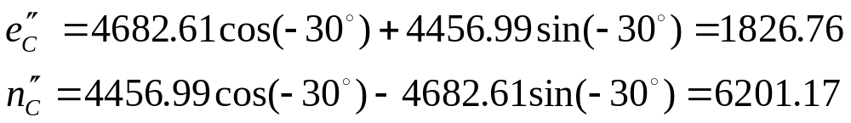
Conformal Transformation Example
C rotated coords:

Slide 43
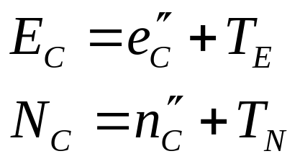
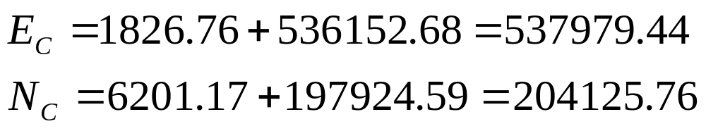
Conformal Transformation Example
C translated coords:

Slide 44
2-D Conformal Coordinate Transformations
Computerized Methods

Slide 45
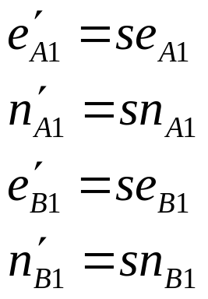
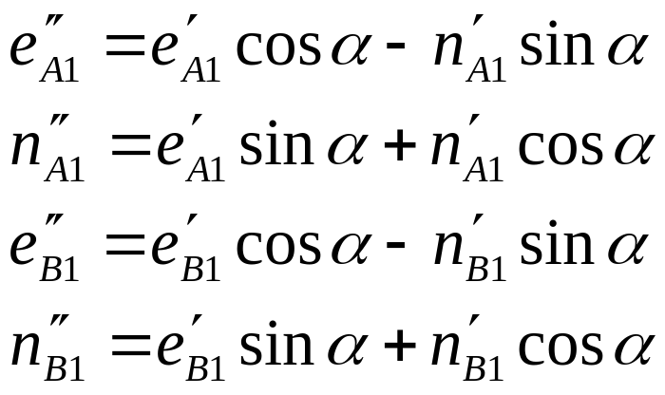
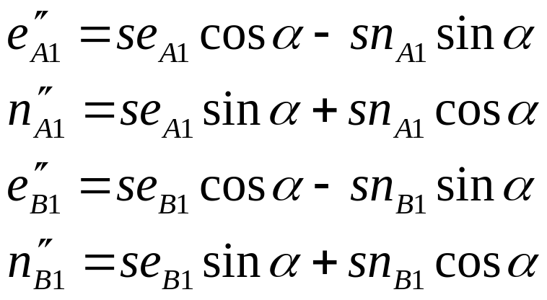
Computerized Methods in Transformations
To computerize the transformation process the equations must be standardized and combined:
Moving from system 1 to system 2 the scale equations are substituted into the rotation equations:

Slide 46
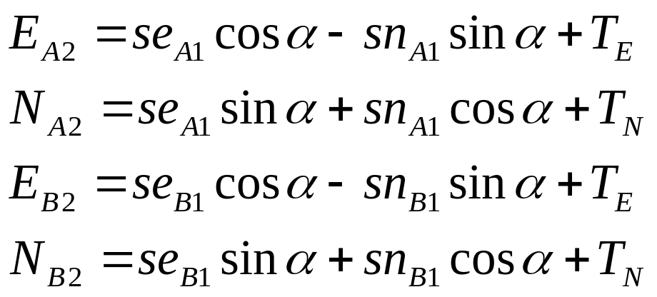
Computerized Methods in Transformations
The angle is standardized as system 1-system 2 and the translation parameters are added on to complete the transformation equations:

Slide 47
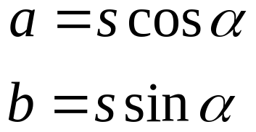
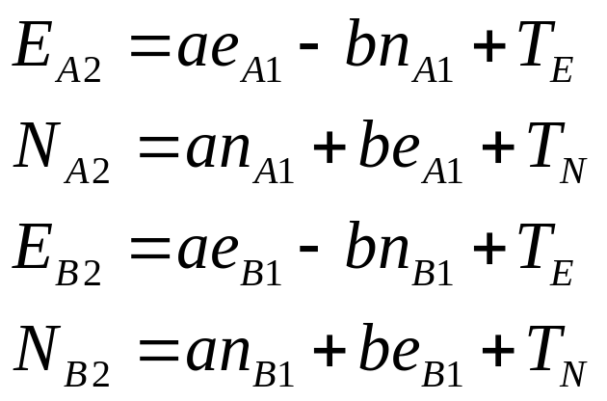
Computerized Methods in Transformations
Now substitute:
To get:

Slide 48
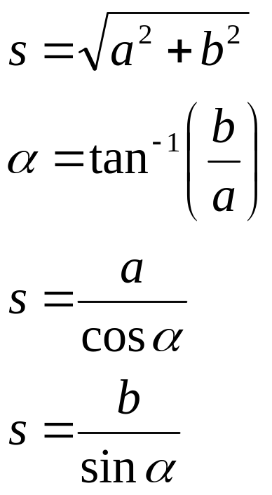
Computerized Methods in Transformations
The scale and rotation need not be determined but if need be:

Slide 49
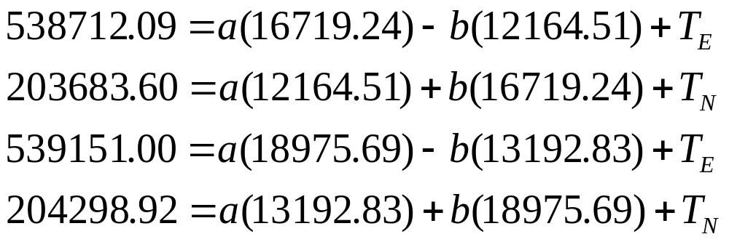
Computerized Methods in Transformations - example
From the previous example:

Slide 50
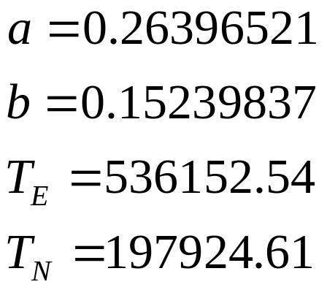
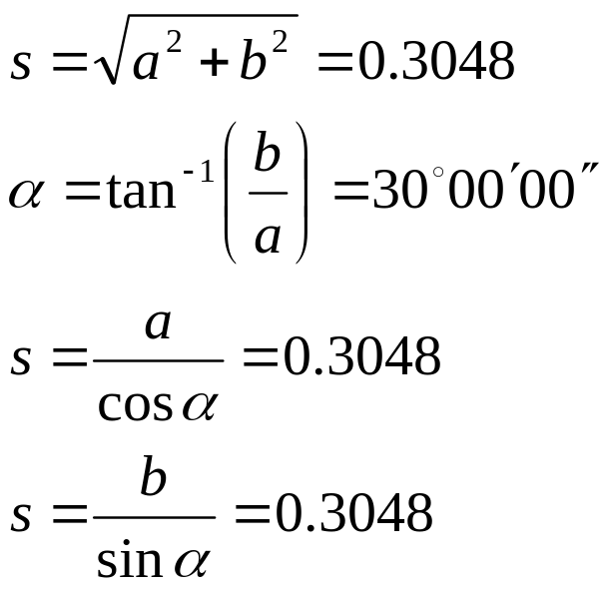
Computerized Methods in Transformations - example
Solving simultaneously:
Substituting:

Slide 51

Computerized Methods in Transformations - example
The equations may be expressed as matrices:
For each pair of equations

Slide 52

Computerized Methods in Transformations - example
or
For each pair of equations
2x1
2x2
2x1
2x1

Slide 53

Computerized Methods in Transformations - example
The individual equations can also be put into the matrix format for solution via inversion:
AX = L
So that:
X = A⁻¹ L
X or the unknowns can be solved using a spreadsheet and then the parameters can be applied to other points to be transformed

Slide 54

Computerized Methods in Transformations – example
Using the previous example

Slide 55
Least Squares in Transformations
Introduction

Slide 56
Least Squares in Transformations
The observation equation method of Least Squares may be used in the computation of the transformation parameters
More than 2 co-located points (points coordinated on both systems) must be known to perform Least Squares
Least Squares minimizes the sum of the squares of the residuals resulting in the best estimate of the value of the unknowns

Slide 57

Least Squares in Transformations
Simple example of least squares method (Wolf and Dewitt 2000)
Given the following measurement equations
x+y=3.0
x=1.5
y=1.4
m = number of observations = 3
n=number of unknowns = (x and y) = 2
Solving equations (1) and (2) gives x = 1.5 and y =1.5
Solving equations (2) and (3) gives x = 1.5 and y = 1.4
Solving equations (1) and (3) gives x = 1.6 and y = 1.4

Slide 58


Least Squares in Transformations
The measurements therefore contain errors so these can be included in the equations
Observation equations
There are many values that the residuals may take so that the same values are obtained for x and y no matter which equations are used to solve for them
For example:
or

Slide 59

Least Squares in Transformations
However the values of the residuals which minimize the sum of the square of the residuals are the most probable values for the residuals.
To obtain these values the following procedure is adopted
1) Square the residuals

Slide 60


Least Squares in Transformations
2) Sum the squared residuals together
3) Minimize the sum of the square of the residuals by taking partial derivatives with respect to each unknown and setting them equal to zero
Normal Equations

Slide 61


Least Squares in Transformations
The simplified normal equations are:
There are now the same number of normal equations as there are unknowns leading to a unique solution for the unknowns when solved

Slide 62


Least Squares in Transformations
These values may be plugged back into the observation equations to determine the residuals
The sum of the squares of the residuals for the example solutions may be compared with the sum of the squares of the residuals derived by the least squares method

Slide 63

Least Squares in Transformations
The process for forming normal equations is lengthy and time consuming but a systematic procedure can be performed
If there are m observation equations in n unknowns:

Slide 64

Least Squares in Transformations
The residuals are squared and summed
Partial derivatives are taken with respect to each unknown
n normal equations are formed
Simplifying the normal equations by reducing and factoring results in the standardized format as follows:

Slide 65


Least Squares in Transformations
The coefficients may be computed and set up in a table to facilitate the construction of the normal equations
Example from the previous problem
Observation equations
A=3x2
X=2x1
L=3x1
V=3x1

Slide 66












Least Squares in Transformations
Equation number (i)
1 | 1 | 1 | 3.0 | 1 | 1 | 1 | 3.0 | 3.0
2 | 1 | 0 | 1.5 | 1 | 0 | 0 | 1.5 | 0.0
3 | 0 | 1 | 1.4 | 0 | 0 | 1 | 0.0 | 1.4

Slide 67


Least Squares in Transformations
The normal equations in the standardized format are therefore:
Substituting from the table gives:
The normal equations may now be solved to determine the unknowns

Slide 68

Least Squares in Transformations
The matrix method proves to be simpler for solving the equations
The observation equations are represented generally as:
The normal equations as obtained in the standardized method are equivalent to:
So that A^{T} A is the matrix of normal equation coefficients of the unknowns

Slide 69
Least Squares in Transformations
Premultiply both sides by the inverse of the A^{T} A matrix to result in:
Reducing :
The unknowns can then be simply determined

Slide 70



Least Squares in Transformations
Example from previous problem:
Observation equations
Observation equations

Slide 71



Least Squares in Transformations

Slide 72

Least Squares in Transformations

Slide 73

Least Squares in Transformations
The Least Squares method applied to the general 2-D conformal coordinate transformation
For each co-located point of m observed points two equations are obtained
The unknowns are a, b, T_{E} and T_{N}

Slide 74


Least Squares in Transformations
Observation equations can be formed
Which are of the form:
A is the matrix of coefficients of the unknown transformation parameters or the coordinates on one system, X is the matrix of the unknown transformation parameters, L is the matrix of observations which are the control coordinates and V is the matrix of residuals or measurement errors

Slide 75




Least Squares in Transformations

Slide 76

Least Squares in Transformations
We can go directly to the normal equations to solve for the unknowns knowing that the normal equations are simply:
Therefore:

Slide 77
Least Squares in Transformations – example (Wolf and Ghilani 1997)
Given the co-located points A, B and C, find the best estimate of the transformation parameters and then transform points 1, 2, 3 and 4
Point | Easting | Northing | X | Y
A | 1049422.40 | 51089.20 | 121.622 | -128.066
B | 1049413.95 | 49659.30 | 141.228 | 187.718
C | 1049244.95 | 49884.95 | 175.802 | 135.728
1 |  |  | 174.148 | -120.262
2 |  |  | 513.520 | -192.130
3 |  |  | 754.444 | -67.706
4 |  |  | 972.788 | 120.994

Slide 78


Slide 79


