Slide 1
IBM IA64 Dual Processors (SDSC IA64)

Slide 2
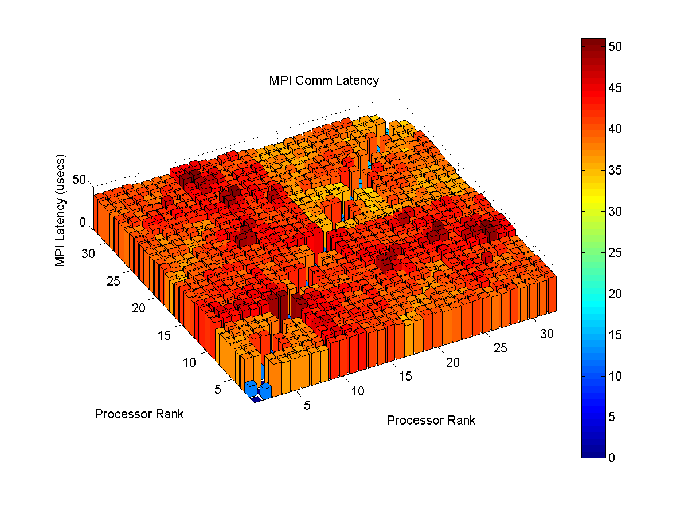
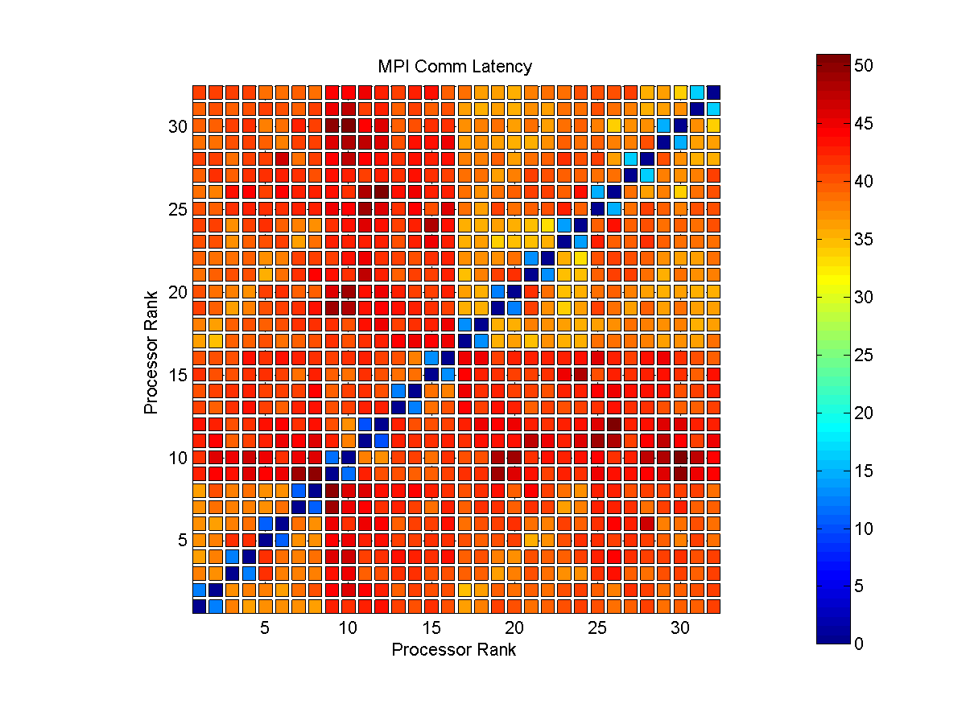
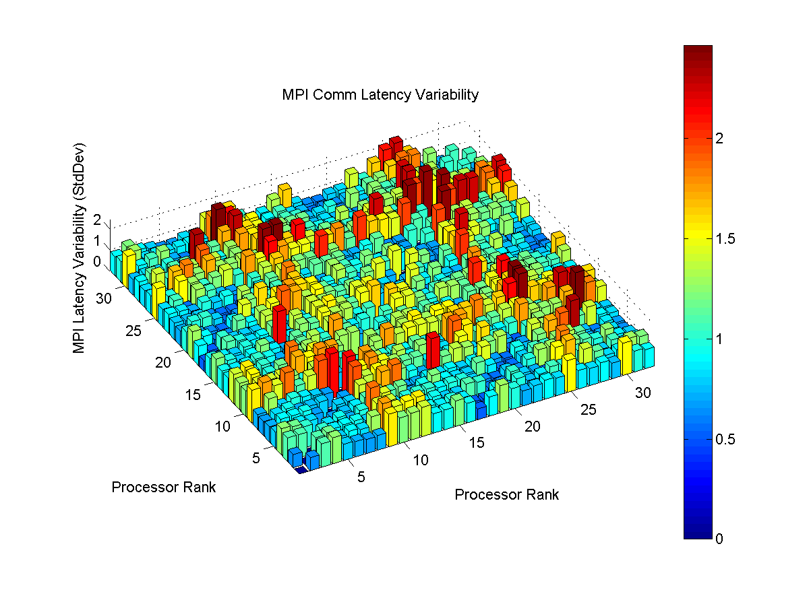
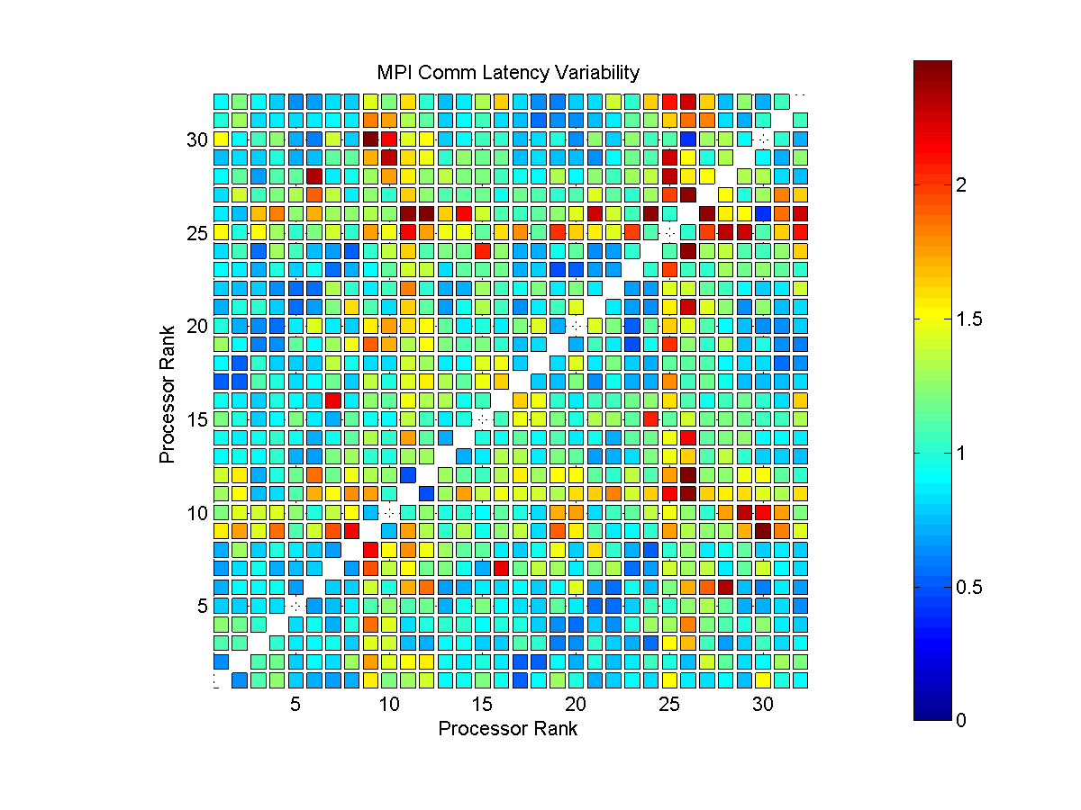
IBM IA64 Dual Processors (SDSC IA64 2008) Total Cores: 32

Slide 3
IBM IA64 Dual Processors (NCSA IA64)

Slide 4
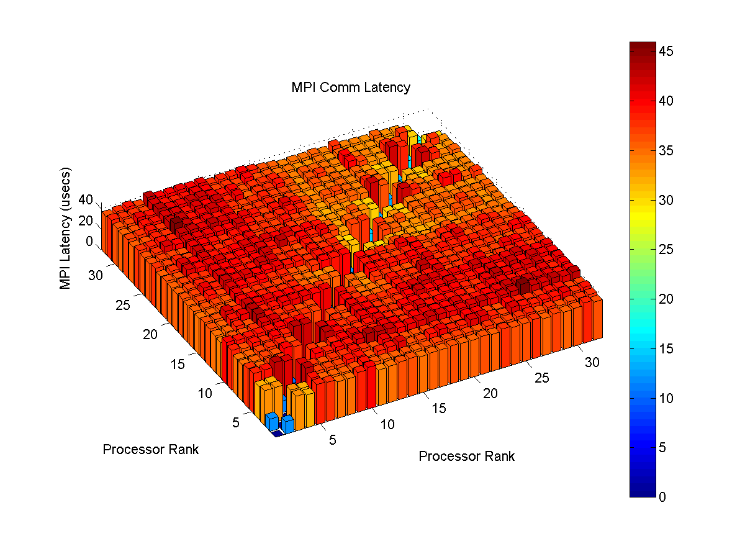
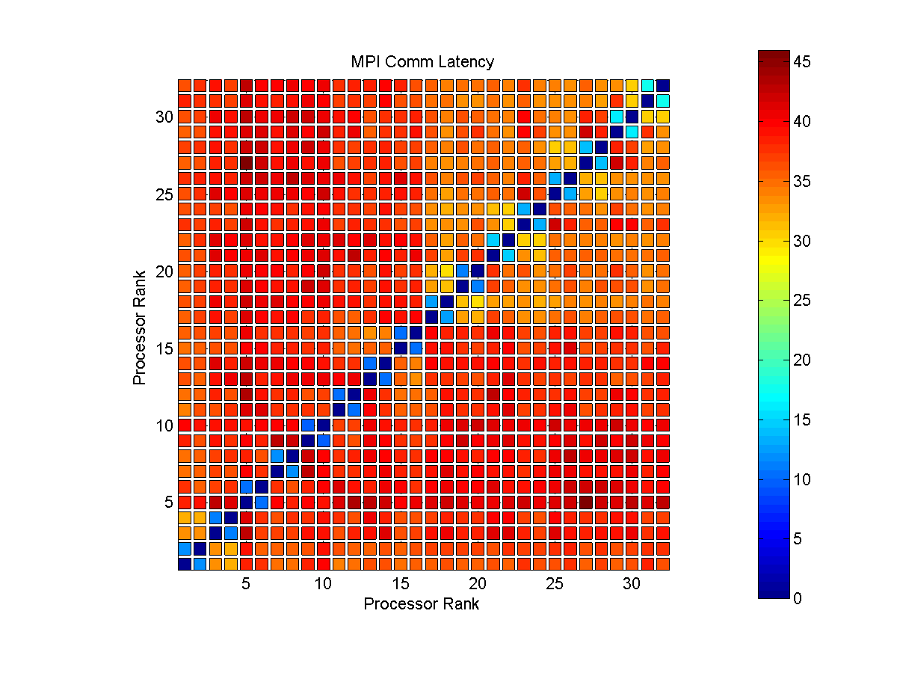
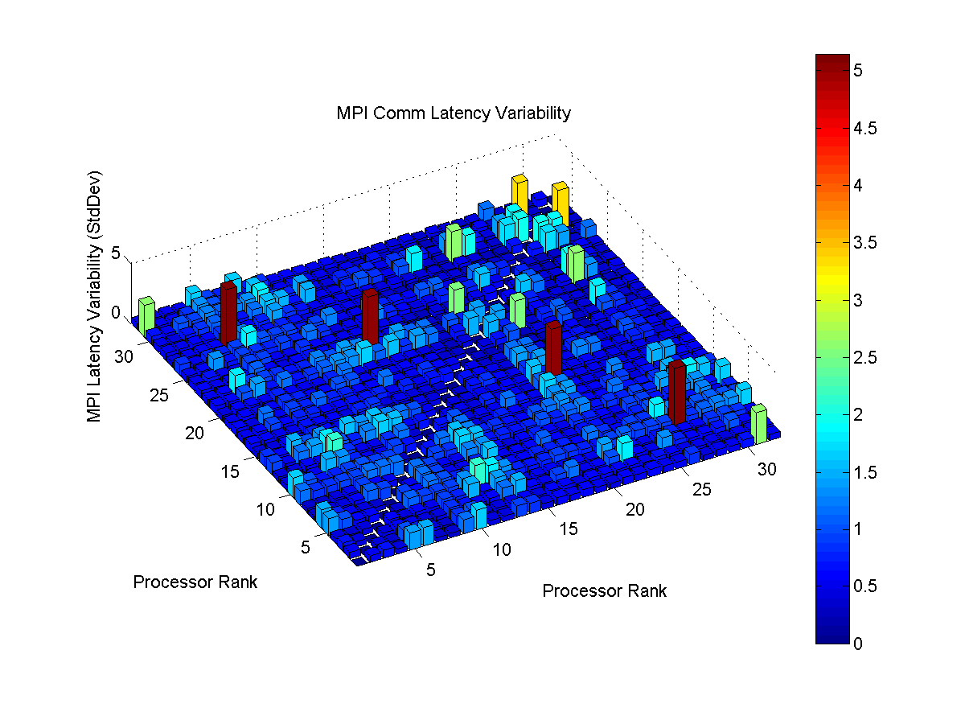
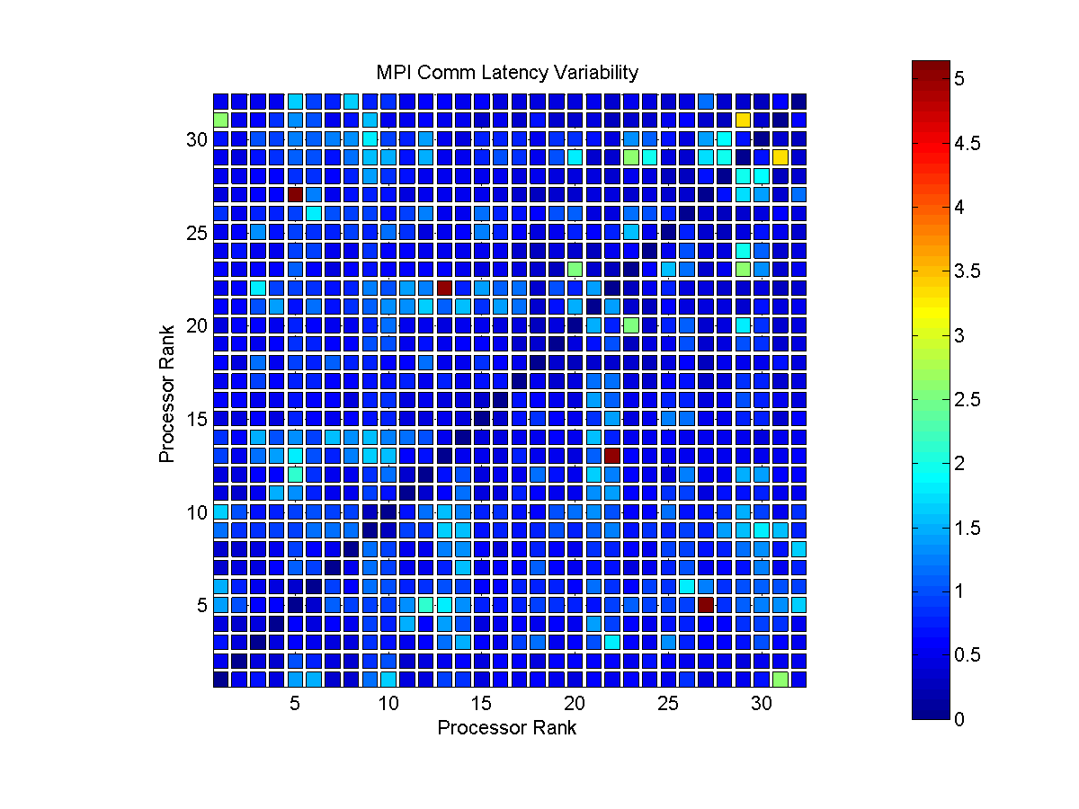
IBM IA64 Dual Processors (NCSA IA64 2008) Total Cores: 32

Slide 5
Dell C8220 Nodes w/ Intel E5 8-Core Sandy Bridge Processors (TACC Stampede)

Slide 6
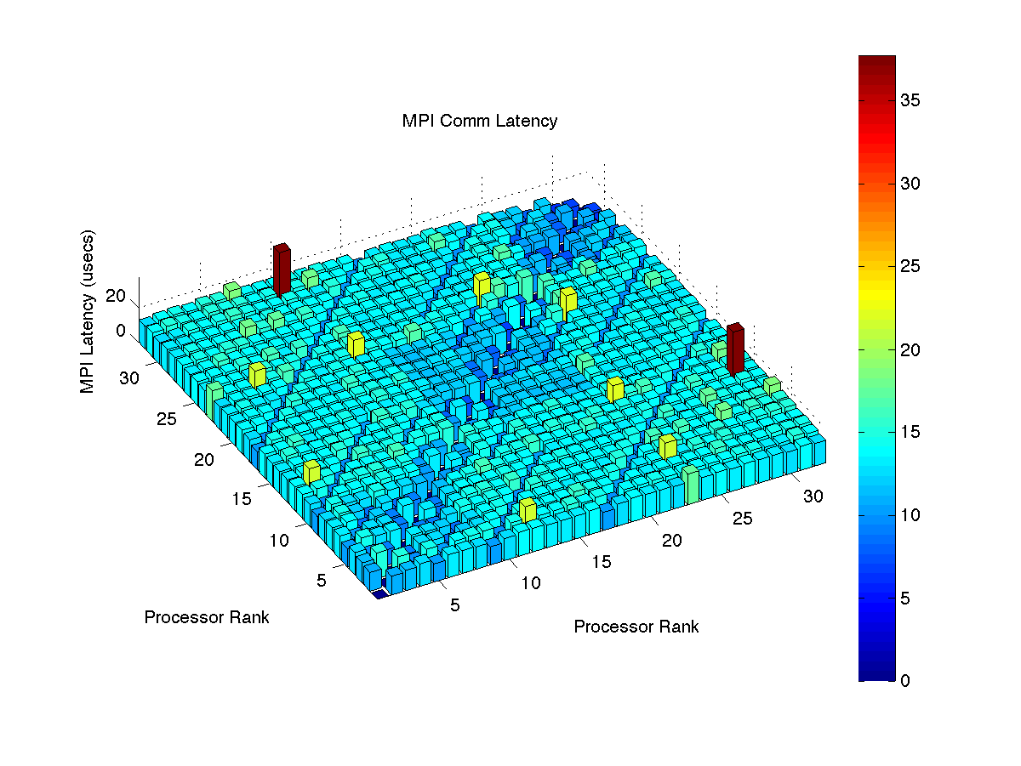
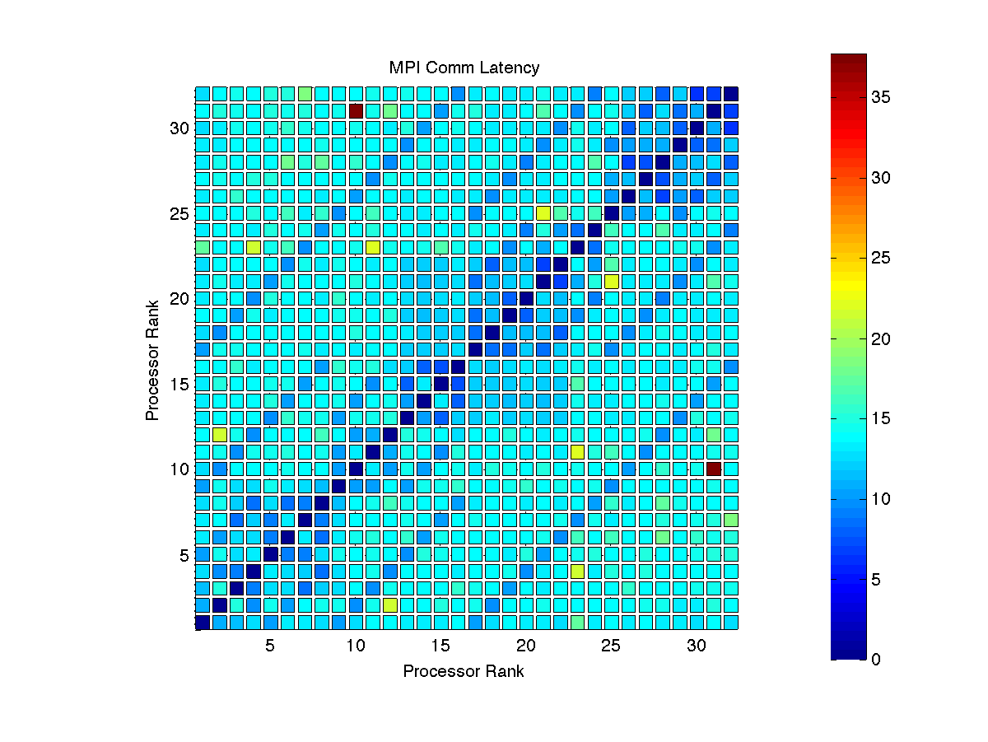
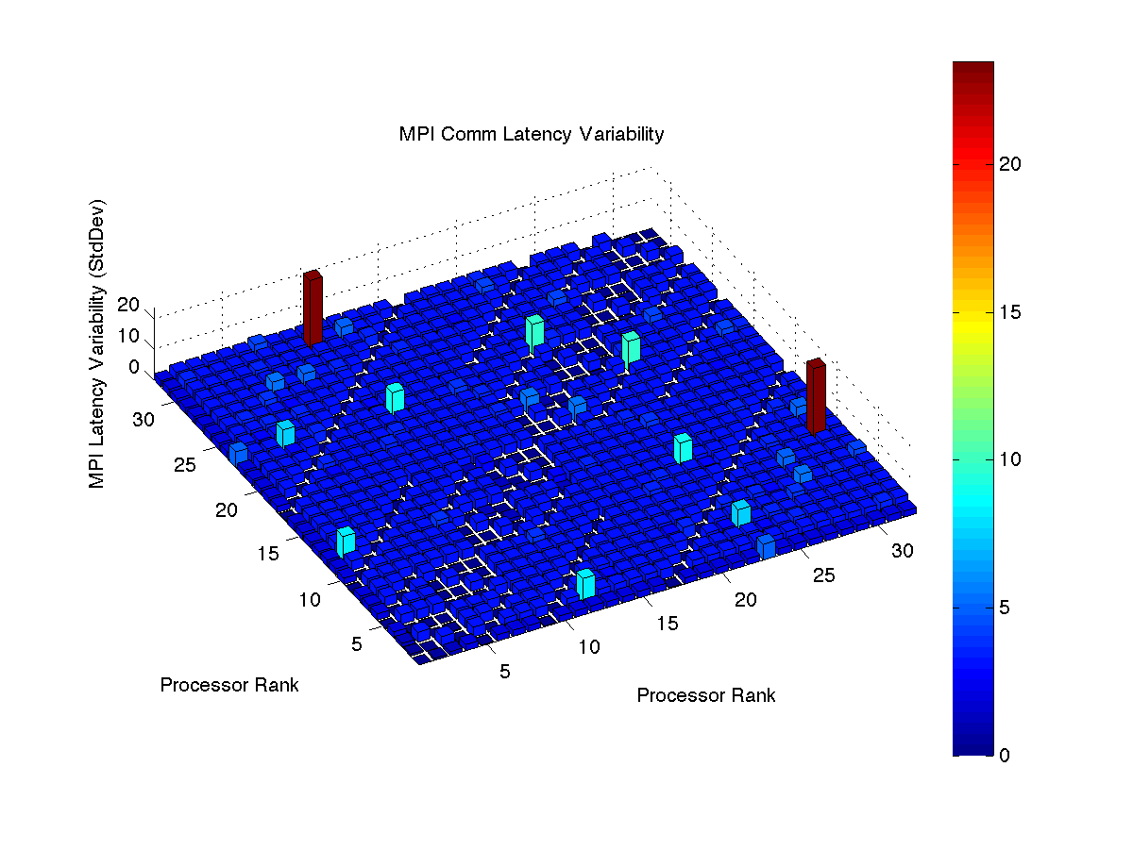
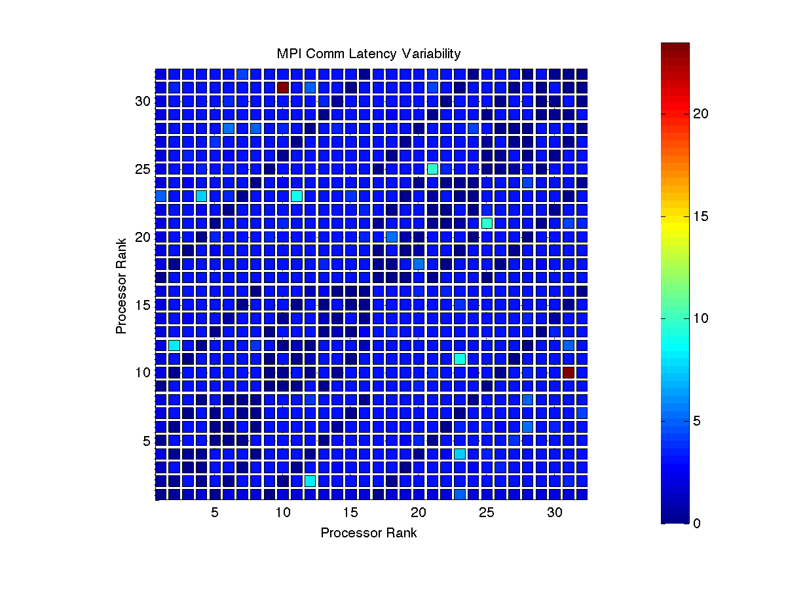
TACC Dell C3800 (TACC Stampede 2014) Nodes: 32 Cores/Node: 1 Total Cores: 32

Slide 7
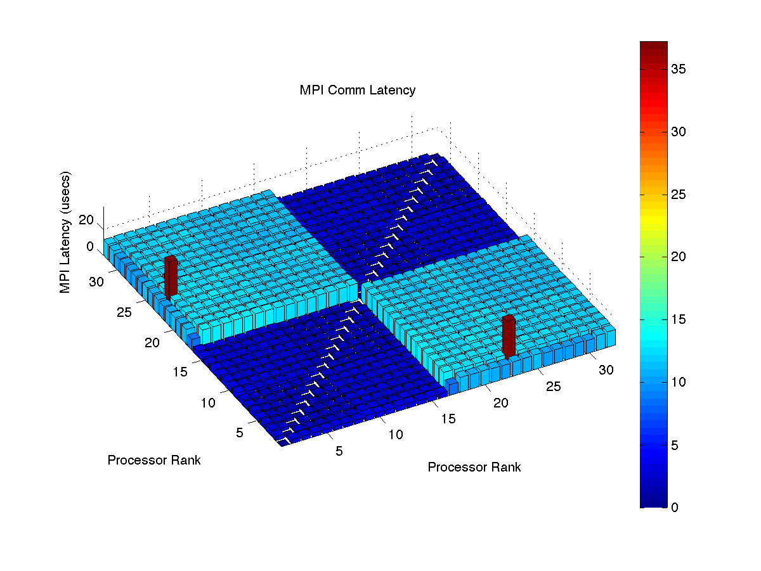
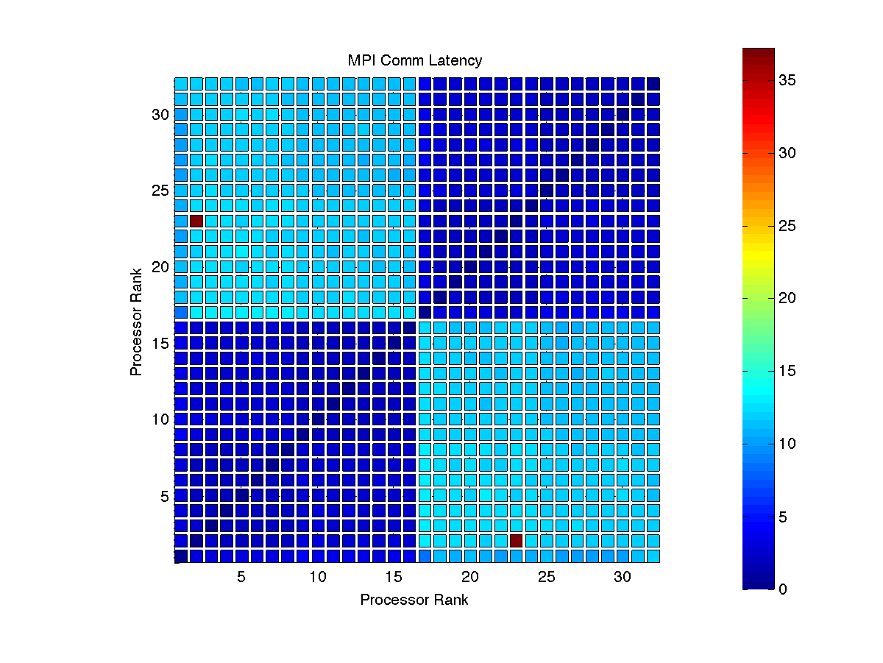
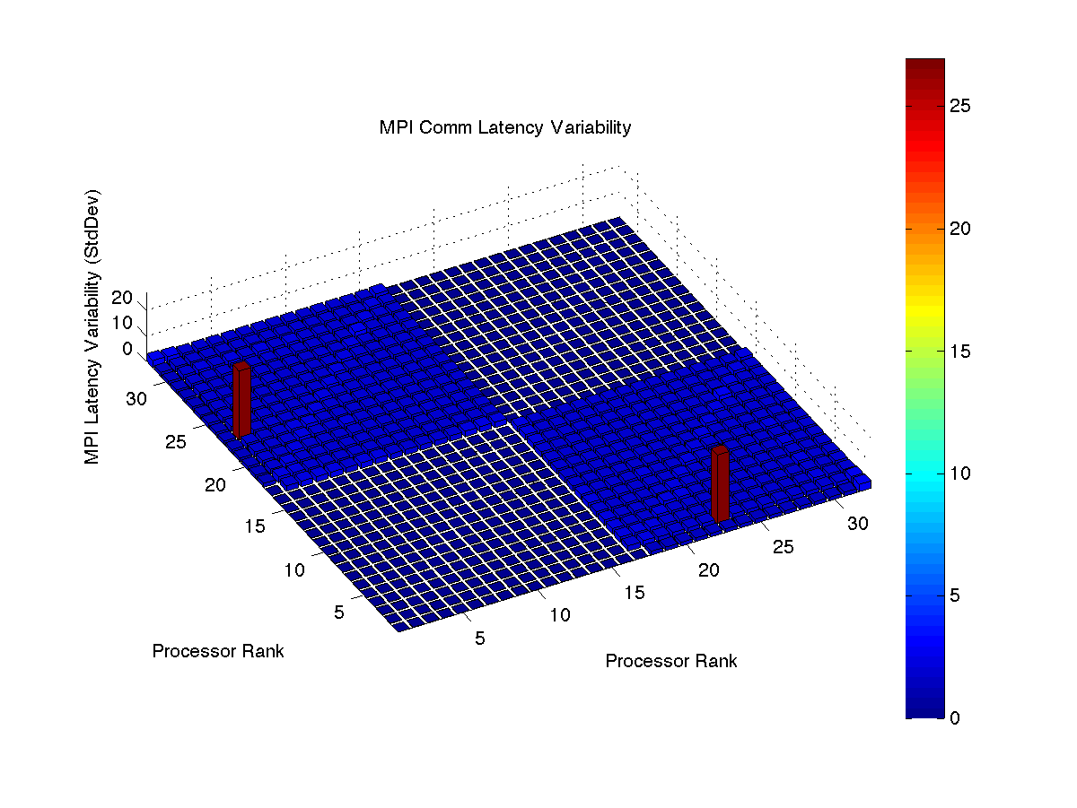
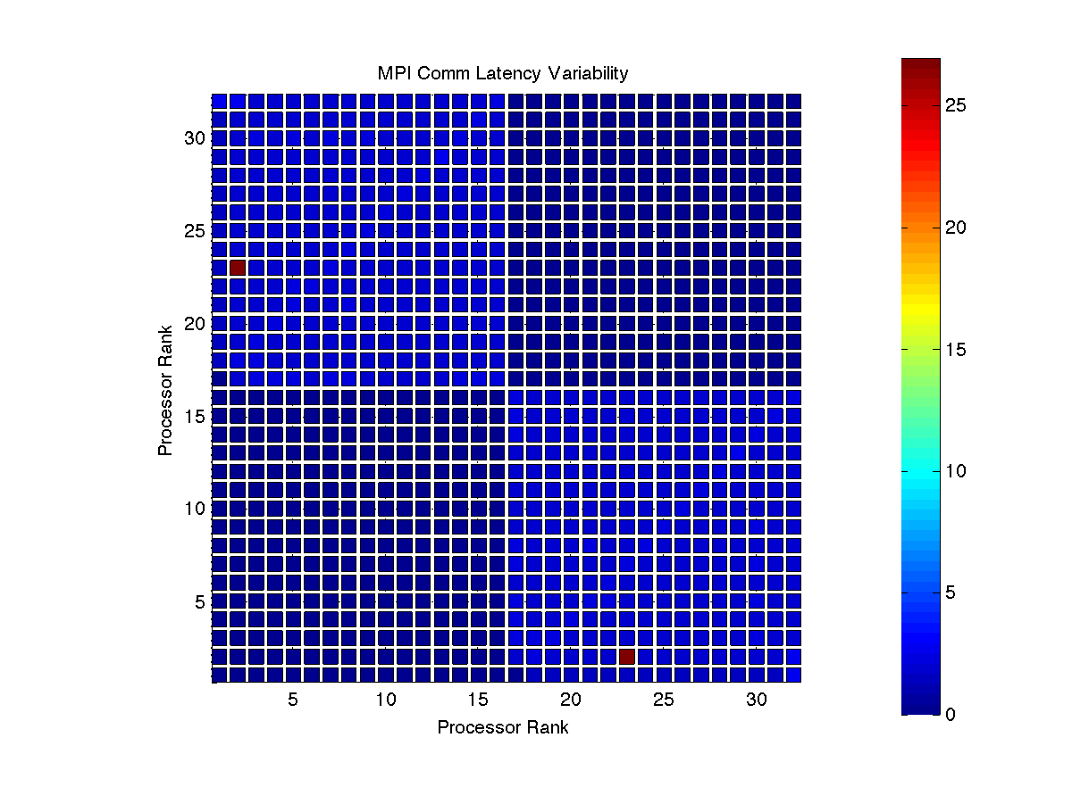
TACC Dell C3800 (TACC Stampede 2014) Nodes: 2 Cores/Node: 16 Total Cores: 32

Slide 8
IBM P655 8-Processor Nodes (SDSC DataStar)

Slide 9
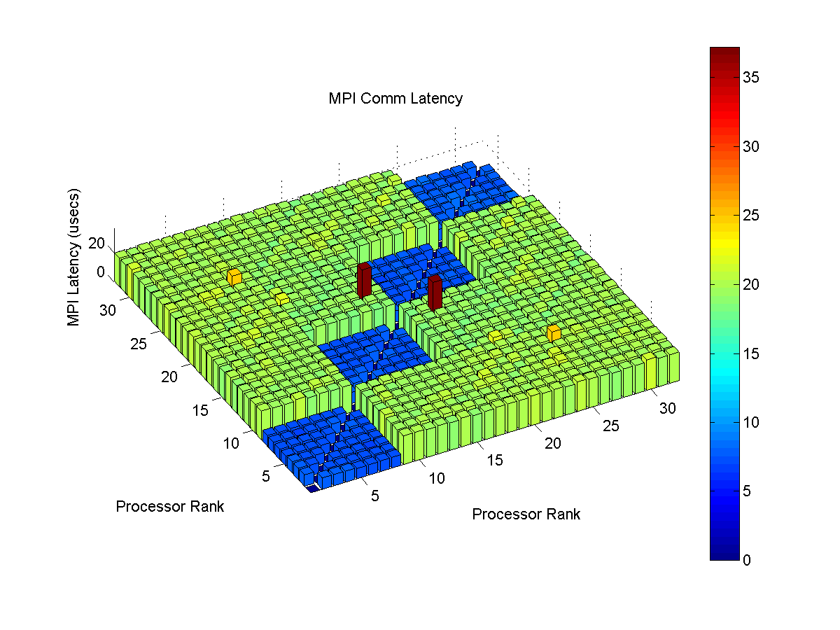
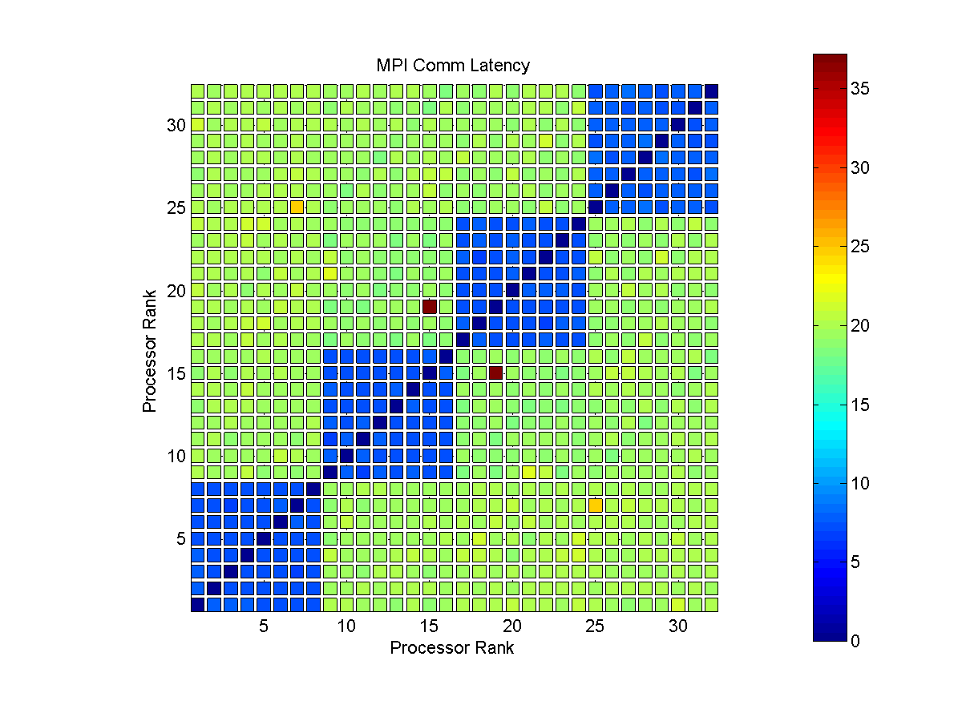
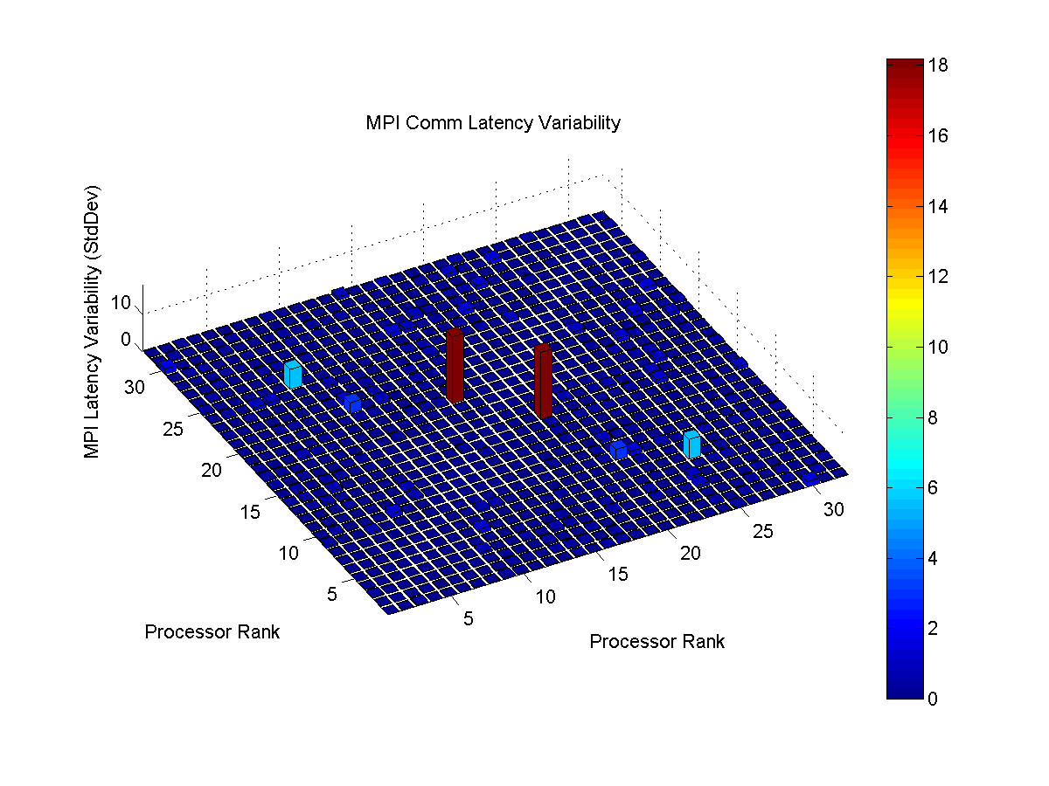
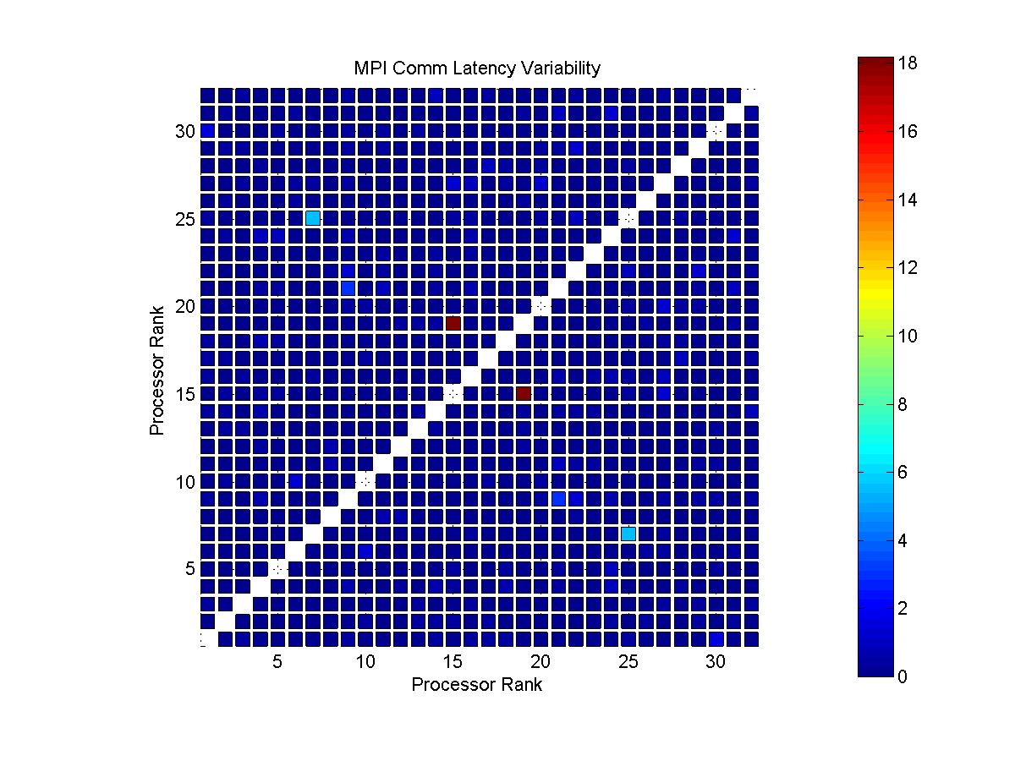
IBM P655 8-Processor Nodes (SDSC DataStar 2008) Nodes: 2 Cores/Node: 8 Total Cores: 32

Slide 10
Cray XT3 MPP Dual Processor Nodes (PSC Big Ben)

Slide 11
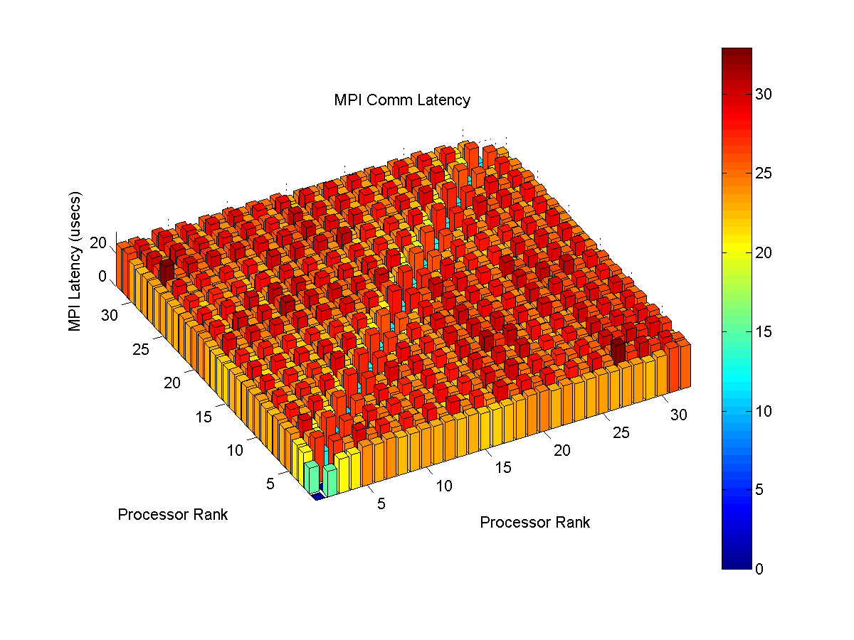
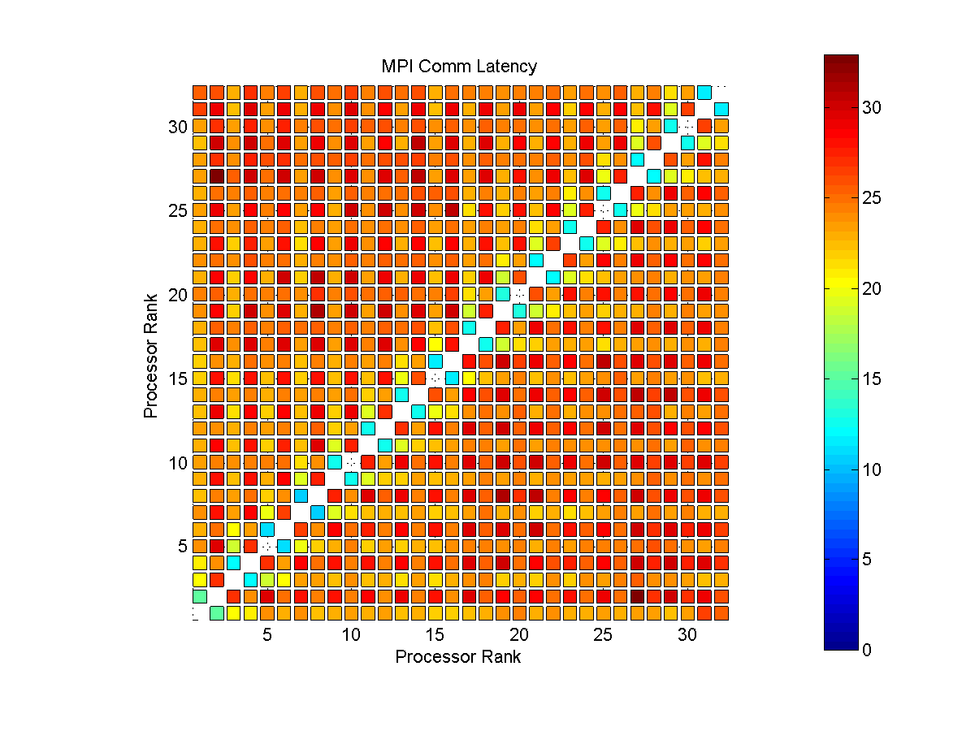
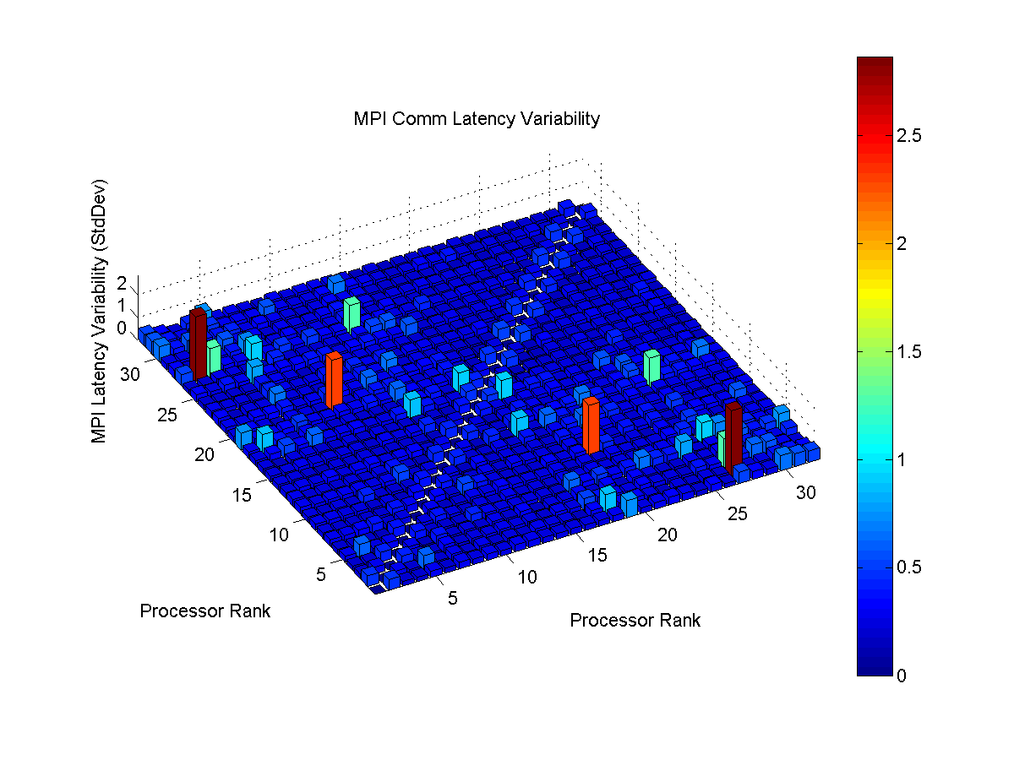
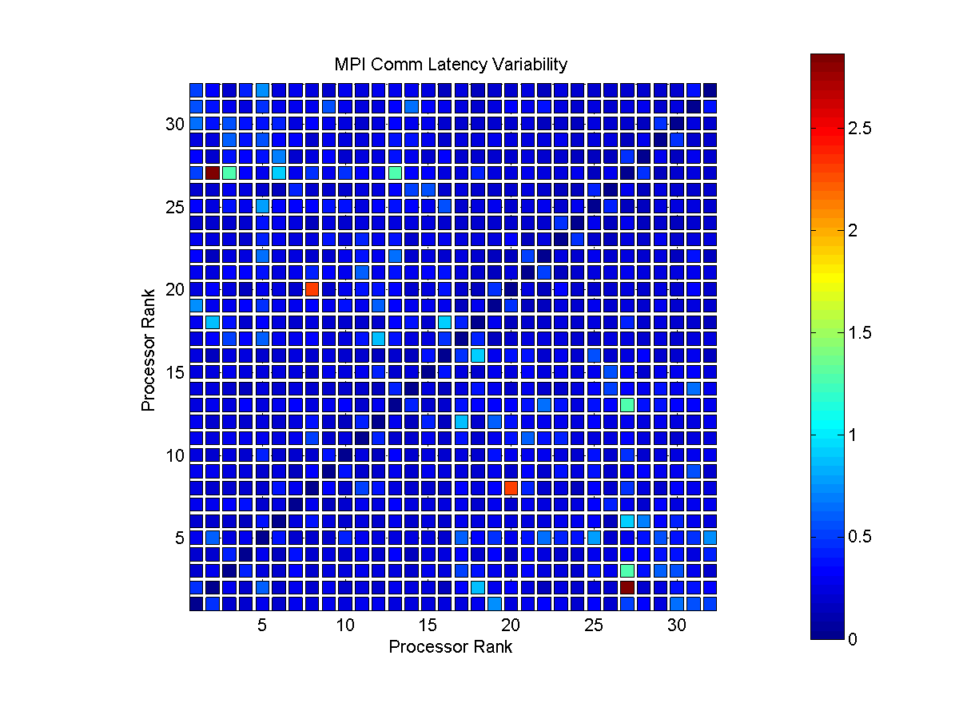
Cray XT3 MPP Dual Processor Nodes (PSC Big Ben 2008) Nodes: 8 Cores/Node: 2 Total Cores: 32

Slide 12
IBM Blue Gene/L (SDSC Blue Gene)

Slide 13
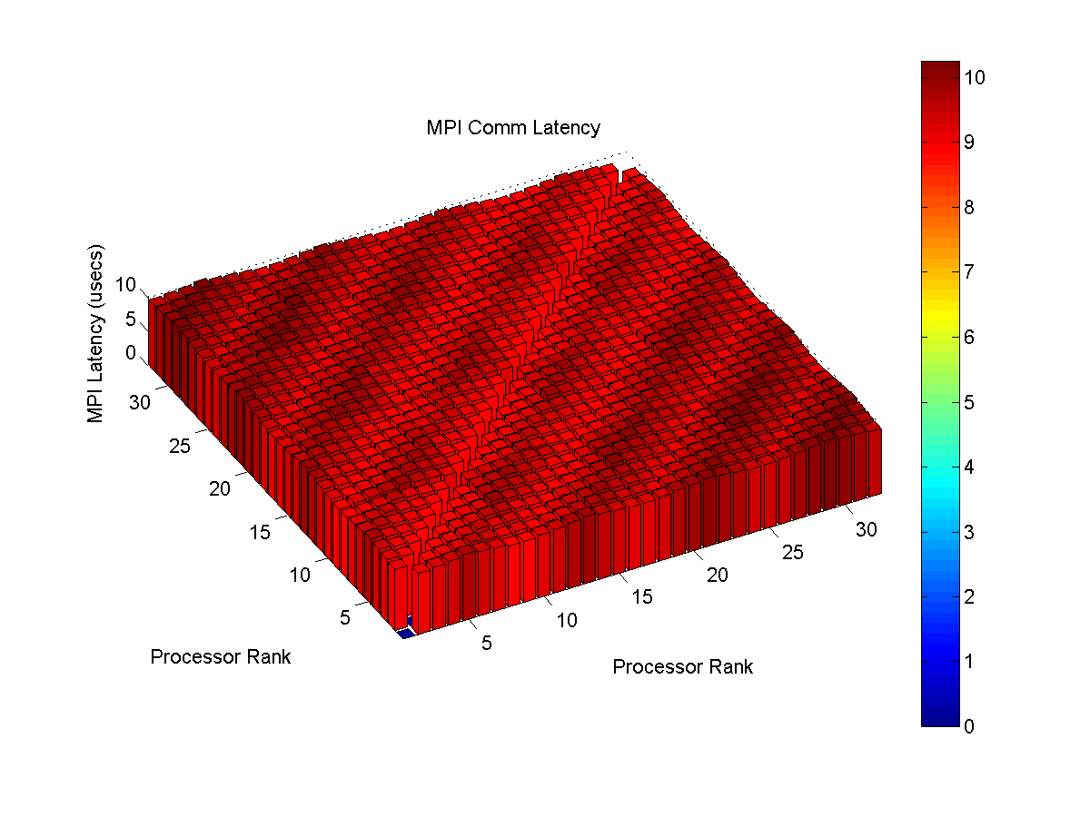
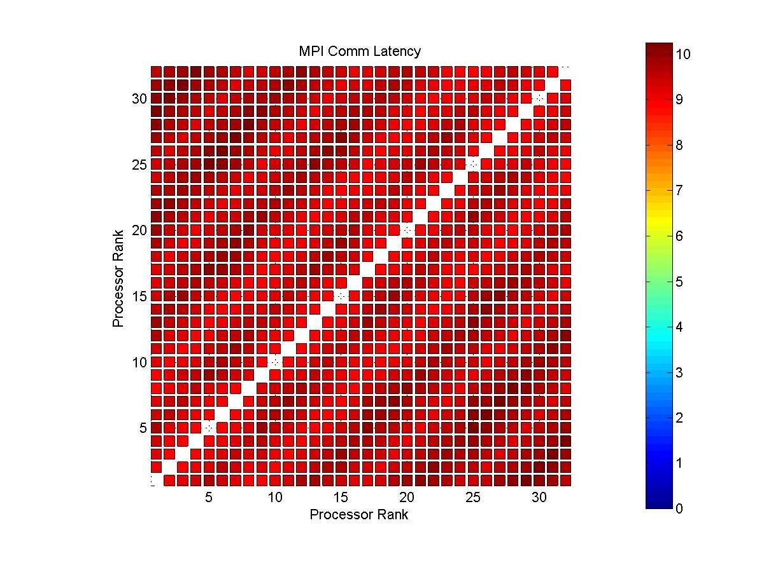
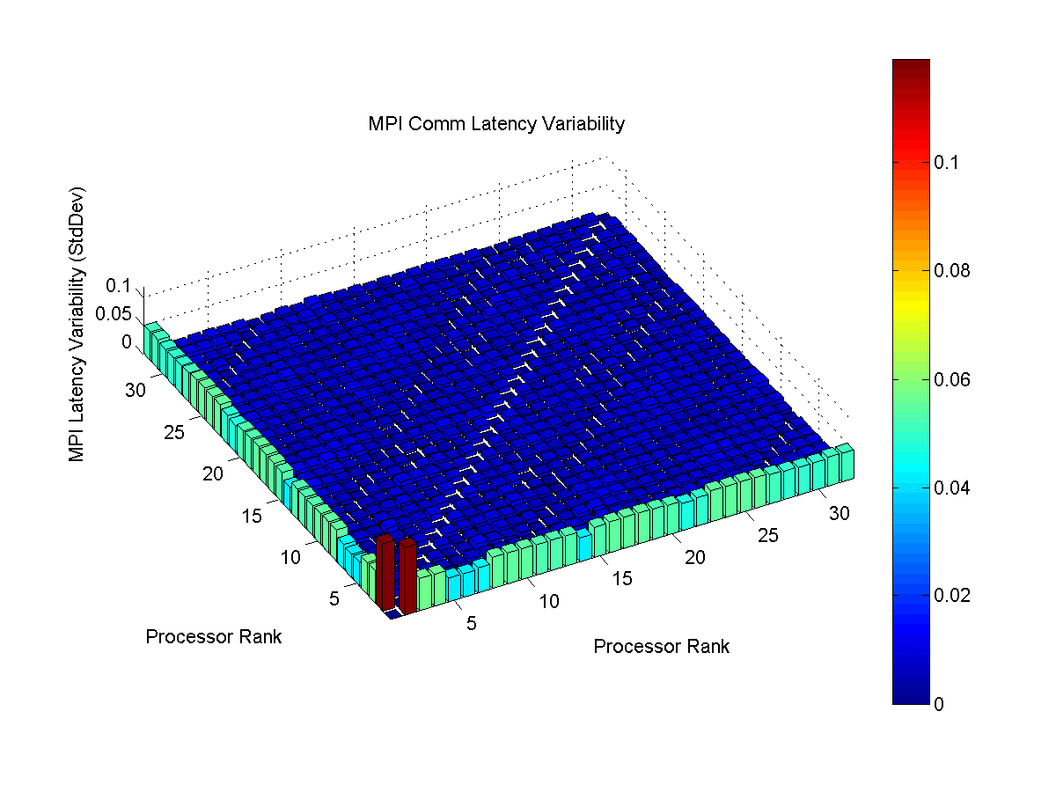
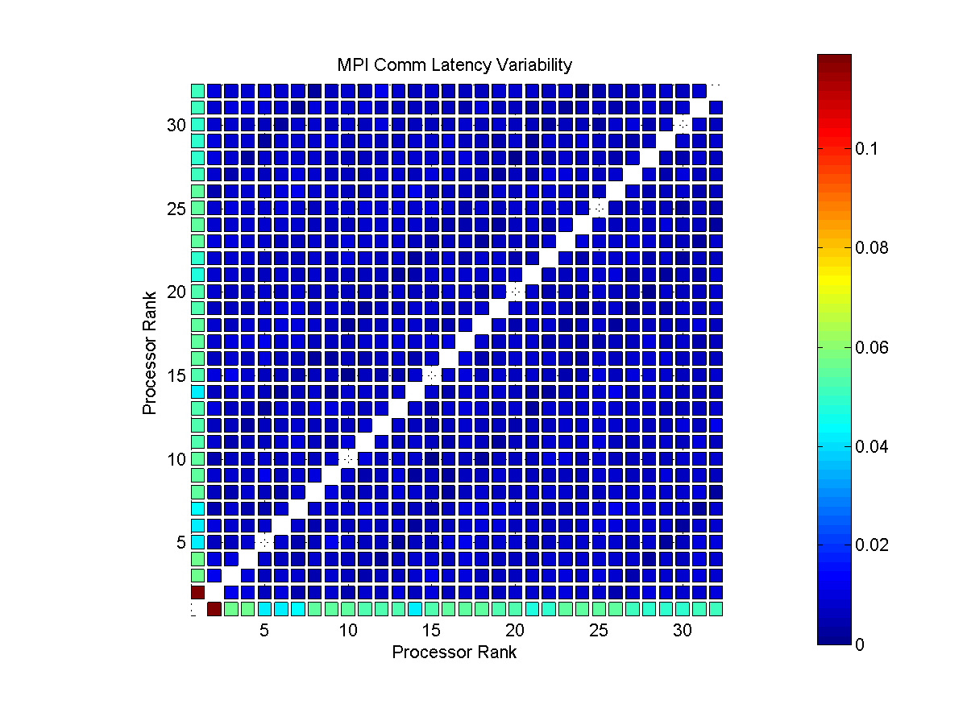
IBM Blue Gene/L (SDSC Blue Gene 2008) Total Cores: 32

Slide 14
Sun Constellation Quad Core (TACC Ranger)

Slide 15
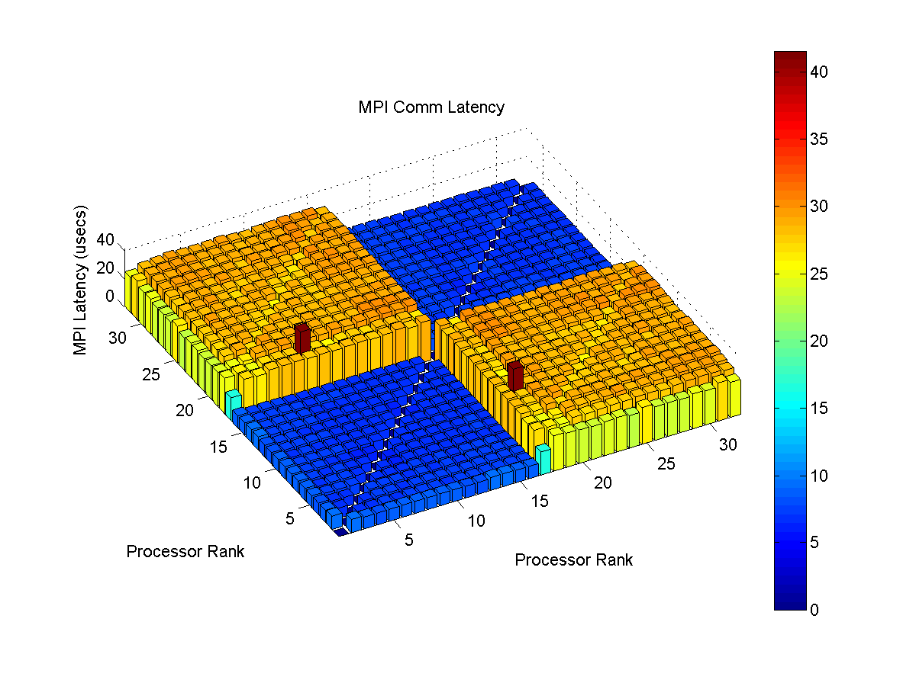
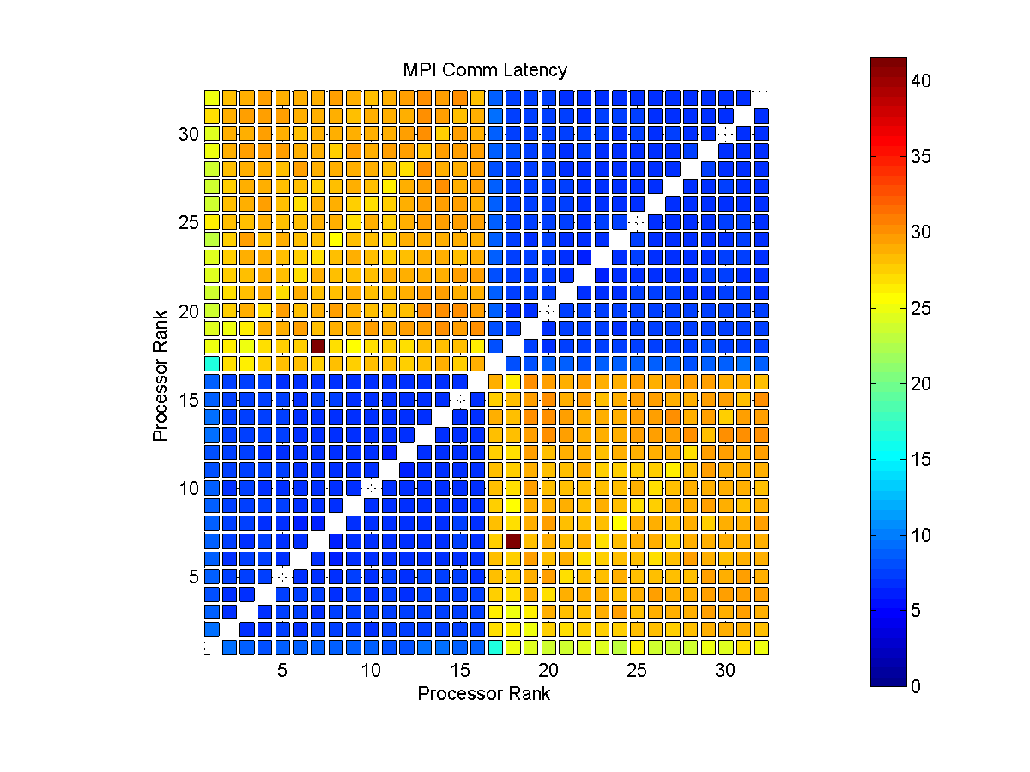
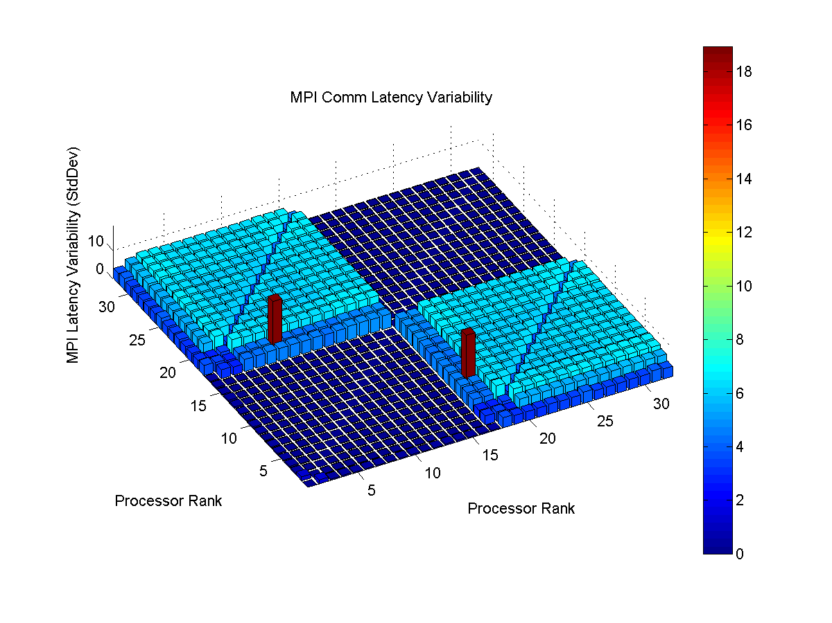
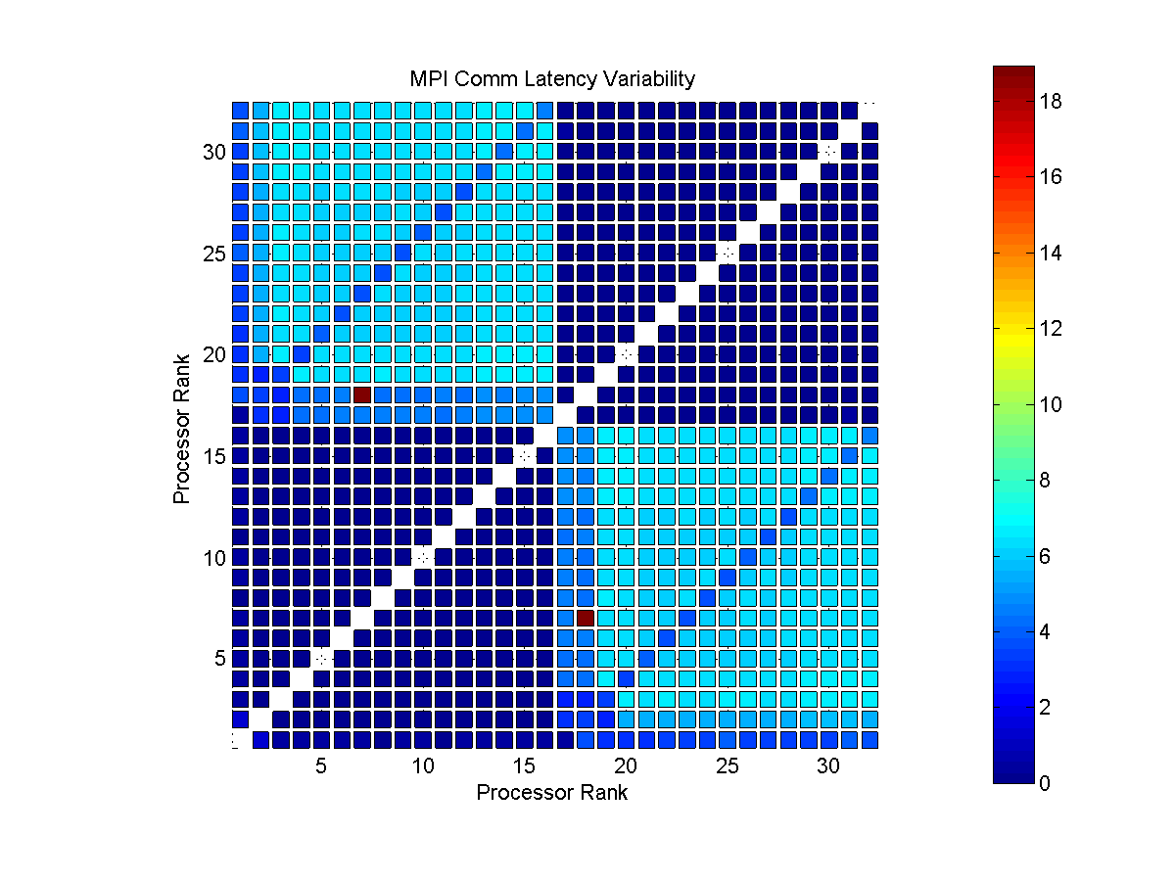
Sun Constellation Quad Core (TACC Ranger 2008) Node: 8 Cores/Node: 4 Total Cores: 32

Slide 16
Dell Dual Core – Dual Processor (TACC Lonestar)

Slide 17
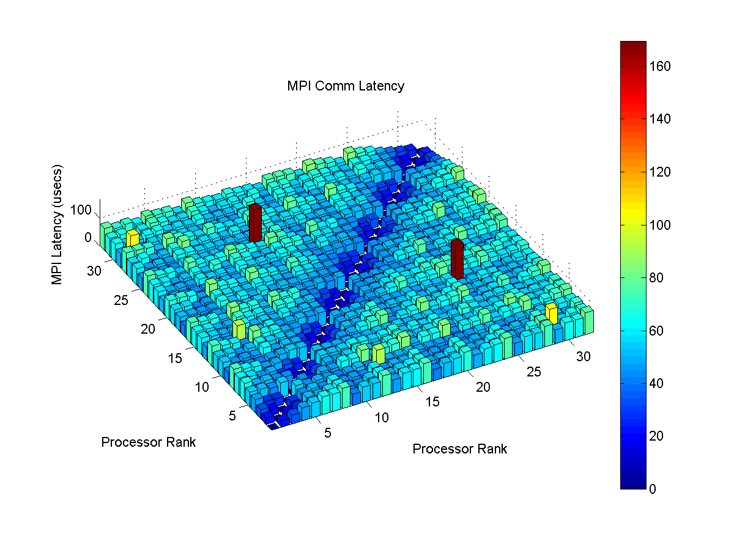
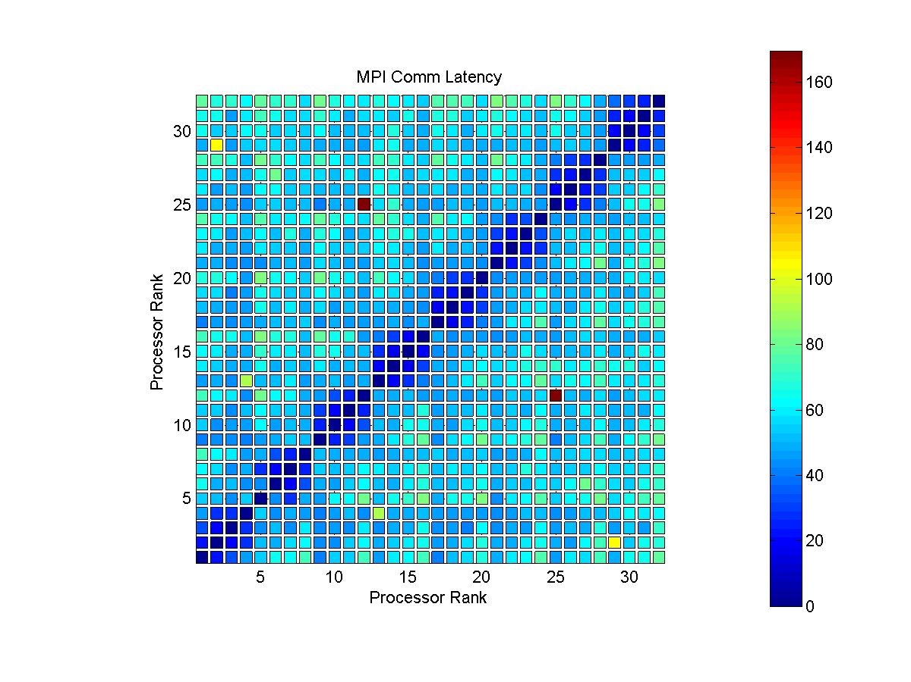
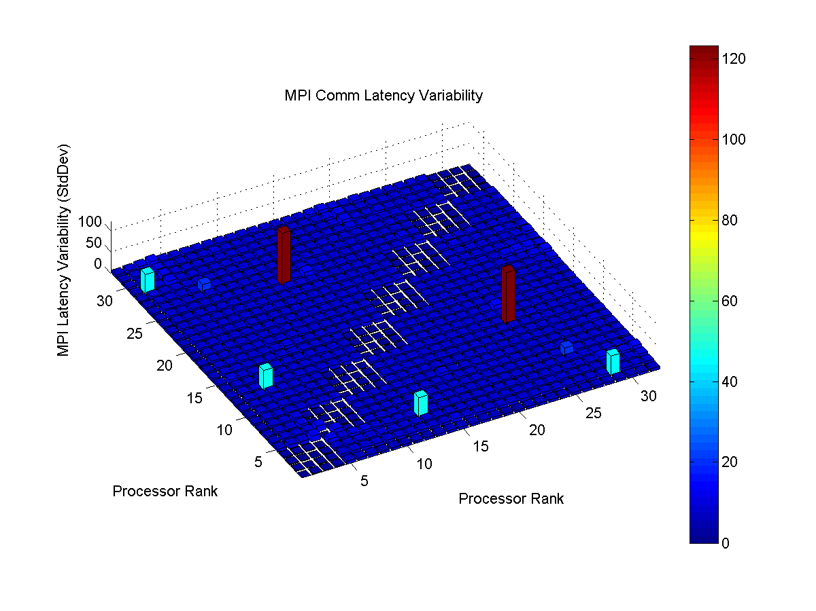
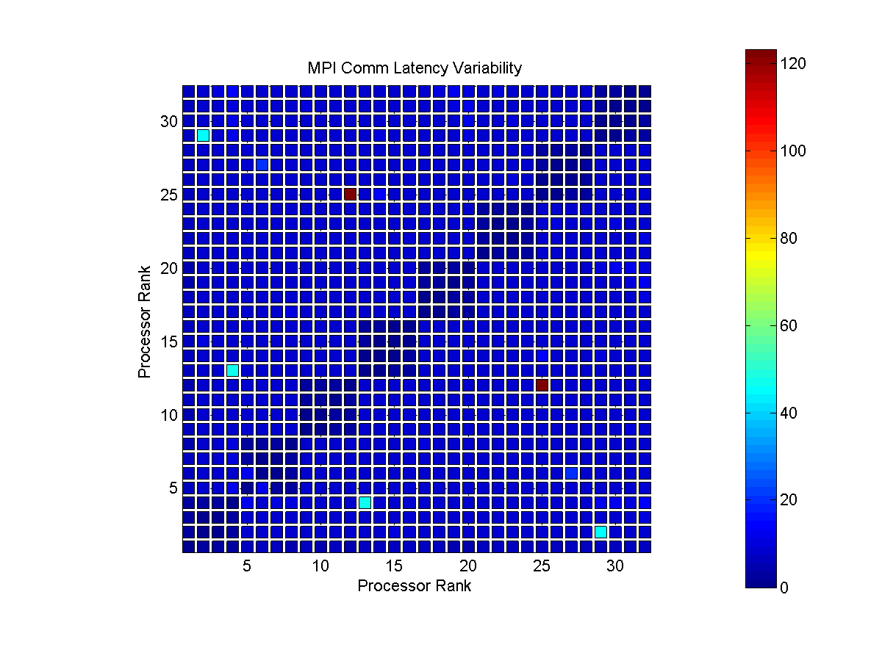
Dell Dual Core – Dual Processor (TACC Lonestar 2008) Total Cores: 32

Slide 18
Intel 64 Quad Core – Dual Processor (NCSA Abe)

Slide 19
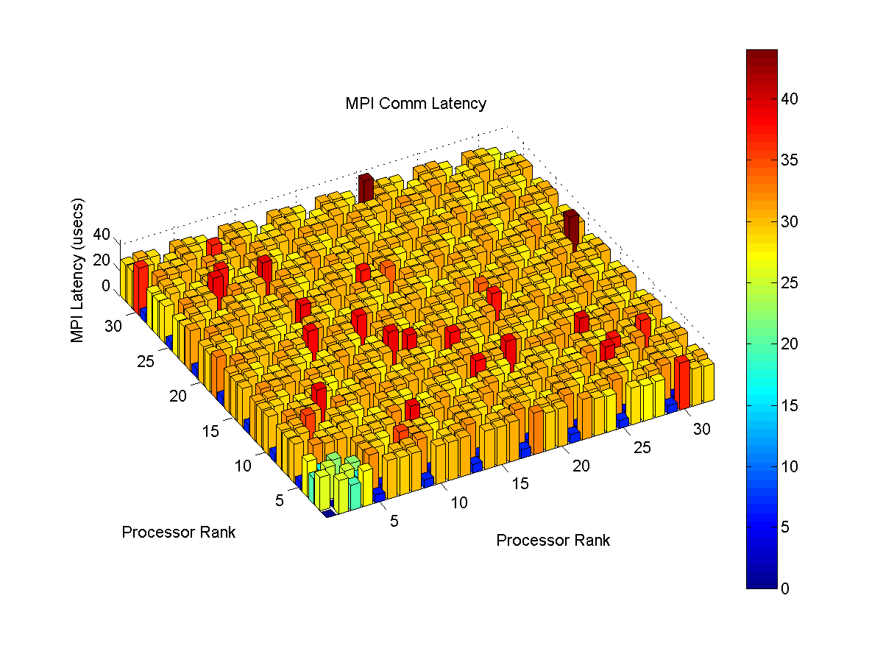
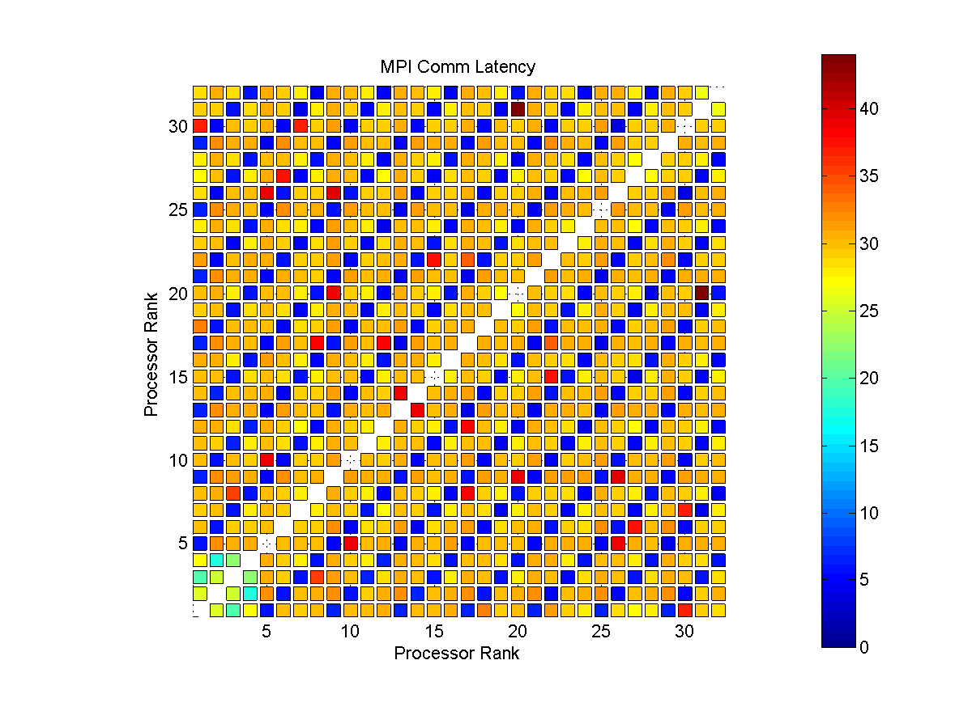
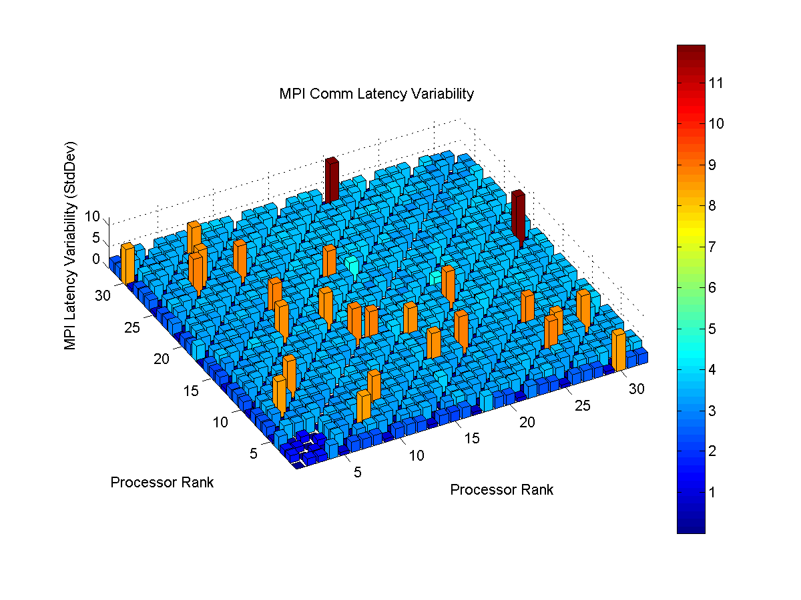
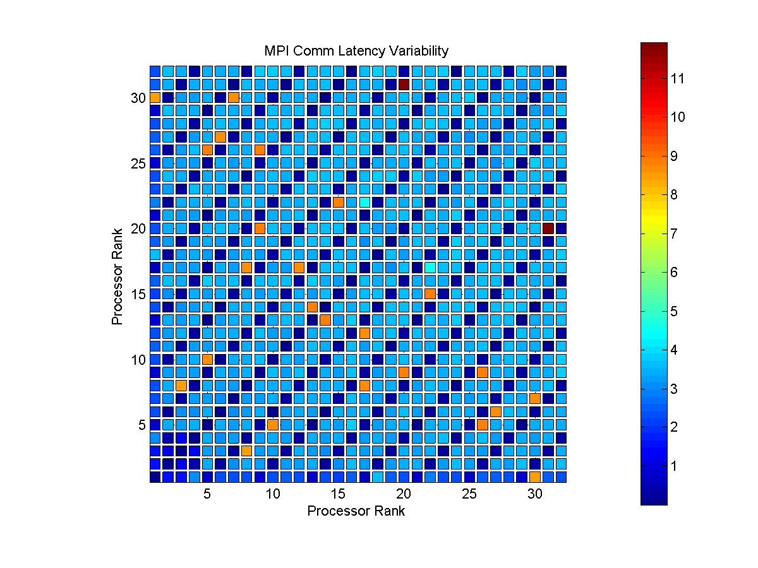
Intel 64 Quad Core – Dual Processor(NCSA Abe 2008) Total Cores: 32

Slide 20
AMD Opteron and XEON (USC HPCC)

Slide 21
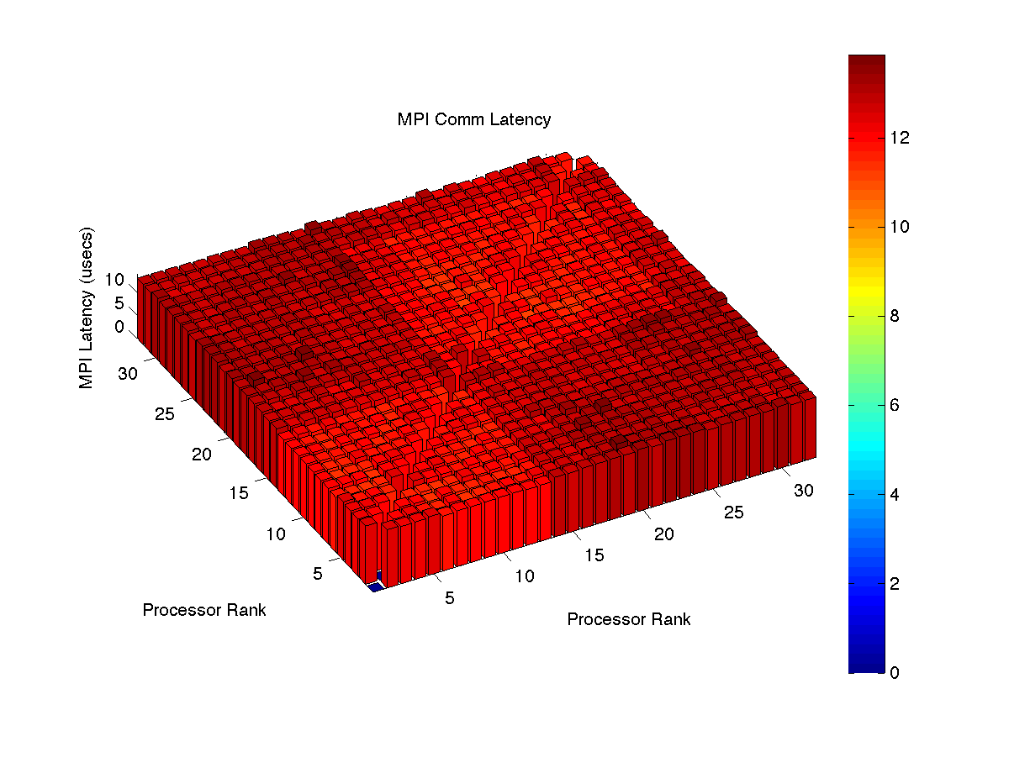
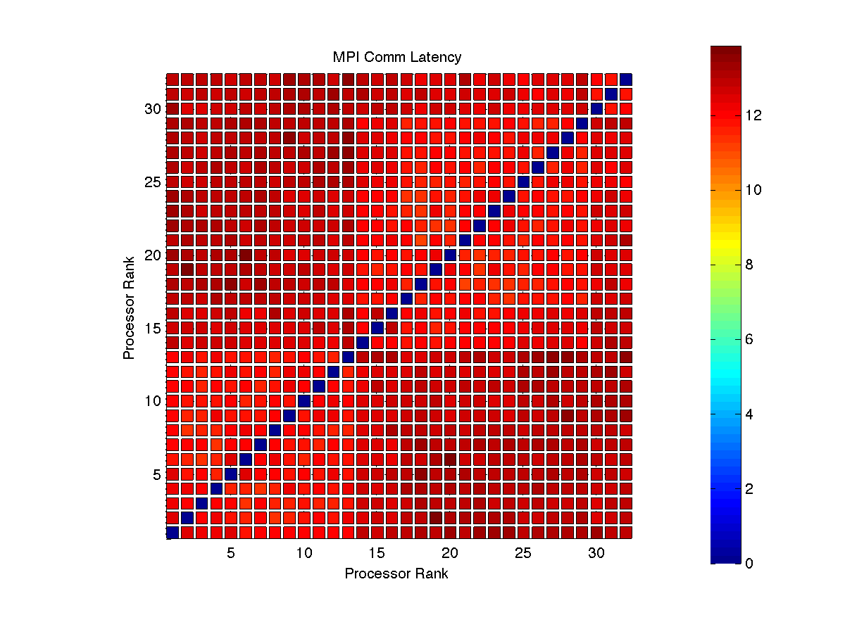
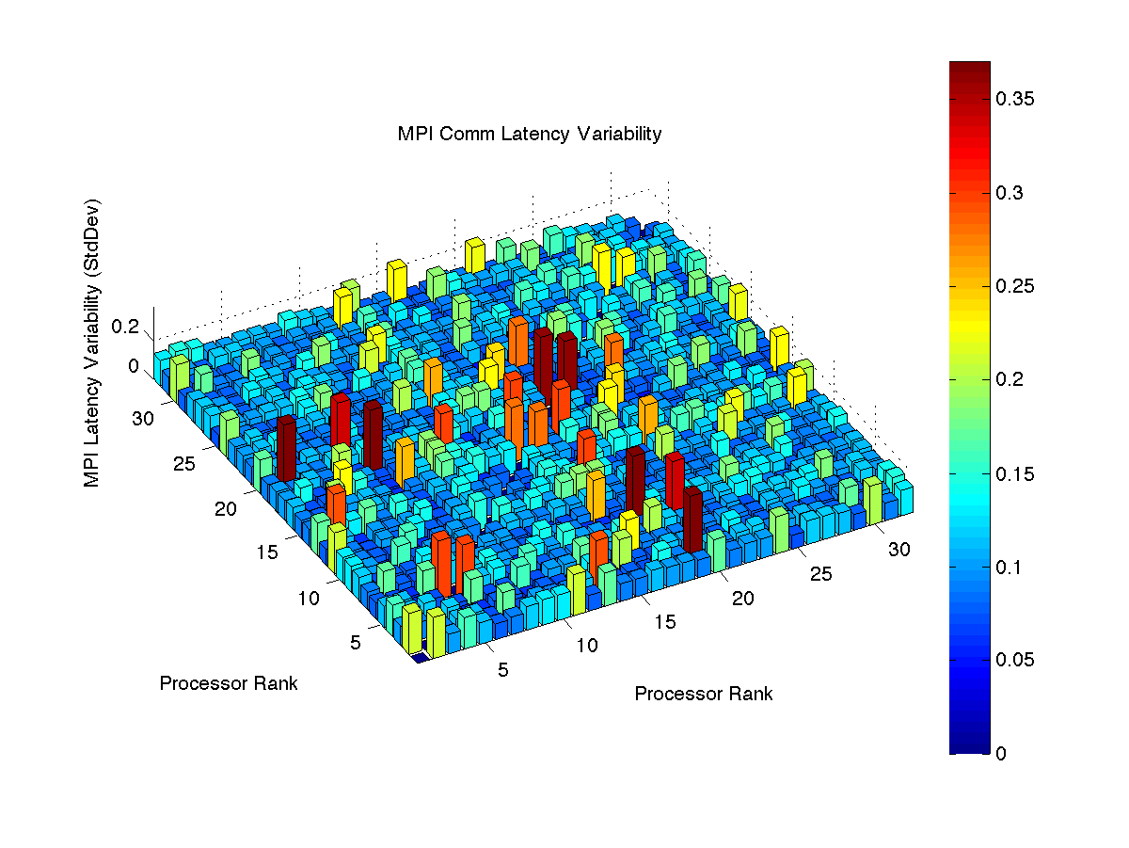
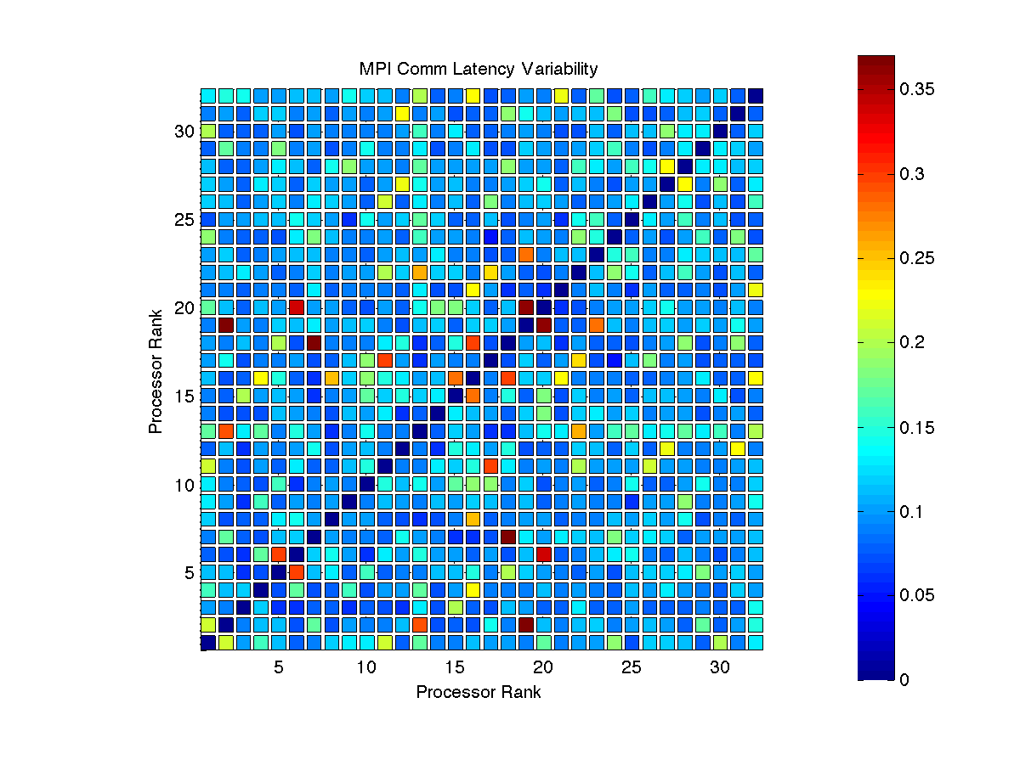
Dual Dodecacore AMD Opteron (USC HPCC NBNS 2014) Nodes: 32 Cores/Node: 1 Total Cores: 32

Slide 22
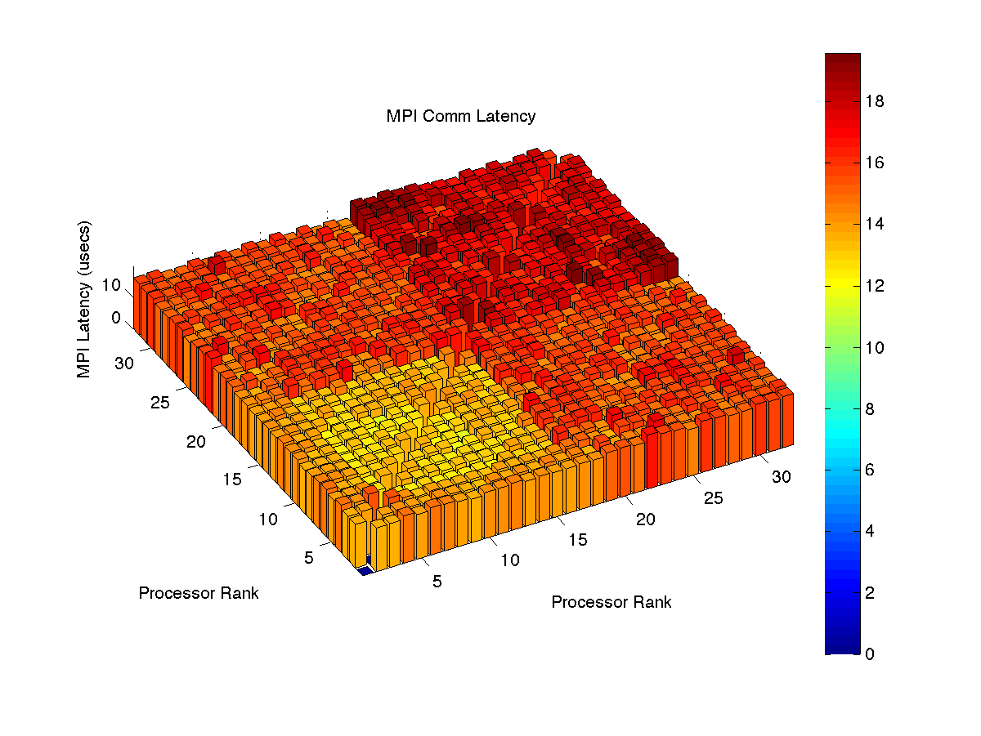
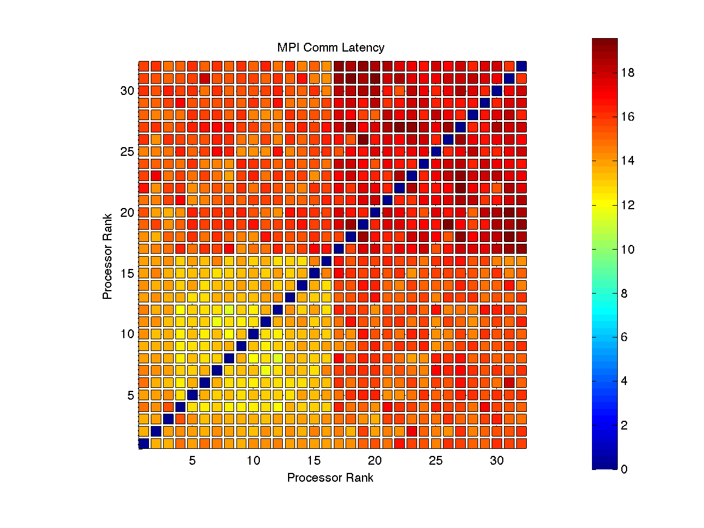
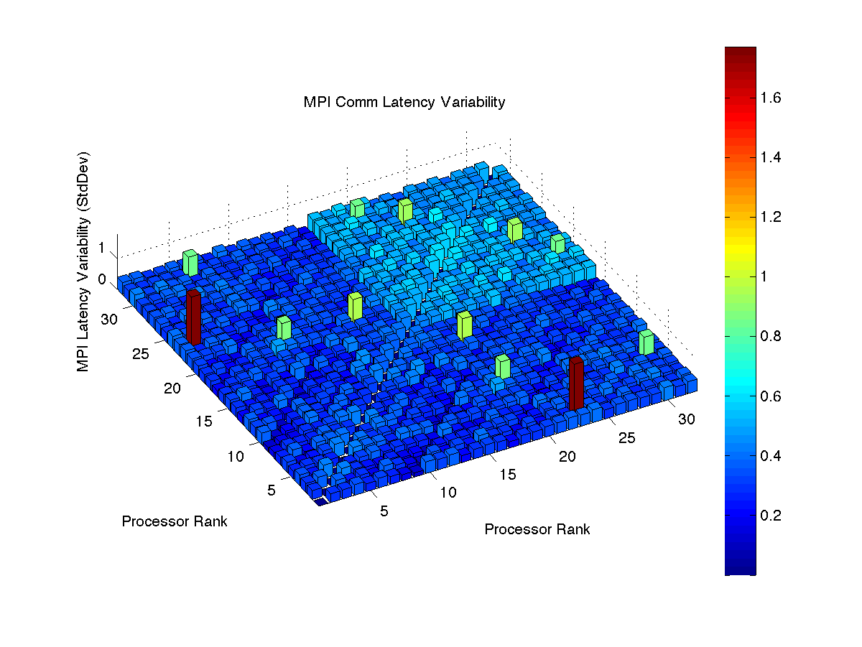
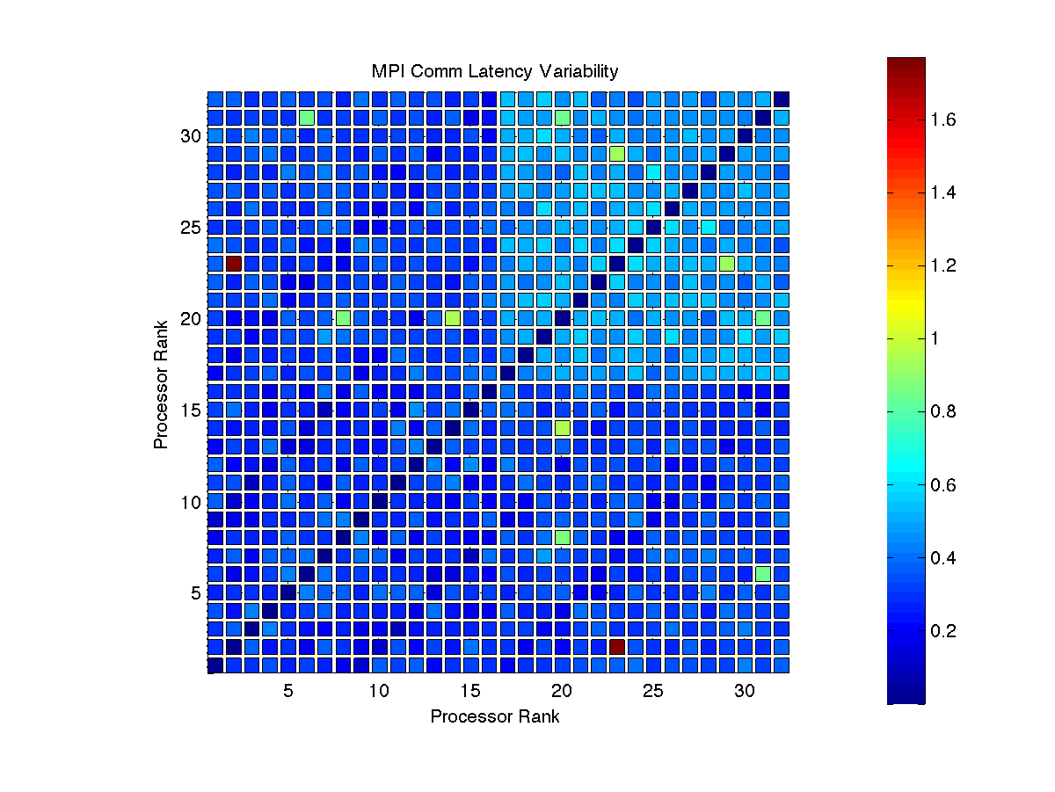
AMD and Dual Quad XEON (USC HPCC Main 2014 ) Nodes: 32 Cores/Node: 1 Total Cores: 32

Slide 23

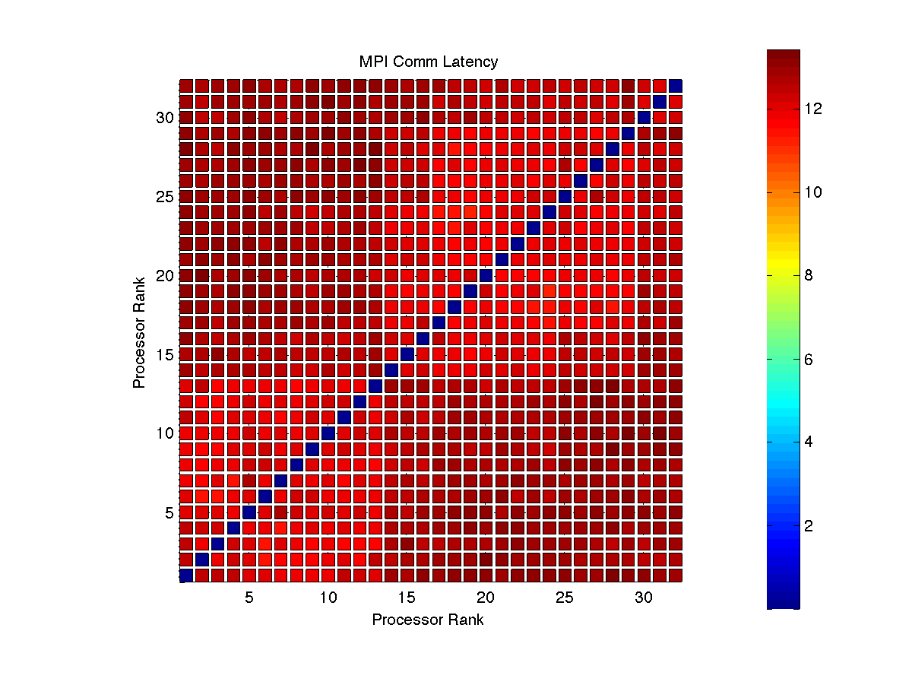
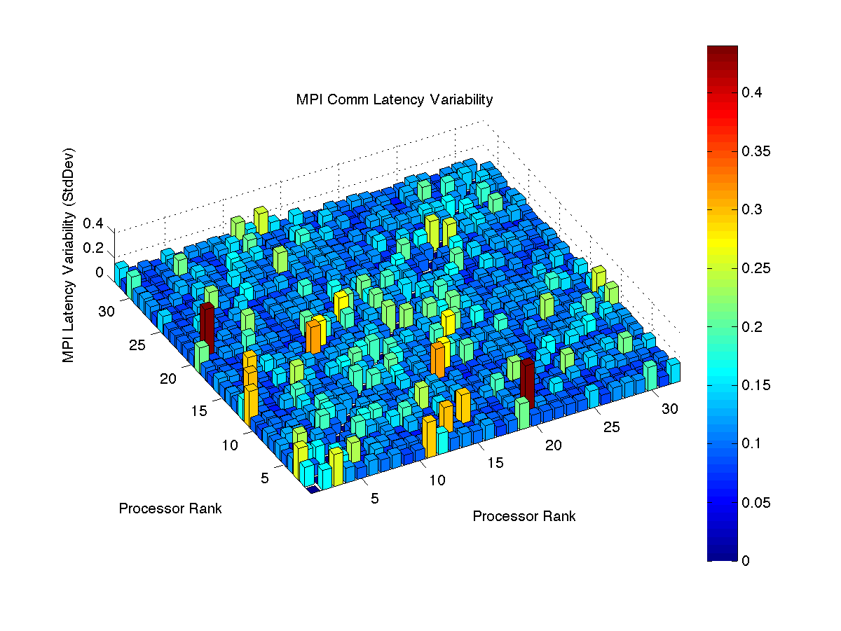

AMD Opteron (USC HPCC Myrinet 2014 ) Nodes: 32 Cores/Node: 1 Total Cores: 32

Slide 24
Cray XT5 (NICS Kraken)

Slide 25




Cray XT5 (NICS Kraken 2014) Nodes: 32 Cores/Node: 1 Total Cores: 32

Slide 26




Cray XT5 (NICS Kraken 2014) Nodes: 3 Cores/Node: 12 Total Cores: 32

Slide 27
IBM Blue Gene/Q (ALCF Mira)

Slide 28




IBM Blue Gene/Q (ALCF Mira 2014) Nodes: 32 Cores/Node: 1 Total Cores: 32

Slide 29




IBM Blue Gene/Q (ALCF Mira 2014) Nodes: 2 Cores/Node: 16 Total Cores: 32

Slide 30
Cray XE6/XK7 (NCSA Blue Waters)

Slide 31




Cray XE6 (NSF Blue Waters 2014) Nodes: 32 Cores/Node: 1 Total Cores: 32

Slide 32




Cray XE6 (NSF Blue Waters 2014) Nodes: 1 Cores/Node: 32 Total Cores: 32

Slide 33




Cray XK7 (NCSA Blue Waters 2014) Nodes: 32 Cores/Node: 1 Total Cores: 32

Slide 34




Cray XK7 (NCSA Blue Waters 2014) Nodes: 2 Cores/Node: 16 Total Cores: 32

