Slide 1


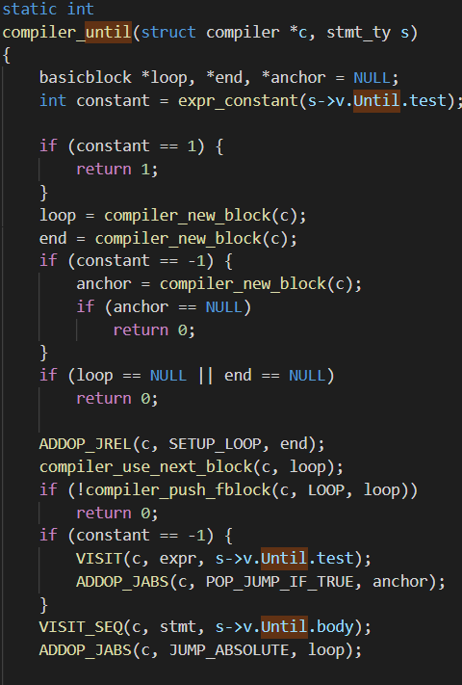

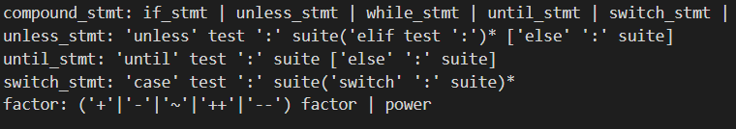
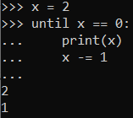

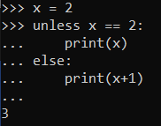
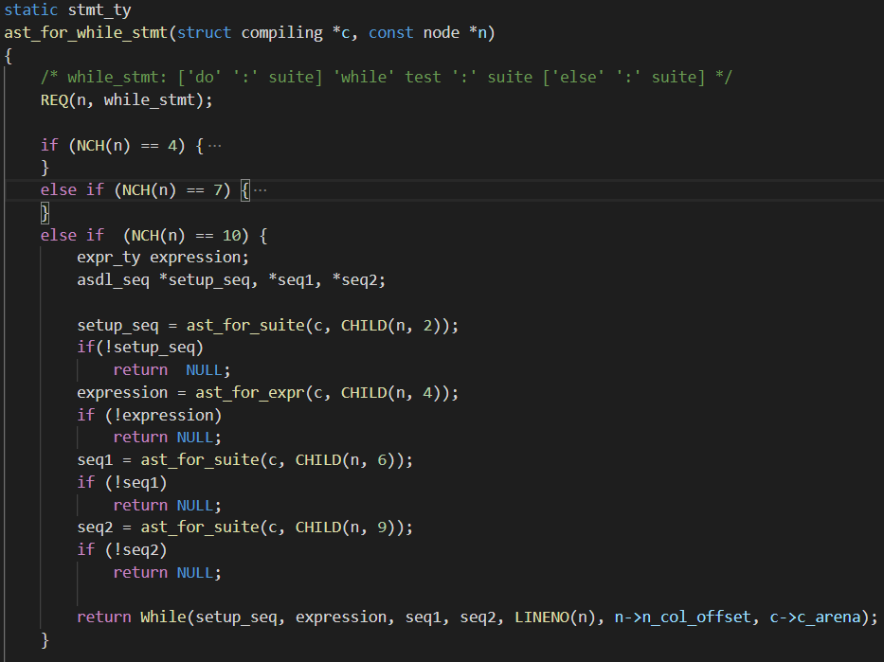
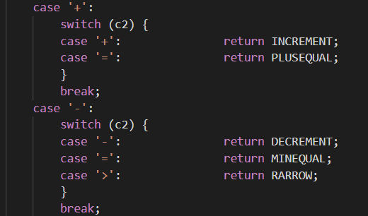



Enhancing Python Syntax: Increment, Decrement, Do- While,
Until, Unless & Switch-Case Statements
By: Zak Ahmed, Pedro Oliveira, Piranaven Selvathayabaran
Department of Computing and Software, McMaster University
April 17th 2019
Problem
CPython Modifications & Example Code Additions
Results
Python is one of the most beloved programming languages. It contains a plethora of syntax that enables its users to achieve their goals.
However, it does not contain a handful of syntax that we believe would enrich the programming language and provide developers with more flexibility. These language constructs are Increment, Decrement, Until, Unless, Do-While Loops, & Switch-Case Statements. These enhancements, although not necessarily pythonic, would undoubtedly strengthen a developers toolkit.
In order to alter Python, we took advantage of the CPython compiler (V 3.7) which executes the following steps²:
Parse source code into a parse tree (Parser/pgen.c)
Transform parse tree into an Abstract Syntax Tree (Python/ast.c)
Transform AST into a Control Flow Graph (Python/compile.c)
Emit bytecode based on the Control Flow Graph (Python/compile.c)
Several other files needed to be altered to achieve our results. Most notably:
Python.asdl → Used for parsing into AST
Grammar → Contains grammar rules
ceval.c → executes byte-code
symtable.c → Generates a symbol table from AST
Following these changes, running a configured Makefile regenerated the remaining necessary source code such as graminit.c and node.h. Finally, we used the “dis” module to verify that the generated bytecode was as expected.
GRAMMAR
All CPython modifications started with some grammar rule changes:
Similar modifications were made in Python.asdl, which defines the AST nodes
AST MODIFICATIONS
Below is an example of the kinds of modifications we had to make to allow for 4 different options in a do-while-else loop. Various combinations would allow for various child node configurations which we had to account for, namely:
While: 4 child nodes
Do While: 7 child nodes
While, Else: 7 child nodes
Do While Else: 10 child nodes
COMPILING TO BYTECODE
OUTPUT FROM TEST CASES
Increment/ Decrement
Increment and decrement oper-
ators are unary operators that
add or subtract one from their
operand, respectively.
Until
An until loop statement
repeatedly executes a target
statement as long as a given
condition is false.
Unless
The unless expression is the
opposite of the if expression.
If the value is false the “else“
expression is executed
The most challenging part of this project was the size and complexity of the code. It was very challenging at first to find what we were looking for and understand how everything in the CPython compiler was connected. This was further magnified by the out of date documentation and heavy use of macros. In hindsight, we didn’t have to write too many lines of code and it was truly a situation of quality over quantity. If we were to do this project again, we would definitely try to implement some compiler optimizations like constant folding. Looking forward, we would love to try and implement some of existing PEP’s, most notably PEP 3124 - Overloading, Generic Functions, Interfaces, and Adaptation.
¹ Python Software Foundation. (n.d.). 24. Changing CPython's Grammar. Retrieved
April 09, 2019, from https://devguide.python.org/grammar/
² Python Software Foundation. (n.d.). 25. Design of CPython's Compiler. Retrieved March 26, 2019, from https://devguide.python.org/compiler/
^{3.} Python Software Foundation. (n.d.). 10. Full Grammar specification. Retrieved April 6, 2019, from https://docs.python.org/3/reference/grammar.html
⁴ Python Software Foundation. (n.d.). PEP 3103 -- A Switch/Case Statement. Retrieved March 22, 2019, from https://www.python.org/dev/peps/pep-3103/
The implementation on the right demonstrates the code needed in order to compile the AST to bytecode. The bytecode is handled via several macros. There are also various helper functions like compiler_use_next_block which handles the offsetting of the next instruction.
Process
Conclusion
PARSE TREE
Parsing tokens like increment and decrement required additional changes to tokenizer.c and token.h. We explicitly defined and handled them since they represented a double token. As seen in the switch case statement below, after first checking for the ‘+’ or ‘-’ symbol, a following check for the same symbol is done such that the appropriate call to increment/decrement is made.
References
Notes:
Changes Based on Feedback:
- Address Bar removed from title header
- Poster was put through Gramarly. Proof Read.
- Section for Developement Stats was Added
- Section for "Conclusion Next Steps" was added to define our experience
- Readme Updated : Need to discuss with TA's to ensure that modifications are visible

