Slide 1
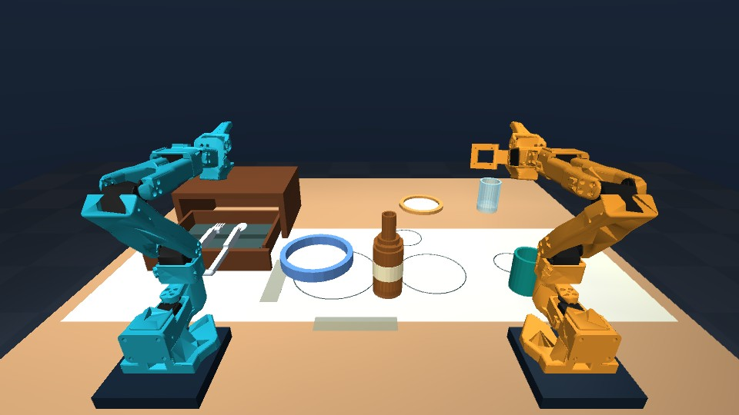
Talos
AI Infra Summit Hackathon
September 2026
Spoken instructions for learned dinner-table tasks
Two SO-101 arms
Six learned skills
Bottle relays in both directions
OpenVINO inference
Speechmatics voice input
A physical simulation prototype.
Broader seven-item control remains unfinished.
Talos
01
Notes:
Current facts: submission/final-v7/PROJECT.md and docs/PC_HANDOFF.md. The image comes from the preserved Talos-v7.pptx and shows actual MuJoCo rendering. All manipulation results refer to simulation. The original six-skill system and broader joint seven-item goal are separate.
Brand palette source: AI Infra Summit Physical AI brochure, accessed 2026-09-14: https://cdn.asp.events/CLIENT_Kisaco_R_E0D4AD69_B740_B124_D2ADF5A777880773/sites/AI-Infra-Summit-2026/media/libraries/downloads/PHYSICAL-AI.pdf . Event: https://lablab.ai/ai-hackathons/ai-infra-summit-hackathon .

Slide 2
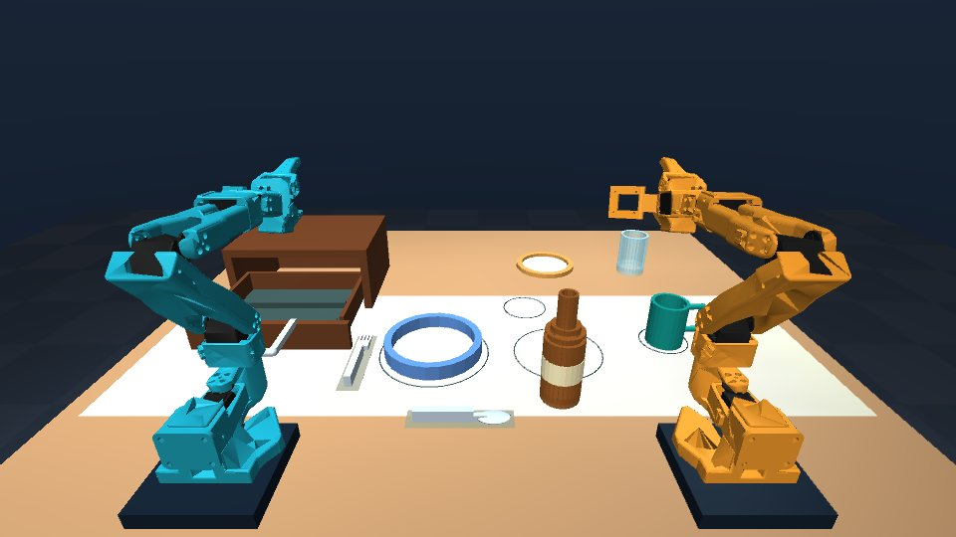
Six skills in one continuous scene
“Set the table”
01
Place the bottle
02
Place the plate
03
Place the mug
04
Open the drawer
05
Place the fork
06
Place the spoon
The human voice rehearsal completed all six skills with 15 live mug corrections.
Talos
02
Notes:
Sequence: bottle, plate, mug, drawer, fork, spoon. Human evidence: docs/robotics/evidence/human-voice-dinner-v1/README.md. Fifteen live mug corrections and both arms parked. Speechmatics transcribes supported commands. Grammar remains bounded. The displayed completed-scene screenshot is from the earlier preserved demo, not a capture of this microphone run. The hosted demo uses typed commands; local browser supports voice.
Brand palette source: AI Infra Summit Physical AI brochure, accessed 2026-09-14: https://cdn.asp.events/CLIENT_Kisaco_R_E0D4AD69_B740_B124_D2ADF5A777880773/sites/AI-Infra-Summit-2026/media/libraries/downloads/PHYSICAL-AI.pdf . Event: https://lablab.ai/ai-hackathons/ai-infra-summit-hackathon .

Slide 3
Learned motion with separate physical checks
The network generates movement
Speechmatics
Transcribes supported spoken commands.
Camera features condition neural joint trajectories.
Measured joint feedback regulates task progress.
Task grammar and RGB checks
Choose the next supported skill.
The selected profile adds stereo observation and a learned local correction model during late mug placement.
MuJoCo physical monitor
Checks contact, placement and parked arms. It does not generate learned actions.
201 verified inputs for five newer dinner skills
52 verified inputs for four relay models
Talos
03
Notes:
Architecture: models/dinner_suite/README.md, models/dinner_visual_mug_v1/README.md, models/bottle_relays/README.md. Original bottle model preserved. Classical RGB perception, learned motion and privileged monitoring are distinct. No teacher, action retrieval, attachments, teleportation or hidden forces generate deployed neural actions. Unsupported instructions are refused; progress and cancellation remain visible. Training: RTX 4070, OpenVINO FP32 export with parity checks.
Brand palette source: AI Infra Summit Physical AI brochure, accessed 2026-09-14: https://cdn.asp.events/CLIENT_Kisaco_R_E0D4AD69_B740_B124_D2ADF5A777880773/sites/AI-Infra-Summit-2026/media/libraries/downloads/PHYSICAL-AI.pdf . Event: https://lablab.ai/ai-hackathons/ai-infra-summit-hackathon .

Slide 4
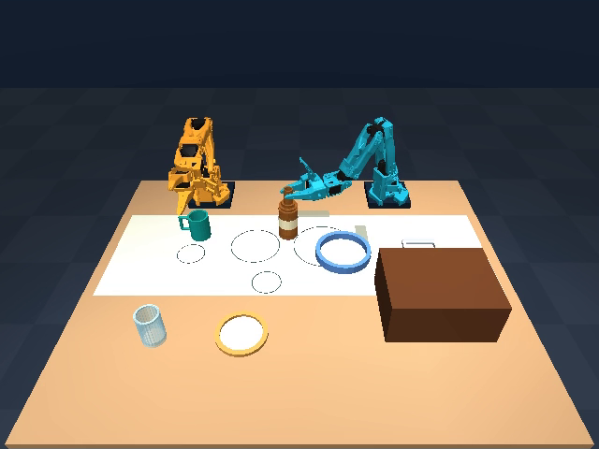
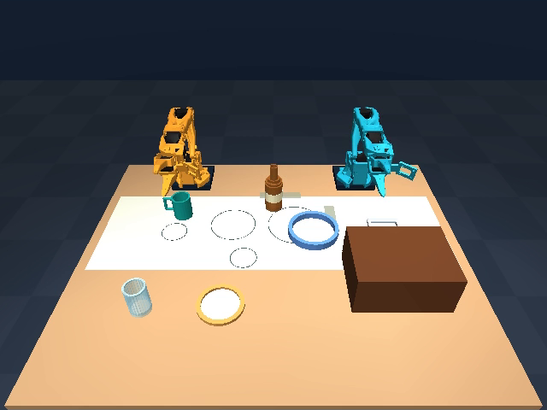
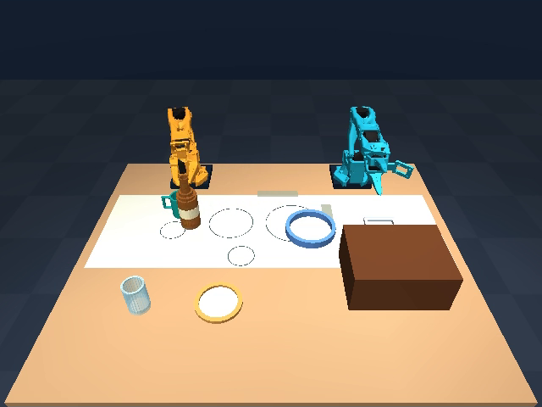
A bottle relay through the shared table
One arm releases the bottle before the other takes over.
Blue arm lifts
Table release and parking
Amber arm carries
12.0 simulated seconds
37.0 simulated seconds
60.0 simulated seconds
5 / 5 left to right 5 / 5 right to left
Upright start regions, fixed goals.
Transfer uses table contact.
Talos
04
Notes:
Models and outcomes: models/bottle_relays/README.md and docs/robotics/evidence/learned-relays-v3/summary.json. Both directions pass 5/5 frozen trials. No airborne handoff. Selected example seed 2026092501: stills from submission/final-v6/Talos-demo-v6.mp4 at video seconds 83.9, 96.4, 107.9, corresponding to 12, 37, 60 simulated seconds. Crop shows only the opposite-side camera pane. All ten trials remain in the source archive.
Brand palette source: AI Infra Summit Physical AI brochure, accessed 2026-09-14: https://cdn.asp.events/CLIENT_Kisaco_R_E0D4AD69_B740_B124_D2ADF5A777880773/sites/AI-Infra-Summit-2026/media/libraries/downloads/PHYSICAL-AI.pdf . Event: https://lablab.ai/ai-hackathons/ai-infra-summit-hackathon .

Slide 5
Frozen trials retain both successes and failures
Limited starting presets and fixed destinations define these results.
Two original dinner failures
14.59 mm
Mug placement XY error
13.61 mm
Spoon placement XY error
The dinner placement threshold stays at 8 mm. Each chart row has its own frozen protocol.
Talos
05
Notes:
Sources: models/dinner_suite/README.md and docs/robotics/evidence/learned-dinner-v6/summary.json, docs/robotics/evidence/learned-relays-v3/summary.json, docs/robotics/evidence/composed-dinner-v1/README.md. Ratios: 8/10,5/5,5/5,8/10. Chart values are 0.8,1,1,0.8 with explicit counts; no pooled denominator or statistical ranking. Two dinner failures: seed 2026091902 mug 14.59 mm, seed 2026091905 spoon 13.61 mm, threshold 8 mm. Composed failures are separate retained spoon failures. These do not establish joint seven-item coverage.
Brand palette source: AI Infra Summit Physical AI brochure, accessed 2026-09-14: https://cdn.asp.events/CLIENT_Kisaco_R_E0D4AD69_B740_B124_D2ADF5A777880773/sites/AI-Infra-Summit-2026/media/libraries/downloads/PHYSICAL-AI.pdf . Event: https://lablab.ai/ai-hackathons/ai-infra-summit-hackathon .

Slide 6
Visual correction during late mug placement
The same correction model receives live or frozen images.
Updated images matter
for the correction model
The original baseline also passes every final case. This does not establish a higher success rate than that baseline.
All 96 development and final workflows remain preserved.
Two narrow presets. Broad visual recovery remains unfinished.
Talos
06
Notes:
Source: docs/robotics/evidence/mug-visual-correction-v2/README.md and models/dinner_visual_mug_v1/README.md. Final live 20/20, original baseline 20/20, frozen 0/20; ten per preset in each condition. Shared correction weights unchanged between live and frozen conditions. All 96 total workflows,422745 state frames,824 correction queries preserved. Does not improve success over the original baseline on this sample. The profile is integrated in the private local and hosted demos.
Brand palette source: AI Infra Summit Physical AI brochure, accessed 2026-09-14: https://cdn.asp.events/CLIENT_Kisaco_R_E0D4AD69_B740_B124_D2ADF5A777880773/sites/AI-Infra-Summit-2026/media/libraries/downloads/PHYSICAL-AI.pdf . Event: https://lablab.ai/ai-hackathons/ai-infra-summit-hackathon .

Slide 7
Intel execution on the available laptop
Six learned tasks complete with Intel CPU or iGPU inference and Intel UHD rendering.
Core i7-10850H
Legacy Intel hardware
Tested on seed 42
Recorded physical outcomes
Historical original-bottle network timing
0.157 ms
0.688 ms
Network-only medians.
These are not full robot
control-loop timings.
Intel CPU, FP32 inference
Intel UHD iGPU, FP32 inference
Core Ultra Series 2/3 eligibility remains unresolved.
The latest live-mug profile also needs its separate Intel verification run.
Talos
07
Notes:
Intel physical execution/rendering: docs/robotics/evidence/intel-final-legacy-v3/README.md. The two later runs use Intel UHD OpenGL and Intel CPU/GPU.0 inference, matching original six checkpoints. Original bottle network-only timing: submission/evidence/intel-network-benchmark.json,0.157ms CPU and0.688ms iGPU. Not full-loop benchmarks. Current required hardware: docs/hackathon/FINAL_SUBMISSION_CHECKLIST.md, Core Ultra Series2/3 unresolved. New live-mug option requires separately scoped Intel run.
Brand palette source: AI Infra Summit Physical AI brochure, accessed 2026-09-14: https://cdn.asp.events/CLIENT_Kisaco_R_E0D4AD69_B740_B124_D2ADF5A777880773/sites/AI-Infra-Summit-2026/media/libraries/downloads/PHYSICAL-AI.pdf . Event: https://lablab.ai/ai-hackathons/ai-infra-summit-hackathon .

Slide 8
Broader seven-item control remains unfinished
0
Jointly randomized objects,
full tabletop rotation and
stable alternative orientations
Complete seven-item
workflows passed
Calibrated RGB-D and adapted CLIPort run on the RTX 4070. The shared Talos action policy is untrained.
Next capability milestone
Reliable physical grasps and routes, then varied whole-scene demonstrations and a shared camera-driven policy.
github.com/jannissio/talos-ai-infra
Private CPU demo verified.
Public access awaits final release.
Code, models, compact inputs and all outcomes. MIT for original work.
Talos
08
Notes:
Goal and latest status: docs/PC_HANDOFF.md and docs/robotics/WHOLE_TABLE_PIPELINE.md. Seven loose objects: bottle,plate,mug,fork,spoon,side_plate,glass. No complete joint randomized scene succeeds. Adapted CLIPort runtime smoke peak Torch reservation5.49GiB does not establish trained action control. Current physical teacher has subset successes across separate scenes; these cannot be combined into a complete table. Latest V28:207 physical attempts, four accepted actions, only glass complete. Next specific dependency is target-inclusive inverted-glass approach clearance followed by same-scene mug-route continuation, under a new finite protocol. Hosted live-mug CPU demo:287.79 wall seconds, docs/robotics/evidence/human-voice-dinner-v1. Links:https://github.com/jannissio/talos-ai-infra and https://huggingface.co/spaces/jannis-sms/talos-dinner-robotics. Both stay private until agreed release. LICENSE and THIRD_PARTY_NOTICES.md preserve component licenses.
Brand palette source: AI Infra Summit Physical AI brochure, accessed 2026-09-14: https://cdn.asp.events/CLIENT_Kisaco_R_E0D4AD69_B740_B124_D2ADF5A777880773/sites/AI-Infra-Summit-2026/media/libraries/downloads/PHYSICAL-AI.pdf . Event: https://lablab.ai/ai-hackathons/ai-infra-summit-hackathon .

