Slide 1
PADAYON
An AI learning partner that turns messy student notes into organized, curriculum-aligned materials in the language students understand best.
AMD Developer Hackathon: ACT II — Unicorn Track + Best AMD-Hosted Gemma Project

Slide 2
The Problem: Filipino Students Are Falling Behind
Sources: PISA 2022 Results; Philippine Basic Education; MTB-MLE research on mother-tongue instruction
• PISA 2022: Philippines ranked 77th out of 81 countries in reading, math, and science.
• Scores: Reading 347, Math 355, Science 356 — vs. OECD averages of 472–485.
• Academic English is a barrier: Science and Math are taught in English, but many students think best in Cebuano/Filipino.
• Students lack organized study habits — notes are scattered, review is last-minute, and study materials are not personalized.
• Most AI tools today give instant answers, enabling shortcut learning instead of building real understanding.
• Result: learners complete homework but do not master concepts.

Slide 3
The Opportunity: AI That Teaches, Not Just Answers
Stanford GSE / Faculty Focus surveys on AI use; MTB-MLE Philippines studies
• 85% of students already use AI for schoolwork — the habit is formed, but the direction is wrong.
• Research shows students want AI for explaining concepts and generating ideas, not writing entire outputs.
• Mother-tongue-based instruction improves comprehension, confidence, and problem-solving.
• What if AI could meet students in their own language, organize their chaos, and grow with them?

Slide 4
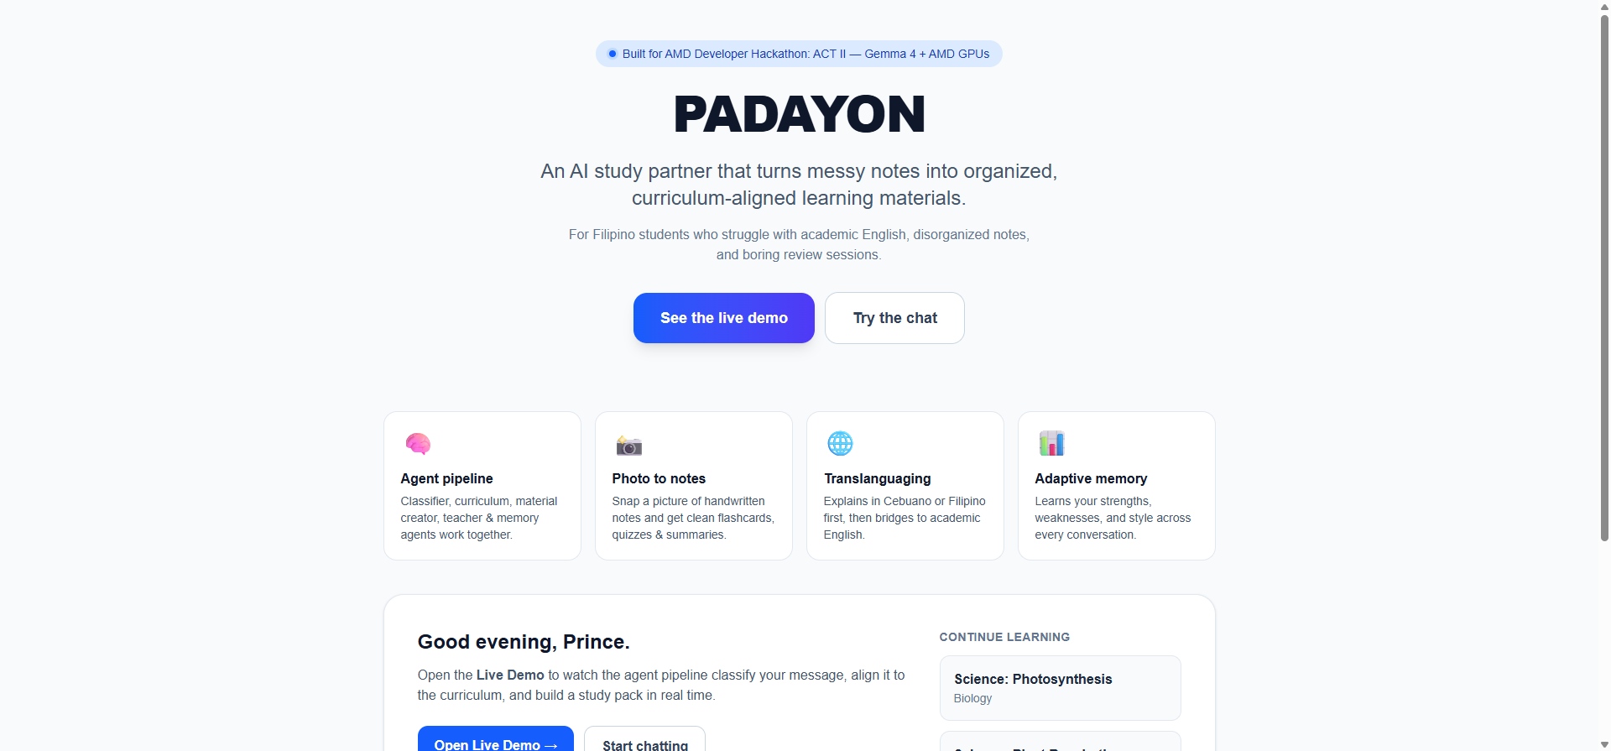
PADAYON: Your AI Study Partner
• Messy notes, photos, or questions → automatic subject/topic classification.
• Aligns every input to the Philippine curriculum / Budget of Work.
• Auto-generates clean notes, reviewer, flashcards, quiz, summary, and story.
• Teaches through translanguaging: Cebuano or Filipino first, then academic English.
• Remembers each learner's strengths, weaknesses, language confidence, and progress.
• Retrieves past materials across sessions — learning continues where it left off.

Slide 5
Agent Architecture Built for Learning
Seven real agents orchestrated through Fireworks AI on AMD hardware
• Classifier Agent — detects subject, topic, intent, and language from student input.
• Curriculum Alignment Agent — matches the topic to DepEd competencies and learning sequence.
• Organizer Agent — saves everything into the right subject/topic folder.
• Material Creator Agent — builds notes, flashcards, quizzes, reviewers, and stories.
• Teaching Agent — explains with translanguaging and guided questions.
• Assessment Agent — checks mastery with hints, feedback, and progress scoring.
• Memory Agent — updates the learner profile after every interaction.

Slide 6
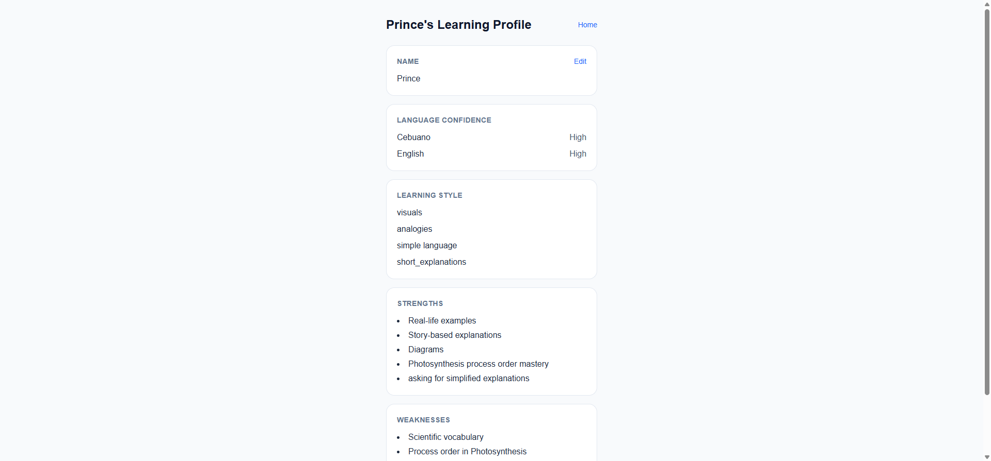
Translanguaging + Adaptive Memory
• Students ask in Cebuano: 'Unsa diay ang photosynthesis?'
• PADAYON answers in Cebuano first, then introduces the English term naturally.
• The learner profile records language confidence, learning style, strengths, and weak areas.
• Every chat shapes the next explanation — it feels like a tutor who remembers you.
• Mastery score tracks progress per topic: started → developing → mastered.

Slide 7
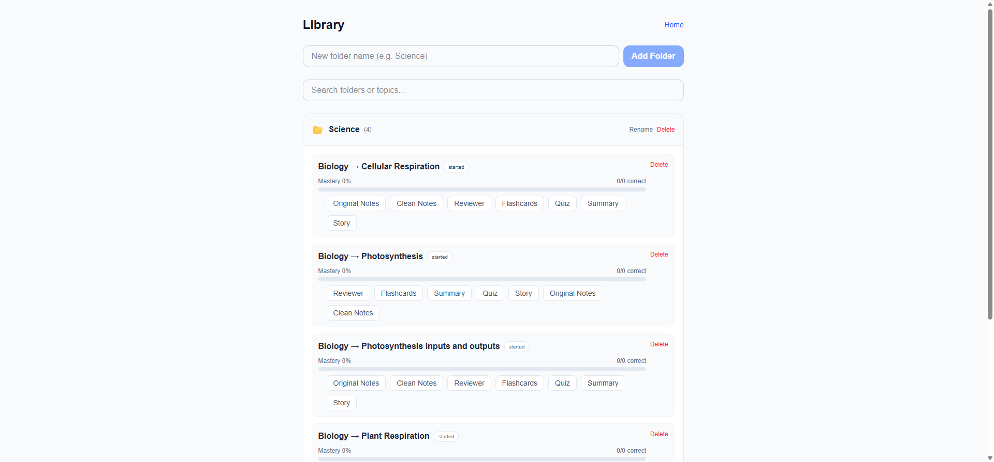
Automatic Organization in Your Library
• Every topic is filed under Subject → Subcategory → Topic.
• One-click access to original notes, clean notes, reviewer, flashcards, quiz, summary, and story.
• Progress bar and mastery status show what needs review.
• Students can return days later and say 'show my flashcards' — PADAYON retrieves instantly.

Slide 8
AMD-Ready Architecture with Gemma Support
• Production runtime: Fireworks AI API — Fireworks is an AMD partner hosting fast, serverless models on AMD infrastructure.
• Default pipeline uses Fireworks serverless models (DeepSeek-V4 / Kimi-K2.5) for reliability and speed.
• Demo toggle switches to Gemma 3/4 when an endpoint is available via Fireworks on-demand or AMD Developer Cloud GPU pod.
• Automatic fallback keeps the demo stable if Gemma is unreachable.
• Containerized with Docker and built with Next.js + Supabase + Tailwind.
• Competes in Unicorn Track and Best AMD-Hosted Gemma Project.

Slide 9
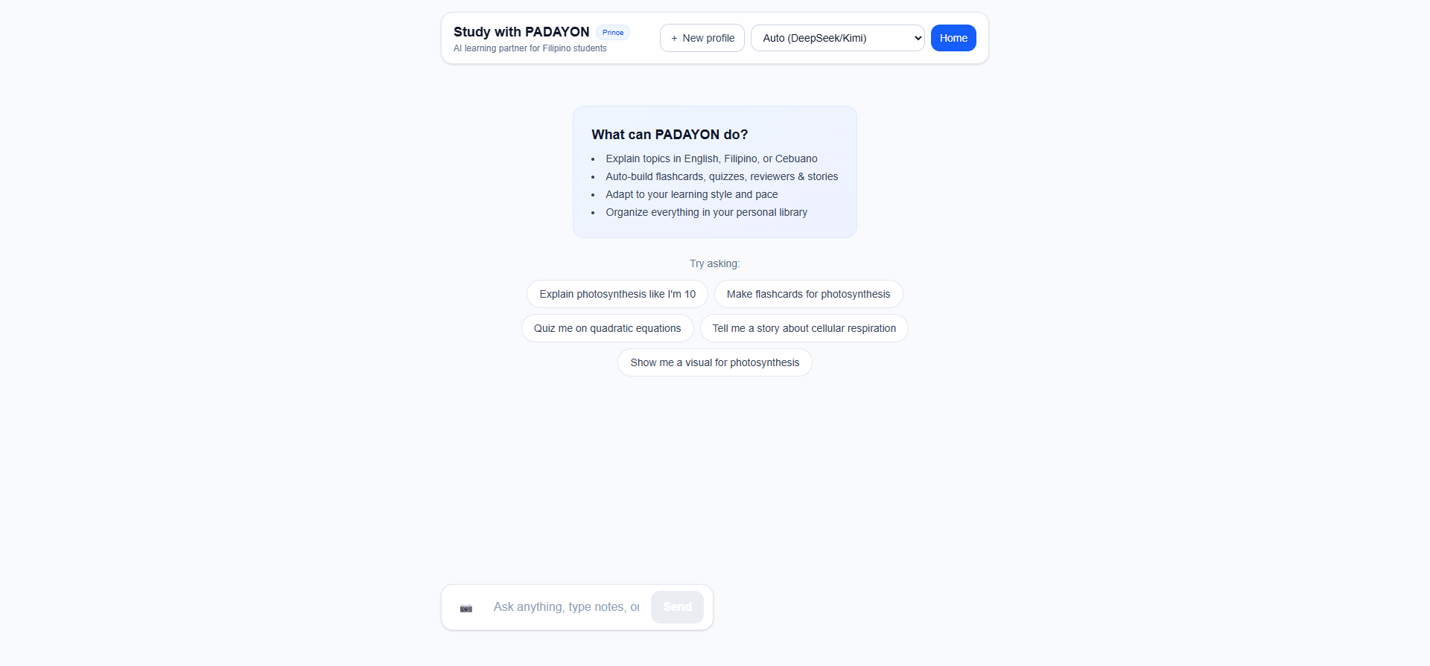
Live Demo Flow
• 1. Student types messy notes: 'photosynthesis chlorophyll sunlight CO2 oxygen glucose'.
• 2. PADAYON detects Science → Biology → Photosynthesis and aligns it to Grade 9 curriculum.
• 3. Clean notes, reviewer, flashcards, quiz, summary, and story are created automatically.
• 4. Student asks in Cebuano and gets a Cebuano-first explanation with English terms.
• 5. Quiz answer updates mastery score and learner profile.
• 6. Student returns later: 'show my flashcards' — saved materials are retrieved instantly.

Slide 10
Market Potential
• Target: 27+ million Filipino K–12 students, especially those in Cebuano/Filipino-speaking regions.
• Go-to-market: public school pilots, review centers, and homeschool communities.
• Differentiation: not another answer bot — it builds study habits and long-term mastery.
• Expansion: add Araling Panlipunan, MAPEH, and senior high tracks; teacher dashboard for classroom analytics.
• Monetization: freemium student plan + school/institution licenses.

Slide 11
Why PADAYON Can Win
• Strong problem-solution fit backed by real PISA and language-barrier research.
• Complete, working demo — not a concept slide. Agents, memory, library, and Gemma toggle all functional.
• Clear use of AMD/Fireworks infrastructure with Gemma 4 integration.
• Differentiated in a sea of chatbots: organizes, teaches, remembers.
• Built for the Philippine context — translanguaging is a genuine competitive moat.

Slide 12
Try It Now
Built with Next.js, Supabase, Tailwind, Fireworks AI, and Gemma on AMD infrastructure
• Live demo: https://courtesy-bacon-post-internet.trycloudflare.com
• GitHub: https://github.com/pjmorales1123/padayon
• Track: AMD Developer Hackathon: ACT II — Unicorn Track
• Also competing for: Best AMD-Hosted Gemma Project
• Contact: Prince Jireh Morales

