Slide 1
Lecture 27 Kubernetes

Slide 2
Problem
Process virtualization means that processes treat the CPU and their address space as their own
and…
Every process sees the same file system and files
Every process sees the same network sockets, and ports
Every process is free to use as much of the machine resources as it can consume
What if less visibility/more control is needed?
What if an administrator needs to provide guarantees of availability to users and groups of users?
Sharing resources
Limiting access to appropriate processes

Slide 3
Problem
Machine virtualization is resource-intensive
Starting, machine-switching machines each running their own OS takes time
Per-VM OS takes memory

Slide 4
Containers: OS-level virtualization
Isolation: Namespaces
adds an additional indirection or translation layer to the naming/visibility of some Unix resource space (such as process ids, or network interfaces) for a specific set of processes
Resource control: Control groups
tracking how much of a resource is being consumed by a set of processes
imposing quantitative limits on that consumption, either absolutely, or just in times of contention.
Menage, P. “Adding Generic Process Containers to the Linux Kernel”,
https://www.kernel.org/doc/ols/2007/ols2007v2-pages-45-58.pdf

Slide 5
P1
P2
P3
P1
P2
P3
P1
P2
P3
Container
Container
Container
Linux
Hardware

Slide 6
System Models
P1
P2
P3
P1
P2
P3
P1
P2
P3
Linux
C1
C2
C3
Linux
VMM
Linux
Hardware
Hardware
Hardware
Process
Virtualization
Machine
Virtualization
Container-
ization

Slide 7
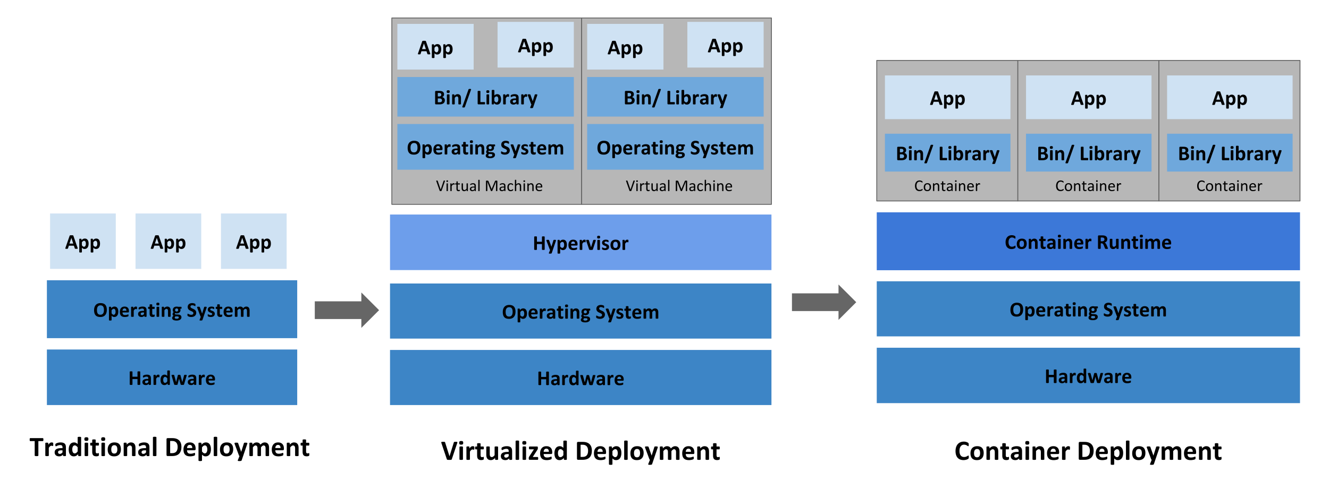
System Models
https://kubernetes.io/docs/concepts/overview/what-is-kubernetes/

Slide 8
System Models
P1
P2
P3
P1
P2
P3
Cs
Cs
Cs
C1
C2
C3
Orchestration
Linux
Linux
L1
L2
L3
Hardware
Hardware
H1
H2
H3
Process
Virtualization
Container-
ization
Orchestration

Slide 9
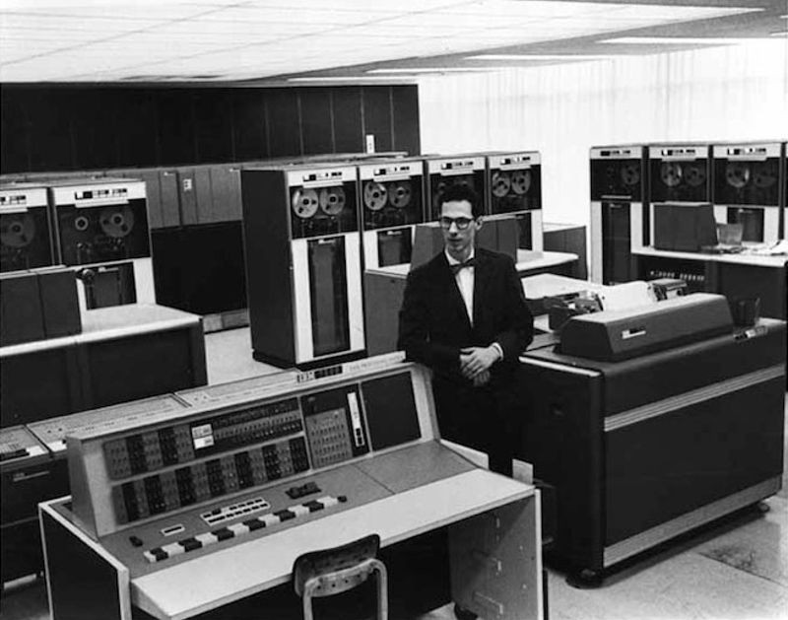
https://www.computerhistory.org/timeline/software-languages/#169ebbe2ad45559efbc6eb3572055b83
Fernando Corbato https://www.youtube.com/watch?v=Q07PhW5sCEk
Notes:
Virtualization

Slide 10
What is an Operating System?
application (user)
operating system
hardware
OS makes it easy to run programs
Run many programs at once (seemingly)
Share memory among programs
Enable interaction with devices, etc.
Correctly and efficiently
A virtual machine, standard library, resource manager

Slide 11
What is a Distributed Operating System?
container
orchestration
Hardware, operating system
Orchestration makes it easy to run containers
Run many containers at once (seemingly)
Share resources among containers
Enable interaction with storage, networking, etc.
Correctly and efficiently
A virtual machine, standard library, resource manager

Slide 12
Kubernetes
Distributed operating system, offering container support services
Service discovery and load balancing
Storage orchestration
Automated rollouts and rollbacks
Automatic bin packing
Self-healing
Secret and configuration management
https://kubernetes.io/docs/concepts/overview/what-is-kubernetes/

Slide 13
Service discovery and load balancing
Kubernetes can expose a container using the DNS name or using their own IP address. If traffic to a container is high, Kubernetes is able to load balance and distribute the network traffic so that the deployment is stable.
https://kubernetes.io/docs/concepts/overview/what-is-kubernetes/

Slide 14
Storage orchestration
Kubernetes allows you to automatically mount a storage system of your choice, such as local storages, public cloud providers, and more.
https://kubernetes.io/docs/concepts/overview/what-is-kubernetes/

Slide 15
Automated rollouts and rollbacks
You can describe the desired state for your deployed containers using Kubernetes, and it can change the actual state to the desired state at a controlled rate. For example, you can automate Kubernetes to create new containers for your deployment, remove existing containers and adopt all their resources to the new container.
https://kubernetes.io/docs/concepts/overview/what-is-kubernetes/

Slide 16
Automatic bin packing
You provide Kubernetes with a cluster of nodes that it can use to run containerized tasks. You tell Kubernetes how much CPU and memory (RAM) each container needs. Kubernetes can fit containers onto your nodes to make the best use of your resources.
https://kubernetes.io/docs/concepts/overview/what-is-kubernetes/

Slide 17
Self-healing
Kubernetes restarts containers that fail, replaces containers, kills containers that don’t respond to your user-defined health check, and doesn’t advertise them to clients until they are ready to serve.
https://kubernetes.io/docs/concepts/overview/what-is-kubernetes/

Slide 18
Secret and configuration management
Kubernetes lets you store and manage sensitive information, such as passwords, OAuth tokens, and SSH keys. You can deploy and update secrets and application configuration without rebuilding your container images, and without exposing secrets in your stack configuration.
https://kubernetes.io/docs/concepts/overview/what-is-kubernetes/

Slide 19
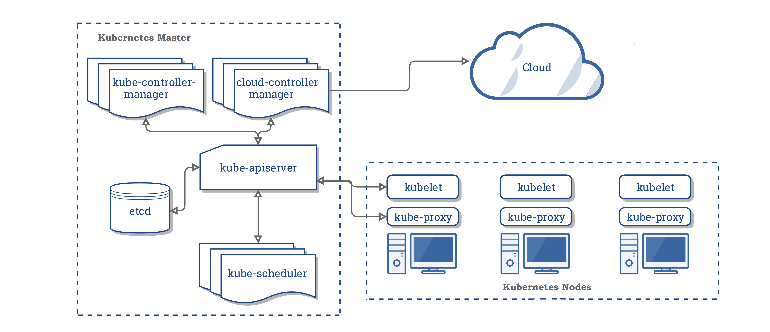
Kubernetes cluster components

Slide 20
Kubernetes resources
Documentation:
https://kubernetes.io/
Thorough tutorial for setting up a production cluster:
https://github.com/kelseyhightower/kubernetes-the-hard-way/blob/master/docs/08-bootstrapping-kubernetes-controllers.md

Slide 21
Course Topics
Virtualization
CPU: process, “time-sharing”
Memory: virtual memory, “space-sharing”
Concurrency
CPU: thread(s)
Memory: locks, semaphores, condition variables
Network: sockets, go channels
Persistence
Long-Term Memory: file

Slide 22
Process
Process state:
Memory
Registers, e.g., PC, stack pointer (Xinu’s different here)
Opened files, I/O status, …
Process state; Ready, Current, Suspended, …
Semaphores
Generic API calls: create, destroy, wait, control, status
Unix: fork/exec, exit, wait, signal (e.g. kill, alarm, interrupt)
Xinu: create, die, kill, panic, sleep, suspend, resume, immortal, getpid, chprio

Slide 23
Limited Direct Execution
Time sharing the CPU:
Run one process for a little while, then run another one, and so forth
How to efficiently virtualize the CPU with control
Performance and control
The “direct execution” part of the idea is simple:
Just run the program directly on the CPU.

Slide 24
Restricted Operations
The need to perform restricted operations
Two processor modes: user mode and kernel mode
Hardware support
How to perform restricted operations from a user process: System calls, pioneered on ancient machines such as the Atlas (1962)
expose certain pieces of functionality to user programs
most operating systems provide a few hundred calls
Notes:
system calls
allow the kernel to carefully expose certain key pieces of functionality to
user programs, such as accessing the file system, creating and destroying
processes, communicating with other processes, and allocating more
memory.

Slide 25
Context Switch
When switching between processes, system must
Save the state of the old process (suspend) and
Load the saved state for the new process (resume)
Context-switch time is overhead
System does no useful work while switching
Time dependent on hardware support
See, e.g, Xinu sys/ctxsw.S
Notes:
Now get the control, no matter how
And if we decide to switch, do something to switch to another process
1996, 4microseconds, now sub-micro

Slide 26
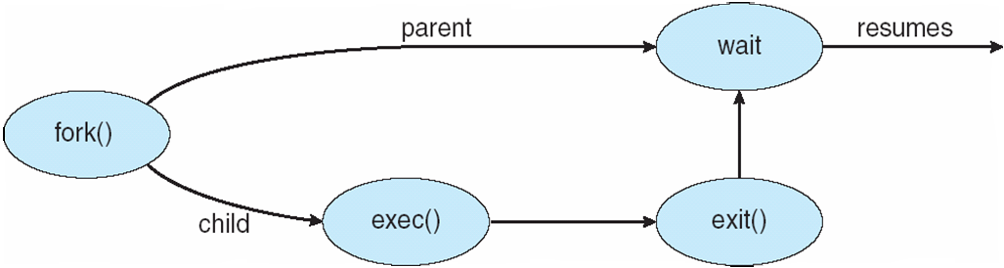
Process Creation
UNIX examples
fork system call creates new process
exec system call used after a fork to replace new process’ memory space with a new program

Slide 27
Scheduling
Metrics:
Turnaround time,
Response time
Policies:
First Come, First Served
Shortest Job First
Shortest Time to Completion First
Round Robin
Multi-Level Feedback Queue (MLFQ)
Lottery Scheduling and stride scheduling

Slide 28
Memory Management
Process address space
Code, data, heap, free, stack
Physical addresses
Virtual addresses, mapping them to physical addresses
Static Relocation
Base
Base+Bounds
Segmentation
Paging
Memory allocation:
first fit, best fit, worst fit, next fit
Fragmentation: internal and external

Slide 29
Paging
Software
Set up exception handler
New process
Context switch
Exception handling
Hardware
Every virtual address translation
Check bounds and also protection bits
Raise exceptions
Remember OS handlers
TLBs
Page tables, multi-level page tables
Swapping, Page faults
Working set

Slide 30
Concurrency
Problem: Multiple threads, shared data
Critical sections
Mutual exclusion
Ordering
Synchronization
Mutexes
Locks
Evaluation criteria: mutual exclusion, fairness, speed independence
Test And Set, Compare and Swap, Load-Linked, Store-Conditional
Spin locks, spinning vs. sleeping
Ticket locks
Concurrency in data structures; linked lists, queues, hash tables
pthreads

Slide 31
Concurrency
Condition variables
Wait, signal
Implementation rules
Producer/Consumer problem
Semaphores

Slide 32
Persistence
Devices
Device drivers, high-level API, low level API
character and block
Interrupts vs. polling
Programmed I/O (instructions) vs. direct memory access (DMA)
Hard drives
Platter(s), head, arm
Tracks (& cylinders), sectors(addressable), blocks
Read/write blocks (random, sequential)
Seek, Rotate, Transfer speeds
Scheduling stream of requests – SJF, SSTF, SCAN, C-SCAN

Slide 33
Persistence
Redundant Arrays of Inexpensive Drives (RAID)
Capacity, performance, reliability
Redundancy, parity, error-correcting codes, checksums
RAID levels
Mirroring, striping
Reliability, Throughput, Latency
Failure models: fail-stop, fail-partial
Latent sector errors
Silent data corruption

Slide 34
Persistence
File, directory, root, path, inode, directory entry, file descriptor, links, Superblock, inode block, data block
File API – open, close, read, write, seek, …
Fsync, rename, fsck
Mapping from file names to inode blocks, data blocks
Original Unix file system organization
Fsck and the need for fsck
FFS organization, refinements
Journaling
LFS organization, refinements
SSDs

Slide 35
Distributed Systems
Network characteristics, benefits, issues
Sockets, UDP, TCP, unreliable and reliable transport
RPC, Client, Server, Stub
NFS organization, refinements
AFS organization, refinements
Virtual Machine Monitors (VMM)/Hypervisors
Machine virtualization vs. process virtualization
Information gap
Containers
Kubernetes

Slide 36
CSC 501: Why Bother?
Learn resource management
Learn good design
Learn systems
Learn how to troubleshoot
Notes:
Not surprisingly, drivers dominate the total amount of source code, accounting for over 50% of all code. The architectural-dependent code (arch) is another substantial contributor, accouting for almost 20%. Both the file system and networking stacks account for about 7% each, though the file system used to play a much more prominent role. Memory management code is insubstantial.

Slide 37
Next
Final, December 12, 6-9pm

Slide 38
TLB and Virtual Machine Monitor TLB Flows: We have an application accessing memory running on an OS with a software managed TLB. Assume, for simplicity, a simple linear page table kept in physical memory. Here are some different hardware and software things that can happen during memory access (next slide).
At first, assume we are not running on a VMM, i.e., this is just an application running on top of the OS.
(a) Write down the flow that occurs when a user application encounters a TLB hit:
(b) Write down the flow that occurs when a user application encounters a TLB miss to a valid page that is present in memory:
(c) Write down the flow that occurs when a user application encounters a TLB miss to a valid page that is not present in memory:
Now assume that the OS is running on a virtual machine monitor.
(d) Write down the flow that occurs when a user application encounters a TLB hit:
(e) Write down the flow that occurs when a user application encounters a TLB miss to a valid page that is present in memory:
Notes:
0, 1
0, 2, 4, 5, 3, and then retry 0, 1
0, 2, 4, 7, 8, 6, 5, 3 and then retry 0, 1
0, 1
0, 9, 2, 4, 5, 11, 3, 10, retry 0, 1

Slide 39
0. the hardware checks the TLB to see if the VPN-to-PFN (or VPN-to-MFN if on a VMM) translation is present
1. the hardware issues a load to a physical address (or machine address if on a VMM)
2. the OS code at the start of the TLB miss handler runs
3. the OS code at the end of the TLB miss handler runs, which returns from trap
4. the OS code that accesses the page table to lookup a translation runs
5. the OS code that updates the TLB with a new mapping runs
6. the OS code that updates the page table with a new VPN-to-PPN mapping runs
7. a disk request is initiated
8. a disk request completes
9. the VMM code at the start of the VMM TLB miss handler runs
10. the VMM code at the end of the VMM TLB miss handler runs, which returns from trap)
11. the VMM code that updates the TLB with a new mapping runs
Notes:
0, 1
0, 2, 4, 5, 3, and then retry 0, 1
0, 2, 4, 7, 8, 6, 5, 3 and then retry 0, 1
0, 1
0, 9, 2, 4, 5, 11, 3, 10, retry 0, 1

