Slide 1
Lecture 4 Memory Management

Slide 2
Last Time…
Scheduling
Metrics
Turnaround Time
Response Time
Policies
First Come, First Served
Shortest Job First
Shortest Time to Completion First
Round Robin
Multi-Level Feedback Queue (MLFQ)
Lottery Scheduling and stride scheduling

Slide 3
OSTEP
Virtualization
CPU: illusion of private CPU
RAM: illusion of private memory
Concurrency
Persistence

Slide 4
Early Systems
0KB
64KB
max
Operating System
(code, data, etc.)
Current Program
(code, data, etc.)

Slide 5
Multiprogramming and Time Sharing
We give the illusion of many virtual CPUs by saving CPU registers to memory when a process isn’t running
We give the illusion of many virtual memories by saving memory to disk when a process isn’t running… inefficient

Slide 6
Space Sharing Memory
Operating System
(code, data, etc.)
(free)
Process C
(code, data, etc.)
Process B
(code, data, etc.)
(free)
Process A
(code, data, etc.)
(free)

Slide 7
The Abstraction
The process address space
Process’s view of memory in the system
a set of addresses that map to RAM cell
private
0KB
1KB
2KB
15KB
16KB
Code
Data
Heap
(free)
Stack
int x;
int main(int argc, char *argv[]) {
int y;
int *z = malloc(1);
}

Slide 8
What is the virtualization?
Every address generated by a user program is a virtual address
The program really isn’t in memory at physical addresses 0 through 16KB

Slide 9
Goals and Mechanism
Transparency
Efficiency
Protection and isolation
Hardware-based address translation

Slide 10
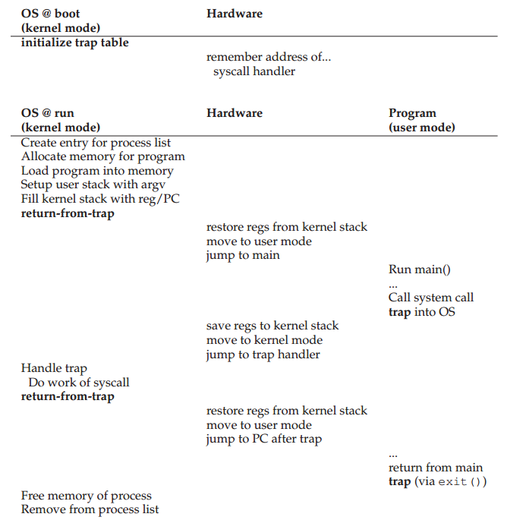

Slide 11
Memory Accesses
_main:
0000000000000000 pushq %rbp
…
0000000000000010 movl -0x14(%rbp), %r8d
0000000000000014 addl $0x1, %r8d
0000000000000017 movl %r8d, -0x14(%rbp)
…
…
x = x + 1;
…

Slide 12
Memory Accesses
%rip starts with 0x10
%rbp starts with 0x200
0x10 movl -0x14(%rbp), %r8d
0x14 addl $0x1, %r8d
0x17 movl %r8d, -0x14(%rbp)
Fetch inst at 0x10
Exec inst, load from 0x186
Fetch inst at 0x14
Exec inst, no memory access
Fetch inst at 0x17
Exec inst, store to 0x186

Slide 13
How to Run Multiple Processes
Time Sharing
Static Relocation
Base
Base+Bounds
Segmentation

Slide 14
Static Relocation
Rewrite each program before loading it as a process
0x1010 movl -0x14(%rbp), %r8d
0x1014 addl $0x1, %r8d
0x1017 movl %r8d, -0x14(%rbp)
0x10 movl -0x14(%rbp), %r8d
0x14 addl $0x1, %r8d
0x17 movl %r8d, -0x14(%rbp)
0x3010 movl -0x14(%rbp), %r8d
0x3014 addl $0x1, %r8d
0x3017 movl %r8d, -0x14(%rbp)

Slide 15
0KB
4KB
8KB
12KB
16KB
(free)
code, data
heap
(free)
stack
(free)
code, data
heap
(free)
stack
(free)
0x1010 movl -0x14(%rbp), %r8d
0x1014 addl $0x1, %r8d
0x1017 movl %r8d, -0x14(%rbp)
0x3010 movl -0x14(%rbp), %r8d
0x3014 addl $0x1, %r8d
0x3017 movl %r8d, -0x14(%rbp)

Slide 16
How to Run Multiple Processes
Time Sharing
Static Relocation
Base
Base+Bounds
Segmentation

Slide 17
Base
Idea: translate virtual addresses to physical by adding a fixed offset each time.
Store offset in a base register.
Each process has a different value in the base register when running.
This is a “dynamic relocation” technique

Slide 18
0KB
1KB
P1
2KB
4KB
P2
5KB
(free)
code, data
heap
(free)
stack
(free)
code, data
heap
(free)
stack
(free)
physical address =
virtual address + base
P1: load 100, R1 -> load 1124, R1
P2: load 100, R1 -> load 4196, R1
P2: load 1000, R1 -> load 5096, R1

Slide 19
Memory Accesses
%rip starts with 0x10
%rbp starts with 0x200
0x10 movl -0x14(%rbp), %r8d
0x14 addl $0x1, %r8d
0x17 movl %r8d, -0x14(%rbp)
Fetch inst at 0x10
Exec inst, load from 0x186
Fetch inst at 0x14
Exec inst, no memory access
Fetch inst at 0x17
Exec inst, store to 0x186

Slide 20
0KB
1KB
P1
2KB
4KB
P2
5KB
(free)
code, data
heap
(free)
stack
(free)
code, data
heap
(free)
stack
(free)
physical address =
virtual address + base
P1: load 100, R1 -> load 1124, R1
P2: load 100, R1 -> load 4196, R1
P2: load 1000, R1 -> load 5096, R1
P1: store R1, 3072 -> store R1, 4096

Slide 21
Base+Bounds
Memory Management Unit (MMU)
Now with base and bounds registers
Will add more into it
Who should do translation with base register?
(1) process, (2) OS, or (3) HW
Who should modify the base register?
(1) process, (2) OS, or (3) HW

Slide 22
0KB
1KB
P1
2KB
4KB
P2
5KB
(free)
code, data
heap
(free)
stack
(free)
code, data
heap
(free)
stack
(free)
P1: load 100, R1 -> load 1124, R1
P2: load 100, R1 -> load 4196, R1
P2: load 1000, R1 -> load 5096, R1
P1: store R1, 3072 -> store R1, 4096
an exception, interrupt OS!

Slide 23
Hardware Requirements
Privileged mode
Base/bounds registers
Ability to translate virtual addresses and check if within bounds
Privileged instruction(s) to update base/bounds registers
Privileged instruction(s) to register exception handlers
Ability to raise exceptions

Slide 24
Operating System Issues
Memory management
Generally manage memory via free list
Base/bounds management
Exception handling

Slide 25
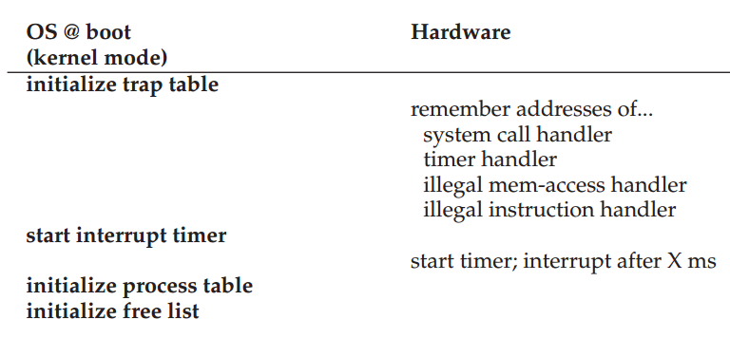

Slide 26
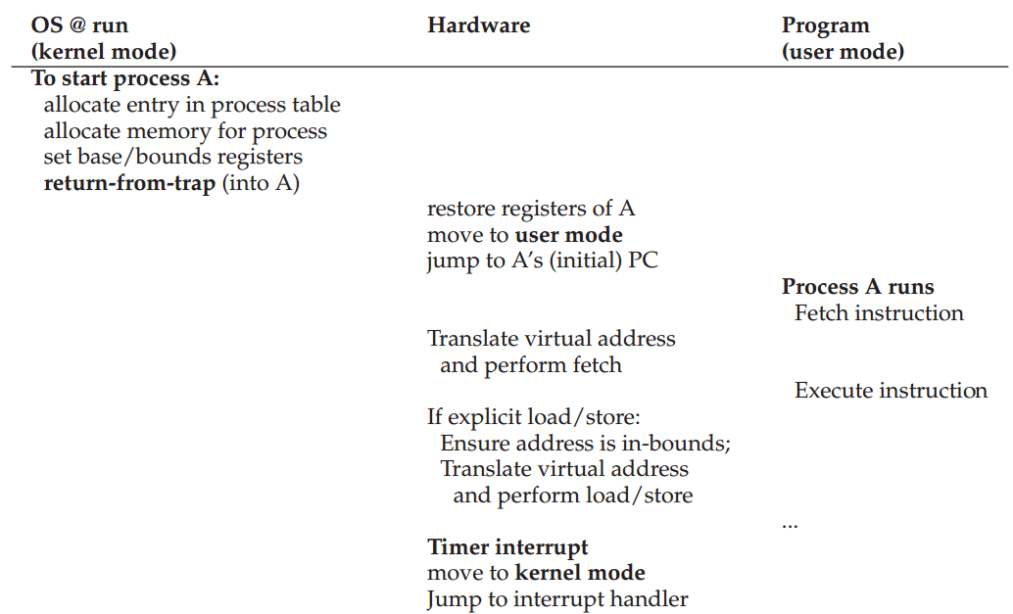

Slide 27
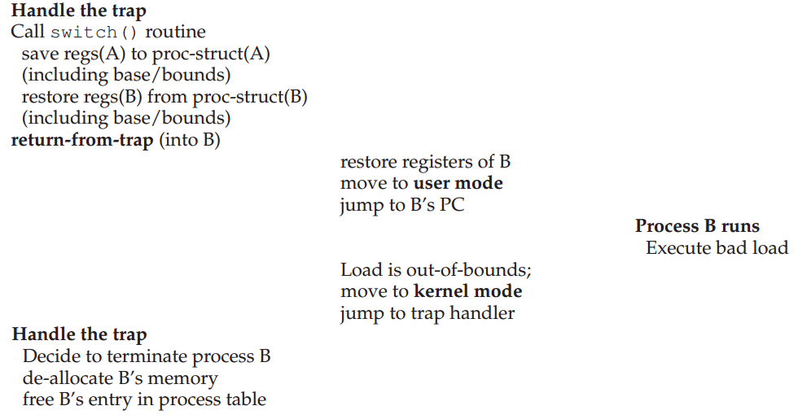

Slide 28
0KB
1KB
P1
2KB
4KB
P2
5KB
(free)
code, data
heap
(free)
stack
(free)
code, data
heap
(free)
stack
(free)
P1: load 100, R1 -> load 1124, R1
P2: load 100, R1 -> load 4196, R1
P2: load 1000, R1 -> load 5096, R1
P1: store R1, 3072 -> store R1, 4096
an exception, interrupt OS!
Problems?
Internal fragmentation
Virtual space size constraint

Slide 29
How to Run Multiple Processes
Time Sharing
Static Relocation
Base
Base+Bounds
Segmentation

Slide 30
Segmentation
Idea: generalize base+bounds
One base+bounds pair for each segment
Requires more registers
Resize segments as needed

Slide 31
Virtual Address
Break virtual addresses into two parts
one part indicates segment
one part indicates offset within segment
If an address has 14 bits, 2 for segment, 12 for offset
0: code+data
1: heap
2: stack

Slide 32
1 // get top 2 bits of 14-bit VA
2 Segment = (VirtualAddress & SEG_MASK) >> SEG_SHIFT
3 // now get offset
4 Offset = VirtualAddress & OFFSET_MASK
5 if (Offset >= Bounds[Segment])
6 RaiseException(PROTECTION_FAULT)
7 else
8 PhysAddr = Base[Segment] + Offset
9 Register = AccessMemory(PhysAddr)

Slide 33
0KB
1KB
2KB
3KB
4KB
5KB
(free)
heap
(free)
stack
(free)
Segment Base Size
Code
Heap 1KB 1KB
Stack
Virtual
0x1010
0x1100
0x1400
Physical
1KB+16
1kB+256
Interrupt OS

Slide 34
0KB
1KB
2KB
3KB
4KB
5KB
(free)
heap
(free)
stack
(free)
Segment Base Size Positive?
Code 1
Heap 1KB 1KB 1
Stack 5KB 1KB 0
Virtual
0x2C00
Physical
4KB

Slide 35
Support for Code Sharing
Idea: make base/bounds for the code of several processes point to the same physical mem
Careful: need extra protection!
Adding protection bits
Segment Base Size Positive? Protection
Code 1 Read-Execute
Heap 1KB 1KB 1 Read-Write
Stack 5KB 1KB 0 Read-Write

Slide 36
Space Management
Generally manage memory via free list
Free chunks can be scattered through memory
Allocate memory from a chunk able to accommodate it
Maintain information about allocated and free regions
Policies:
First-fit: Allocate the first chunk that is big enough
Best-fit: Allocate the smallest chunk that is big enough
Worst-fit: Allocate the largest chunk; must also search entire list
Next-fit: Allocate the second chunk that is big enough
Segregated Lists, Buddy Allocation

Slide 37
Fragmentation
External Fragmentation – total memory space exists to satisfy a request, but it is not contiguous
Internal Fragmentation – allocated memory may be slightly larger than requested memory; this size difference is memory internal to a partition, but not being used
Reduce external fragmentation by compaction
Shuffle memory contents to place all free memory together in one large block
Compaction is possible only if relocation is dynamic, and is done at execution time

Slide 38
Segmentation
Pros?
supports sparse address space
code sharing
fine grained protection
Cons?
external fragmentation
Next: paging

Slide 39
Next Time…
Work on PA0
Reading: chapters 17-18, Paging

