Slide 1
Lecture 6 Memory Management: Paging

Slide 2
Virtual Memory Approaches
Time Sharing: one process uses RAM at a time
Static Relocation: statically rewrite code before run
Base: add a base to virtual address to get physical
Base+Bounds: also check physical addr is in range
Segmentation: many base+bounds pairs

Slide 3
Virtual Memory Approaches
Time Sharing: one process uses RAM at a time
Static Relocation: statically rewrite code before run
Base: add a base to virtual address to get physical
Base+Bounds: also check physical addr is in range
Segmentation: many base+bounds pairs
Paging

Slide 4
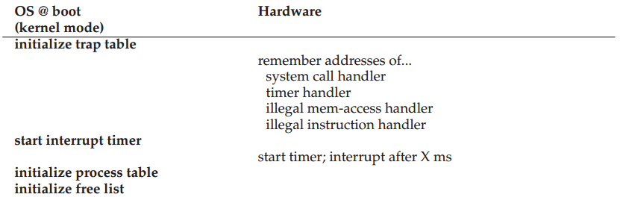
Segmentation Overview, redux

Slide 5
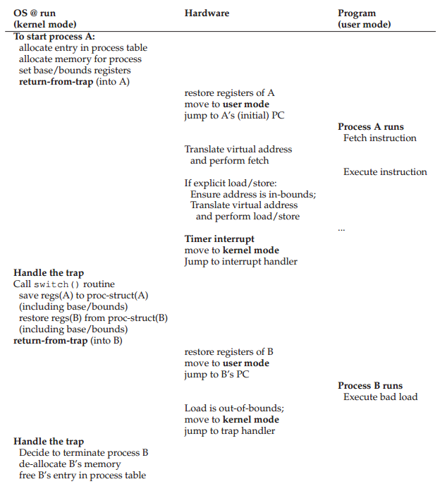

Slide 6
When is OS Involved
Set up exception handler
New process
Context switch
Exception handling
Growth of segmentation

Slide 7
When is HW Involved
Every virtual address translation
Check bounds and protection bits
Raise exceptions
Remember OS handlers

Slide 8
Segmentation
Pros?
Supports sparse address space with no internal fragmentation
Code sharing
Fine grained protection
Cons?
External fragmentation
Waste address space

Slide 9
Fragmentation
Internal Fragmentation – allocated memory may be slightly larger than requested memory; this size difference is memory internal to a partition, but not being used

Slide 10
0KB
1KB
P1
2KB
4KB
P2
5KB
(free)
code, data
heap
(free)
stack
(free)
code, data
heap
(free)
stack

Slide 11
Fragmentation
Internal Fragmentation – allocated memory may be slightly larger than requested memory; this size difference is memory internal to a partition, but not being used
External Fragmentation – total memory space exists to satisfy a request, but it is not contiguous
Reduce external fragmentation by compaction
Shuffle memory contents to place all free memory together in one large block
Possible only if relocation is dynamic, and is done at execution time

Slide 12
Paging
Segmentation is coarse-grained, large, variable-sized chunks of memory
Paging is a fine-grained, fixed-size alternative
Divide mem into small, fixed-sized units (aka page frames)
Map each virtual page independently
Grow memory segments however we please

Slide 13
Paging
P1
P2
P3
VirtMem
PhysMem
0 1 2 3 4 5 6 7 8 9 10 11
P1
P2
P3
3
0
8
Page Tables
1
4
5
7
2
9
10
6
11

Slide 14
Addressing
For segmentation
High bits => segment type
Low bits => offset
Segment number vs. number of high bits
Segment size vs. number of low bits
For paging
High bits => page number
Low bits => offset
Page number vs. number of high bits
Page size vs. number of low bits

Slide 15
Address Examples
How many low bits do we need for page size:
16 bytes, 1KB, 1MB, 512 bytes, and 4KB?

Slide 16
Address Examples
How many low bits do we need for page size:
16 bytes, 1KB, 1MB, 512 bytes, and 4KB?
4, 10, 20, 9, 12

Slide 17
Address Examples
How many low bits do we need for page size:
16 bytes, 1KB, 1MB, 512 bytes, and 4KB?
4, 10, 20, 9, 12
For a 32-bit address, how many pages of 16 bytes, 1KB, 1MB, 512 bytes, and 4KB?

Slide 18
Address Examples
How many low bits do we need for page size:
16 bytes, 1KB, 1MB, 512 bytes, and 4KB?
4, 10, 20, 9, 12
For a 32-bit address, how many pages of 16 bytes, 1KB, 1MB, 512 bytes, and 4KB?
~2B, 4M, 4K, 8M, 1MB

Slide 19
Virtual => Physical Mapping
For segmentation, we used a formula, e.g.,
Physical address = virt_offset + base_reg
Now, we need a more general mapping mechanism, to translate between page+offset and physical address
Simplest data structure: linear array, a ‘page table’

Slide 20
Page Mapping
P1
P2
P3
VirtMem
PhysMem
0 1 2 3 4 5 6 7 8 9 10 11
P1
P2
P3
3
0
8
Page Tables
1
4
5
7
2
9
10
6
11

Slide 21
Where are Page Tables Stored?
The size of a typical page table?
assume 32-bit address space
assume 4 KB pages
assume 4 byte entries (or this could be less)
2 ^ (32 - log(4KB)) * 4 = 4 MB
Store in memory, and CPU finds it via registers
4MB * number of processes => large

Slide 22
Page Table Translation Steps
H/W: for each memory reference:
1. Extract VPN (virtual page number) from VA (virtual address)
2. Look up of PTE (page table entry) based on VPN
3. Fetch PTE
4. extract PFN (page frame number)
5. build PA (physical address)
6. fetch PA to register

Slide 23
offset = VirtualAddress & OFFSET_MASK (Original)
PhysAddr = (PFN << SHIFT) | offset
1 // Extract the VPN from the virtual address
2 VPN = (VirtualAddress & VPN_MASK) >> SHIFT
3
4 // Form the address of the page-table entry (PTE)
5 PTEAddr = PTBR + (VPN * sizeof(PTE))
6
7 // Fetch the PTE
8 PTE = AccessMemory(PTEAddr)
9
10 // Check if process can access the page
11 if (PTE.Valid == False)
12 RaiseException(SEGMENTATION_FAULT)
13 else if (CanAccess(PTE.ProtectBits) == False)
14 RaiseException(PROTECTION_FAULT)
15 else
16 // Access is OK: form physical address and fetch it
17 offset = VirtualAddress & OFFSET_MASK
18 PhysAddr = (PTE.PFN << PFN_SHIFT) | offset
19 Register = AccessMemory(PhysAddr)

Slide 24
// VirtualAddress (e.g. from OSTEP Ch 18) = 21 = 0x010101
// VPN_MASK = 0x110000, SHIFT=4
// Extract the VPN from the virtual address
VPN = (VirtualAddress & VPN_MASK) >> SHIFT // VPN = 0x01
// Form the address of the page-table entry (PTE)
PTEAddr = PTBR + (VPN * sizeof(PTE))
// Fetch the PTE
PTE = AccessMemory(PTEAddr)
// OFFSET_MASK = 0x001111
Offset = VirtualAddress & OFFSET_MASK // Offset = 0x000101
PhysAddr = (PFN << SHIFT) | offset

Slide 25
// Check if process can access the page
if (PTE.Valid == False)
RaiseException(SEGMENTATION_FAULT)
else if (CanAccess(PTE.ProtectBits) == False)
RaiseException(PROTECTION_FAULT)
else
// Access is OK: form physical address and fetch it
offset = VirtualAddress & OFFSET_MASK
PhysAddr = (PTE.PFN << PFN_SHIFT) | offset
Register = AccessMemory(PhysAddr)

Slide 26
Memory Accesses Again
PT, load from 0x5000
Fetch instruction at 0x2010
PT, load from 0x5004
Exec, load from 0x0100
…
0x0010 movl 0x1100, %r8d
0x0014 addl $0x1, %r8d
0x0017 movl %r8d, 0x1100
PT
2
Assume PT is at 0x5000
Assume PTE’s are 4 bytes
Assume 4KB pages
0
TOO SLOW
80
99

Slide 27
Other Information in Page Table
What other data should go in page table entries besides translation?
valid bit
protection bits
present bit
reference bit
dirty bit

Slide 28
Basic Paging
Flexible Address Space
don’t need to find contiguous RAM
doesn’t waste whole data pages (valid bit)
Easy to manage
fixed size pages
simple free list for unused pages
no need to coalesce
Problems (to be addressed in upcoming lectures)
Too big
Too slow

