Slide 1
Lecture 7 Translation Lookaside Buffers

Slide 2
Virtual Memory Approaches
Time Sharing
Static Relocation
Base
Base+Bounds
Segmentation
Paging

Slide 3
Basic Paging
Flexible Address Space
don’t need to find contiguous RAM
doesn’t waste whole data pages (valid bit)
Easy to manage
fixed size pages
simple free list for unused pages
no need to coalesce
Too slow
Too big

Slide 4
Page Mapping with Linear Page Table
P1
P2
P3
VirtMem
PhysMem
0 1 2 3 4 5 6 7 8 9 10 11
P1
P2
P3
3
0
8
Page Tables
1
4
5
7
2
9
10
6
11
Notes:
VA size
PA size

Slide 5
Other Information in Page Table
What other data should go in page table entries besides translation?
valid bit
protection bits
present bit
reference bit
dirty bit

Slide 6
Memory Accesses
PT, load from 0x5000
Fetch instruction at 0x2010
PT, load from 0x5004
Exec, load from 0x0100
…
0x0010 movl 0x1100, %r8d
0x0014 addl $0x3, %r8d
0x0017 movl %r8d, 0x1100
PT
2
Assume 4KB pages
Assume PTBR is 0x5000
Assume PTE’s are 4 bytes
0
TOO SLOW
80
99

Slide 7
A Memory Trace
int array[1000];
...
for (i = 0; i < 1000; i++)
array[i] = 0;
0x1024 movl $0x0,(%edi,%eax,4)
0x1028 incl %eax
0x102c cmpl $0x03e8,%eax
0x1030 jne 0x1024

Slide 8
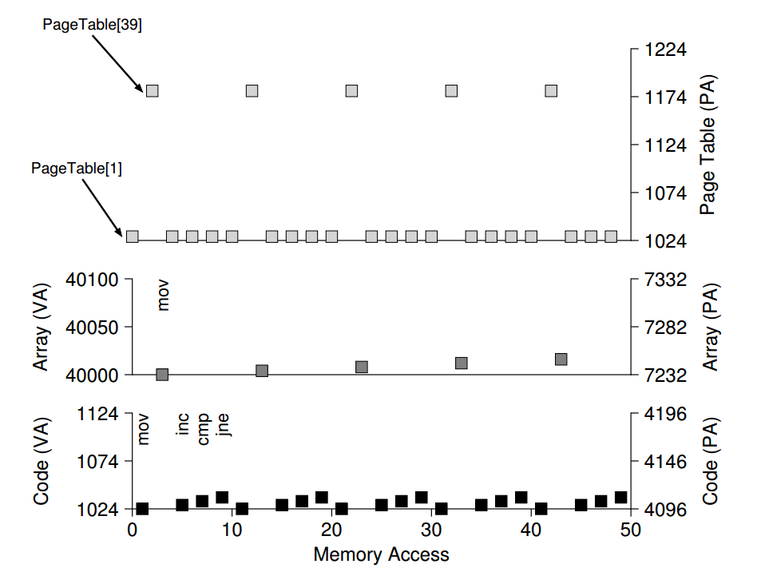

Slide 9
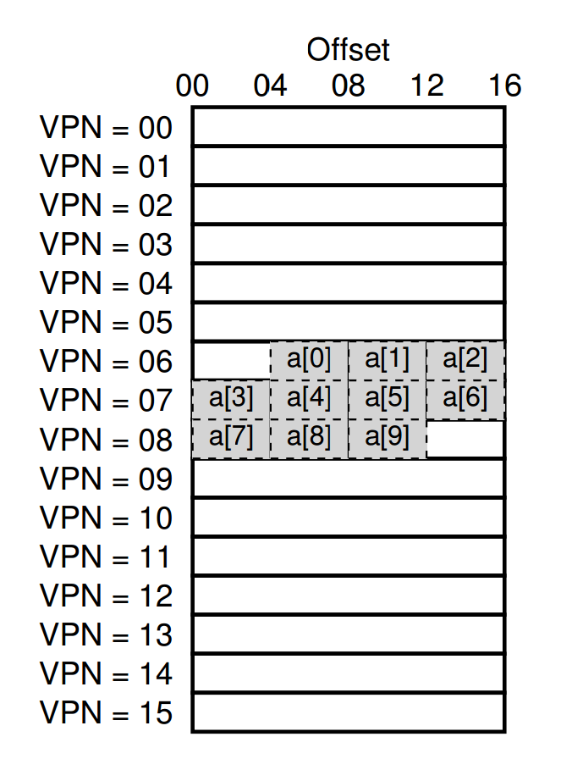
Array Iterator
int sum = 0;
for (i = 0; i < 10; i++) {
sum += a[i];
}
What is the memory trace?
Notes:
What’s the virtual address for a[0]
0x604, and the following?
PTBR+24, 0xA04
PTBR+24, 0xA08
PTBR+24, 0xA12

Slide 10
Basic strategy
Take advantage of repetition - use a CPU cache
Translation Lookaside Buffer (TLB)
Address Translation Cache
CPU
TLB
RAM
PT
Notes:
ATC?

Slide 11
TLB Cache Type
Fully-Associative: entries can go anywhere
most common for TLBs
must store whole key/value in cache
search all in parallel
There are other cache types

Slide 13
TLB Contents
VPN | PFN | other bits
TLB valid bit
whether the entry has a valid translation
TLB protection bits
rwx
Address Space Identifier
TLB dirty bit

Slide 14
A MIPS TLB Entry
Notes:
19 bits for the
VPN; as it turns out, user addresses will only come from half the address
space (the rest reserved for the kernel)
(PFN), and hence can support systems with up to 64GB of (physical) main
memory (2^24 4KB pages).
a global
bit (G), which is used for pages that are globally-shared among processes.
Thus, if the global bit is set, the ASID is ignored
Too much memory to store page tables
assume 32-bit address space
assume 4 KB pages
assume 4 byte entries (or this could be less)
2 ^ (32 - log(4KB)) * 4 = 4 MB

Slide 15
1 VPN = (VirtualAddress & VPN_MASK) >> SHIFT
2 (Success, TlbEntry) = TLB_Lookup(VPN)
3 if (Success == True) // TLB Hit
4 if (CanAccess(TlbEntry.ProtectBits) == True)
5 Offset = VirtualAddress & OFFSET_MASK
6 PhysAddr = (TlbEntry.PFN << SHIFT) | Offset
7 AccessMemory(PhysAddr)
8 else
9 RaiseException(PROTECTION_FAULT)
10 else // TLB Miss
11 PTEAddr = PTBR + (VPN * sizeof(PTE))
12 PTE = AccessMemory(PTEAddr)
13 if (PTE.Valid == False)
14 RaiseException(SEGMENTATION_FAULT)
15 else if (CanAccess(PTE.ProtectBits) == False)
16 RaiseException(PROTECTION_FAULT)
17 else
18 TLB_Insert(VPN, PTE.PFN, PTE.ProtectBits)
19 RetryInstruction()

Slide 16
Array Iterator with TLB
int sum = 0;
for (i = 0; i < 10; i++) {
sum += a[i];
}
How many TLB hits?
How many TLB misses?
Notes:
TLB
Valid VPN PFN
0
0
0
0
What’s the virtual address for a[0]
0x604, and the following?
PTBR+24, 0xA04
PTBR+24, 0xA08
PTBR+24, 0xA12

Slide 17
Array Iterator with TLB
int sum = 0;
for (i = 0; i < 10; i++) {
sum += a[i];
}
How many TLB hits?
How many TLB misses?
Hit rate?
Miss rate?
Notes:
TLB
Valid VPN PFN
0
0
0
0
What’s the virtual address for a[0]
0x604, and the following?
PTBR+24, 0xA04
PTBR+24, 0xA08
PTBR+24, 0xA12

Slide 18
Reasoning about TLB
Workload: series of loads/stores to accesses
TLB: chooses entries to store in CPU
Metric: performance (i.e., hit rate)

Slide 19
TLB Workloads
Spatial locality
Sequential array accesses can almost always hit in the TLB, and so are very fast!
Temporal locality
What pattern would be slow?
highly random, with no repeat accesses

Slide 20
TLB Replacement Policies
LRU: evict least-recently used a TLB slot is needed
Random: randomly choose entries to evict
When is each better?
Sometimes random is better than a “smart” policy!

Slide 21
Who Handles The TLB Miss?
H/W or OS?
H/W: CPU must know where page tables are
CR3 on x86
Page table structure not flexible
OS: CPU traps into OS upon TLB miss

Slide 22
1 VPN = (VirtualAddress & VPN_MASK) >> SHIFT
2 (Success, TlbEntry) = TLB_Lookup(VPN)
3 if (Success == True) // TLB Hit
4 if (CanAccess(TlbEntry.ProtectBits) == True)
5 Offset = VirtualAddress & OFFSET_MASK
6 PhysAddr = (TlbEntry.PFN << SHIFT) | Offset
7 AccessMemory(PhysAddr)
8 else
9 RaiseException(PROTECTION_FAULT)
10 else // TLB Miss
11 PTEAddr = PTBR + (VPN * sizeof(PTE))
12 PTE = AccessMemory(PTEAddr)
13 if (PTE.Valid == False)
14 RaiseException(SEGMENTATION_FAULT)
15 else if (CanAccess(PTE.ProtectBits) == False)
16 RaiseException(PROTECTION_FAULT)
17 else
18 TLB_Insert(VPN, PTE.PFN, PTE.ProtectBits)
19 RetryInstruction()

Slide 23
1 VPN = (VirtualAddress & VPN_MASK) >> SHIFT
2 (Success, TlbEntry) = TLB_Lookup(VPN)
3 if (Success == True) // TLB Hit
4 if (CanAccess(TlbEntry.ProtectBits) == True)
5 Offset = VirtualAddress & OFFSET_MASK
6 PhysAddr = (TlbEntry.PFN << SHIFT) | Offset
7 AccessMemory(PhysAddr)
8 else
9 RaiseException(PROTECTION_FAULT)
10 else // TLB Miss
11 RaiseException(TLB_MISS)

Slide 24
OS TLB Miss Handler
OS: CPU traps into OS upon TLB miss
check page table for page table entry
if valid, extract PFN and update TLB w special inst
return from trap
Where to resume execution?
The instruction that caused the trap
How to avoid double traps?
keep TLB miss handlers in physical memory
reserve some entries in the TLB for permanently-valid translations
Modifying TLB entries is privileged

Slide 25
Context Switches
What happens if a process uses the cached TLB entries from another process?
Solutions?
Flush TLB on each switch
Remember which entries are for each process
Address Space Identifier

Slide 26
Address Space Identifier
You can think of the ASID as a process identifier (PID), but usually it has fewer bits
P1
(ASID 11)
P2
(ASID 12)
valid | VPN | PFN | ASID
0 | - | - | -
1 | 1 | 1 | ?
1 | 1 | 4 | ?
1 | 0 | 3 | ?
3
0
1
4
7
2
10
6

Slide 27
Next time: solving the “Too Big” problem
For fun:
Trapcc - compute with 0 instructions on Intel! Discover the awesomeness of the Intel MMU!” https://github.com/jbangert/trapcc
”Game of Life, without executing instructions” - https://www.youtube.com/watch?v=eSRcvrVs5ug

