Slide 1
Lecture 14 I/O Devices & Hard Disk Drives

Slide 2
Abstraction: Processes
A process is a system abstraction:
illusion of being the only job in the system
Mechanism? Policy?
user: application
create, kill processes,
inter-process comm.
operating system: process
multiplex resources
hardware: computer
Notes:
Mechanism:
Creation, destruction, suspension, context switch, signalling, IPC, etc.
Policy:
Minor policy questions:
Who can create/destroy/suspend processes?
How many active processes can each user have?
Major policy question that we will concentrate on:
How to share resources between multiple processes?

Slide 3
Abstraction: Virtual memory
Virtual memory is a memory abstraction: illusion of large contiguous memory, often more memory than physically available
Mechanism? Policy?
application: address space
virtual addresses
operating system: virtual memory
physical addresses
hardware: physical memory
Notes:
Mechanism:
Virtual-to-physical memory mapping, page-fault, etc.
Policy:
How to multiplex a virtual memory that is larger than the physical memory onto what is available?
How to share physical memory between multiple processes?

Slide 4
Abstraction: Thread
A thread is a processor abstraction:
illusion of having 1 processor per execution context
Mechanism? Policy?
application: execution context
create, kill, synch.
operating system: thread
context switch
hardware: processor

Slide 5
Abstraction: file
A file is a storage abstraction:
illusion of structured storage space
application/user: copy file1 file2
naming, protection,
operations on files
operating system: files, directories
operations on disk
blocks
hardware: disk
Notes:
Mechanism:
Naming, protection, operations on files
Different data structures
Policy:
When to write to disk?
How to order accesses?
Where to write on the disk?

Slide 6
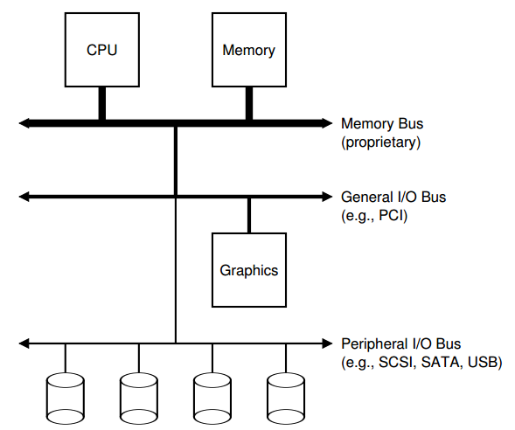
But first… we need I/O devices

Slide 7
The Canonical Device
The interface for OS to interact
Device Registers
Hidden Internals
Micro-controller (CPU)
Memory (DRAM or SRAM or both)
Other Hardware-specific Chips
Status
Command
Data

Slide 8
The Canonical Protocol
While (STATUS == BUSY) // 1
; // wait until device is not busy
Write data to DATA register // 2
Write command to COMMAND register // 3
(To start the device & executes the command)
While (STATUS == BUSY) // 4
; // wait until device is done with your request

Slide 9
A trace
3
1 2 4
CPU:
Disk:
A
B
C
A

Slide 10
Using interrupts to avoid spinning
1 3,4
2
CPU:
Disk:
B
B
A A A
B
C
A

Slide 11
Interrupts vs. Polling
Discussion: could interrupt be worse under some cases?
Techniques:
Hybrid approach
Interrupt coalescing

Slide 12
What else can we optimize?
1 3,4
2
CPU:
Disk:
B
B
A A A
B
C
A

Slide 13
Programmed I/O vs. Direct Memory Access
PIO (Programmed I/O):
CPU directly tells device what data is
DMA (Direct Memory Access):
CPU leaves data in memory
Device reads it directly

Slide 14
Using DMA
1 3,4
CPU:
Disk:
B
B
A A
B
C
A

Slide 15
How does OS access registers?
Special instructions
each device has a port
in/out instructions (x86) communicate with device
Memory-Mapped I/O
H/W maps registers into address space
loads/stores sent to device
Doesn’t matter much (both are used).

Slide 16
Protocol Variants
Status checks: polling vs. interrupts
Data: PIO vs. DMA
Control: special instructions vs. memory-mapped I/O

Slide 17
Variety is a Challenge
Problem:
many, many devices
each has its own protocol
How can we avoid writing a slightly different OS for each H/W combination?
Encapsulation!
Write driver for each device.
Drivers are 70% of Linux source code.

Slide 18
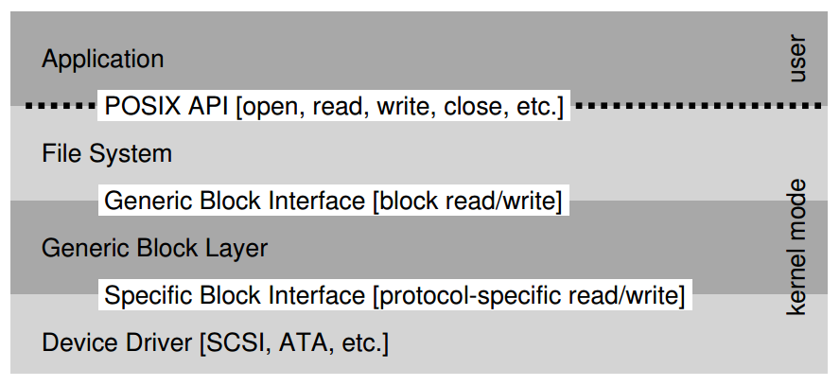
The File System Stack

Slide 19
Hard Disk Basic Interface
Disk has a sector-addressable address space (so a disk is like an array of sectors).
Sectors are historically 512 bytes, more recently 4096 bytes.
Main operations: reads + writes to sectors.

Slide 20
Disk Internals
Platter: covered with a magnetic film.
Surface: each platter has two surfaces
Spindle: many platters may be bound to the spindle.
Track: each surface is divided into rings, each track is further divided into numbers sectors
Cylinder: a stack of tracks across platters
Heads on a moving arm can read from each surface.

Slide 21
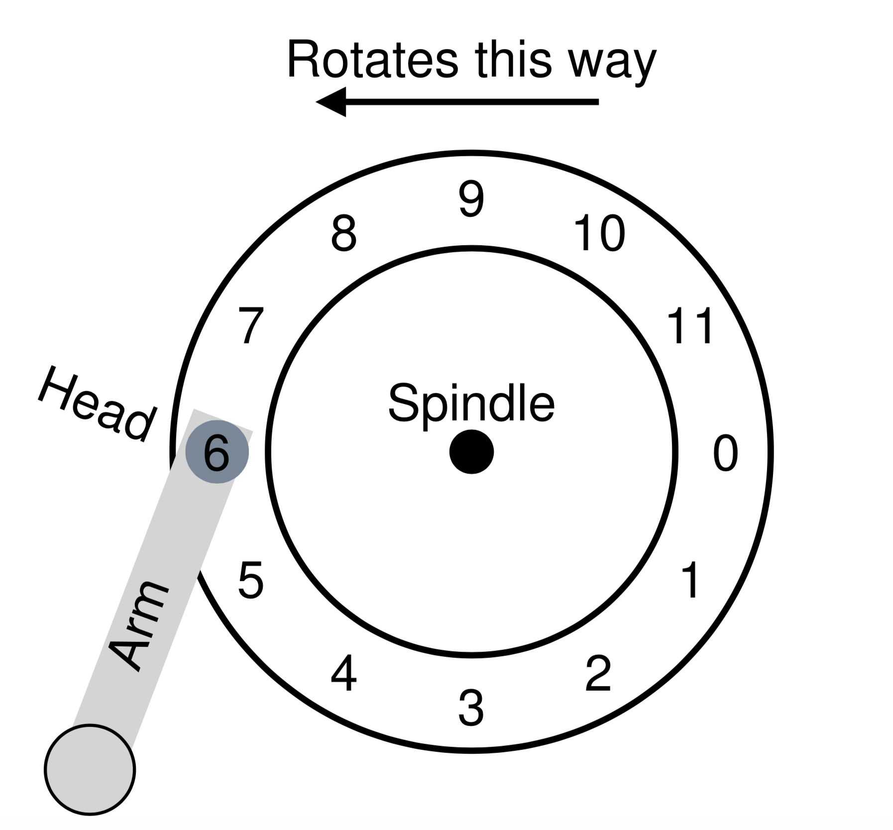
Single Track, Disk Arm and Head

Slide 22
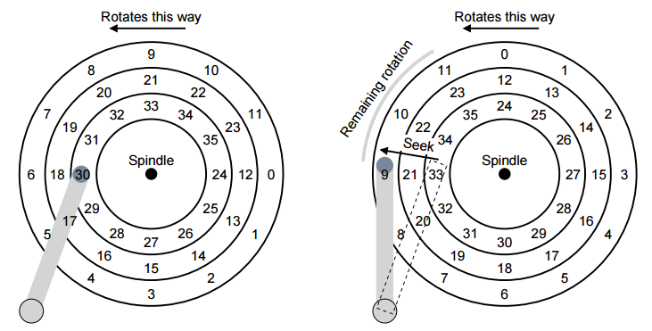
Three Tracks Plus A Head

Slide 23
https://www.youtube.com/watch?v=9eMWG3fwiEU
Seagate, ‘How a Hard Disk Drive Works’ https://www.youtube.com/watch?v=NtPc0jI21i0

Slide 24
Seek, Rotate, Transfer
Must accelerate, coast, decelerate, settle
Seeks often take several milliseconds!
Settling alone can take 0.5 - 2 ms.
Entire seek often takes 4 - 10 ms.
Notes:
Ms = millisecond, thousandths of a second

Slide 25
Seek, Rotate, Transfer
Depends on rotations per minute (RPM).
7200 RPM is common, 15000 RPM is high end.
1 / 7200 RPM = 1 minute / 7200 rotations = 1 second / 120 rotations = 8.3 ms / rotation
so it may take 4.2 ms on avg to rotate to target (0.5 * 8.3 ms)

Slide 26
Seek, Rotate, Transfer
Pretty fast — depends on RPM and sector density.
100+ MB/s is typical.
1s / 100 MB = 10 ms / MB = 4.9 us / sector (assuming 512-byte sector)

Slide 27
Workload
So…
seeks are slow
rotations are slow
transfers are fast
What kind of workload is fastest for disks?
Random: access sectors arbitrarily (seek+rotation dominated)
Sequential: access sectors in order (transfer dominated)

Slide 28
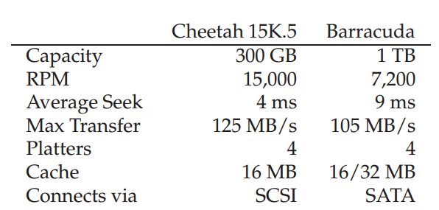
Disk Spec
Sequential workload: what is throughput for each?
Close to max transfer rate if workload large enough
Random workload: what is throughput for each?
Assume 16-KB reads, 2.5 MB/s and 1.2MB/s
Notes:
avg rotation =1/2 x 1 min/15000 x 60 sec/1 min x 1000 ms/1 sec= 2 ms
transfer =1 sec/125 MB x 16 KB x 1,000,000 us/1 sec= 125 us
Cheetah time = 4ms + 2ms + 125us = 6.1ms
throughput =16 KB/6.1ms x 1 MB/1024 KB x 100 ms/1 sec =2.5 MB/s
avg rotation =1/2 x 1 min/7200 x 60 sec/1 min x 1000 ms/1 sec= 4.1 ms
transfer =1 sec/105 MB x 16 KB x 1,000,000 us/1 sec= 149 us
Cheetah time = 9ms + 4.1ms + 149us = 13.2ms
throughput =16 KB/13.2ms x 1 MB/1024 KB x 100 ms/1 sec =1.2 MB/s

Slide 29
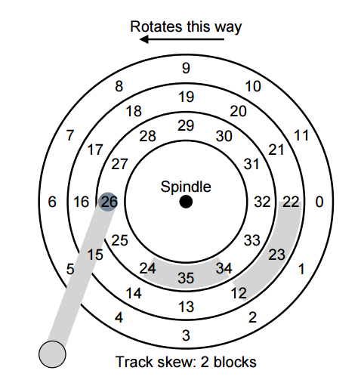
Track Skew

Slide 30
Zones

Slide 31
Other Improvements
Track Skew
Zones
Cache
Drives may cache both reads and writes.

Slide 32
Schedulers
Given a stream of requests, in what order should they be served?
Try to follow SJF (shortest job first)
SSTF: Shortest Seek Time First
Difficult for OS, starvation
Elevator (a.k.a. SCAN or C-SCAN)
Still ignore rotation time

Slide 33
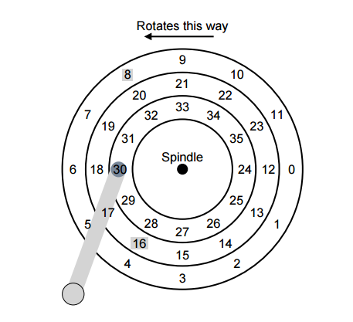
SPTF: Shortest Positioning Time First

Slide 34
Other Issues
Both OS and disk do some scheduling
I/O merging
Work Conservation

Slide 35
Only One Disk?
Sometimes we want many disks — why?
capacity
performance
reliability
Challenge: most file systems work on only one disk.

Slide 36
Solution 1: JBOD
JBOD: Just a Bunch Of Disks
Application is smart, stores different files on different file systems.
Application
FS
FS
FS
FS

Slide 37
Solution 2: RAID
RAID: Redundant Array of Inexpensive Disks
Transparent and deployable
Capacity and performance
Reliability?
Application
FS
Fake Disk

Slide 38
Why Inexpensive Disks?
Economies of scale! Cheap disks are popular.
You can often get many commodity H/W components for the same price as a few expensive components.
Strategy: write S/W to build high-quality logical devices from many cheap devices.
Alternative to RAID: buy an expensive, high-end disk.

Slide 39
General Strategy
Build fast, large disk from smaller ones.
Add even more disks for reliability.
0 100 200
RAID
Disk
Disk
Disk
Disk
0 100 0 100
0 100 0 100

Slide 40
Mapping
How should we map logical to physical addresses?
How is this problem similar to virtual memory?
Dynamic mapping: use data structure (hash table, tree)
paging
Static mapping: use math
RAID

Slide 41
Redundancy
Redundancy: how many copies?
System engineers are always trying to increase or decrease redundancy.
Increase: replication (e.g., RAID)
Decrease: deduplication (e.g., code sharing)
One strategy: reduce redundancy as much is possible. Then add back just the right amount.

Slide 42
